Slide 1
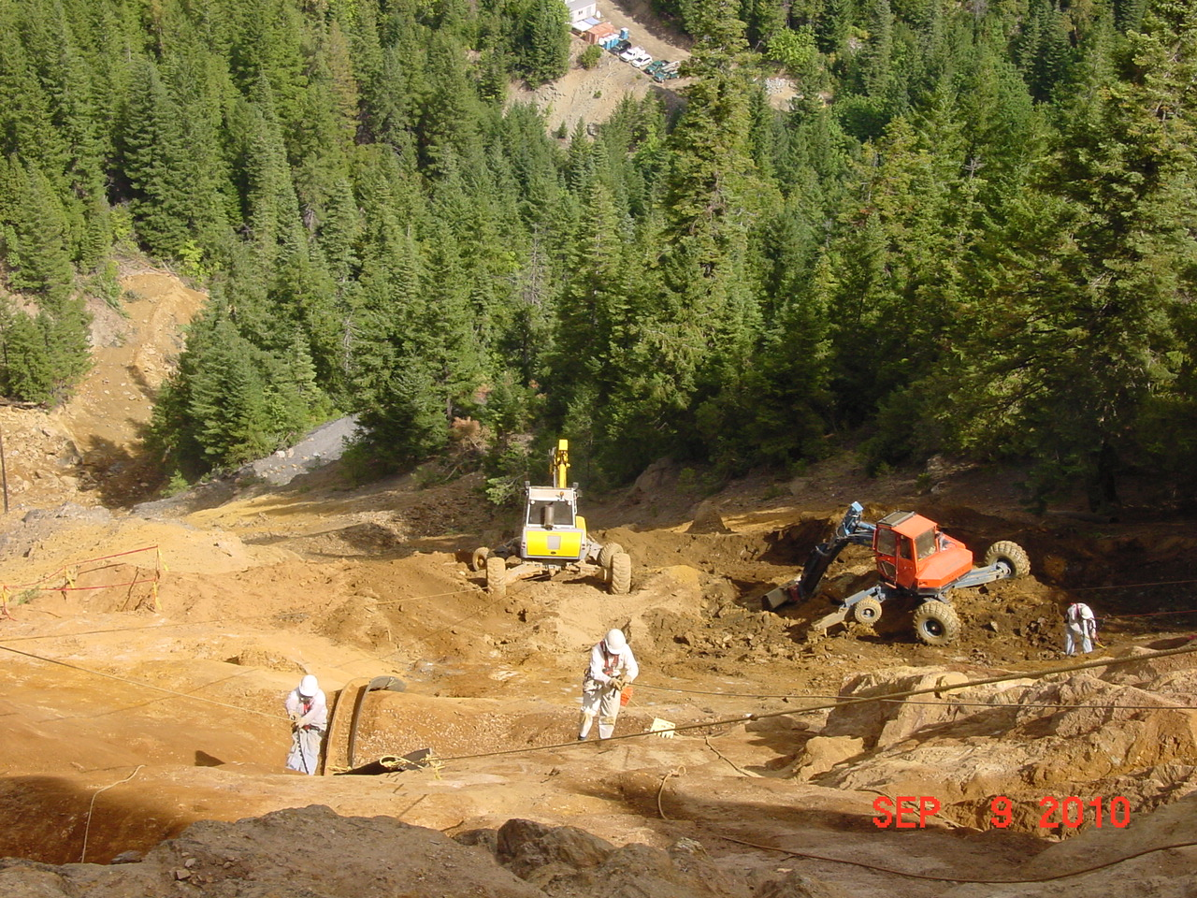
Blue Ledge Mine
Superfund Site Presentation Overview
Location
Mine Development
Site Features
Acid Mine Drainage
Distribution of Metals Contamination
Impacts to Ecosystem
2010-11 USFS Non-Time-Critical Removal Action
Q&A

Slide 2
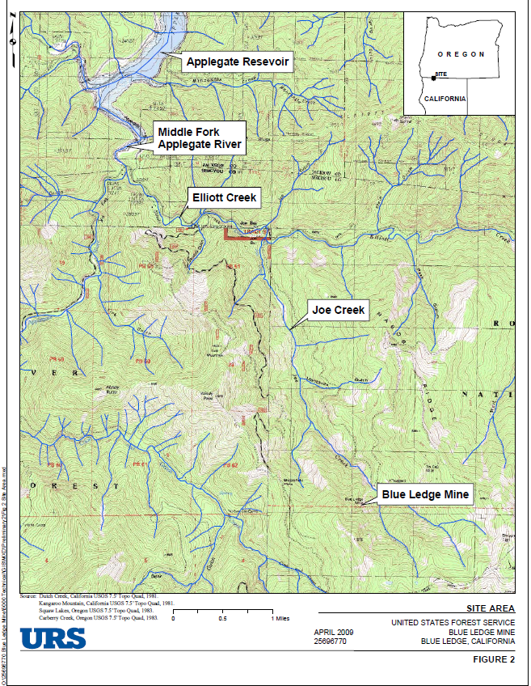
LOCATION
OR
CA

Slide 3
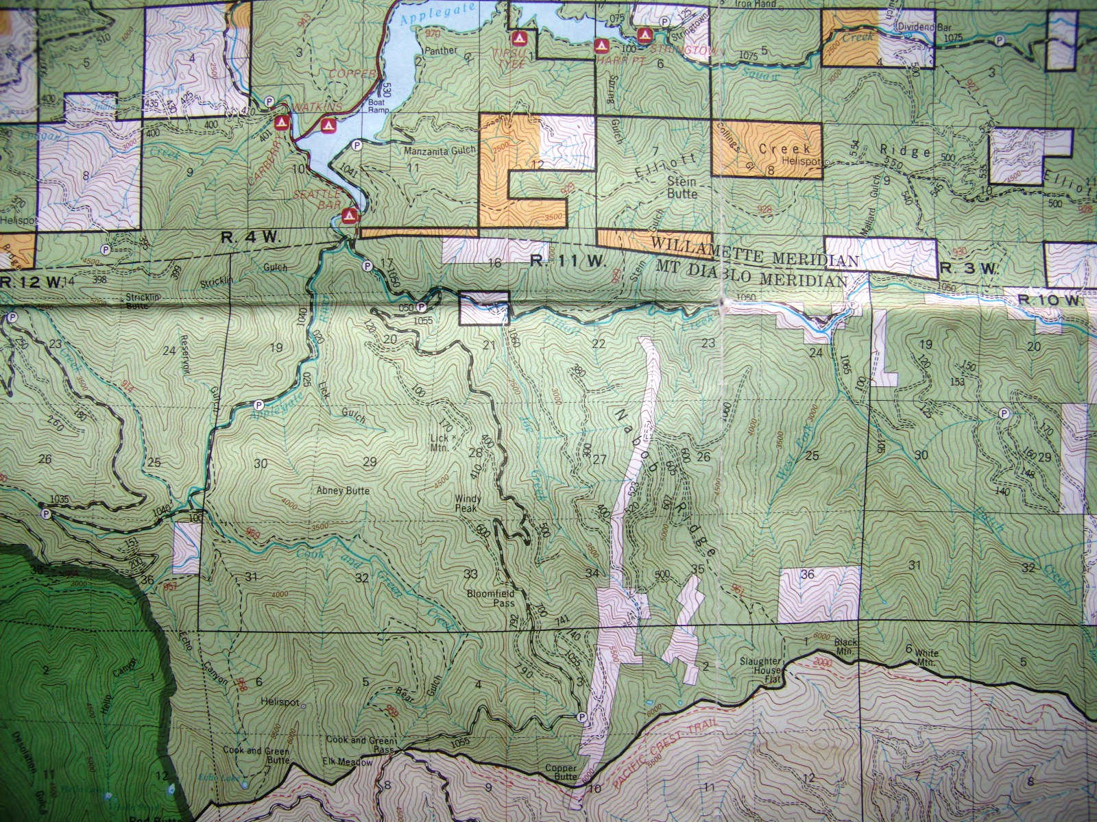
OR
CA
600 Acres
Patented Land
Mine Site

Slide 4
Mine Development
1898 Discovered
1904-1909 Developed
1918-1920 8,000 tons shipped in support of WW I
1930’s 2,500 tons shipped
Over 2 miles of underground workings on ten levels
13 adits and one shaft
High grade massive sulfide deposits mined for Cu, Zn, Au, Ag
Ore hand sorted, sent to ASARCO smelter in Tacoma, WA
>150,000 tons of sulfide-rich waste rock dumped on slopes/drainages
No mill or associated tailings on Site

Slide 5
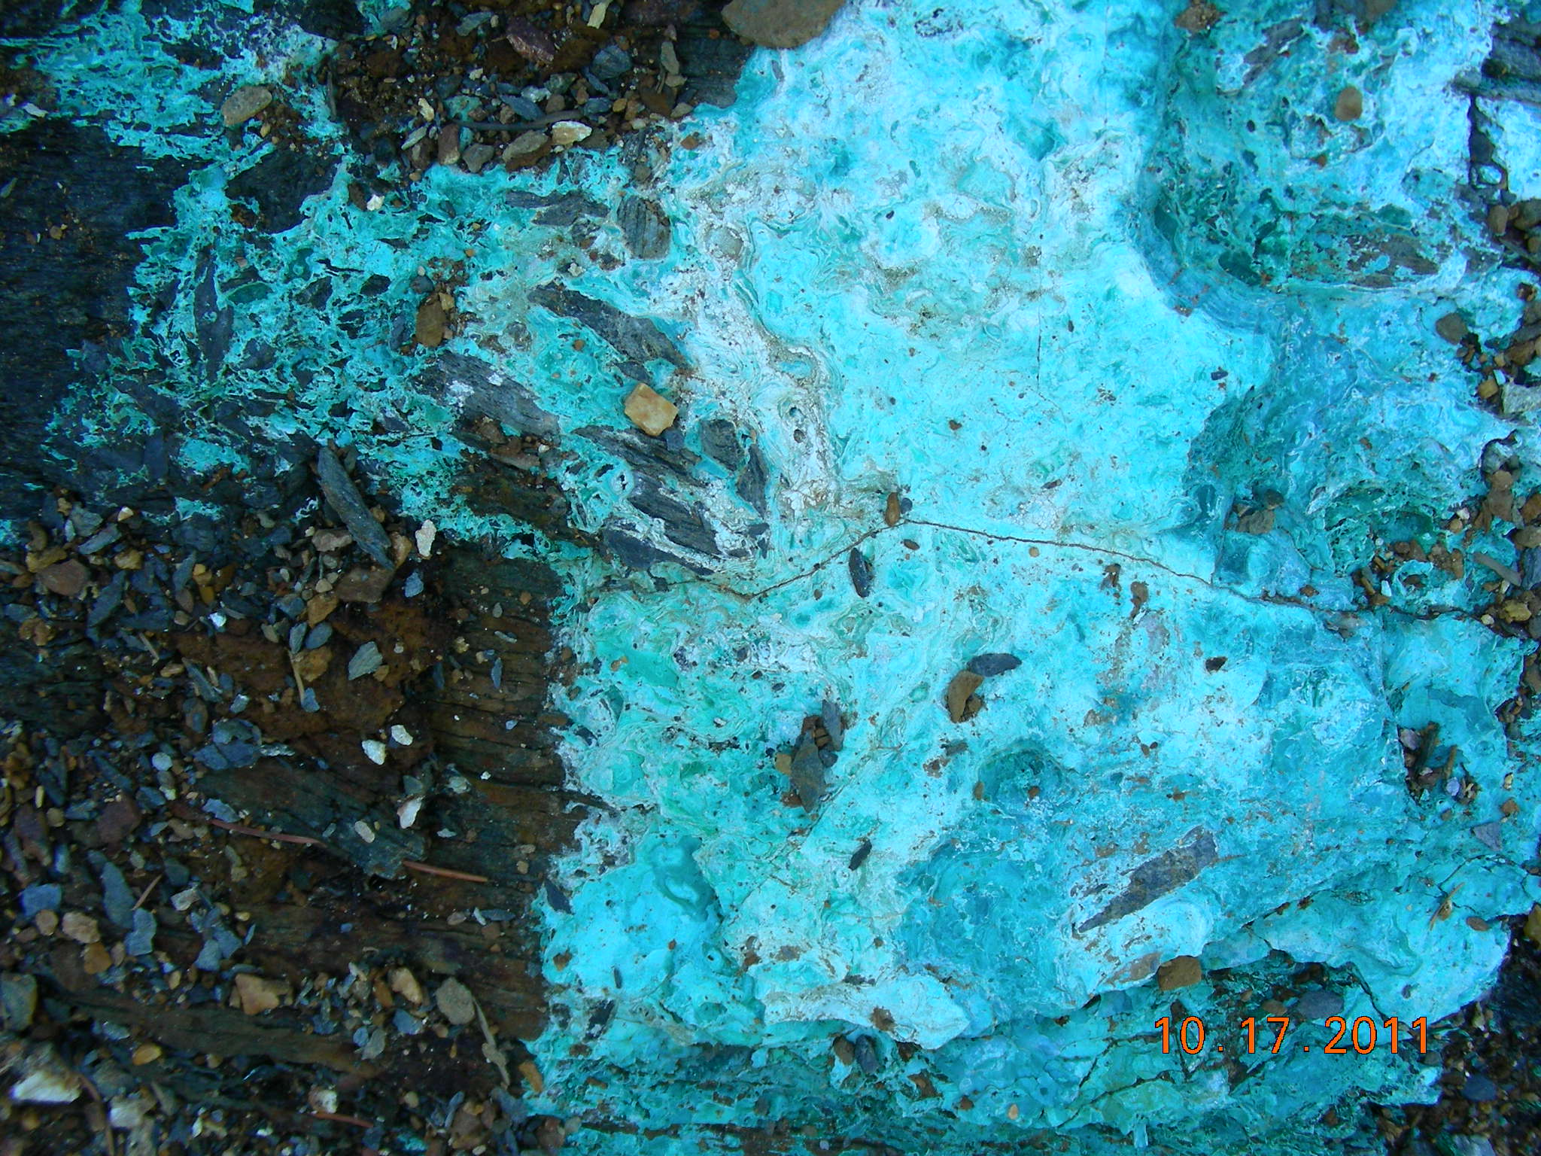
Blue Ledge Mine Site Features
Copper Ore,
Namesake for
Blue Ledge Mine

Slide 6
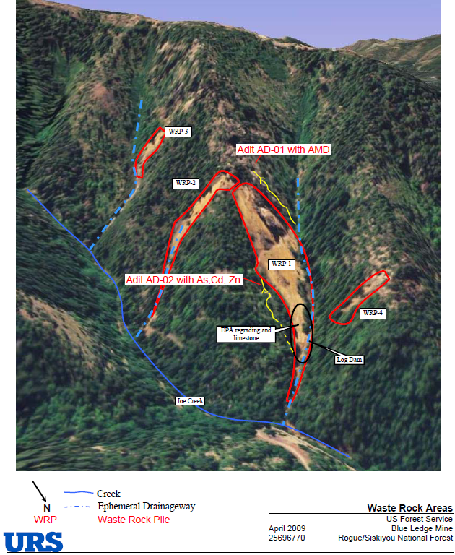

Slide 7
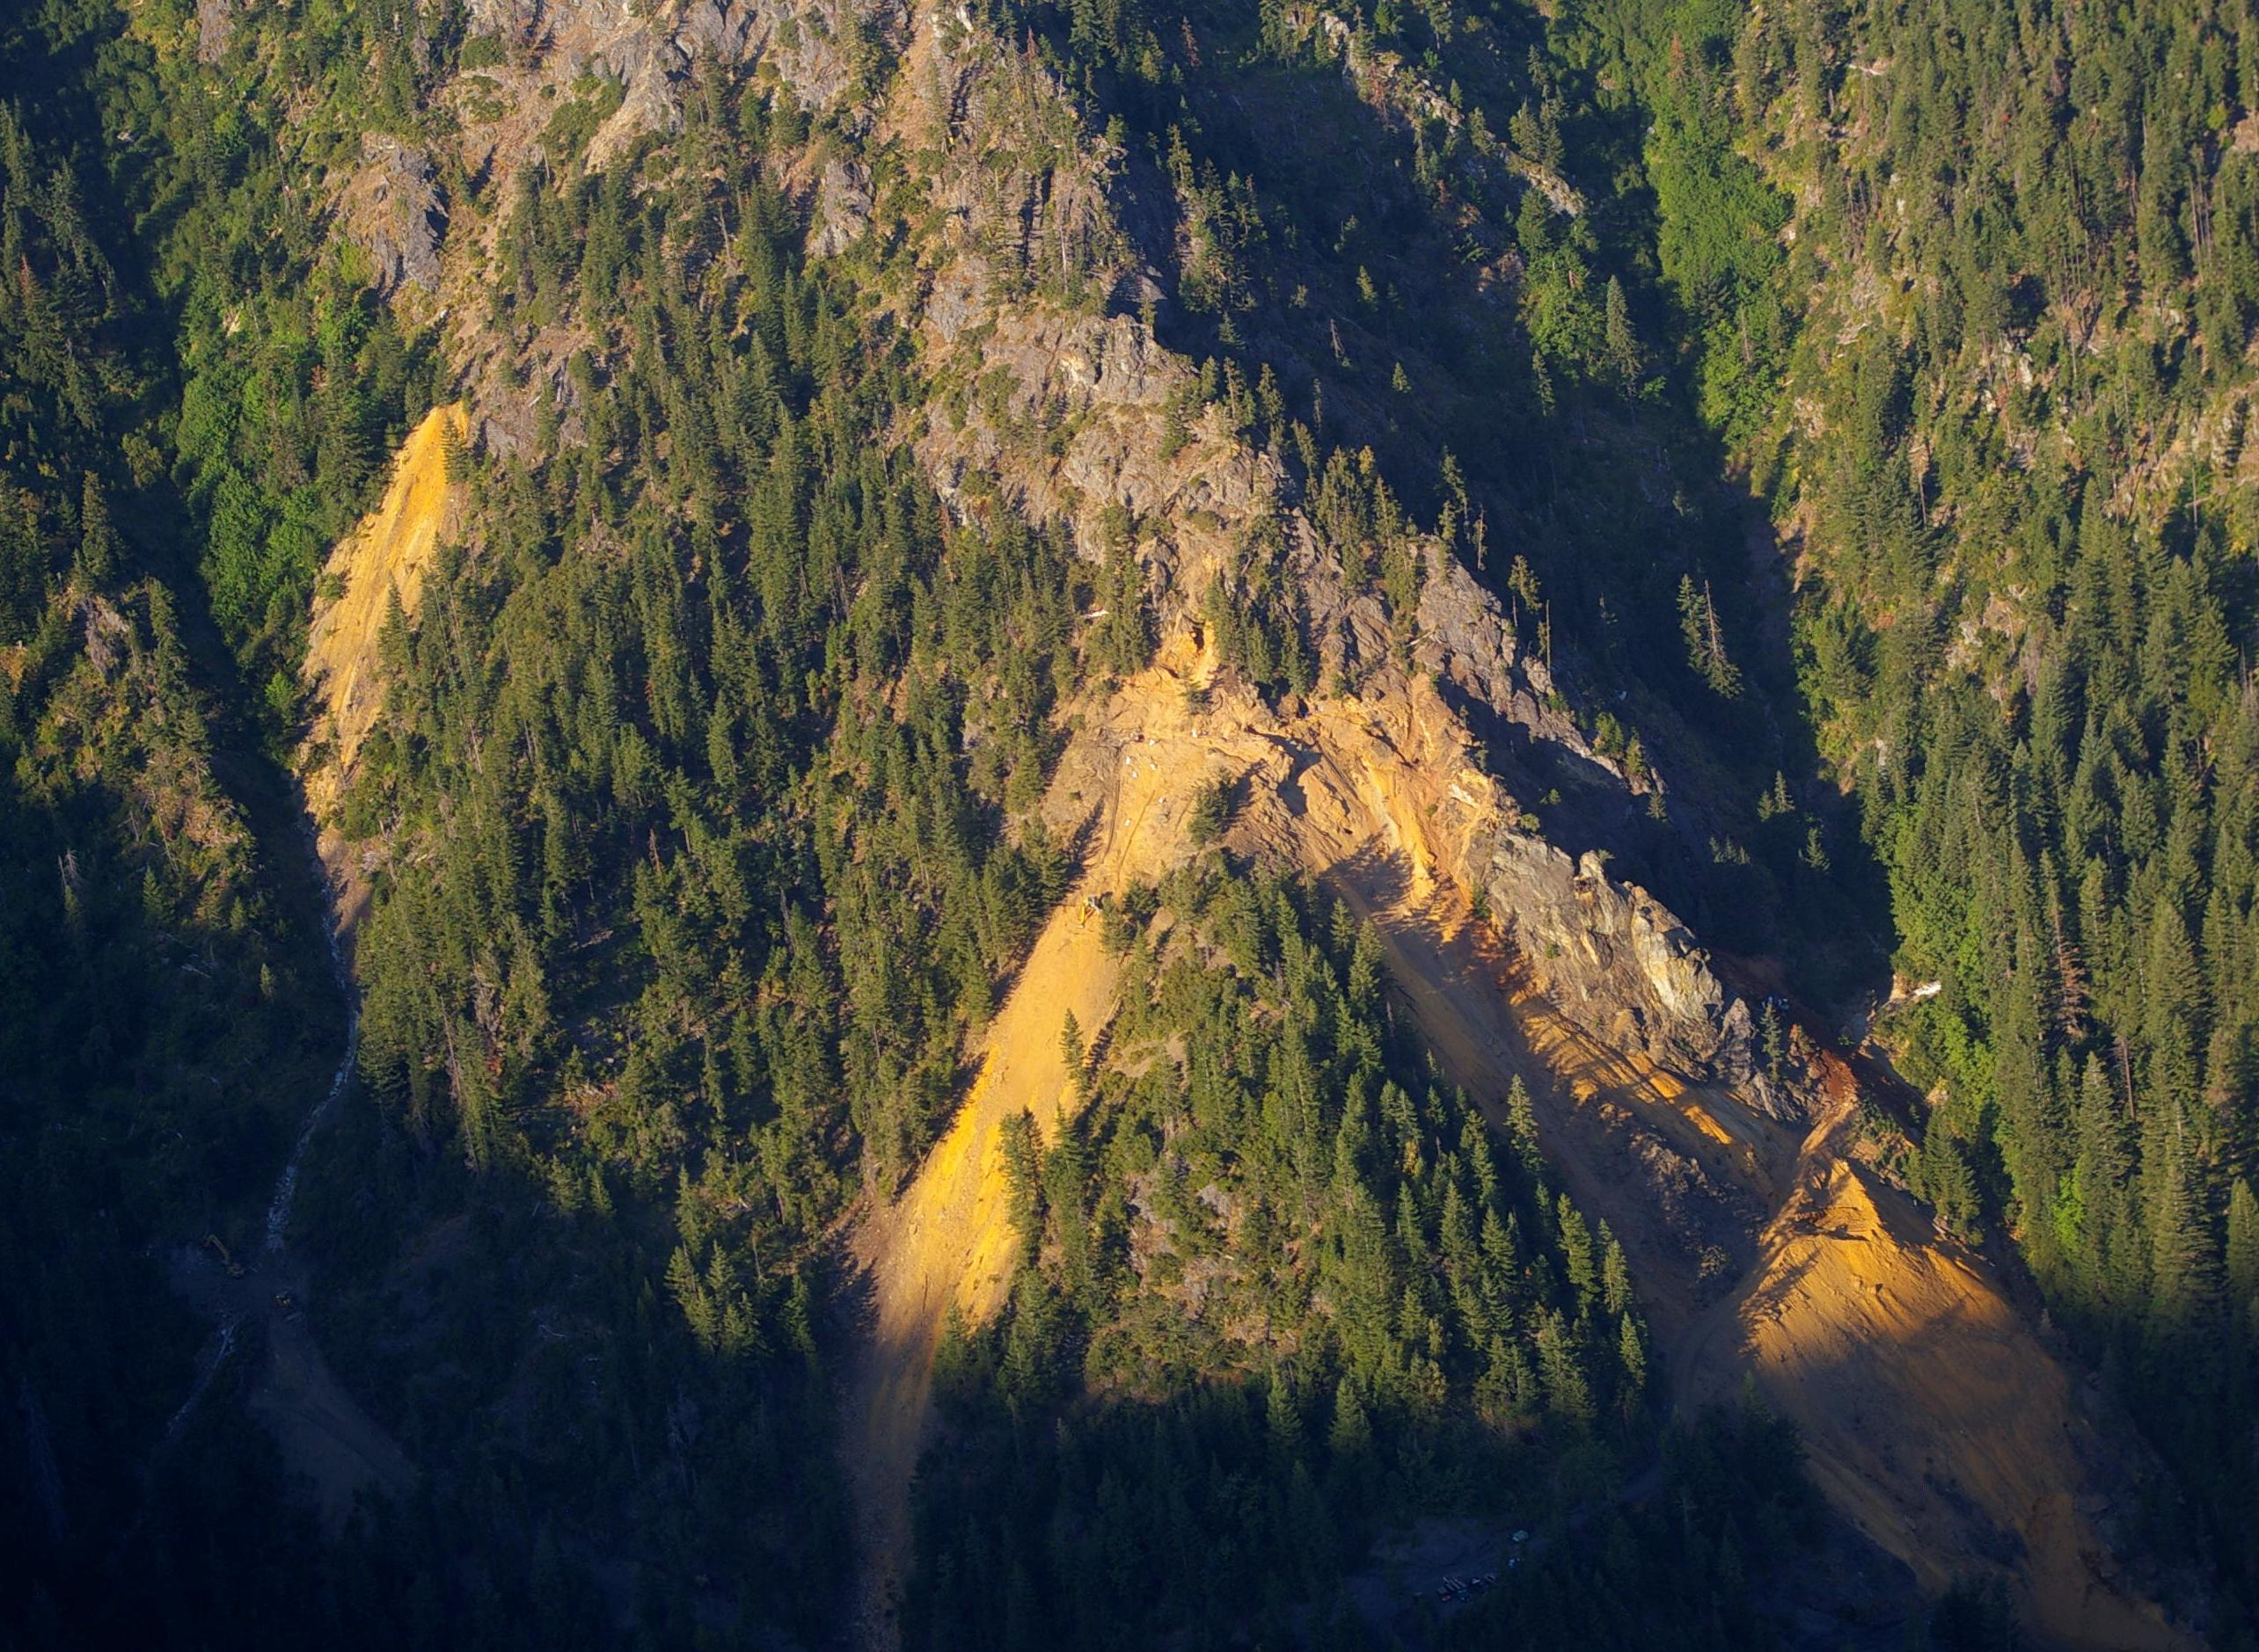
August 2010
WRP 3
WRP 2
WRP 1
WRP 4

Slide 8
Blue Ledge Mine Acid Mine Drainage Discharged to the Environment

Slide 9
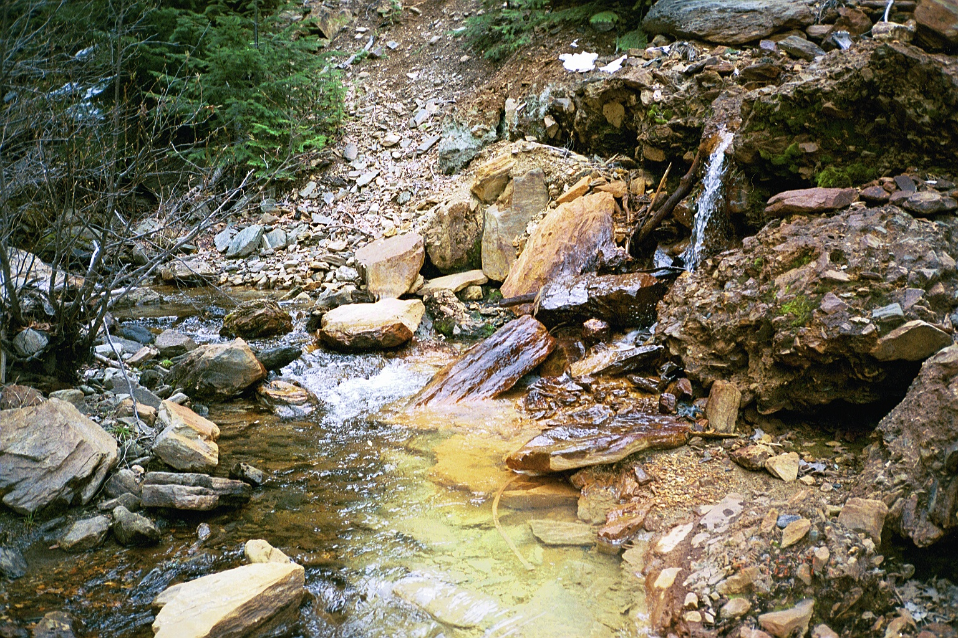
500k g/p/d
AMD Entered
Joe Creek in Spring

Slide 10
Surface Waters

Slide 11
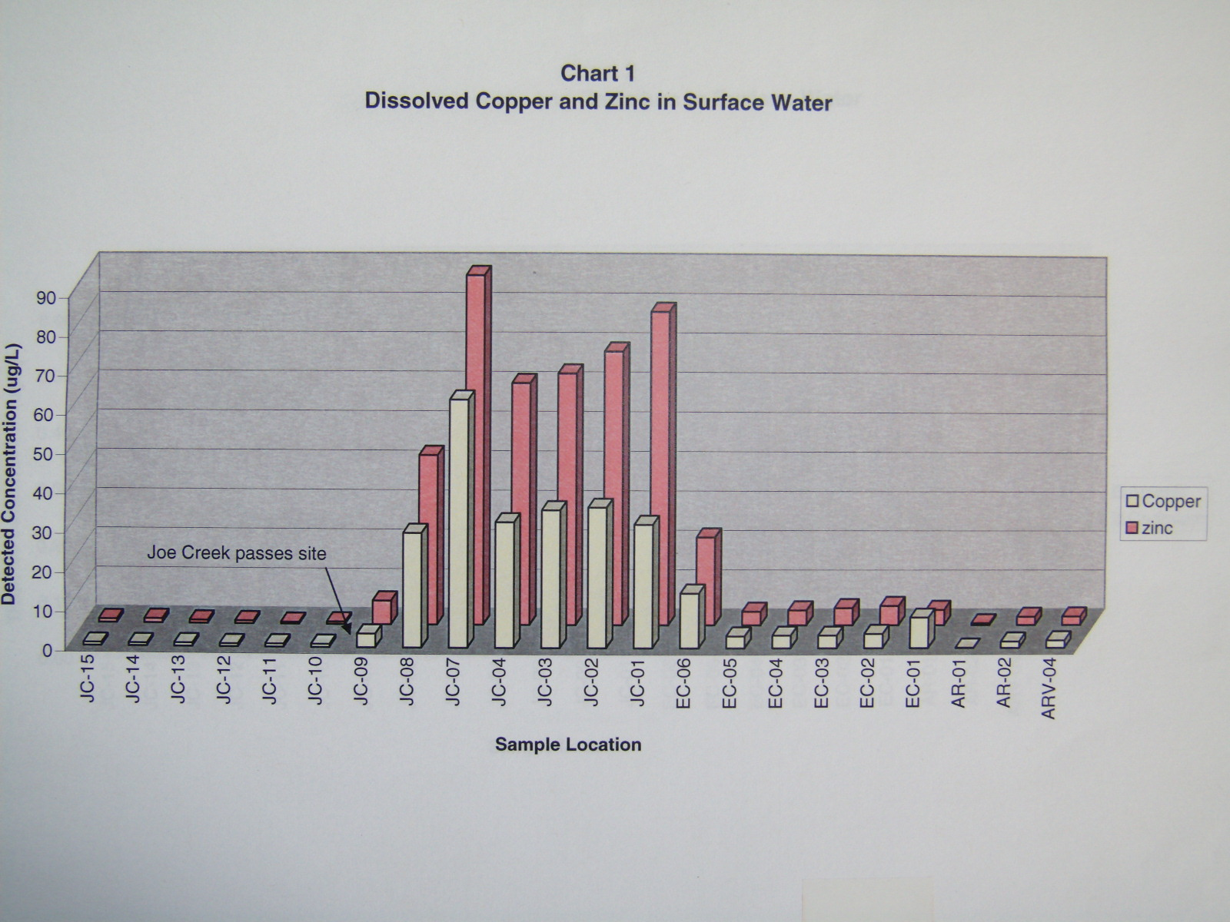
Dissolved Copper & Zinc in Surface Water

Slide 12
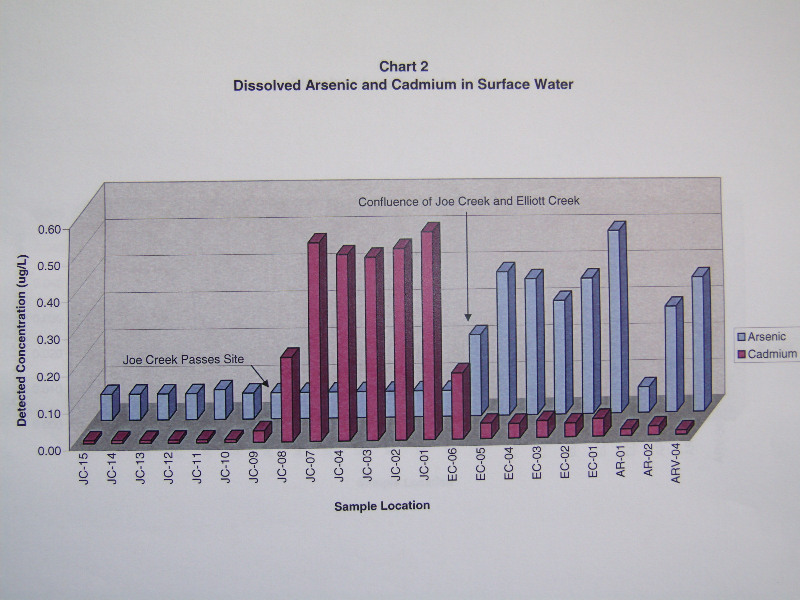
Arsenic & Cadmium in Water

Slide 13
Blue Ledge Mine Impacts to the Ecosystem

Slide 14
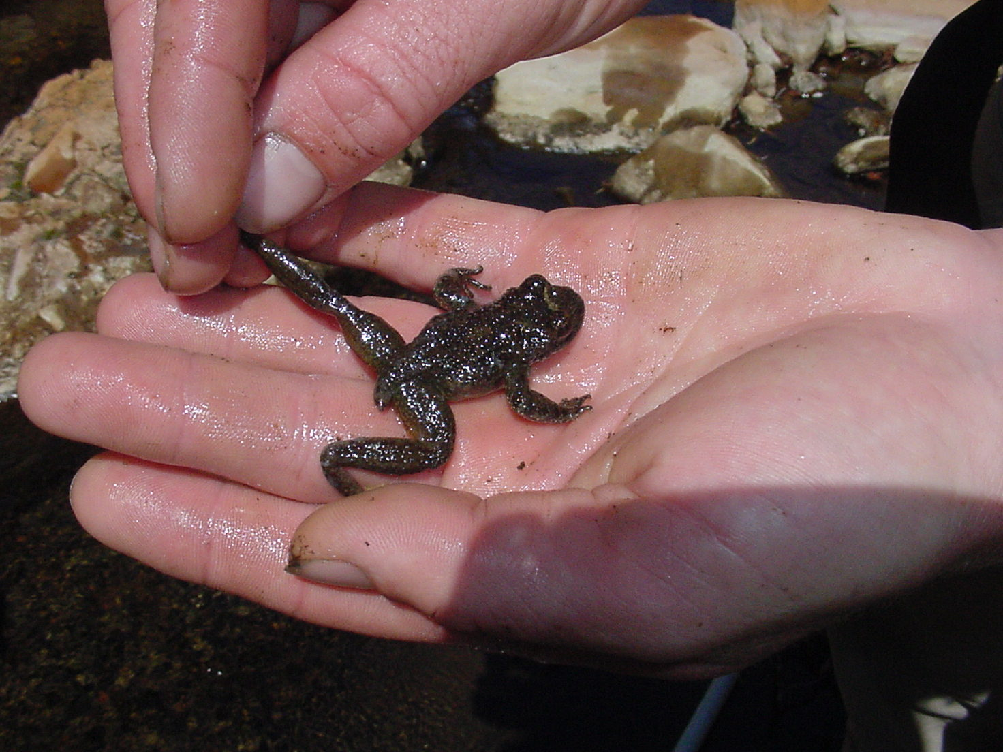
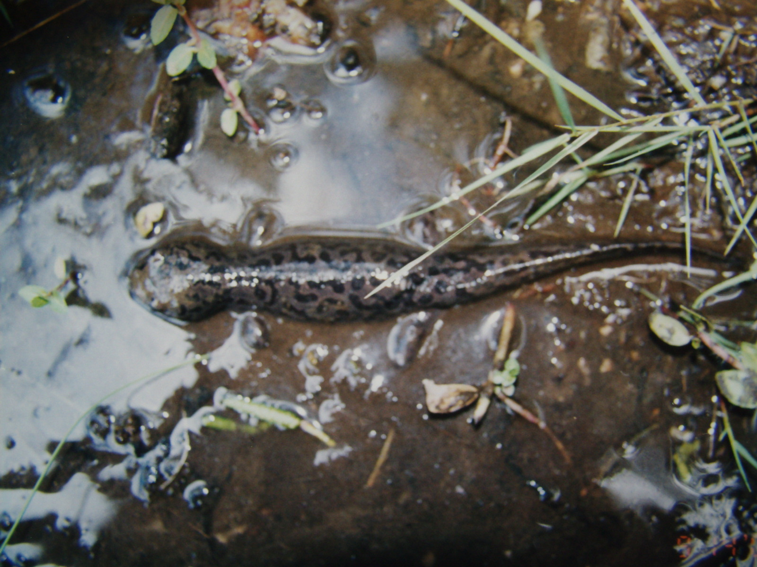
Abundant Aquatic Life Upstream of Mine
Pacific Giant Salamander
Tailed Frog

Slide 15
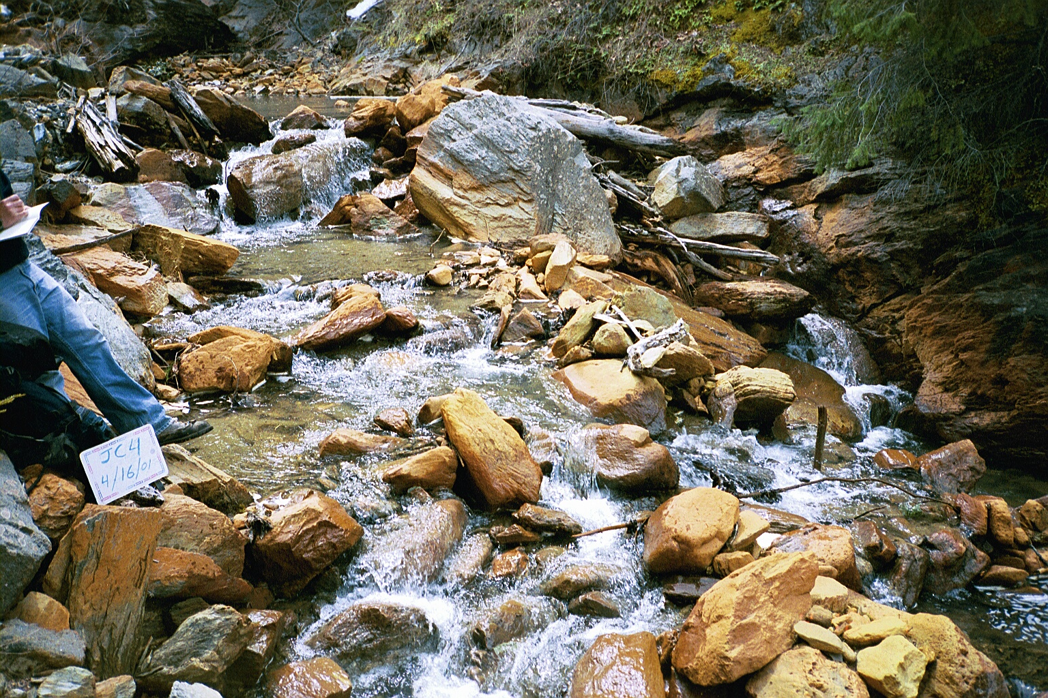
4 Miles of Sterile Stream Below Waste Rock Piles

Slide 16
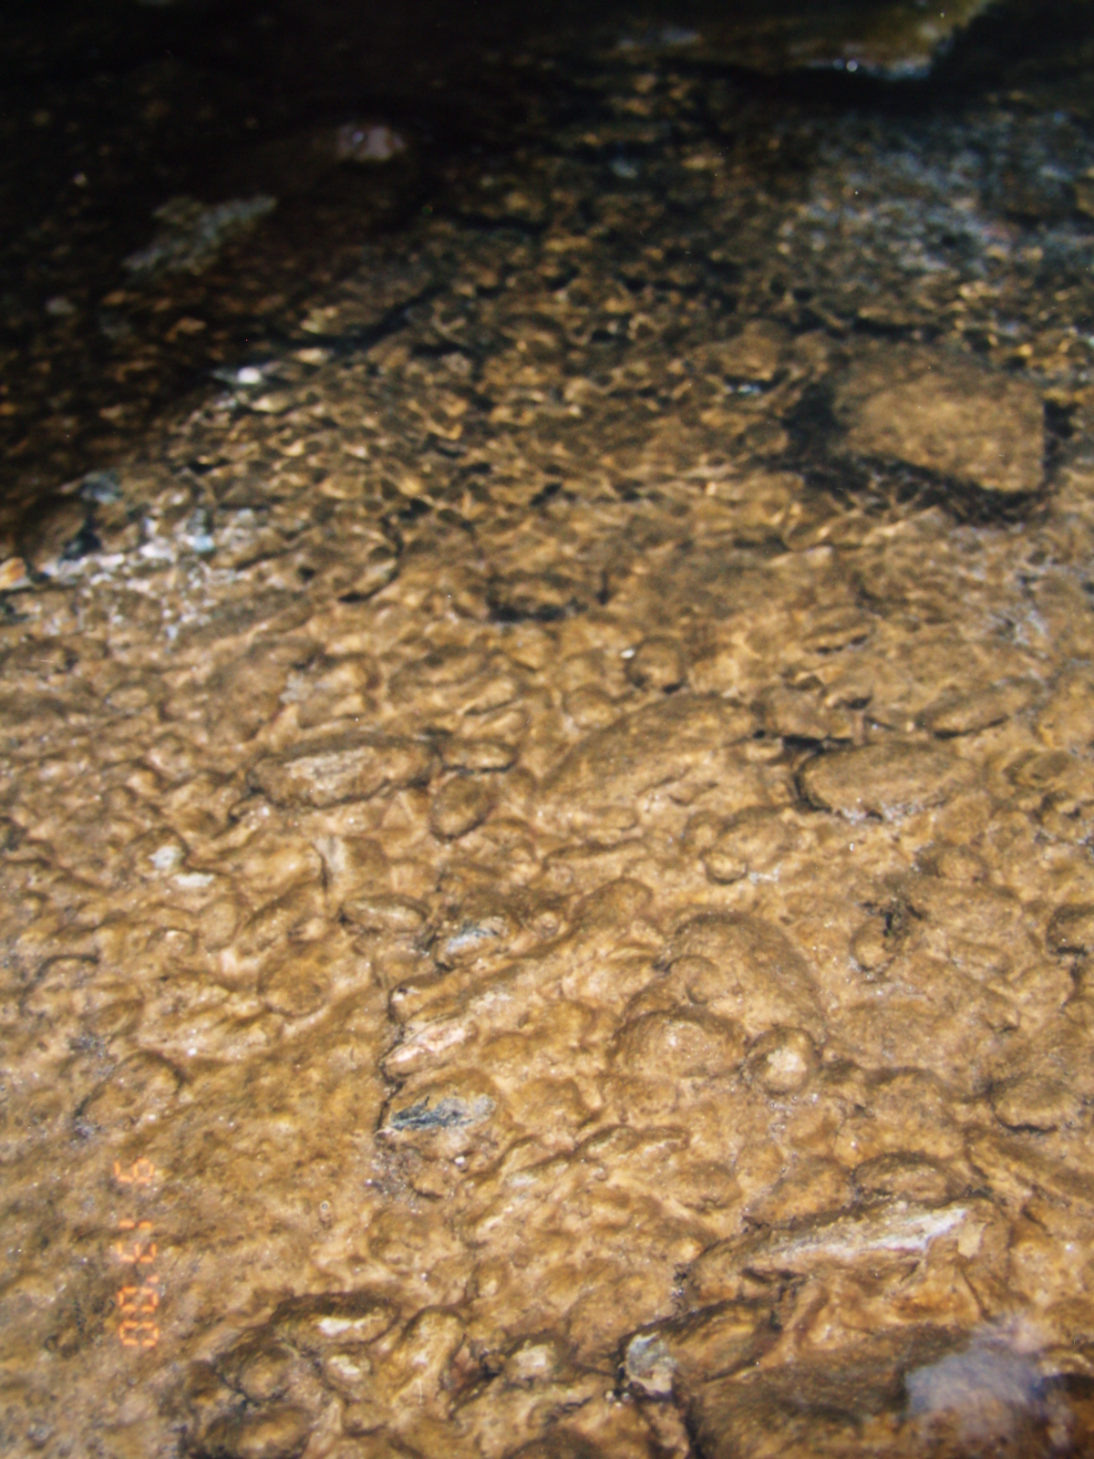
One Mile Below Mine
Brown Algal Mat is Only Living Organism

Slide 17
Joe Creek
Elliott Ck

Slide 18
Joe Creek
Elliott Ck

Slide 19
2010-11 US Forest Service Non-Time-Critical Removal Action

Slide 20
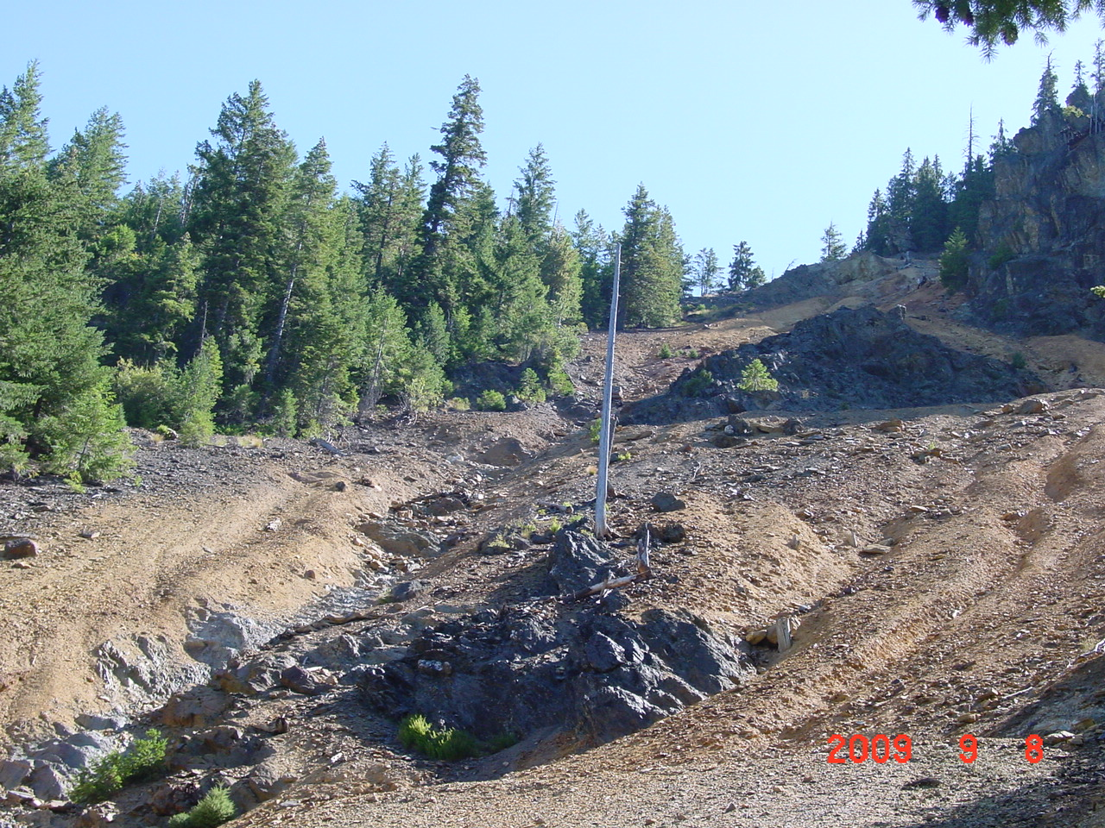
Emphasis on AMD Source Control
by Removing Waste Rock Piles

Slide 21
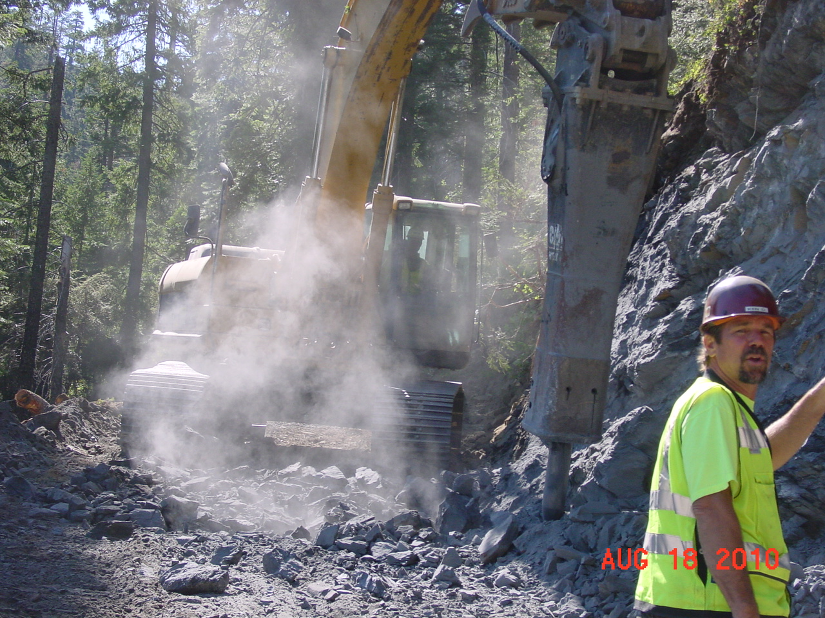
Solid Rock Excavation For
Haul Road at 30% Grades

Slide 22
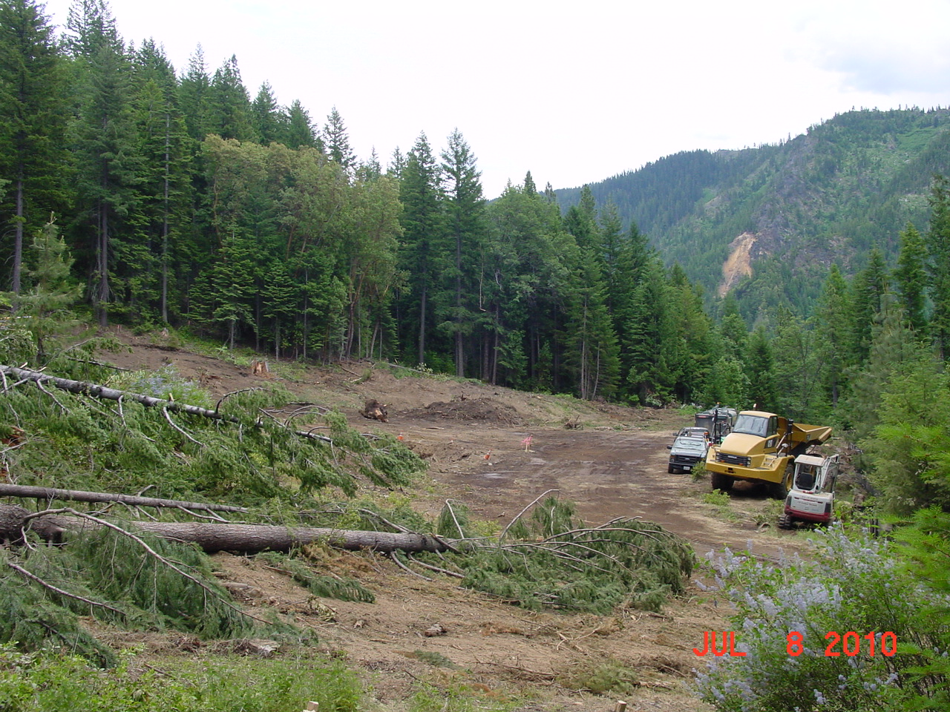
Construct Repository on Ancient Landslide
BL Mine

Slide 23
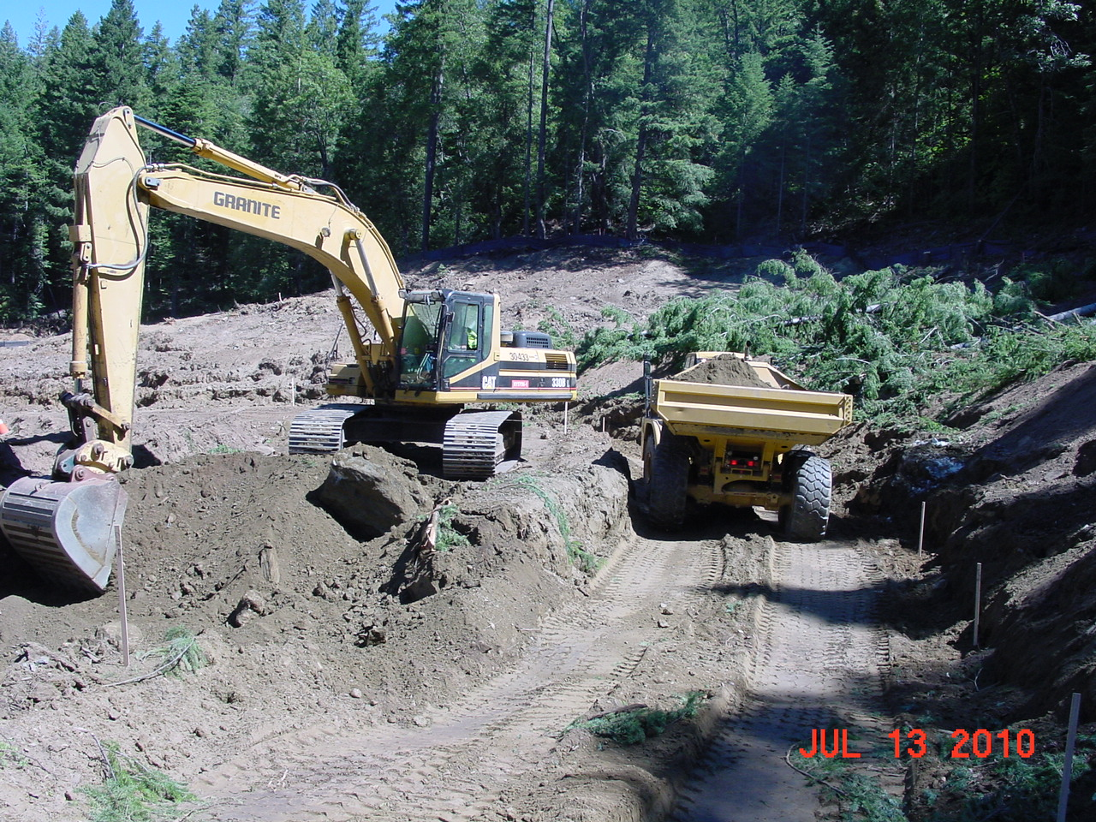
Excavate 45,000 Cubic Yards

Slide 24
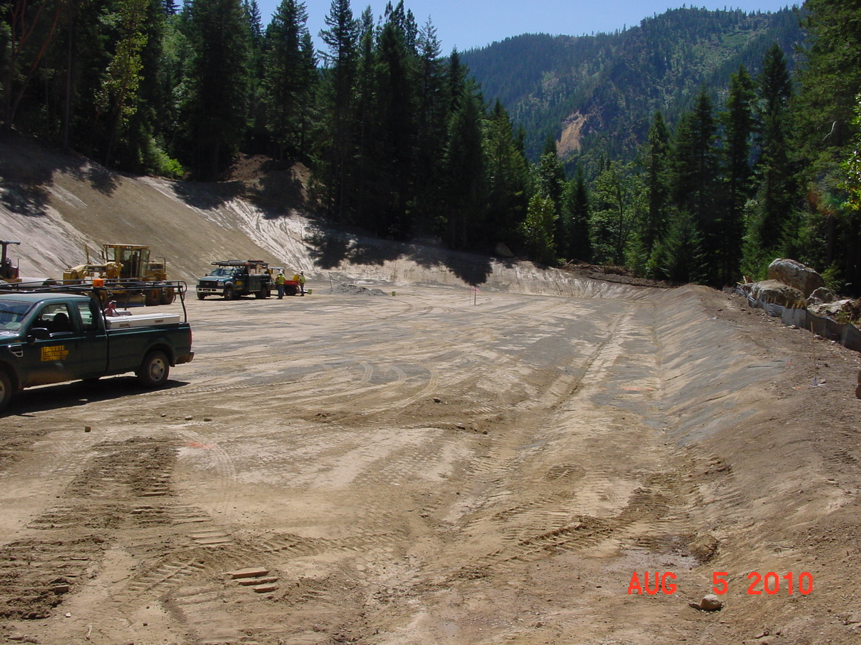
Prepare Repository Subgrade
BL Mine

Slide 25
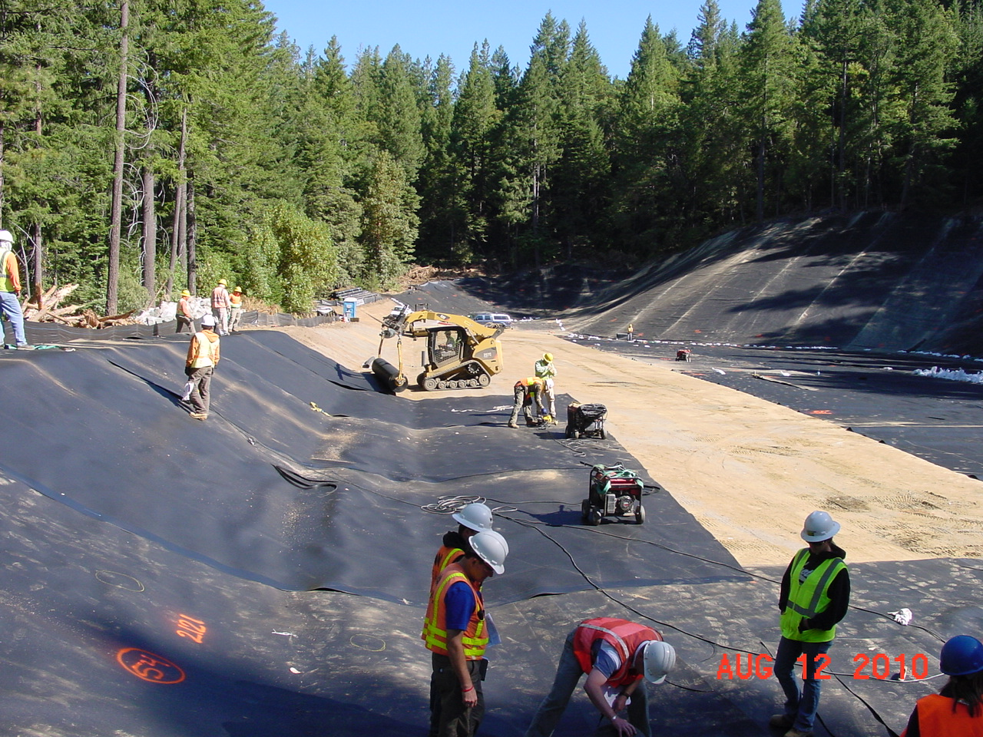
Install 60 mil Double-Textured HDPE Liner

Slide 26
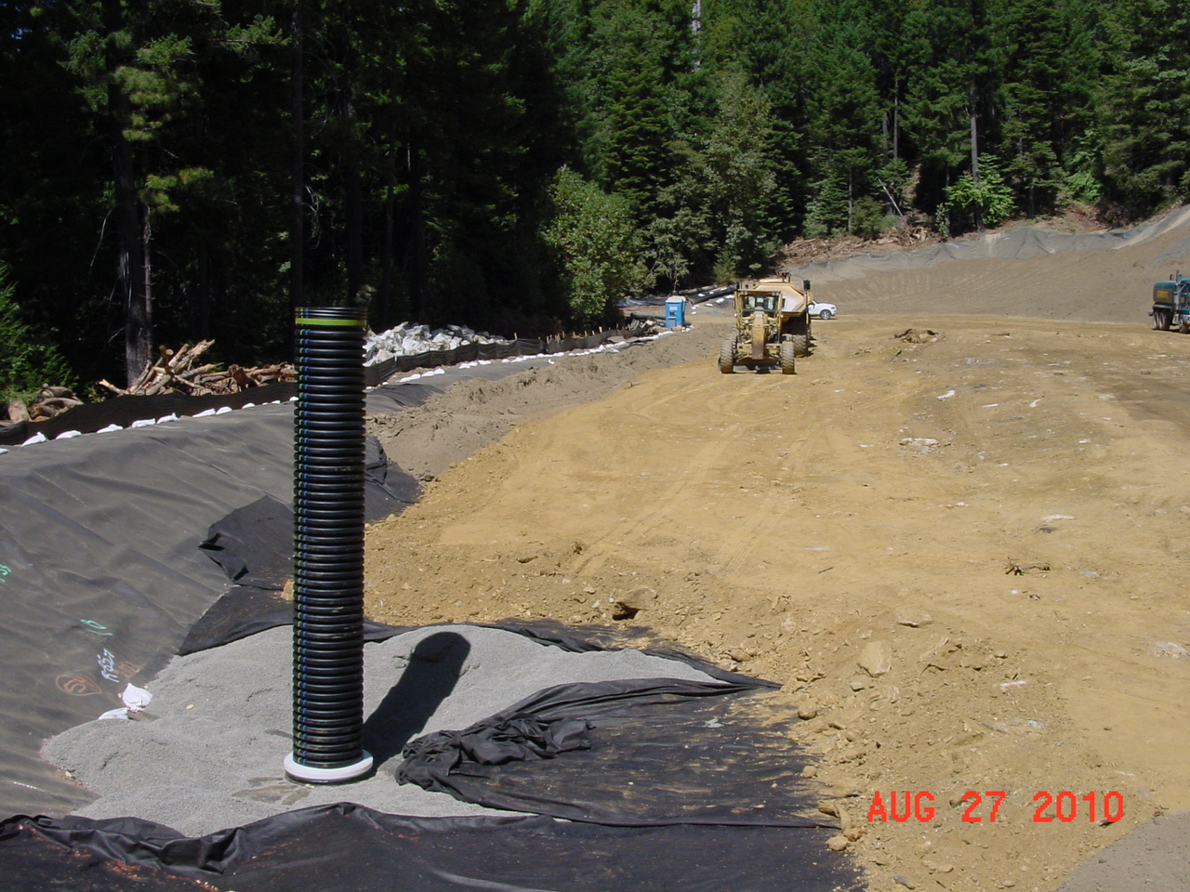
Base of Repository System
Cushion Soil
Waste Rock
60 mil Liner
Leachate Collection Tank and Riser
Drain Rock
Separation Geotextile

Slide 27
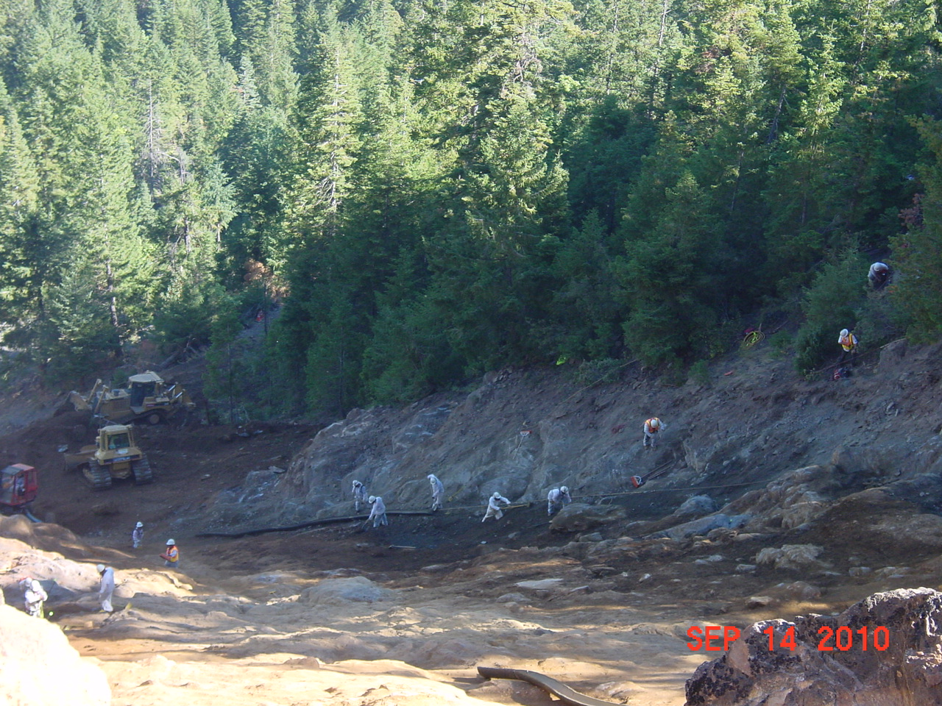
Excavate Waste Rock
by Machine and Manpower

Slide 28
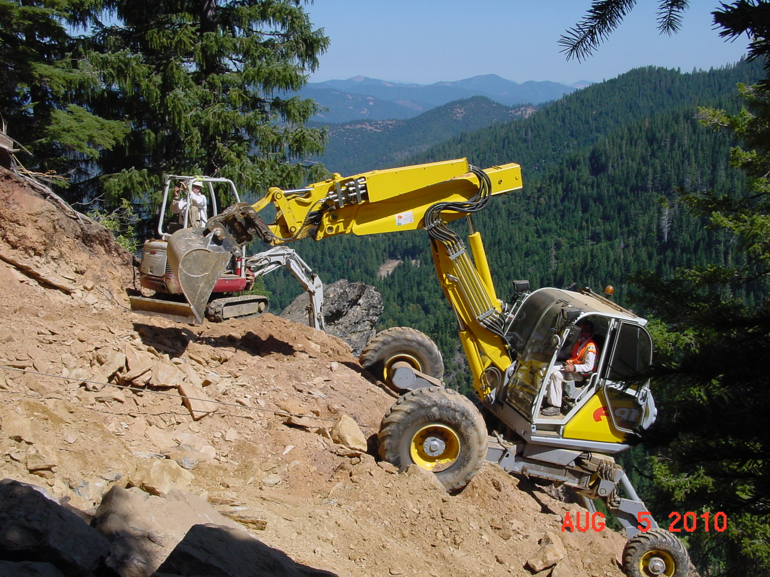
Mini-Excavator Flown From Repository to
Top by Helicopter
3 Spider Excavators Climb to Top of Piles
Repository

Slide 29
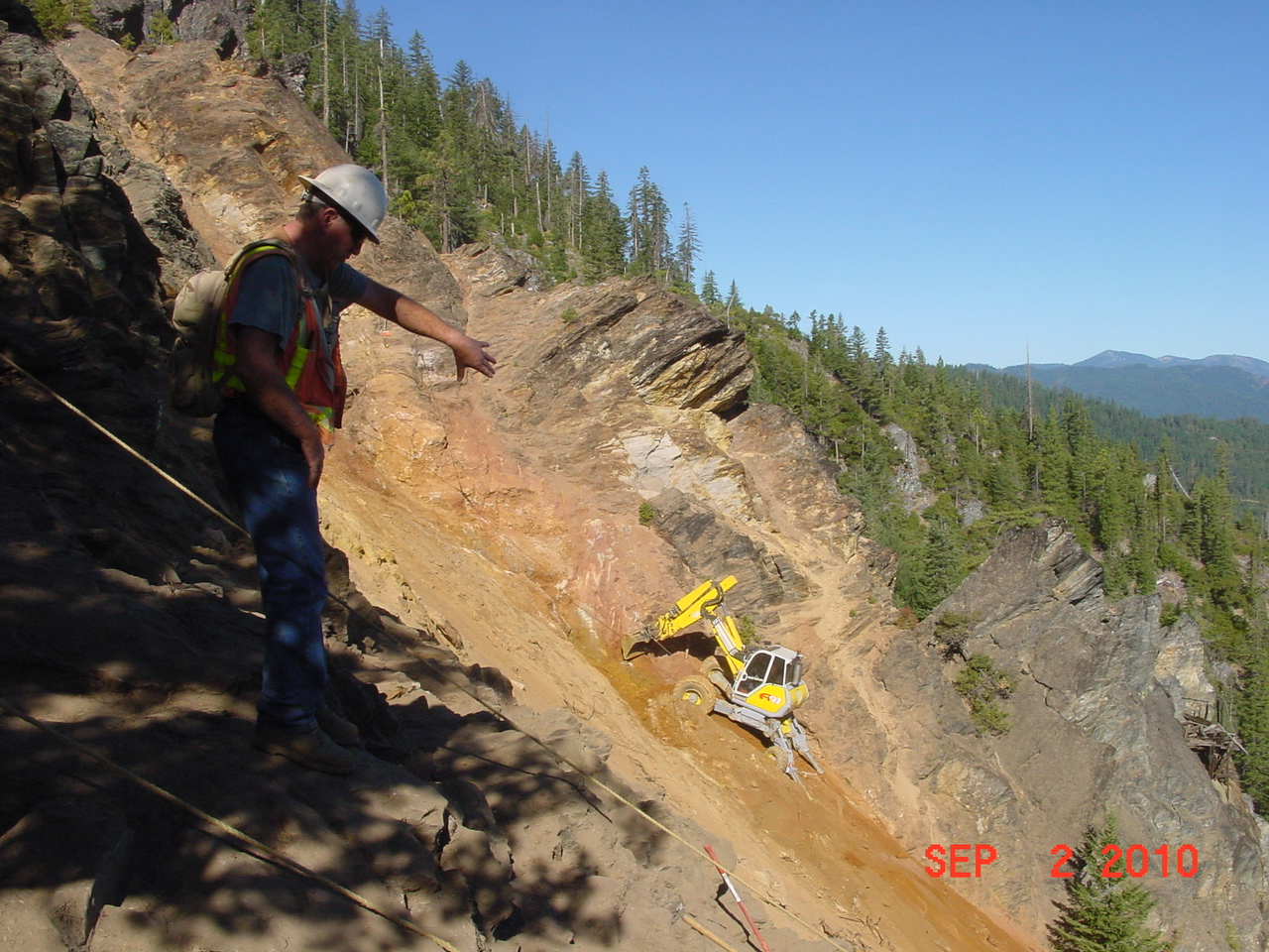
Spiders Excavated Waste Rock, Uncovered 6 Unknown Buried Adits and 1 Shaft

Slide 30
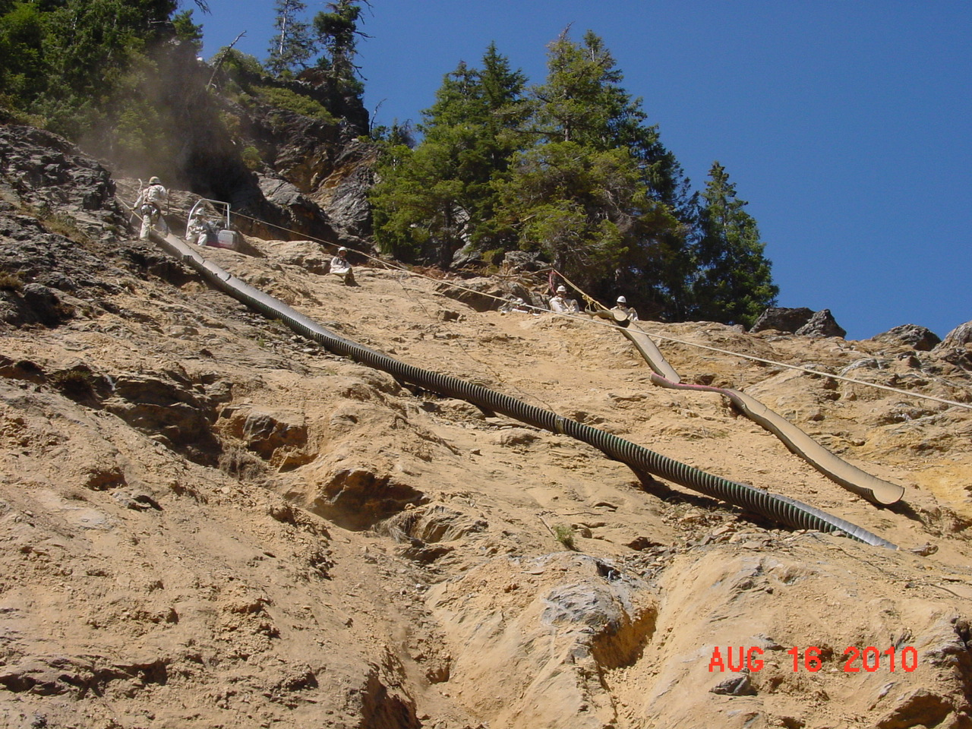
Laborers Remove Waste Rock Down to Clean Soil or Bedrock
Chutes Convey Hand-Excavated Waste Rock to Spiders Below

Slide 31
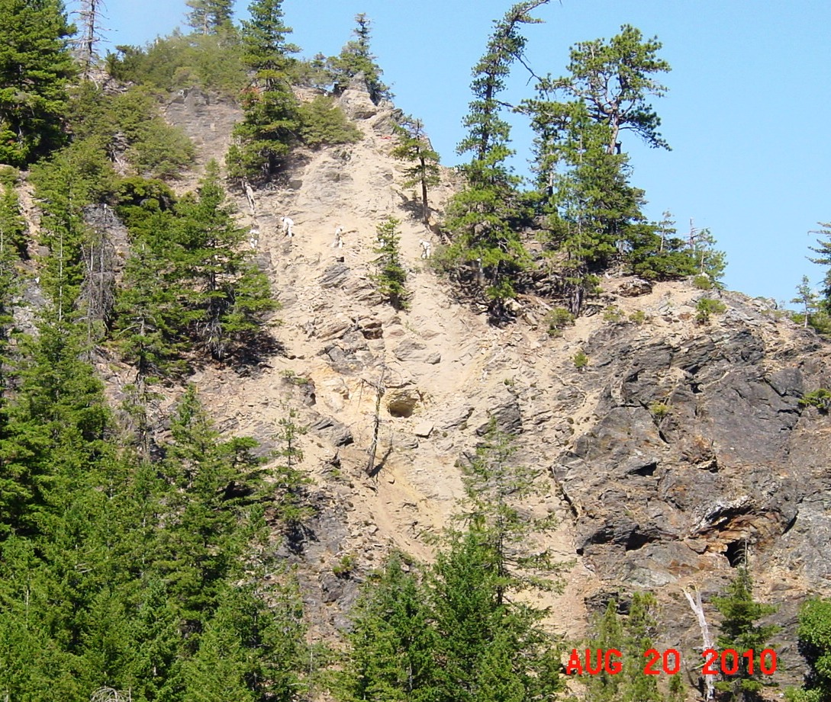
Adits
Scalers Remove Rock Above Before Waste Excavation Below

Slide 32
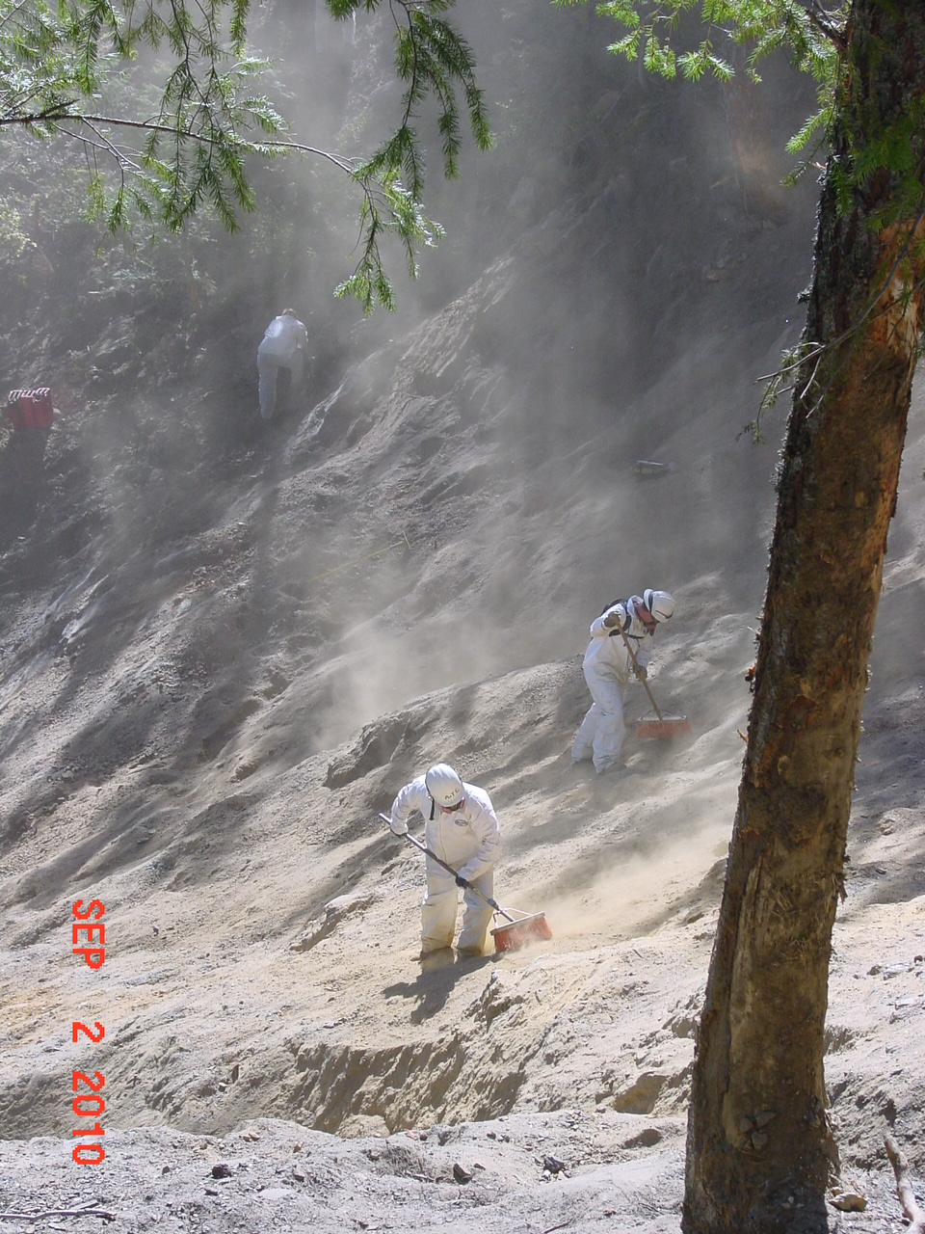
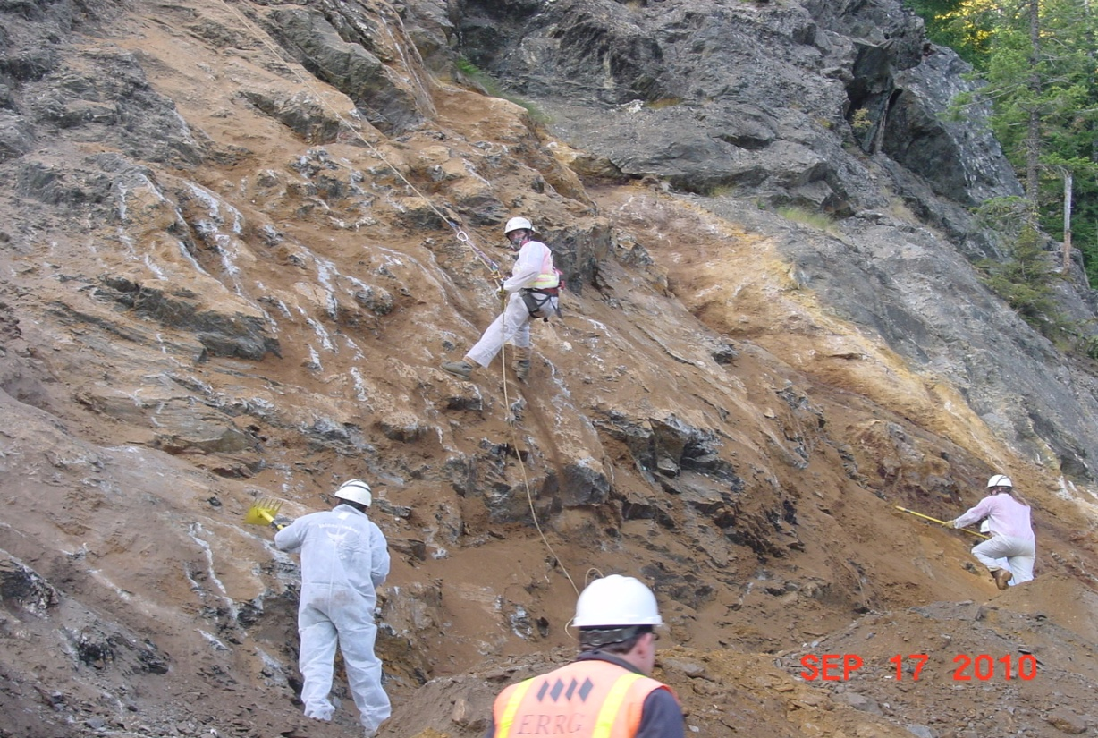
Laborers With Hand Tools
Clean to Bare Rock

Slide 33
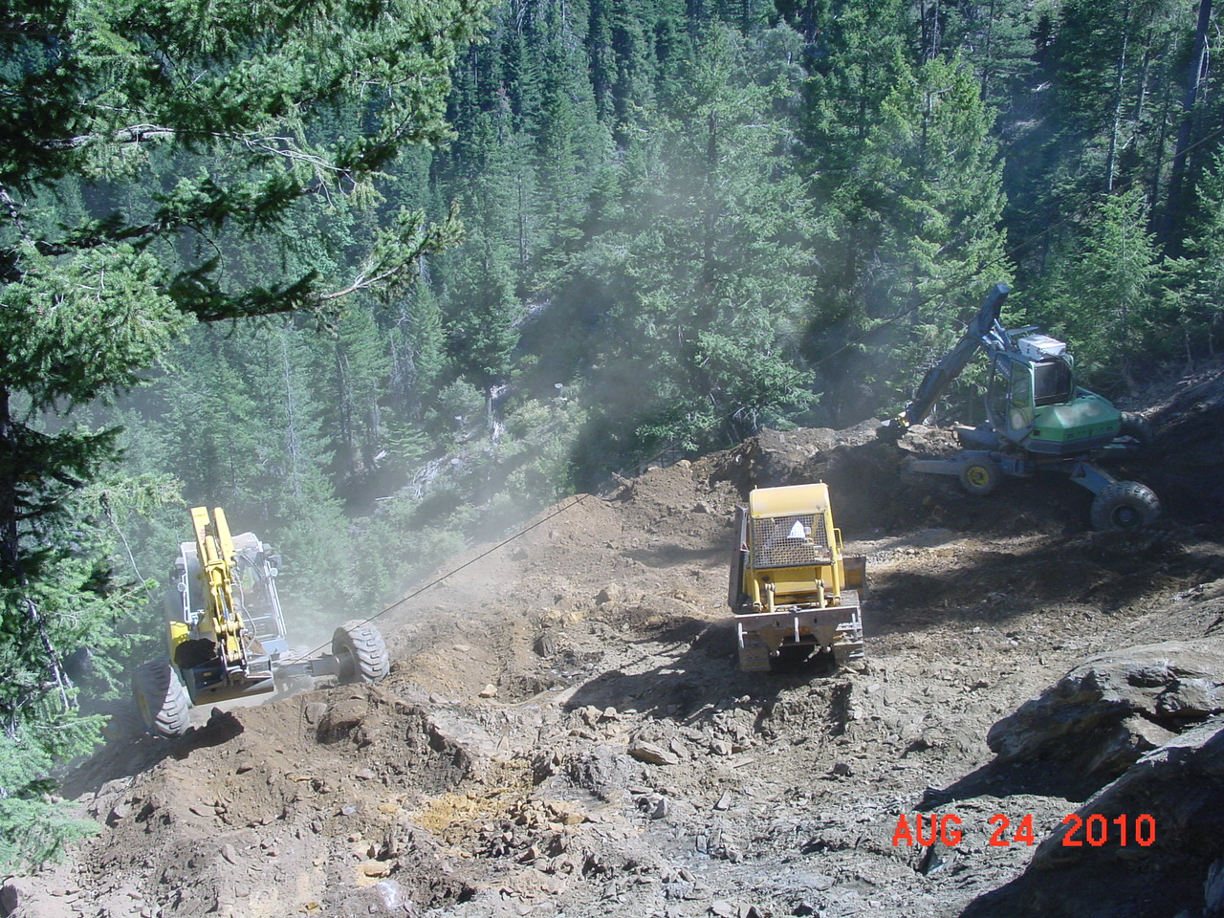
D4 Joins Spiders to Push Surge Pile to Excavator & Haul Trucks Below
Spider Winch Cable

Slide 34
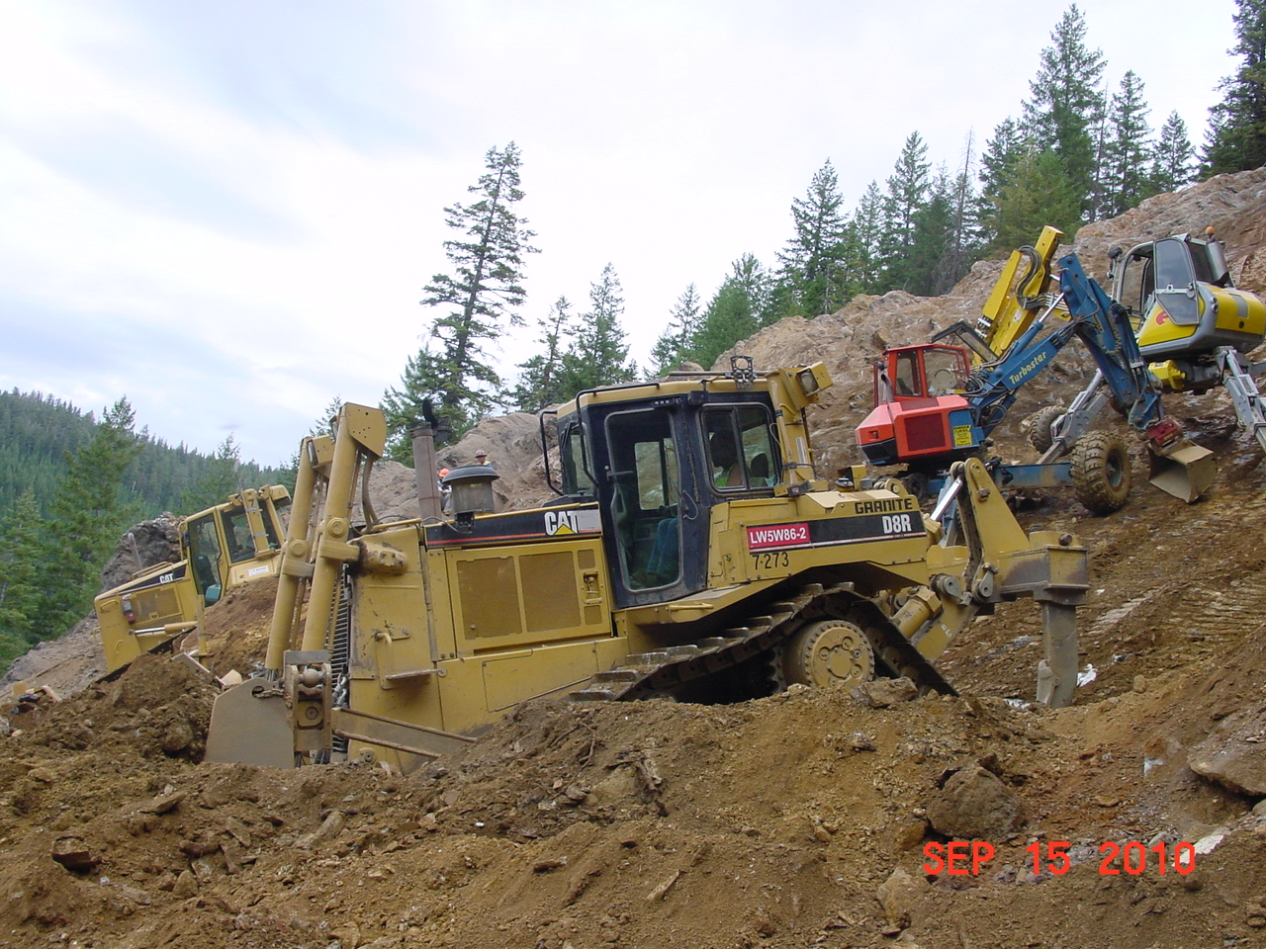
D8 & D6 Push Surge Pile From Spiders

Slide 35
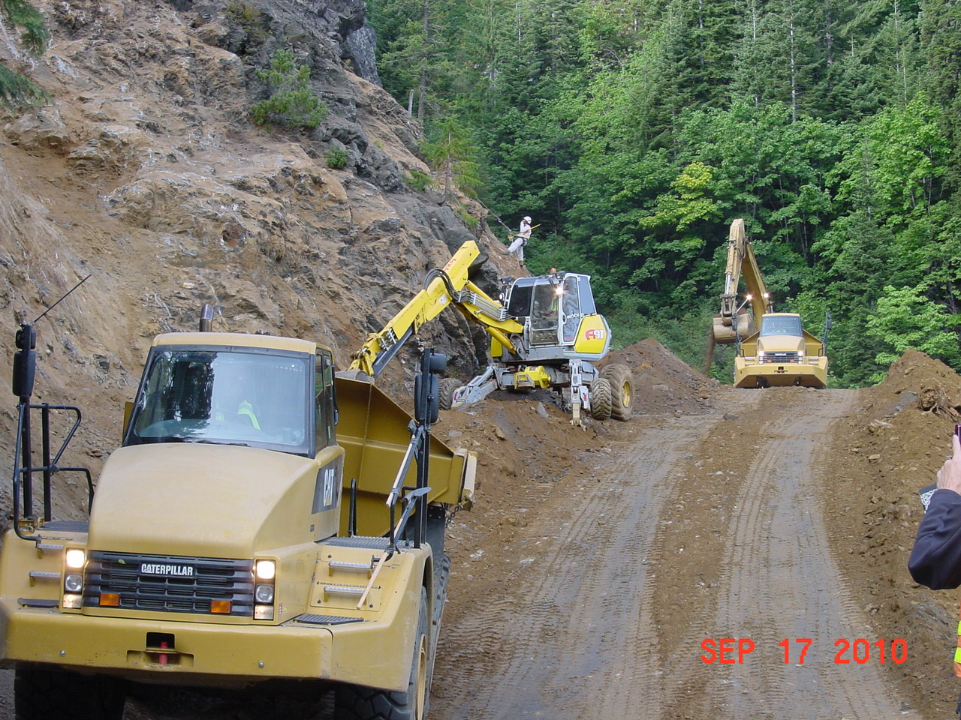
Excavator Loaded 35-Ton Haul Trucks That Made 5,000 Trips to Repository

Slide 36
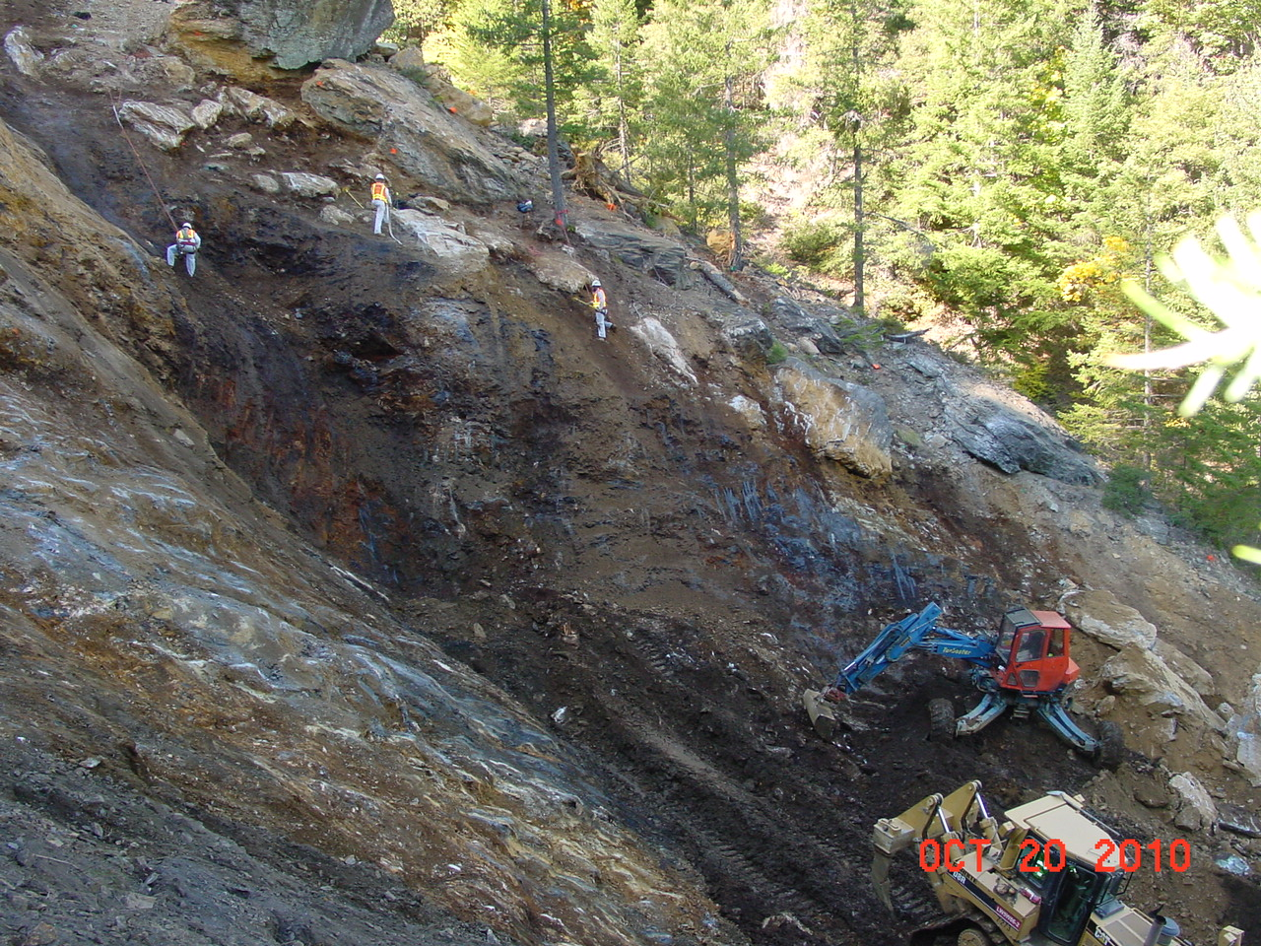
Current Stream Channel
Cleaning Unknown Old Stream Channel Buried by Mine Waste

Slide 37
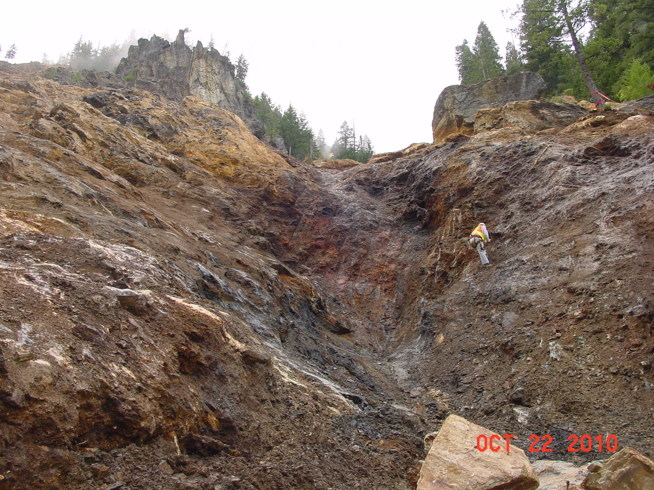
Final Cleaning of
35’-Deep Pre-Mining Era
Drainage Channel

Slide 38
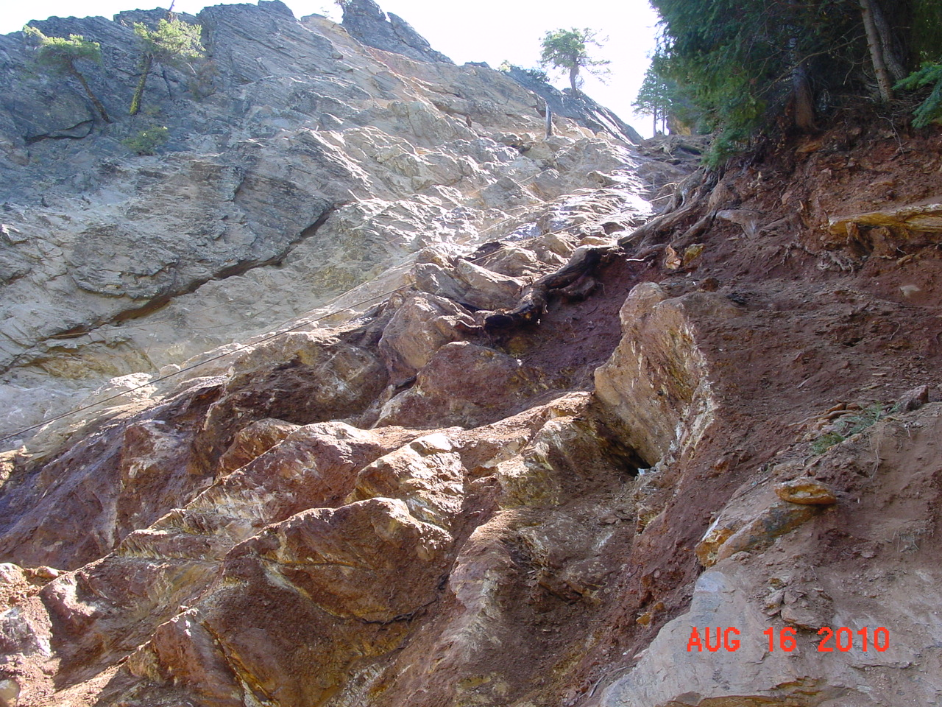
Chute Cleaned by
Spiders And Laborers

Slide 39
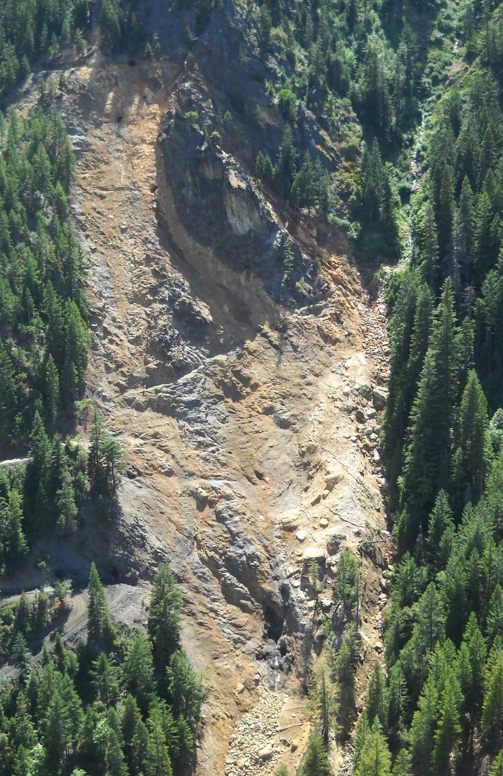
Aerial View After Removal
Adits
Pre-mining stream path

Slide 40
Blue Ledge Mine Reclamation
Repository Cover
Erosion Control Haul Roads
Sediment/pH Treatment Basins
Log & Straw Wattles on Residual Soil
Plant 10,000 Native Plants, 18 Different Species
Native Grass Seed
Straw, Bark, Hydromulch, Slash
Riprap Channel Banks
Stabilize Channel Bank
Install Bat Gates

Slide 41
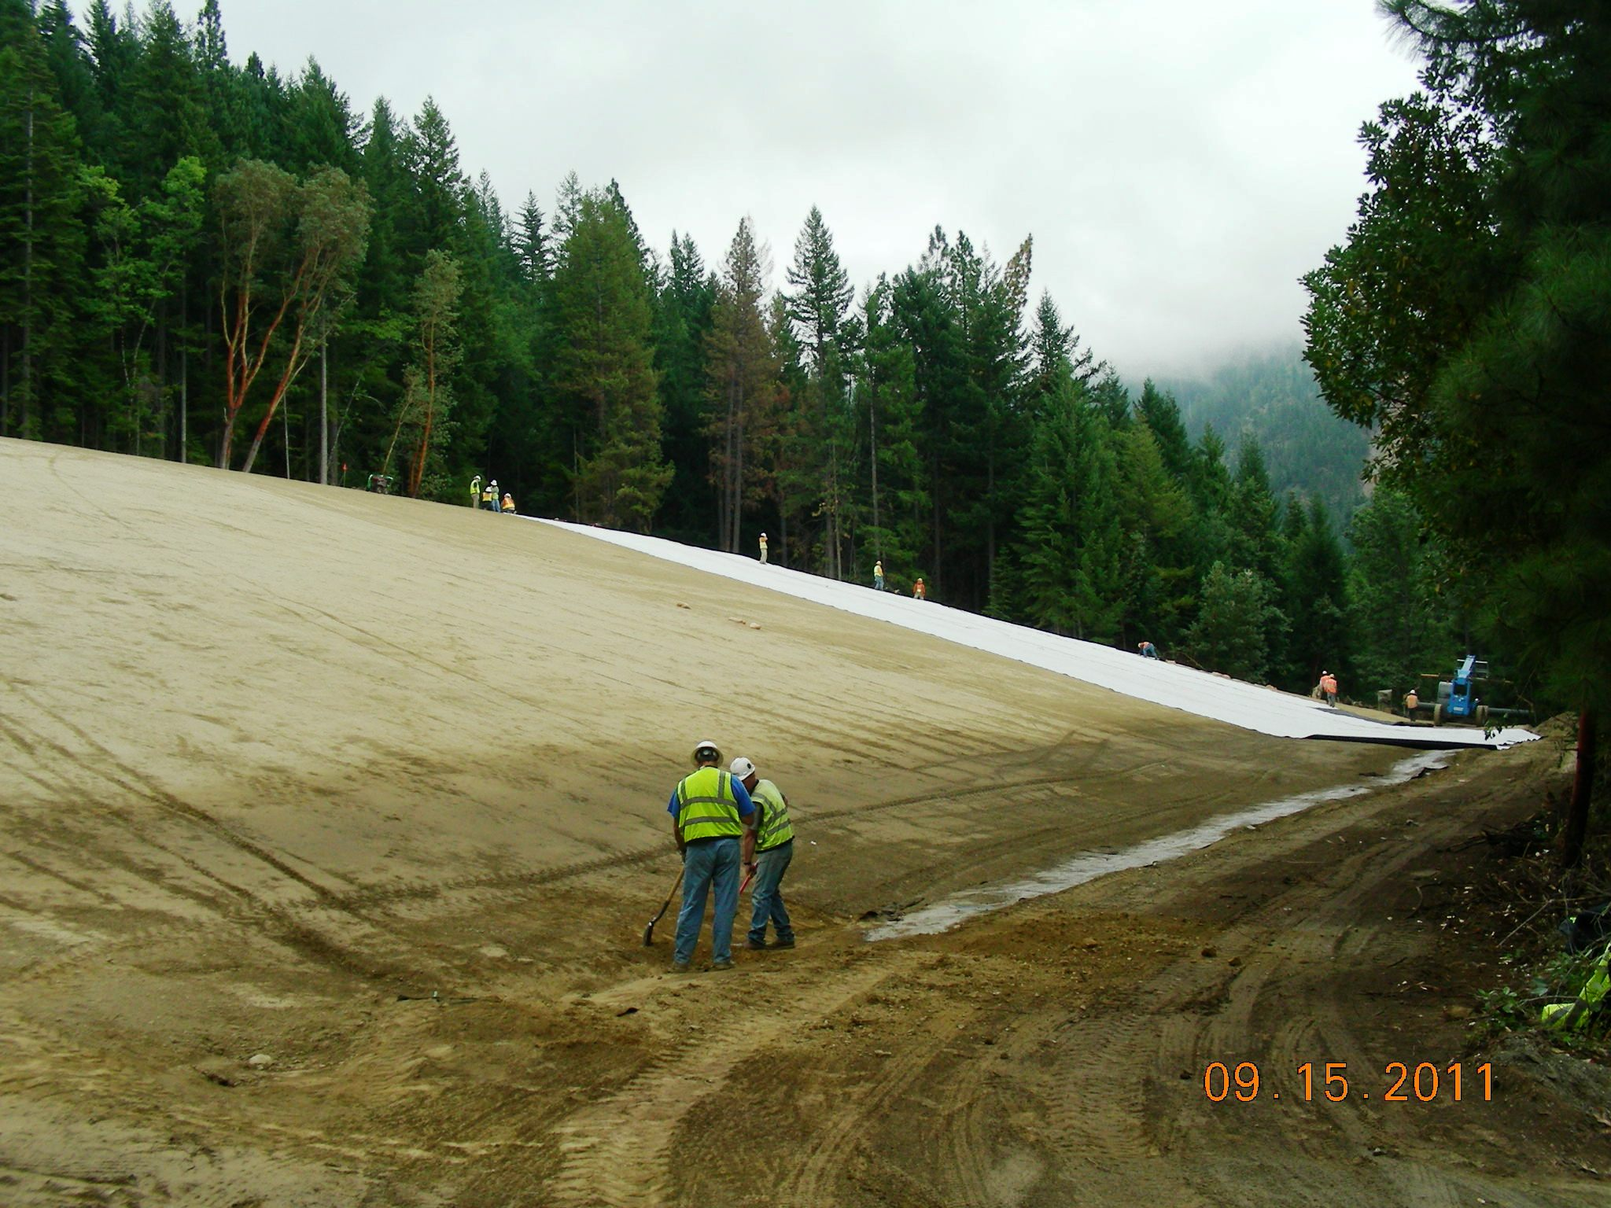
66,500 CY of Waste Rock Placed in the Repository
60 mil Double-Textured HDPE Repository Cover
Screened Cushion Soil

Slide 42
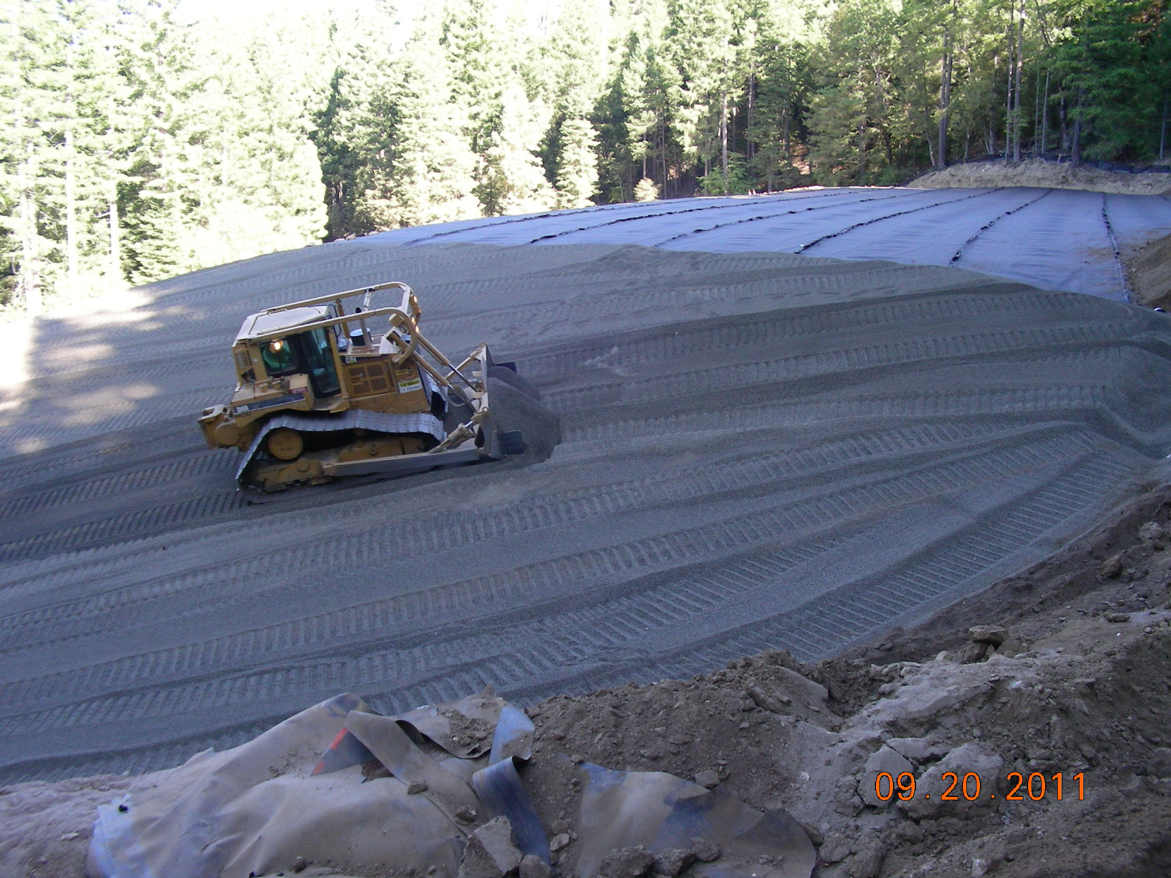
Repository Cover Drainage Layer
Geocomposite Top Deck
1’ Pea Gravel On Slopes

Slide 43
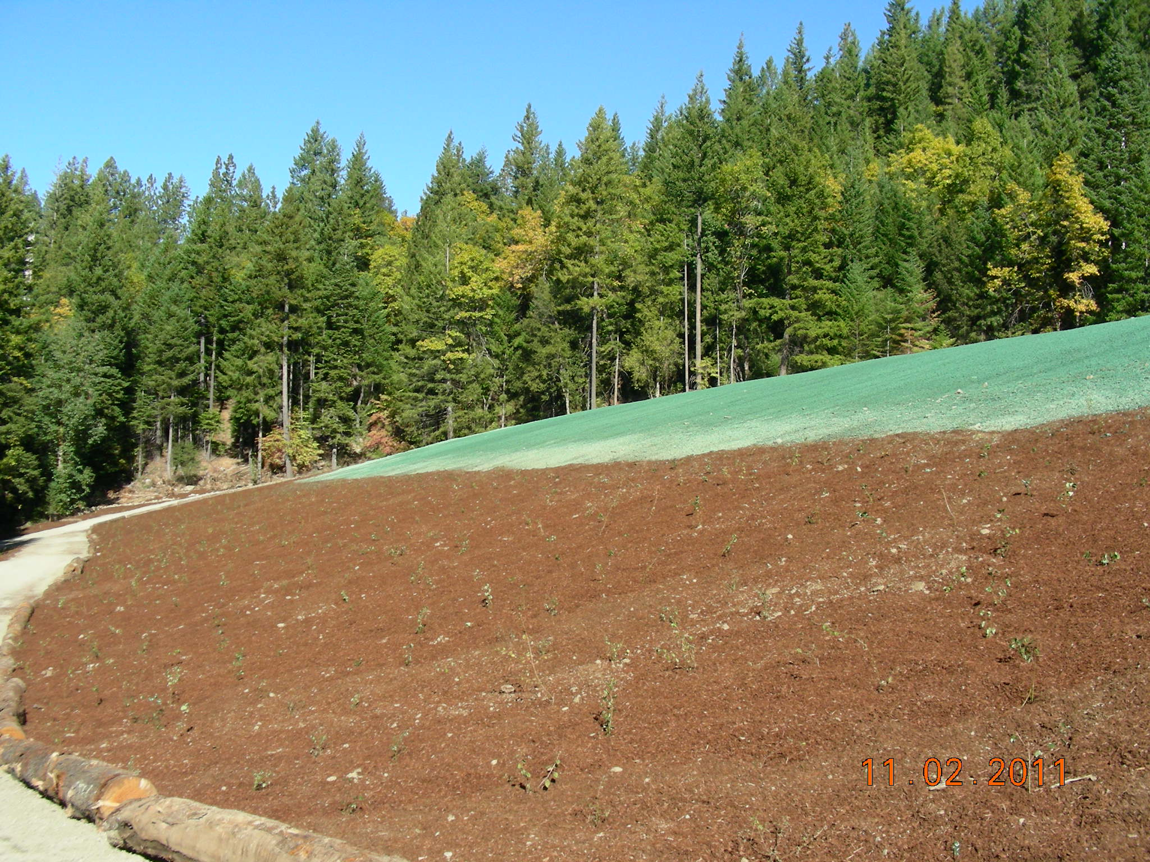
Completed Repository Cover
Flexterra Hydromulch
with Native Grass Seed
Bark Mulch and Native Shrubs
Maintenance Access Road

Slide 44
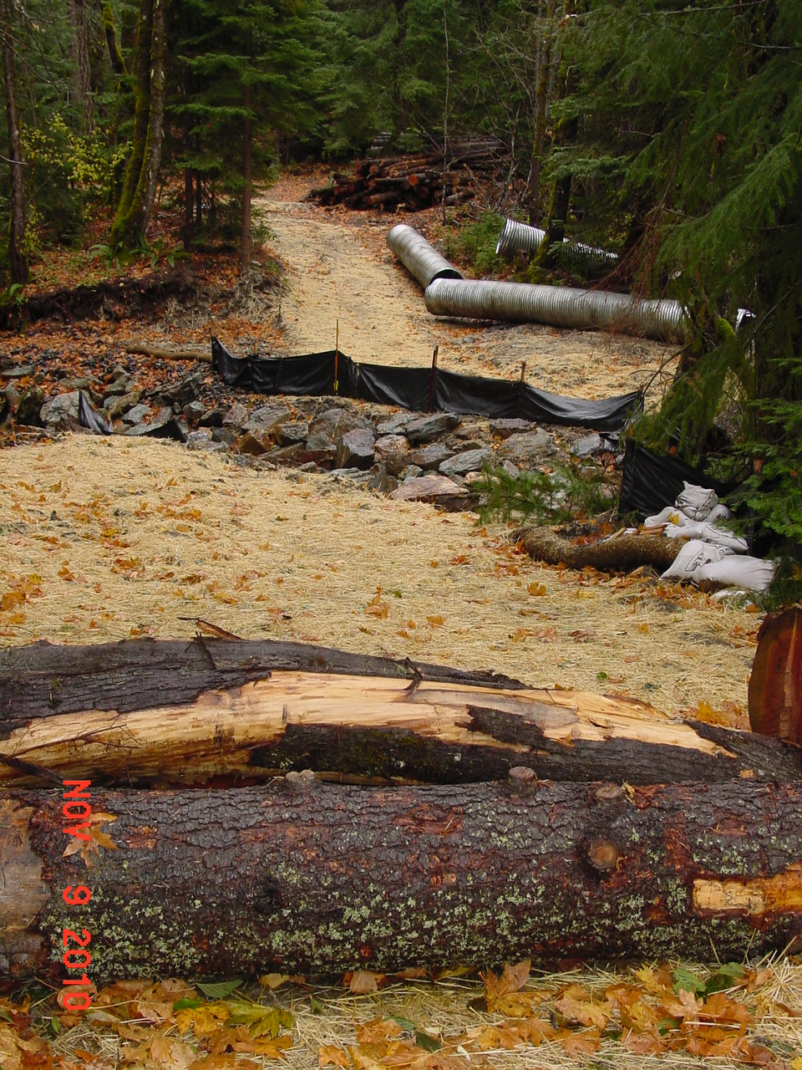
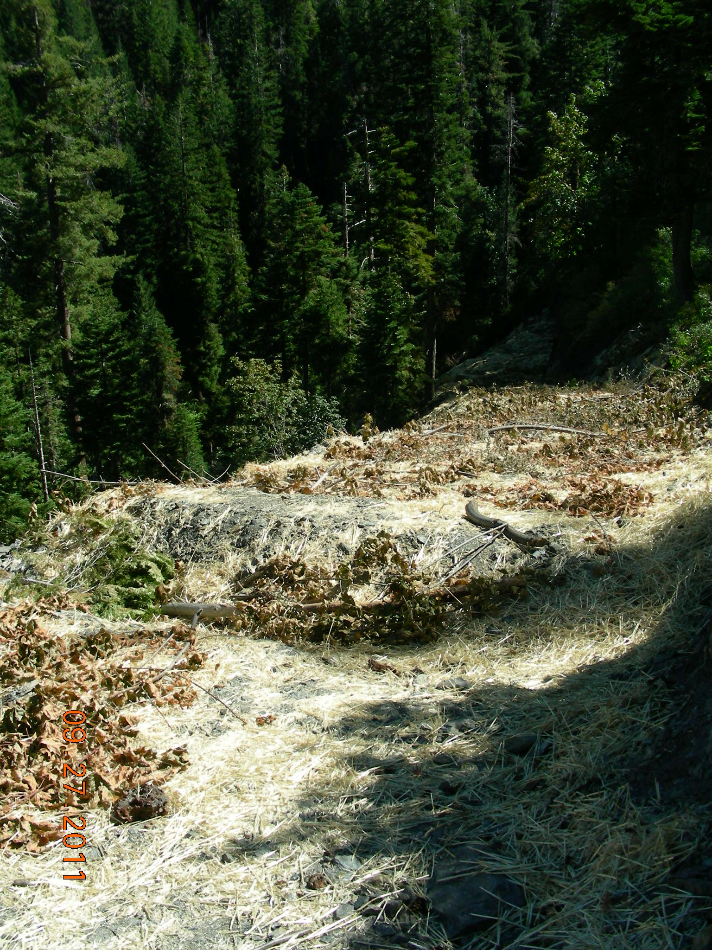
Pull Culverts
Riprap Creek Banks
Decommission Haul Roads
Outslope, Waterbar, Seed, Straw, Slash

Slide 45
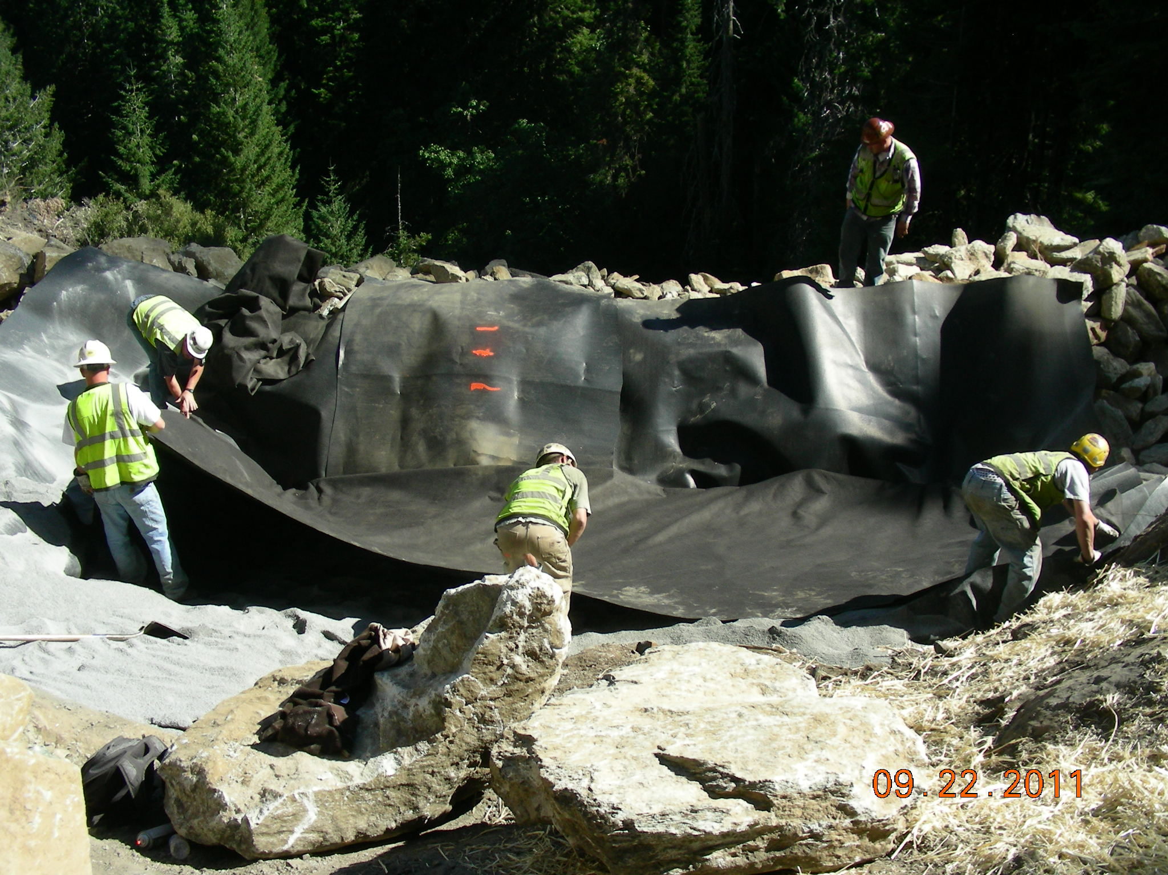
Sediment/pH Treatment Basins
Rock Buttress
Geomembrane Liner w/Drain Holes
Limestone Sand
Geotextile Cover
Over Lime Sand

Slide 46
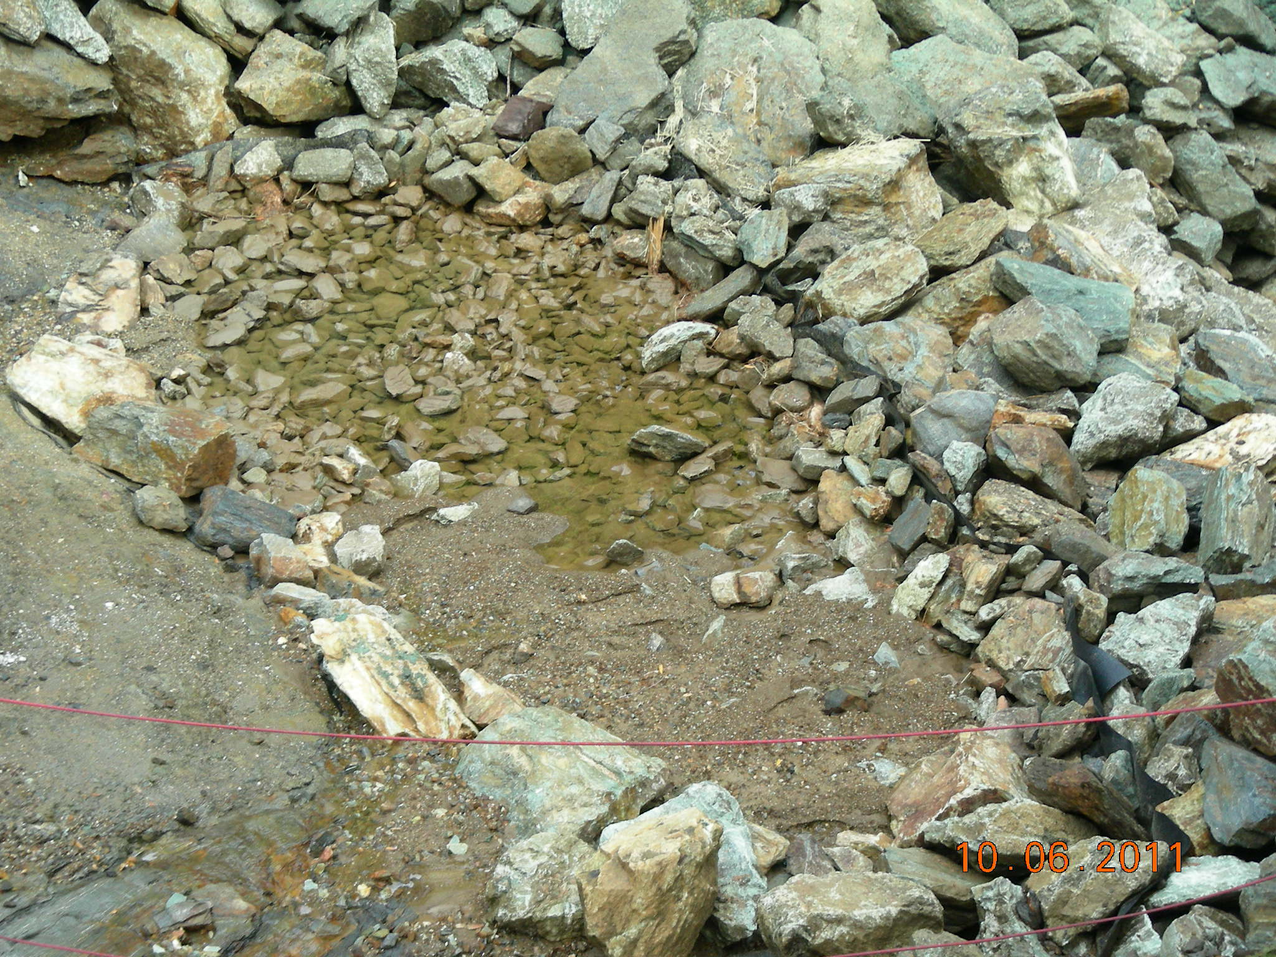
Residual Coarse-Fine Waste Rock Eroded From Bedrock Slopes
Overflow Spillway
Geomembrane Liner

Slide 47
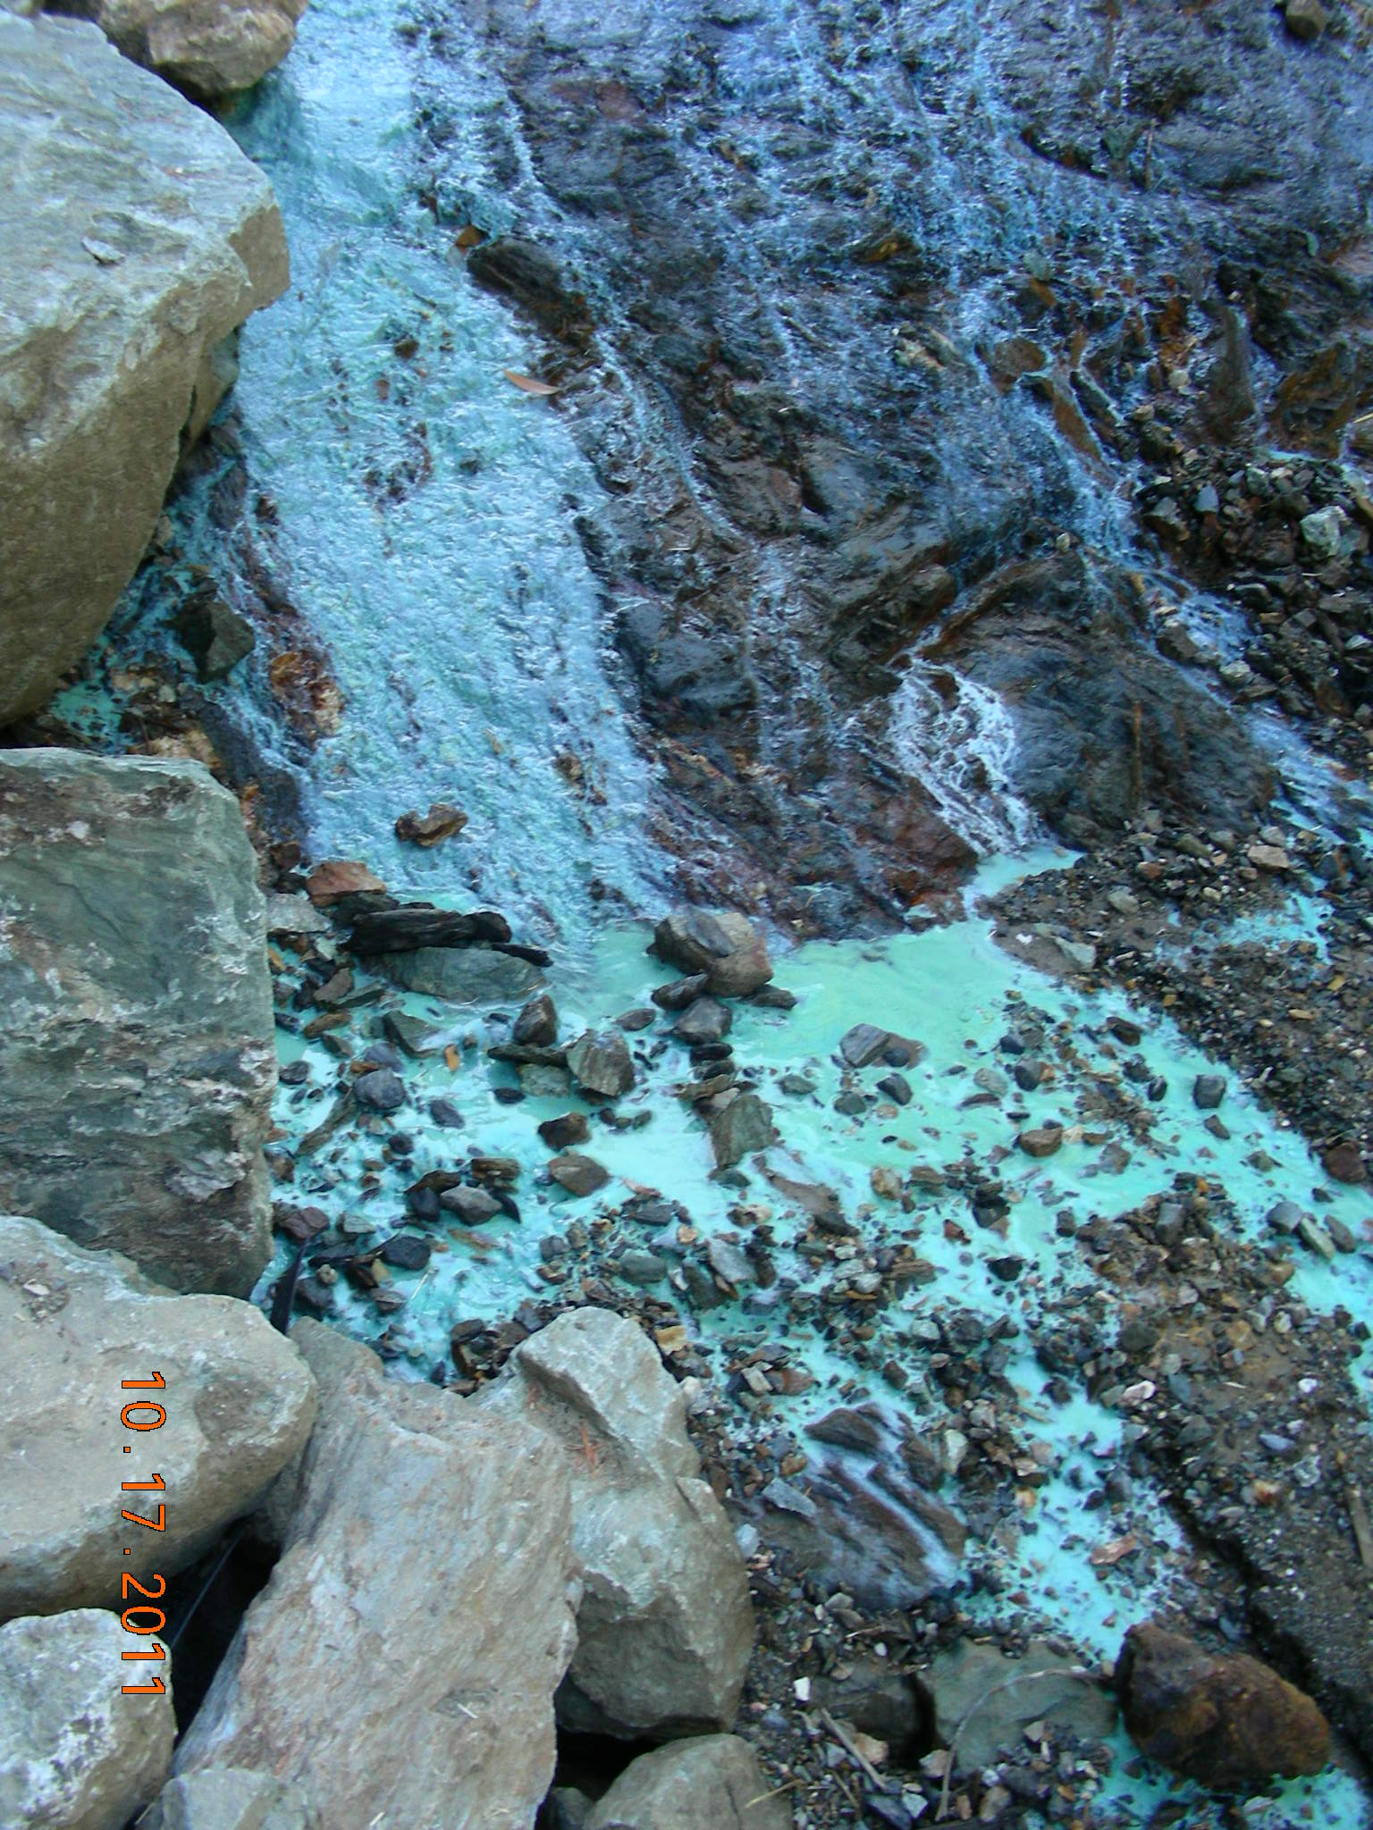
During Low Flows Seepage Through Limestone Sand in Basins Raises pH From 4 to 7
Copper and Other Metals Precipitate

Slide 48
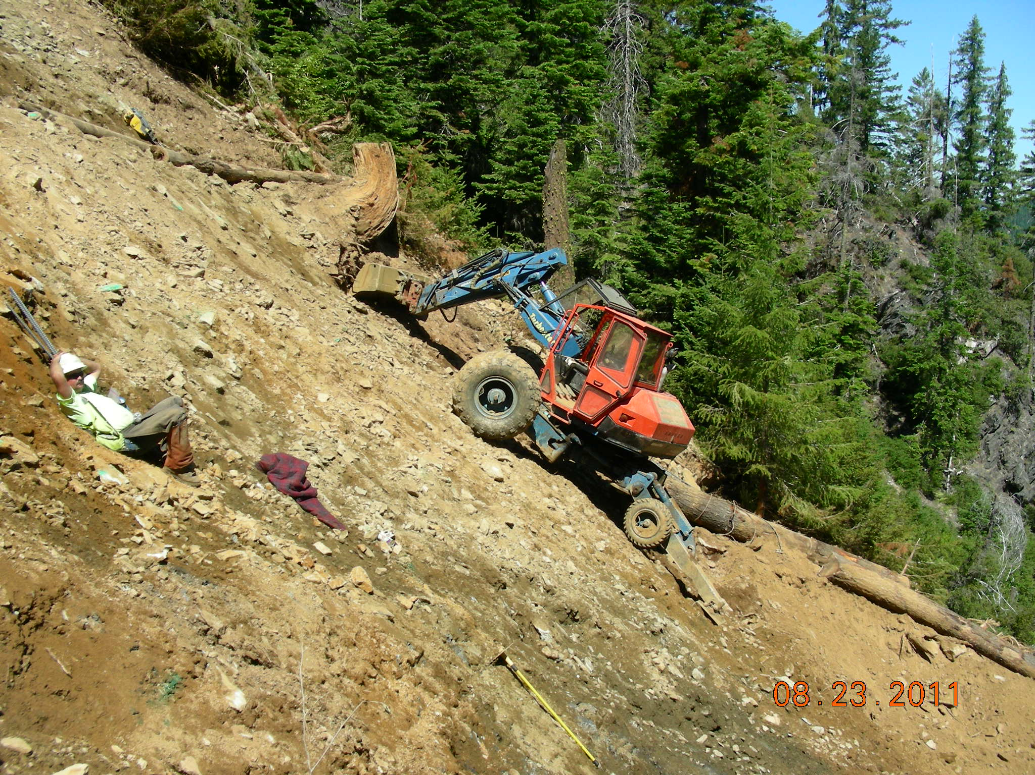
80%-90% Slopes Underlying Waste Rock Piles 3, 4 Needed Short/Long-Term Erosion Control Measures

Slide 49
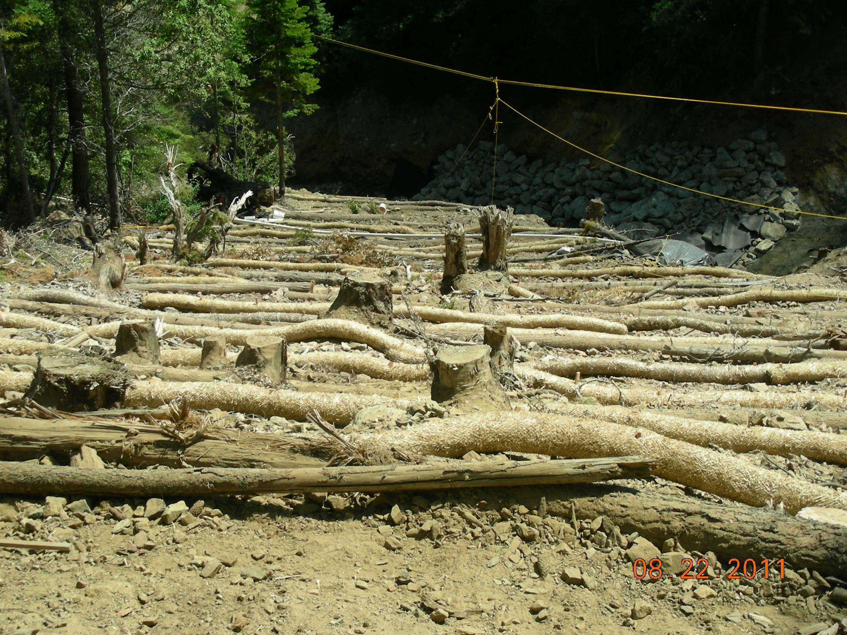
50’ Spacing for Log Wattles
2 Rows of Straw Wattles Between

Slide 50
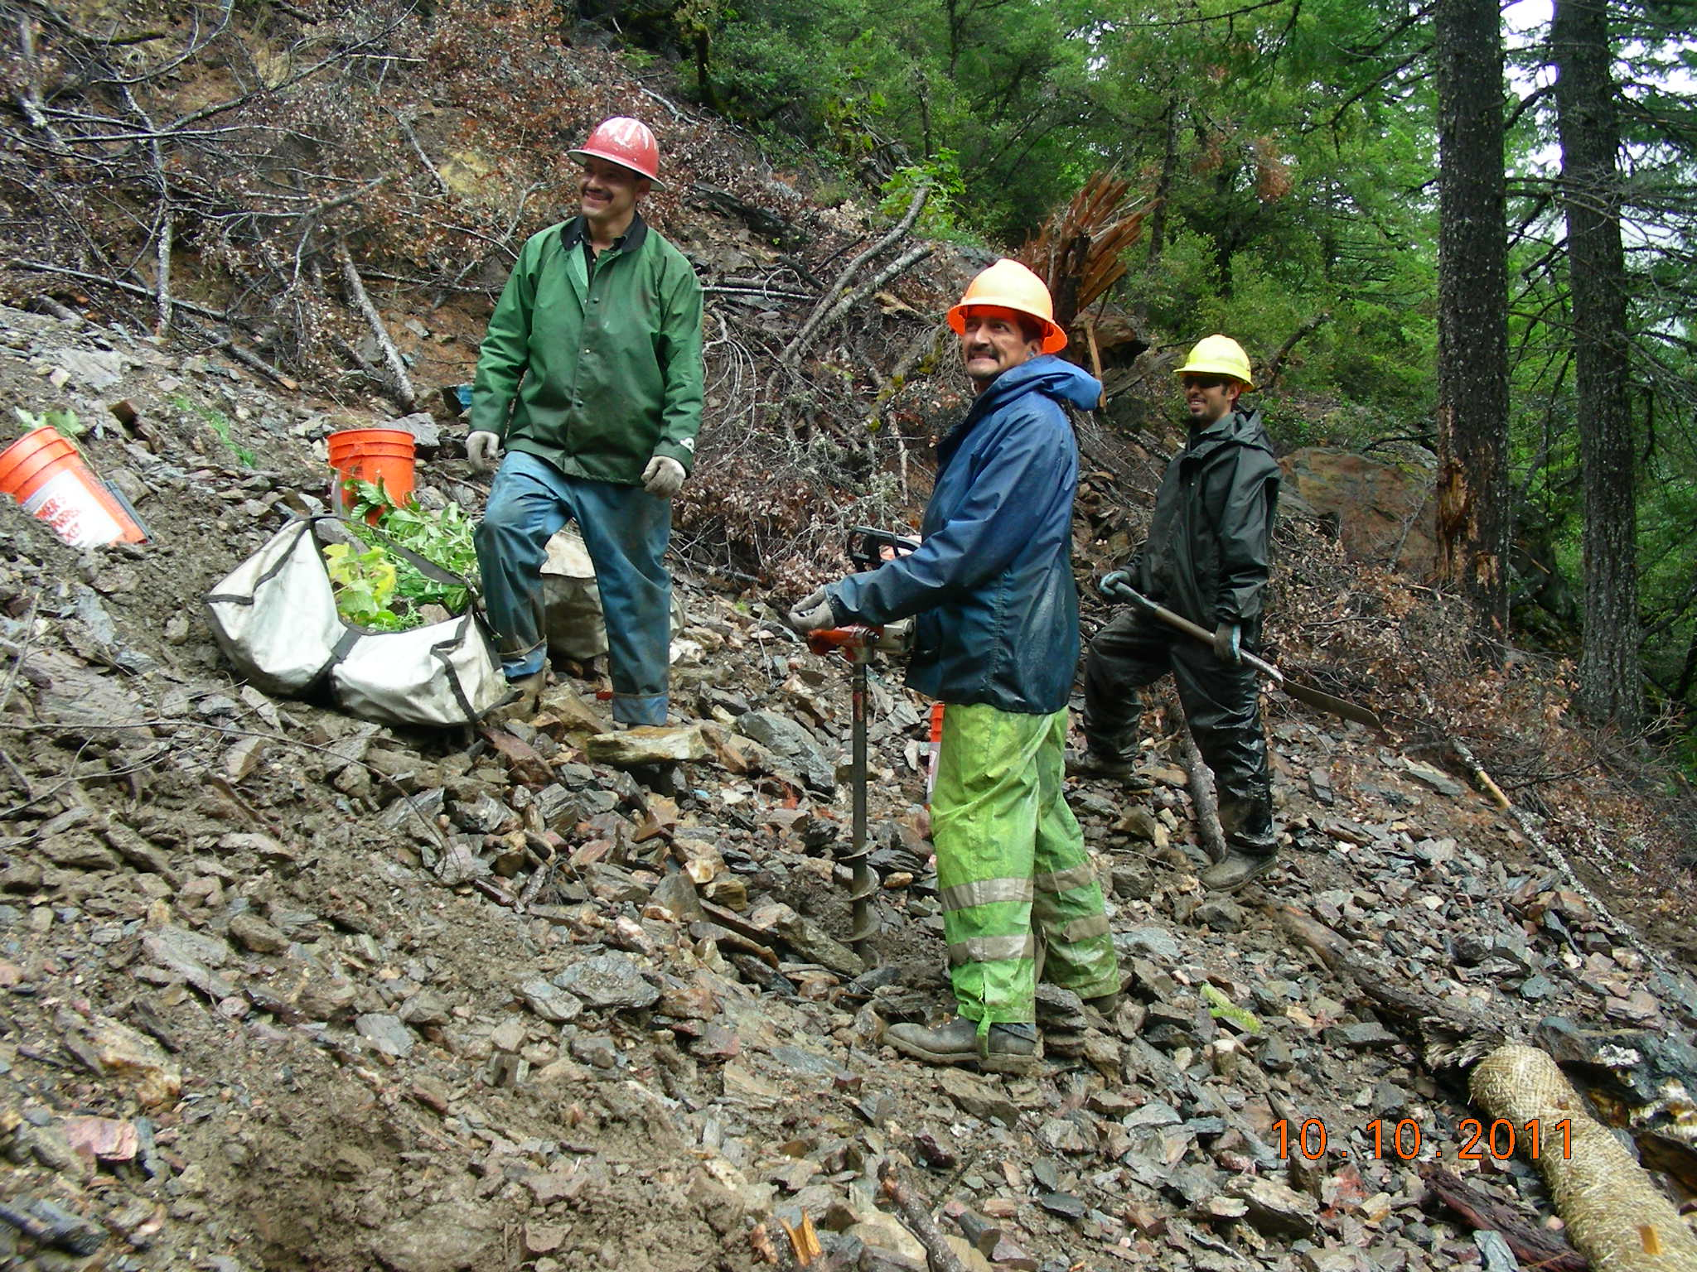
Power Augers, Picks, Shovels to Create Planting Holes in Rocky Soils
Power Auger

Slide 51
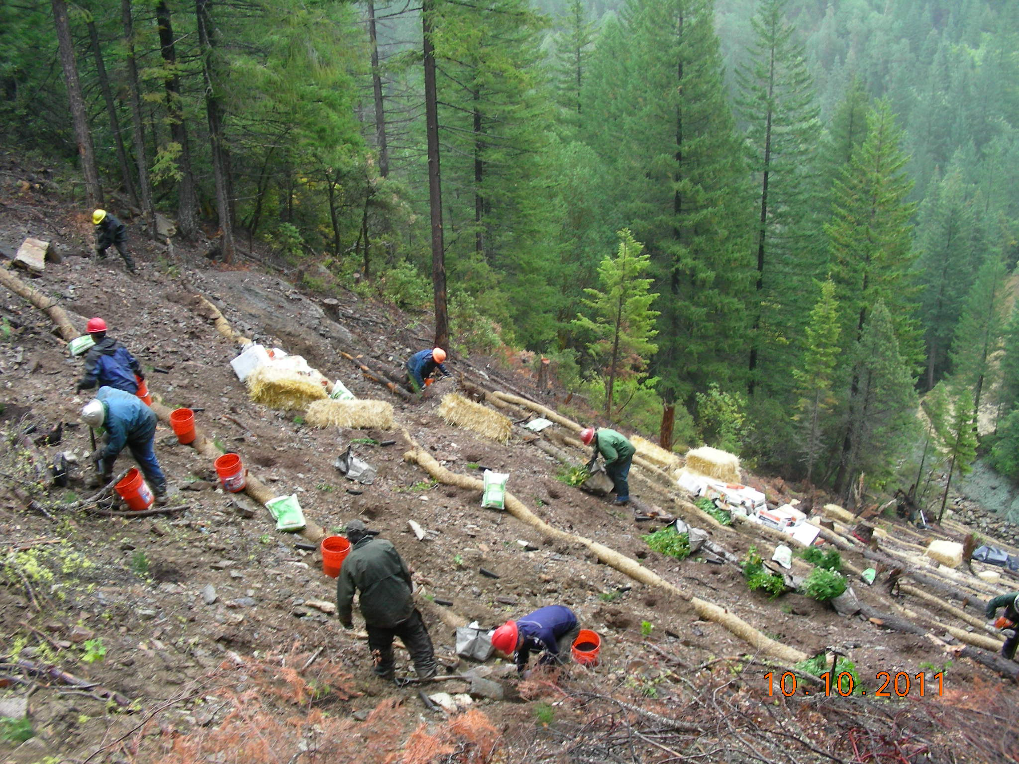
10-Man Evergreen Reforestation Crew
Mix Lime Sand, Compost, Soil, Fertilizer

Slide 52
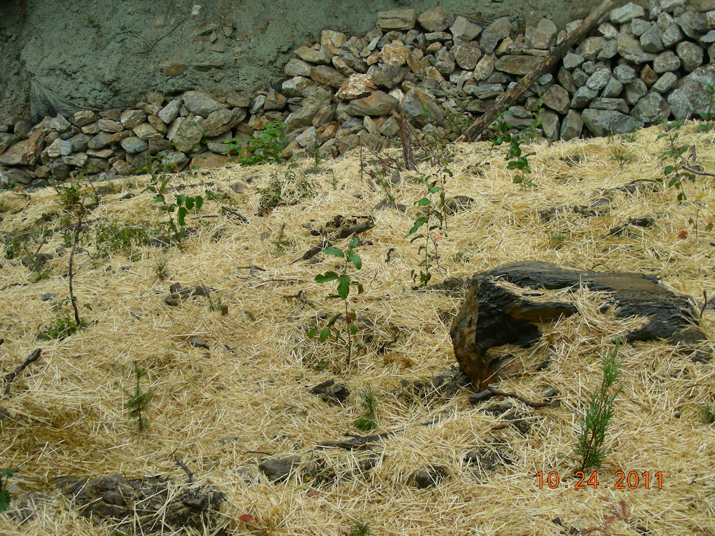
Conifers, Hardwoods, Shrubs, Straw Mulch
Flexterra Hydromulch, Channel Riprap

Slide 53
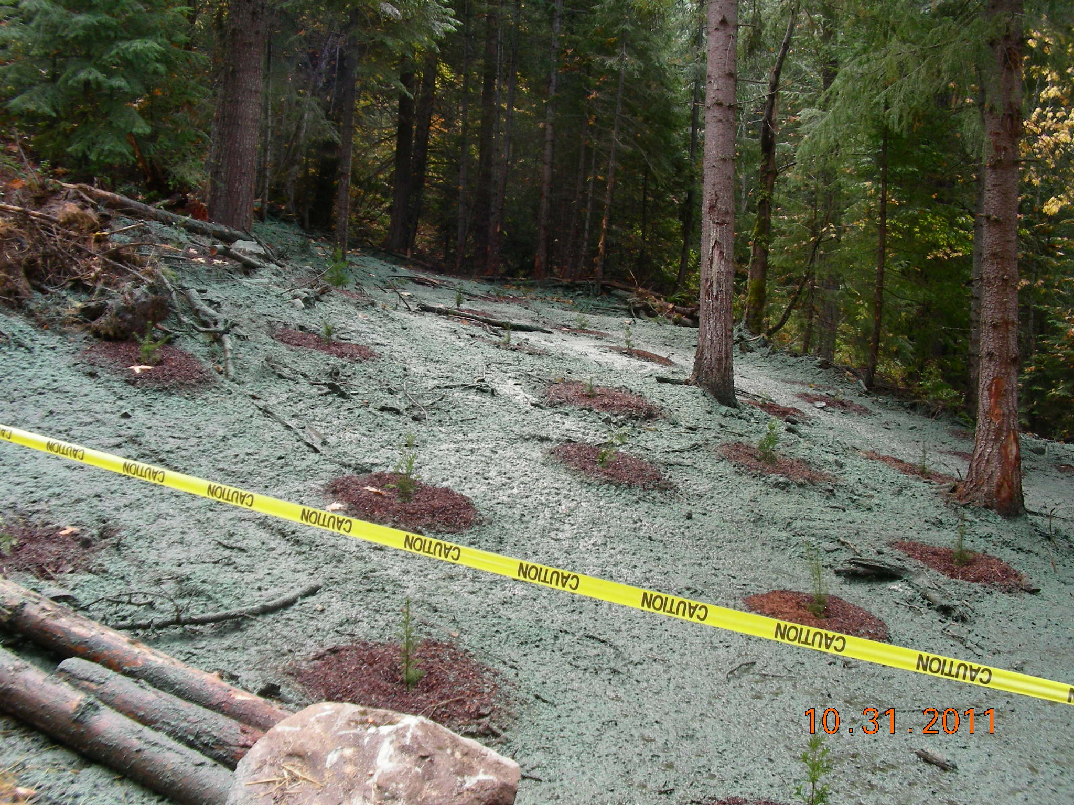
Stockpile Sites And All Disturbed Site
Planted, Bark Mulched, Hydromulched

Slide 54
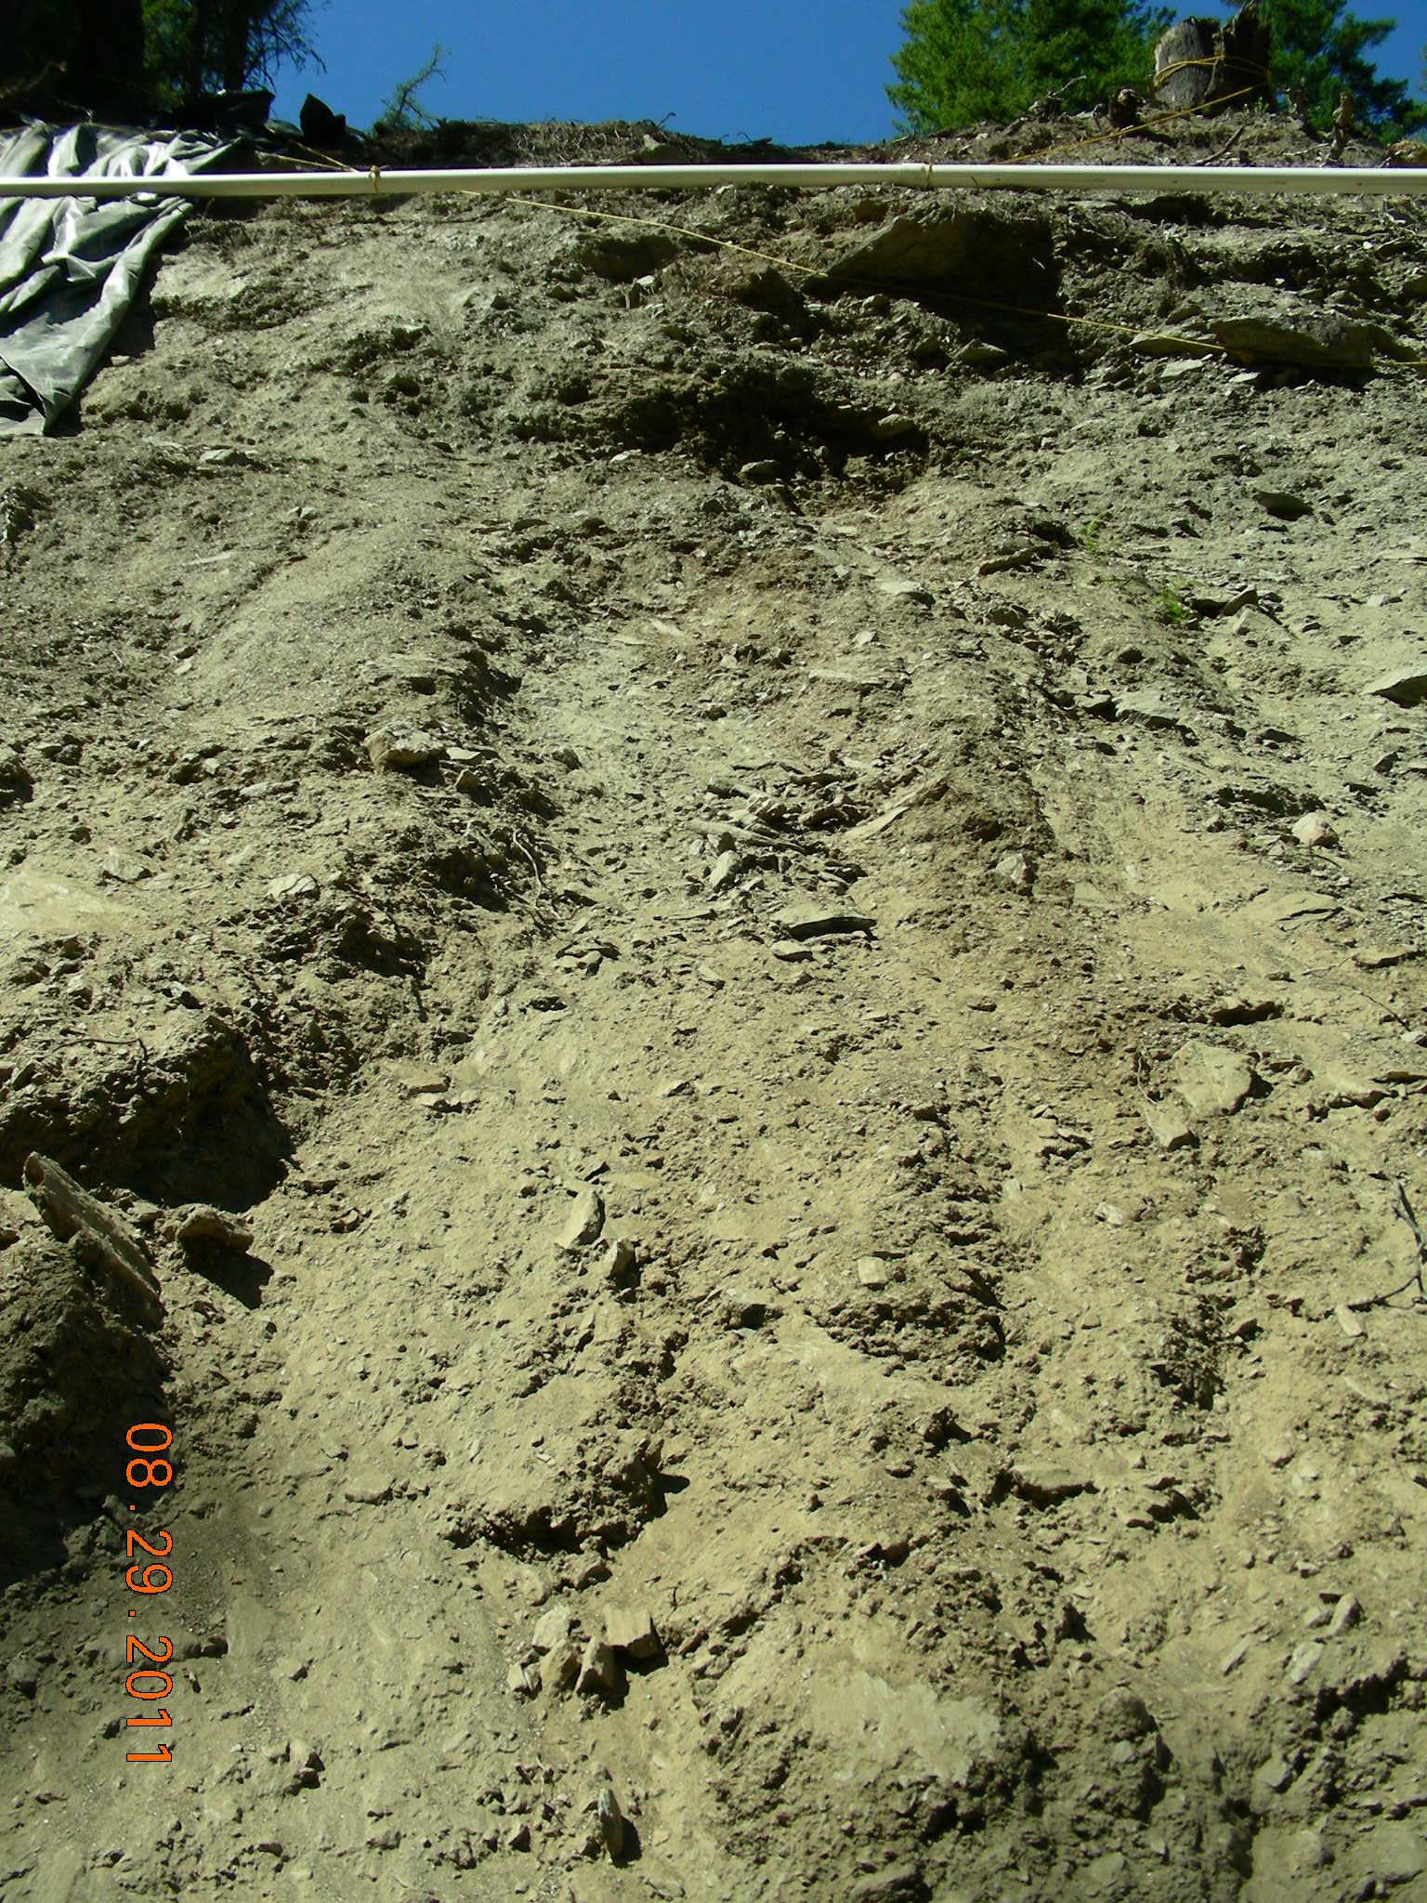
100% Slope Raveling Above Channel Needs Stabilization

Slide 55
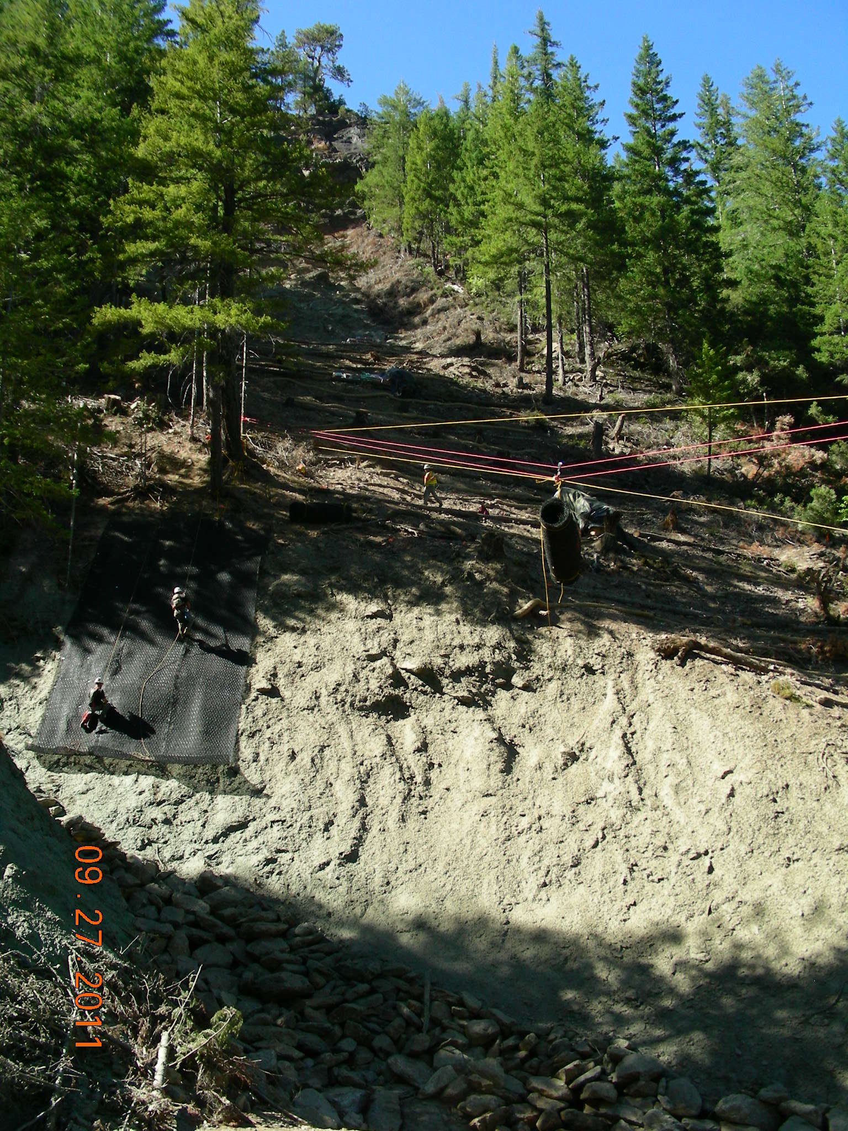
Double-Twisted PVC-Coated Steel Mesh With Lofted Polypropylene Netting
Running Skyline Delivers Mesh Rolls to Slope

Slide 56
Completed Mesh Slope Stabilization
Flexterra Hydromulch
Riprap
Channel Protection

Slide 57
Bat Gate Steel Members & Welding Equipment Was Transported by Helicopter to 10 Adits

Slide 58
Each Bat Gate Was
Custom Fit/Welded
Drilled and Epoxied Gate Anchors
Lock Box

Slide 59
Completed Bat Gate
With Controlled Access
Removable Bar with Locks

Slide 60
Operations/Maintenance/Monitoring 2011-May 2015
Leachate sampling
Sediment/pH basin cleaning
Erosion control
Revegetation monitoring
Surface water sampling
Stream sediment sampling
Macroinvertebrate and fish sampling
Residents water well sampling

Slide 61
Blue Ledge Funding Sources
Removal Action Contract - $15 million
CY 2010 Funding Sources:
American Recovery & Reinvestment Act - $12.4 million
ASARCO Trust – CY ‘10 $1.4 million
CY 2011-2015 Funding Sources:
ASARCO Trust – CY ’11 $1 million
ASARCO Bankruptcy Settlement (to EPA) $200k
CY 2015 & Beyond Funding Sources for EPA:
ASARCO Bankruptcy Settlement (to EPA) $2.5 million
Superfund Program Funds

Slide 62
CONTRACTORS
Prime Contractor: Engineering/Remediation Resources Group, LLC Martinez, CA
Earthworks Contractors: Granite Construction, Sacramento, CA
All Mountain Construction, Breckenridge, CO
Carlson’s Construction, Yreka, CA
D & E Construction (Liner), Visalia, CA
Site Inspection, EE/CA, Removal Design: URS Corp, Portland, OR
Independent Quality Assurance: JBR Environmental, White City, OR
*Over 75 workers and support staff put to work under the American Recovery and Reinvestment Act
*More than $4 million spent in the local economy, with some of the highest unemployment rates in the nation

Slide 63
Questions???
Pete Jones:
pajones@fs.fed.us

