Slide 1
A multiple tracer / geochemical approach to characterizing water and contaminant movement through abandoned mine workings near Rico, Colorado
Mike Wireman, Region 8, U.S. EPA, Denver, CO;
Rory Cowie, University of Colorado Boulder, Boulder, CO;
Mark W. Williams, University of Colorado, Boulder, CO;
Robert L. Runkel, United States Geological Survey, Denver, CO
Thanks to Jan Christner

Slide 2
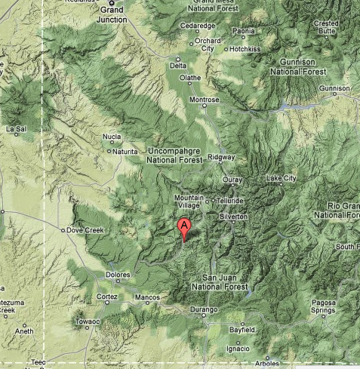
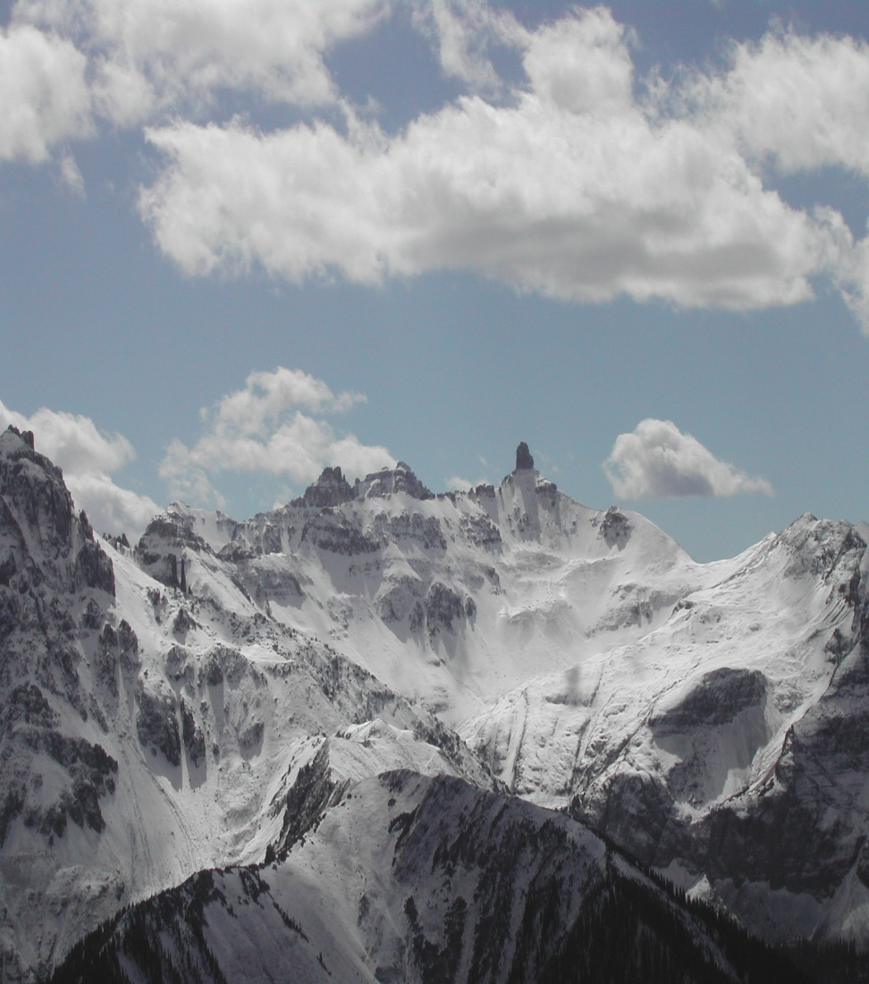
RICO MINING DISTRICT
Southwest Colorado
San Juan Mountains
Colorado
mineral belt
Rico
Utah
Delores River
New Mexico

Slide 3
Rico mining district
Mining history
1869 -1977 – Active silver, zinc, lead mining district
1930-31 - St. Louis tunnel driven to explore for deep ore bodies
1955 - Sulfuric acid production plant (from pyrite)
1956 – 1979 - Series of ponds constructed for sulfuric acid production and tailings disposal
1971 –Rico Argentine Mining Co ceased mining operations and deeper workings allowed to flood
1973-1975 –Heap leach NW of St. Louis tunnel adjacent to Delores River
1976-1977 – Mining activities ended
1980 – 1983 - Anaconda acquired Rico Argentine Mining Co. & conducted exploration drilling – no mining
1879 -1968 – production - 83,000 ounces of gold, 14,500,000 ounces of silver, 5600 tons copper, 84,000 tons lead ,83,000 tons zinc.

Slide 4
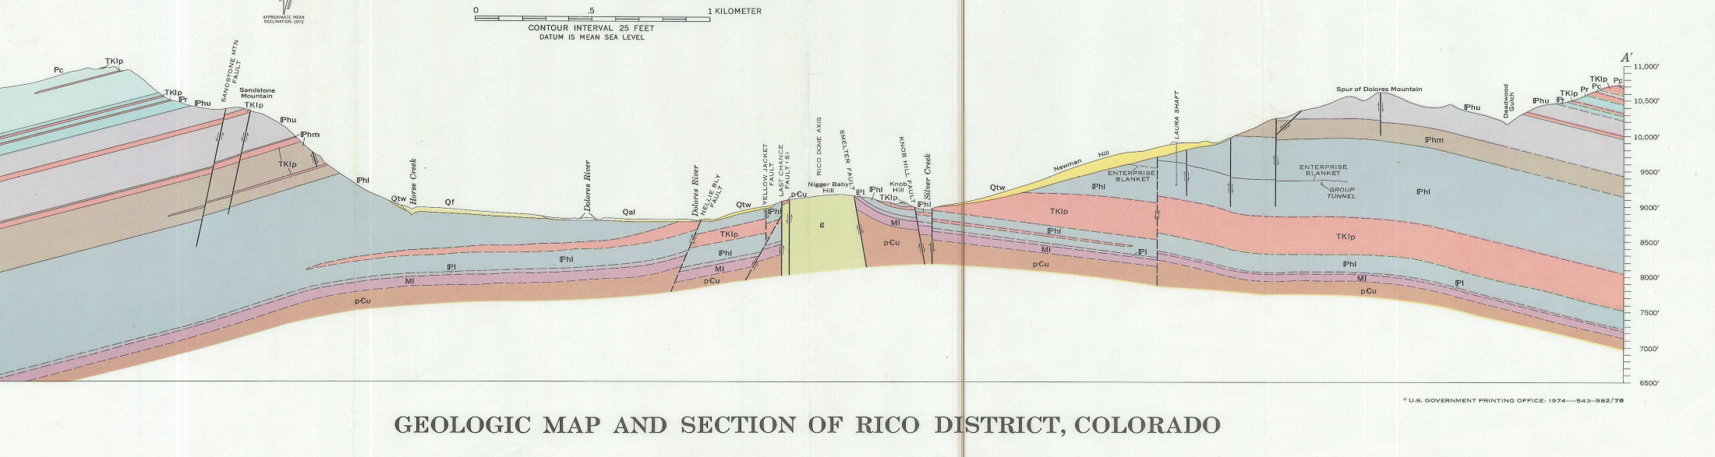
GEOLOGY
Domal uplift PC monzonite -6000 ft.
Dome bounded by numerous near vertical faults
NE_SW Blackhawk fault bounds east side of dome – numerous associated reverse& normal faults sub-paralell to BH Fault
Pennsylvania age Hermosa Fm was intruded by dome – widespread in outcrop /subcrop –dips away from dome -2800 ft thick
Comprised of interbedded sandstones, limestones, shale, conglomerate, arkose – extensively faulted
Dome
Hermosa Fm.

Slide 5
ORE BODIES
Mineralization due to hydrothermal fluids moving along faults and limestone bedding planes in the downdip direction.
Significant mineralization can occur 400 -500 feet from the major faults.
The primary ore deposits are:
  massive sulfide replacement deposits in the limestones of the middle and upper members of the Hermosa Formation,
  metamorphic deposits of sulphides in limestones of the Ouray, Leadville and Hermosa formations and as
  veins on fractures and small faults in Hermosa sandstones and arkoses. The
  ores were mined primarily by stoping limestone blocks that contain target metals at a high enough grade. The limestone beds were stoped in a downdip direction, which resulted in a lot of connection between levels of mine workings.

Slide 6
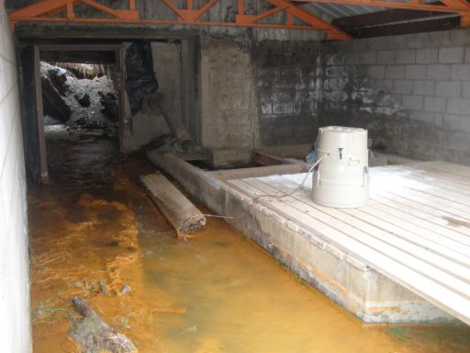
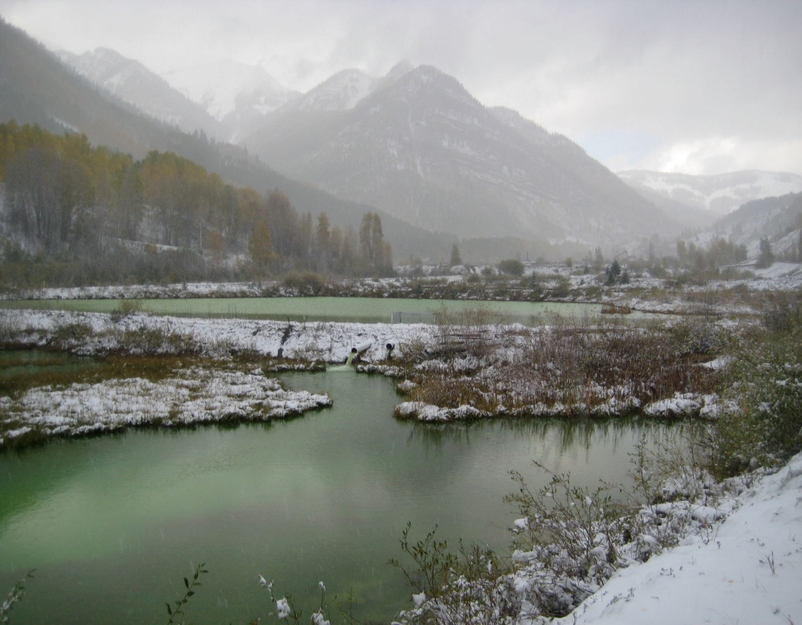
Environmental issues
Discharge from St. Louis tunnel contains high concentrations of heavy metals –NPDES permit lapsed - June 2010 –Zn -3900 ug/l - Portal discharge to ponds which discharge to Delores River
Unlined ponds - adjacent to Delores River –ponds contain sludge / tailings - 64,000 yd³
  Zn – 18,000 – 38,000 ppm
  Cd – 51 - 190 ppm
  Cu – 650 -2400 ppm
  Pb – 200 – 1000 ppm
Discharge of AMD (pH -2-3) from Blaine workings – ore bodies have high sulphide content
TMDL on Silver Creek –dissolved Cd & Zn

Slide 7
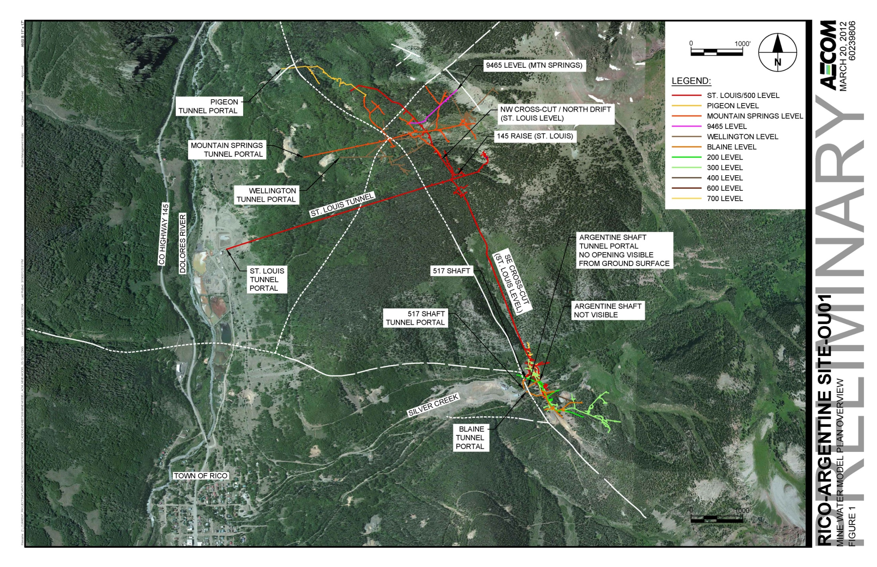
Treatment ponds
Mill Tailings

Slide 8
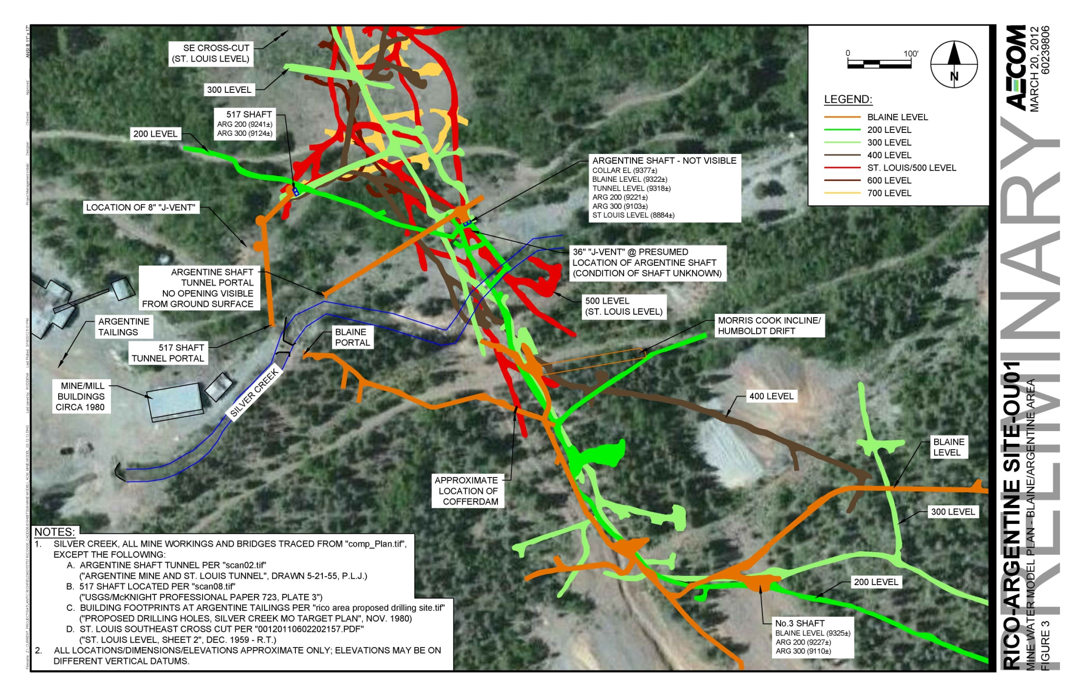

Slide 9
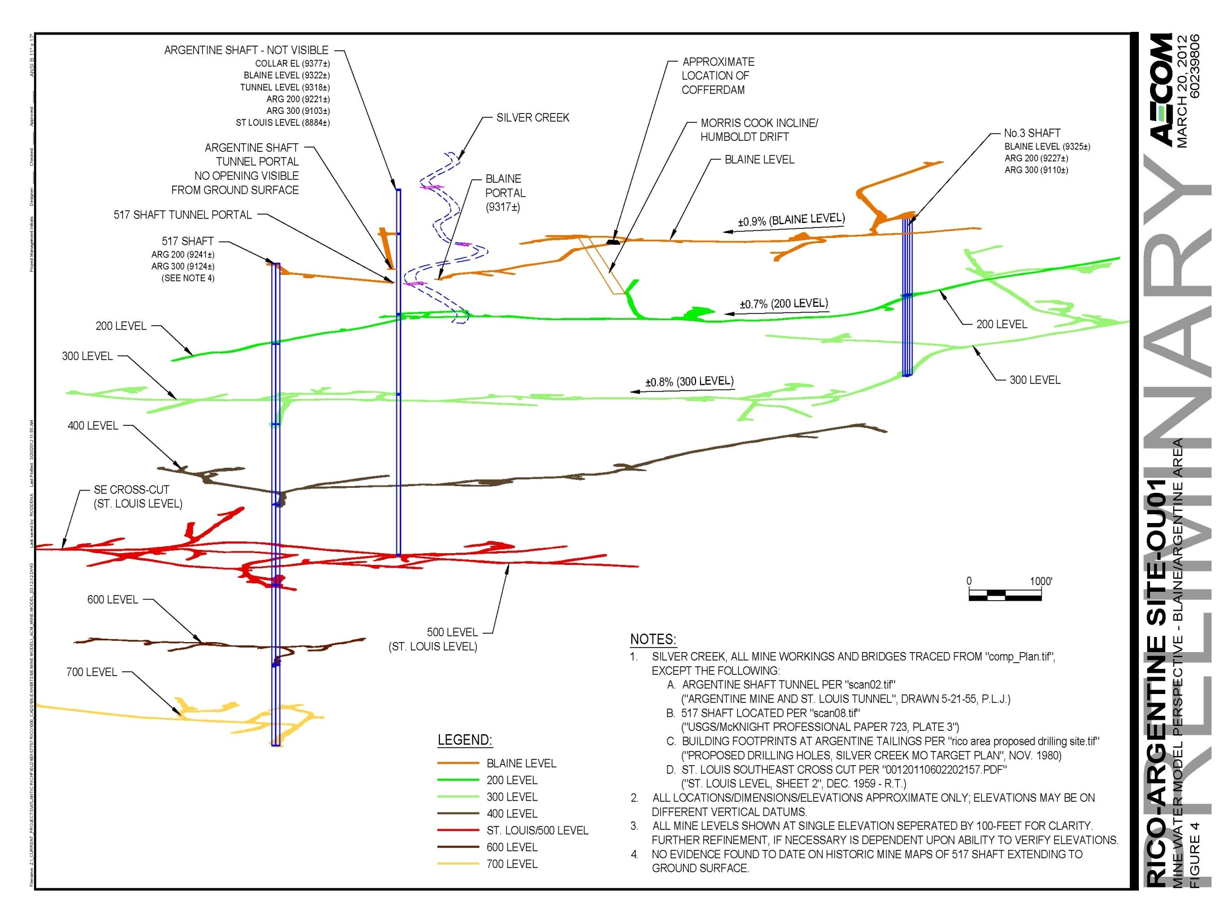

Slide 10
Project Goals
Characterize stream /groundwater/mine hydrology
Evaluate feasibility of hydraulic controls to reduce volume of discharge and /or contaminant load from St. Louis tunnel
    Reduce flow of water into / through mine workings
    Reduce mobilization of contaminants within the mine workings
    Isolate high-concentration contaminant source waters for limited small scale treatment

Slide 11
Hydrologic investigation
Determine if significant volume of surface water from Silver creek enters mine workings
Identify sources of AMD
Characterize mine water flowpaths – contribution to St. Louis tunnel
Determine flow and chemistry of Silver creek and mine water
Chemical / isotopic analysis
Stream Tracer studies
Mine workings tracer studies

Slide 12
WATER CHEMISTRY / METALS LOADING
  St. Louis tunnel portal discharge
Silver Creek
  Time series at SC-493
  Synoptic along entire study reach (SC-106- SC-1131)
Underground – mine waters
  517 Shaft
  Pipe discharge to 517 shaft access tunnel
  Blaine tunnel pool and discharge from a raise from above Blaine level
  Argentine tunnel – above Blaine level
Argentine tails seep

Slide 13
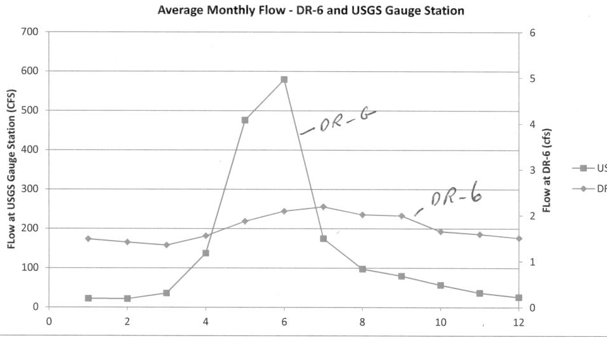
St. Louis Tunnel
Portal discharge vs. Delores River flow
Portal discharge chemistry (DR-3)
DR-G - Delores River
DR-6 – Pond outfall
Parameter (dissolved ) (ug/l) | June 2011 | October 2011
pH | 6.7 | 7.4
Cd | 52 | 17.5
Cu | 55.2 | 5.0 U
Fe | 445 | 1090
Pb | 1.0 U | 1.0 U
Zn | 10,200 | 3810

Slide 14
suspected loss reach below SC-106
Approx location of Argentine seep
Water chemistry – Silver Creek

Slide 15
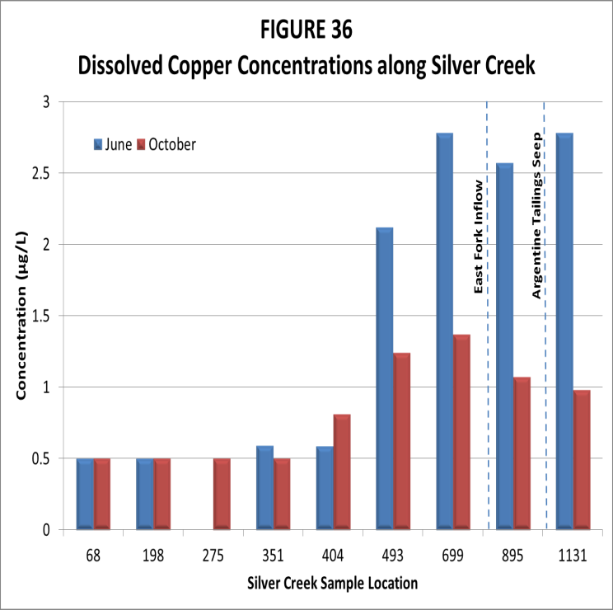
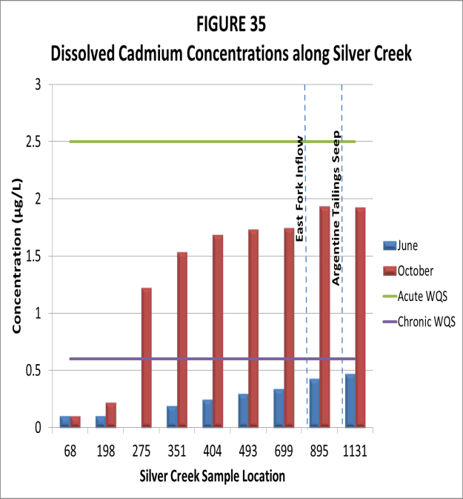
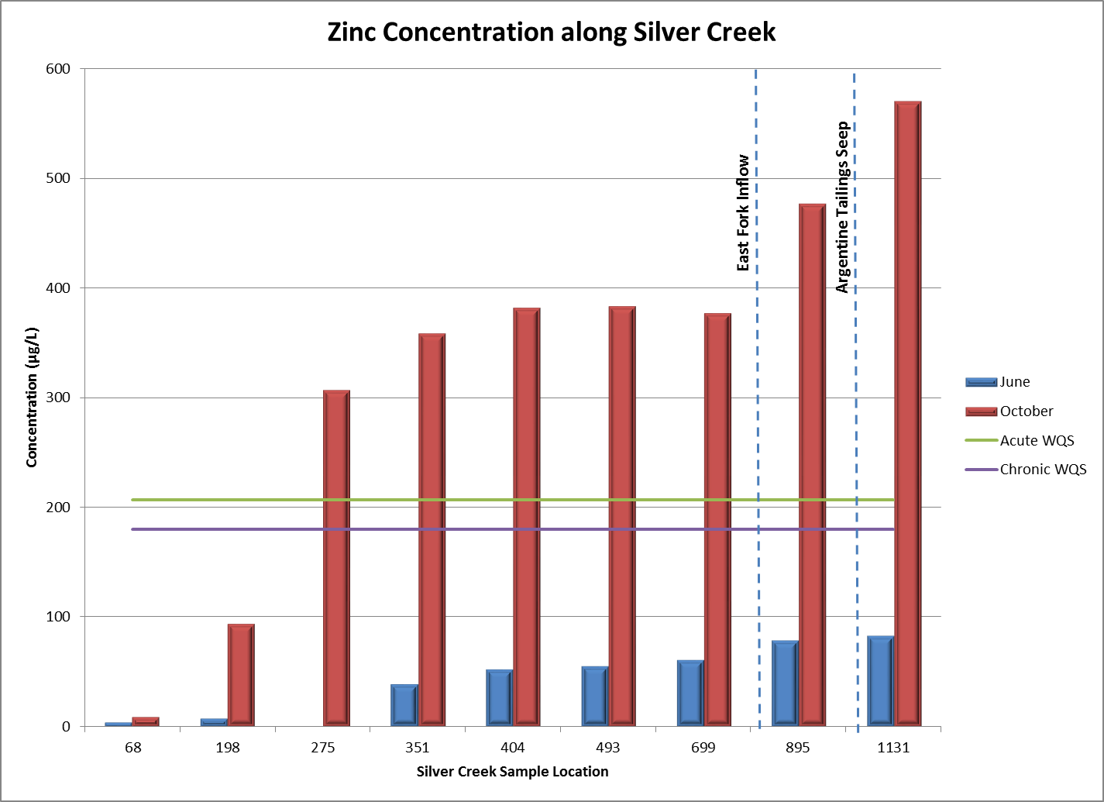
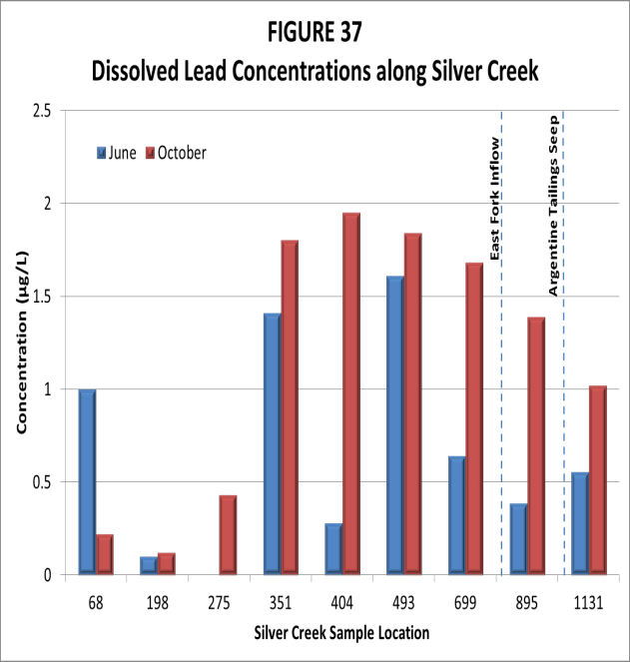

Slide 16
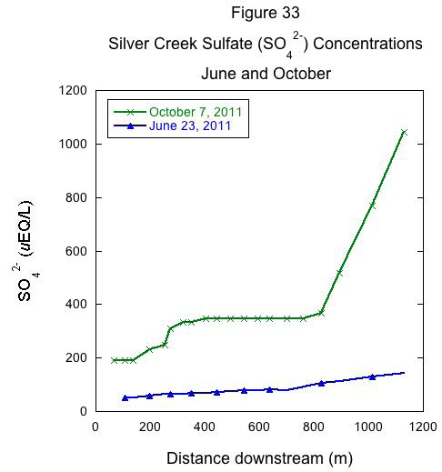

Slide 17
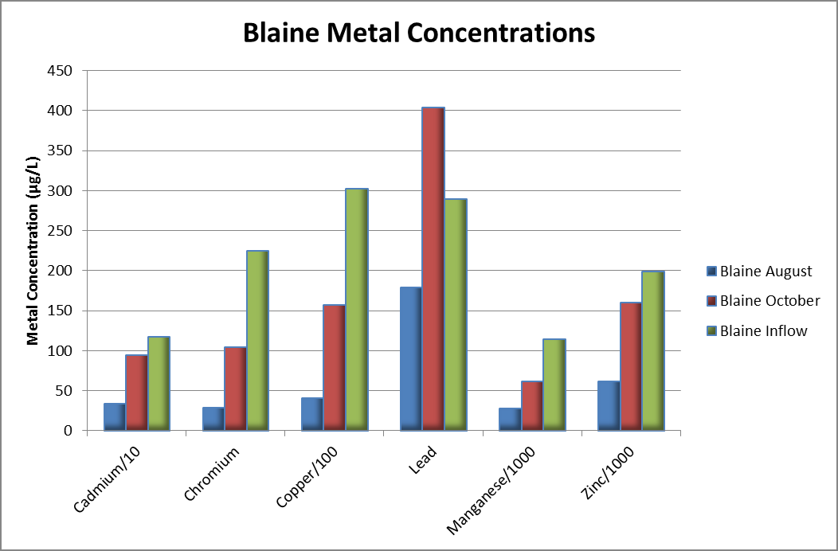
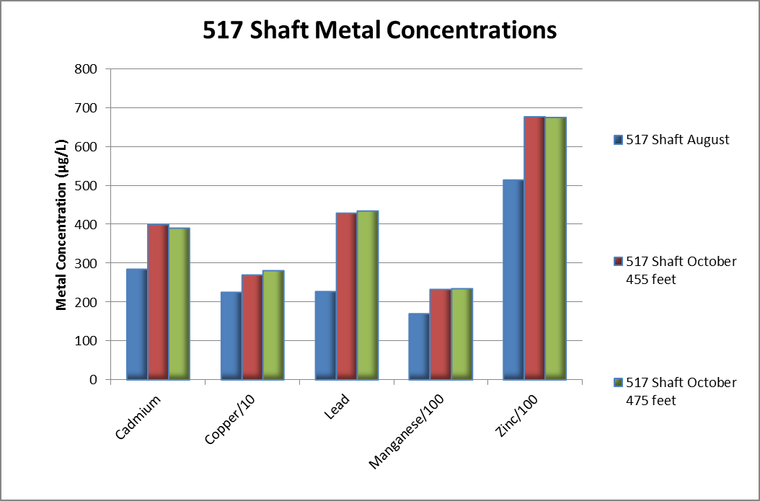
MINE WATER CHEMISTRY
pH
2-2.5
pH
2-2.5
Argentine tunnel (ug/l)
Cu-349,000
Zn – 2,460,000
Mn – 294,000
Pb – 239,000
Cd -12,000
pH – 2 - 2.5
517 tunnel pipe - bedrock gw??
Cu-0.5
Zn – 10.8
Mn – 1.0
Pb – 0.14
Cd -0.1

Slide 18
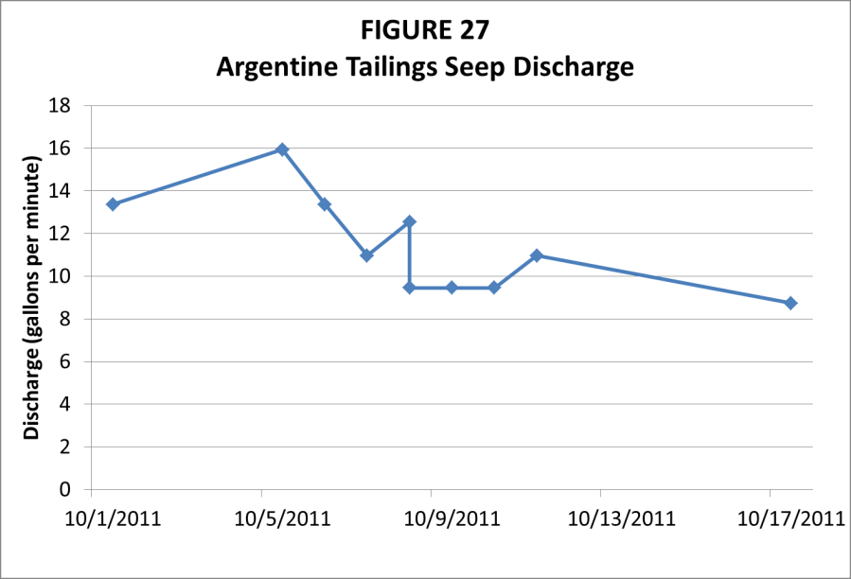
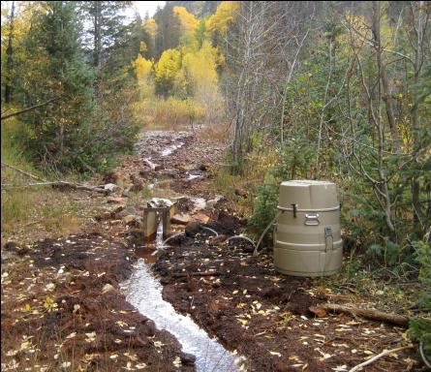
Argentine seep chemistry
Parameter (dissolved) (ug/l) | June 2011 | October 2011
pH | 7.8 | 7.8
Cu | 5.00 U | 2.50 U
Cd | 1.00 U | 1.00 U
Pb | 1.00 U | 1.18 J
Fe | 1000 U | 1000 U
Zn | 3780 ug/l | 3810 ug/l

Slide 19
SW & mine waters are a mixture of snow & rain

Slide 20
St. Louis tunnel – well mixed gw source
Minewaters more depleted in Oct. suggests
gw baseflow is from snowmelt
June SC sample – snow dominated
517, Blaine & seep similar to Silver Creek - indicates similar source of water

Slide 21
Relatively new water
No bomb spike water
No old water
Residence time in gw / mine water flow system is few years

Slide 22
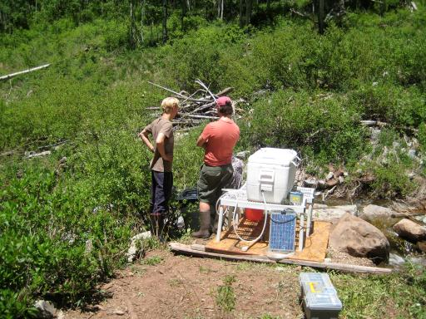
Silver Creek - Stream tracing
( evaluate loss to mine workings)
Stage-discharge relationships at 2 locations – time series of flow
Slug additions to develop point flow estimates above & below suspected loss reach
Continuous additions to measure discharge above & below suspected loss reach

Slide 23
suspected loss reach below SC-106
Approx location of Argentine seep

Slide 24
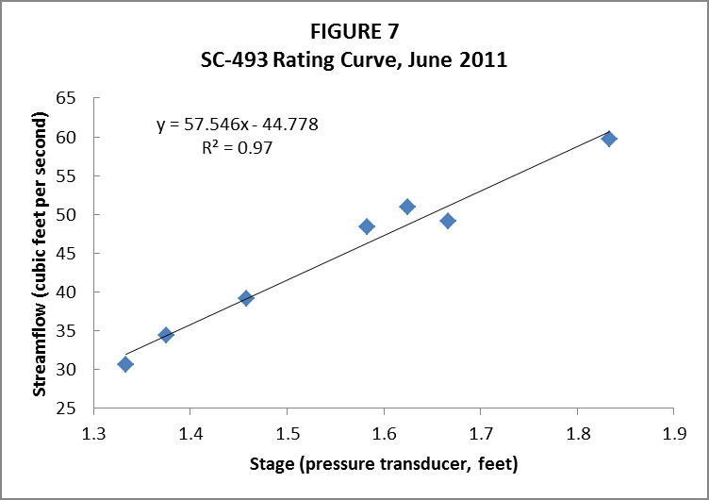
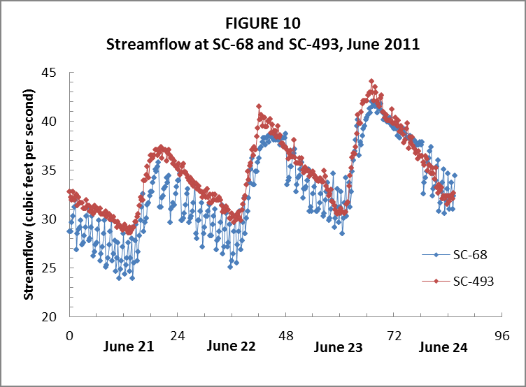
Silver Creek – Stage discharge relationship
High flow –June 2011
Rating curves developed @ SC-68 & SC-493 by correlating data from pressure transducers with flow measurements made w/ Marsh –McBirney flow meter
Pressure transducer recorded stage every 15 minutes
Used to help adjust slug results
Results conflict with slug tests & continuous tracer results
Increase in flow
Data from Runkel, 2012

Slide 25
Silver Creek – Slug additions
High flow –June 2011
Slug tests – dissolve NaCl in stream water –add as a slug to Silver Creek
Cl – SC relationship established at SC-636 – convert SC to Cl concentration
Chloride profiles integrated to estimate streamflow
  Q = (mass Cl added / integrated area under Cl curve) * unit_conversion_factor
Slug results corrected due to unsteady streamflow & fact that slug additions not performed at same time every day

Slide 26
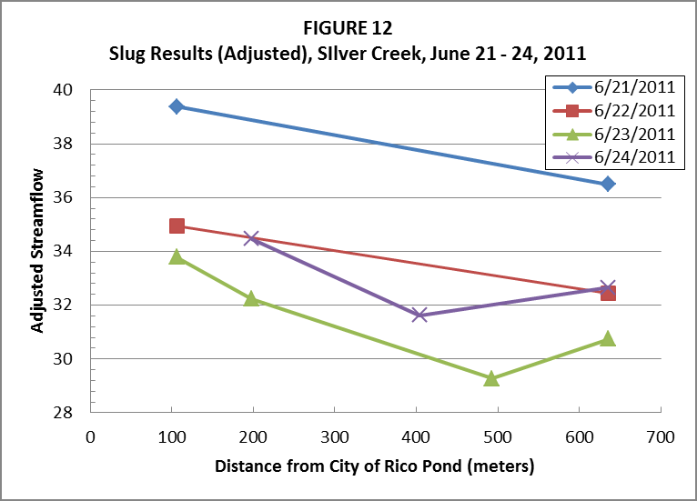
Loss in flow
Data from Runkel, 2012

Slide 27
Silver Creek – Continuous injection tracer dilution method
Sodium Bromide injected on 6/23 from 8:00 -19:40 – plateau concentration reached in Silver Creek
Flow at SC-68 & SC- 106 estimated by Q_{x =} Q₁ C₁/C_{x}
  Q₁ = injection rate; C₁ = injection concentration; C_{x} = average concentration @ SC-68 & SC- 106
Slug tests suggest a loss downstream of SC-106
Flow from SC-106 to SC-636 - Q_{d} = Q_{u} - (MLR * deltaX)
  Q_{u} = streamflow @ upstream site; MLR = median loss rate from slug test; deltaX = distance between 2 sites

Slide 28
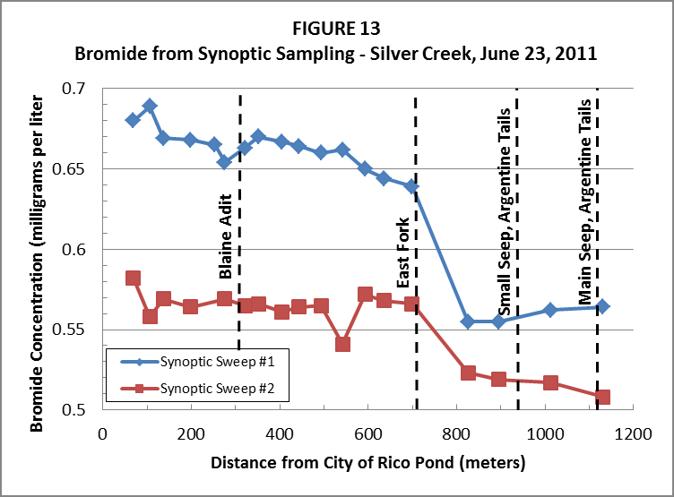
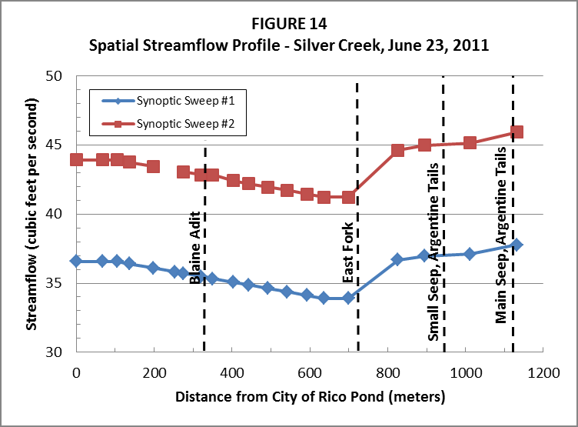
Results of continuous injection
Gaining stream – tracer dilution w/ distance = increase in flow
Losing stream – exhibit steady concentration w/ distance
Flow loss estimated to be 5.3% to 9% - within margin of error?
Data from Runkel, 2012
Synoptic sweep # 1 affected by pump outage
Synoptic sweep # 2 more representative

Slide 29
Mine workings tracing
Objective – verify flowpaths & determine travel times in workings
Tracers injected into 517 shaft, Blaine tunnel and Silver Creek
Sample locations – 517 shaft; St. Louis tunnel portal; Silver Creek @ SC-493; Argentine tailings seep

Slide 30
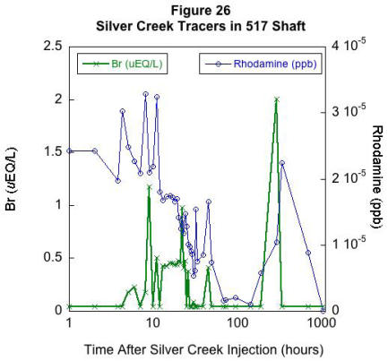
Silver Creek tracer investigation
Objective – to help determine if Silver Creek loses water to mine workings or Argentine seep
Rhodamine WT & bromide injected continuously-for approx. 71 hours (10/5 @ 11:02 to 10/8 @ 9:38)
No rhodamine or bromide found in 517 shaft or Argentine seep above background concentrations

Slide 31
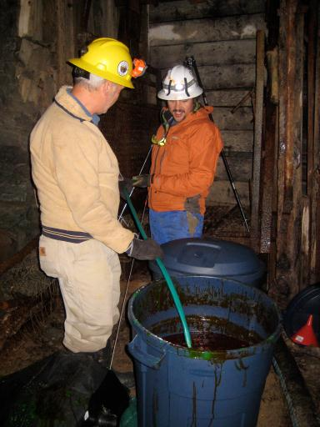
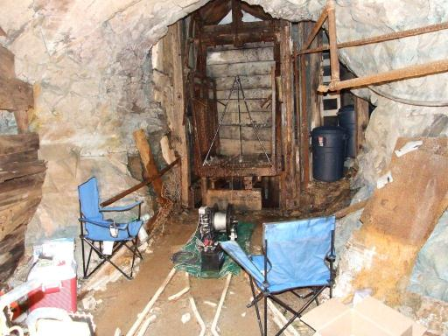
517 Shaft trace
50 gallon slug containing 3.22 lbs of lithium & 22.65 lbs of fluorscein – mixed with pH 2. 7 water
Chased with approx. 50,000 gallons of water from Silver Creek
DTW in shaft 450 ft
TD shaft – 600 ft?

Slide 32
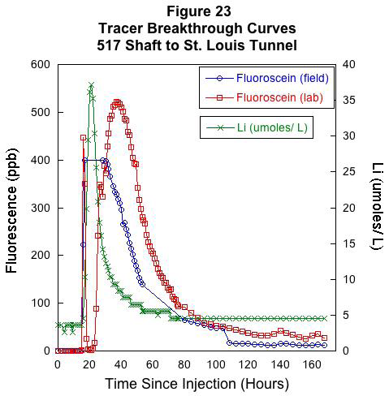
Fluorescein
  first arrival at St. Louis tunnel- 15 hours –velocity 567 ft/hr
  Peak @ 37 hours - velocity 230 ft/hr
Lithium
  first arrival at St. Louis tunnel- 15 hours –velocity 567 ft/hr
  Peak @ 21 hours - velocity 405 ft/hr
Mass recovery -1100 hrs after injection
  Lithium – 74 %
  Fluorescein – 58%

Slide 33
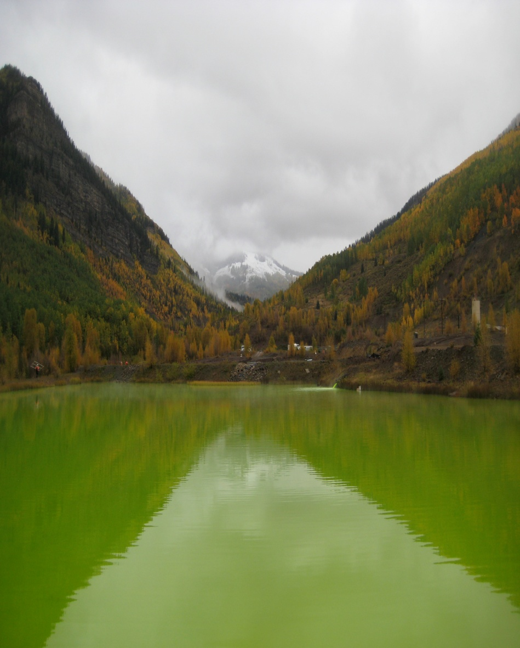
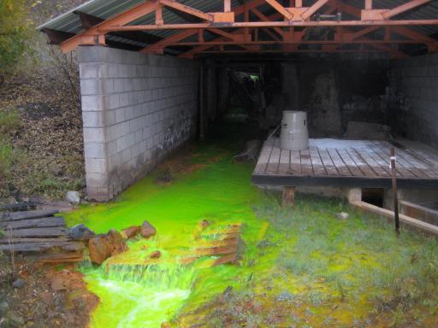
Findings
Fast transport by advection w/ help from chasing water
SE x-cut is open –few obstructions
Significant portion of fluorescein remains in storage -mixed with water in shaft? residence time in pool behind collapsed portion of St. Louis tunnel?
Fluorscein / Li only found at St. Louis tunnel discharge

Slide 34
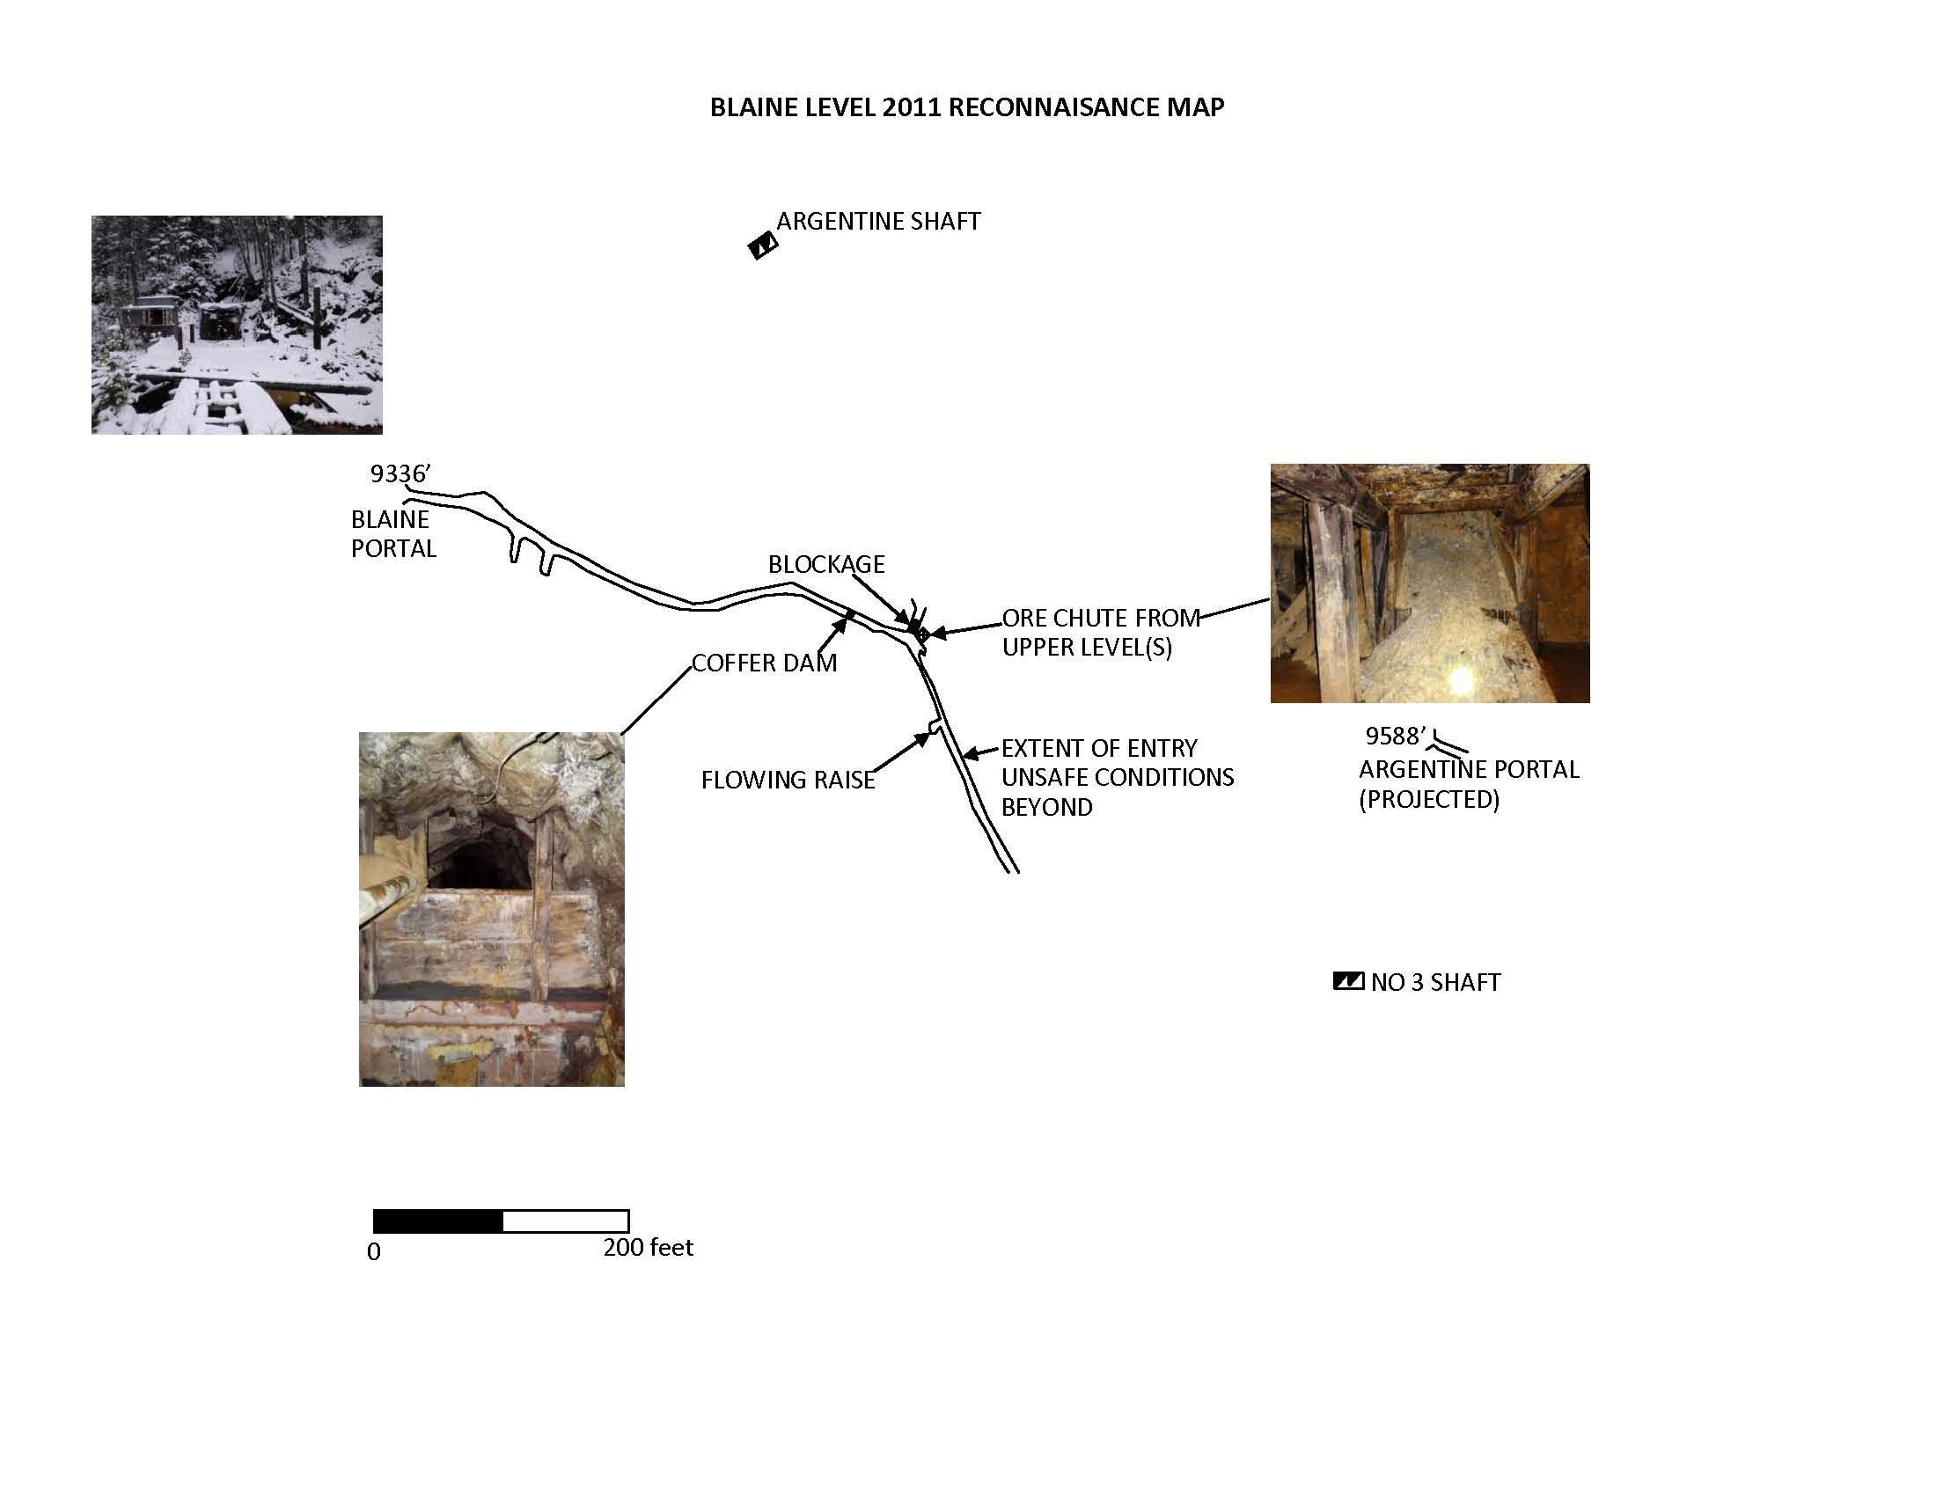
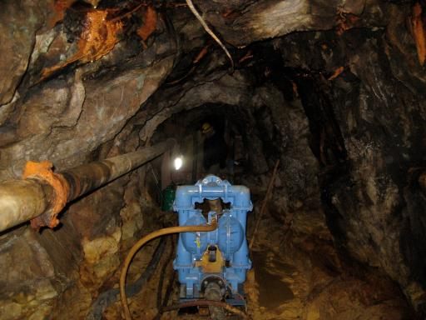
Blaine workings tracing investigation
517 shaft
Silver Creek
Morris Cook incline to lower levels –
Exact pathway to 517 shaft unknown
Slug poured into pool of water behind coffer dam &
pumped over blockage
towards
Morris Cook
Incline (6000 –
9000 gallons
of pool water)
Objective – help evaluate potential connections between Blaine & associated workings & 517 shaft – St. Louis tunnel
Slug injection - 5.9 lbs of fluoride –
Dissolved 13.2 lbs of NaF powder in 8 gallons of Blaine mine water

Slide 35
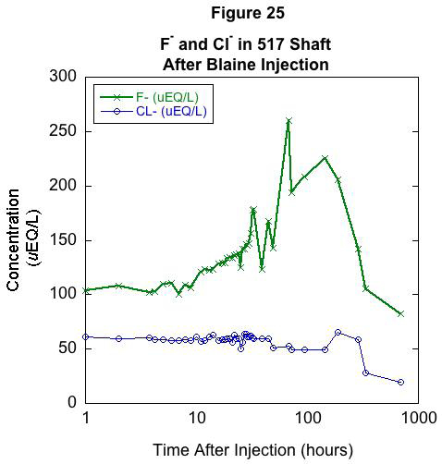
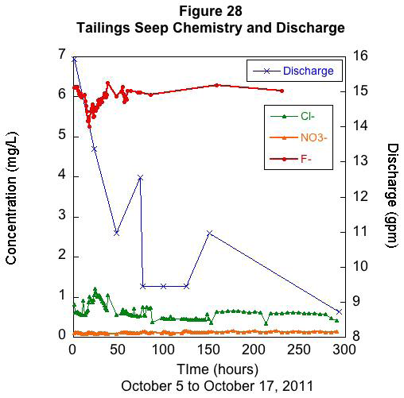
Blaine workings tracing investigation
Samples collected in 517 shaft, Argentine seep & Silver Creek
517 Shaft
  10 hours – 1rst arrival of F @ 517 shaft - ave. velocity – 66 ft/hr
  Peak @ 68 hours –ave. velocity 10 ft/hr
  (Based on estimated distance to 517 of 660 feet)
No detection of F in Silver Creek or Argentine seep

Slide 36
Conclusions
Possible loss from Silver Creek to workings –though not certain
  5-9 % @ high flow 22-23 % at low flow
The x-cut that connects the 517 shaft to the St. Louis tunnel is open and rapidly transports water
Fairly open connections between Blaine workings and 517 shaft
Primary sources of AMD /heavy metals - water in Blaine & associated workings
Water in 517 shaft has some residence time
Argentine seep not recharged by mine workings or gw
Residence time in GW flow systems which discharge to mine workings is 5-15 years
Discharge from St. Louis tunnel is primarily bedrock groundwater with seasonally varying inputs from workings along Silver Creek – Blaine, 517 shaft

