Slide 1
Improving Remediation Planning through Effective Mine Material Delineation
Mark Nelson PG
Nicholas Anton PE
Howard Young LG
Formosa Mine Superfund Site, Douglas County, OR
April 2012

Slide 2
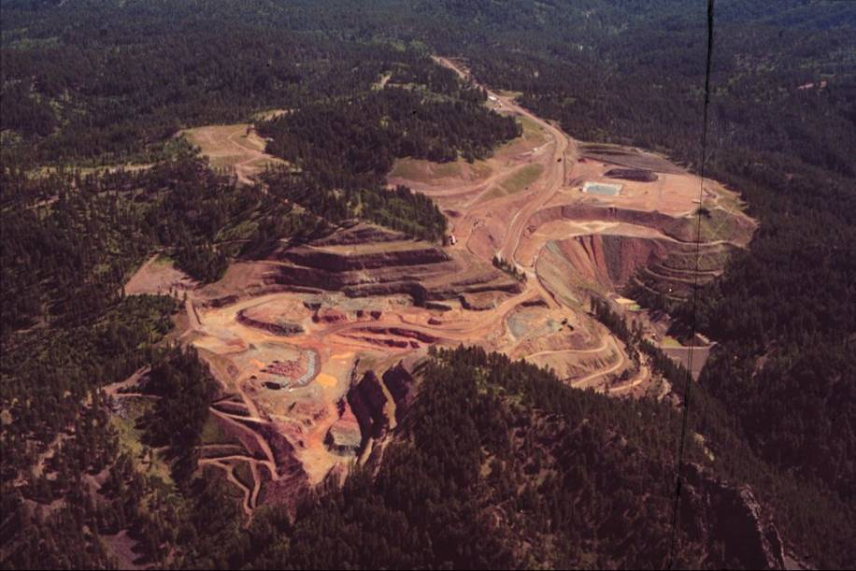
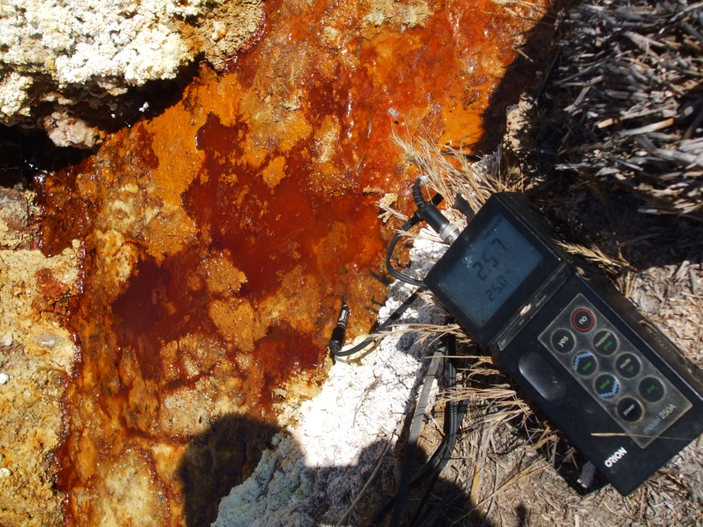
Why would one delineate mine materials?
Mine Remediation Projects
Understand potential connections between suspect source materials and observed water quality effects
Delineate problematic materials
Support remedial action decisions
Cause?
Active Mine Projects
Manage potential environmental liabilities
Comply with environmental regulations
Effects?

Slide 3
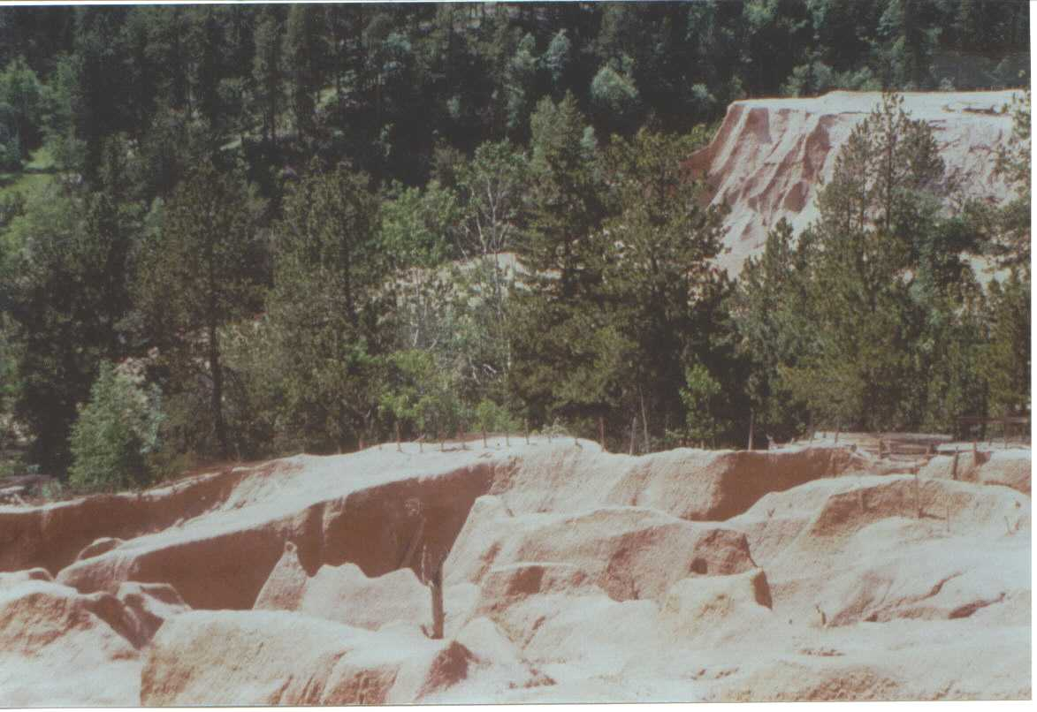
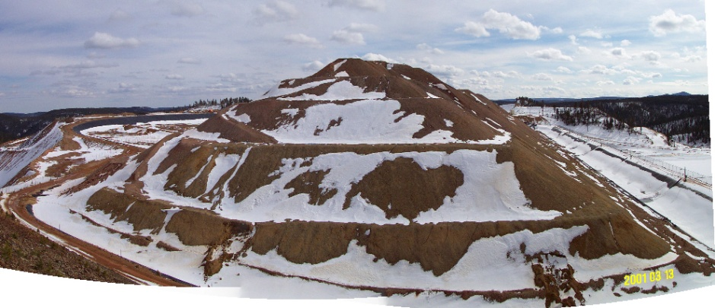
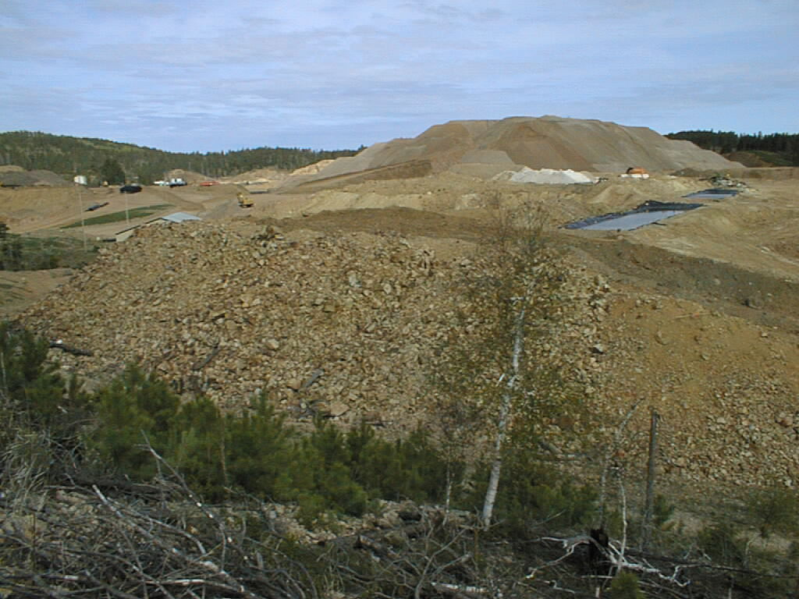
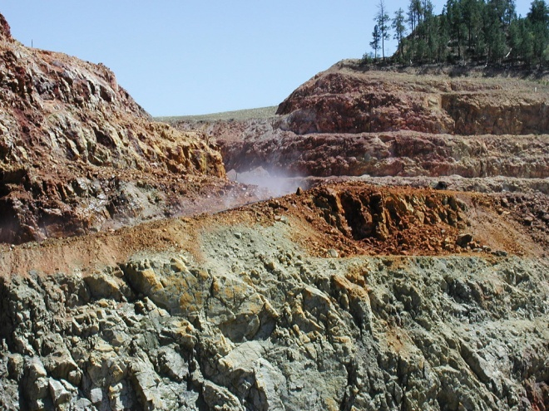
What are mine materials?
Tailings
Spent ore
Highwalls
Waste rock
Mine Materials are potential source materials for dissolved metals in surface water and groundwater

Slide 4
Effective Mine Material Delineation
Mine Remediation Projects
Active Mining Projects
Supports
Accurate alternative assessment
Reasonable cost estimates
Sound remedial action decisions
Effective remedial designs
Successful remediation
Data often support multi-million dollar decisions
Supports
Mine permitting activities
Environmental management
Successful reclamation
Manages potential environmental liabilities
Clean Water Act, CERCLA
Various state environmental laws
Improving Remediation Planning though Effective Mine Material Delineation, Formosa Mine Superfund Site

Slide 5
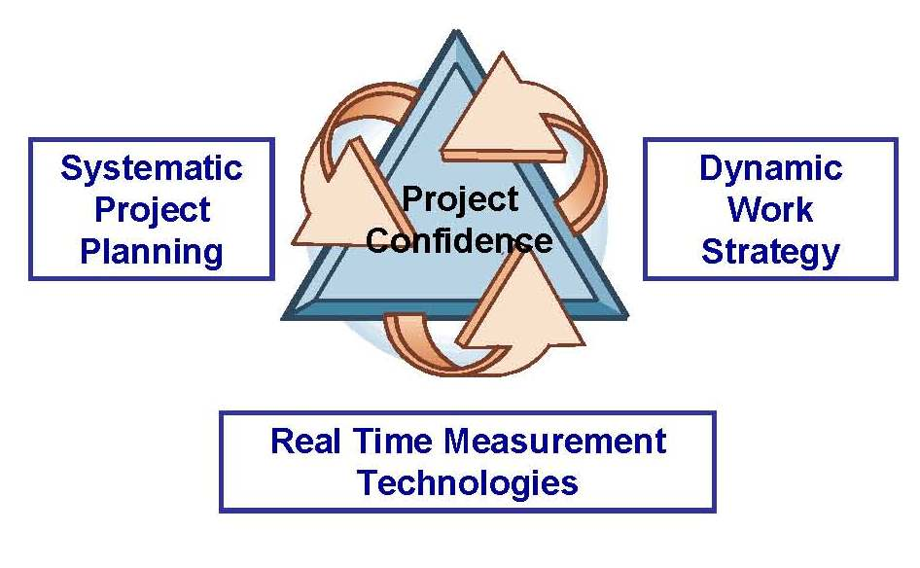
Approach to Data Collection and Analysis
Rapid field geochemical characterization
Triad approach
Save costs throughout project lifecycle
Utilize field tools for real time measurements
Conduct laboratory verification
Components
Lithological examination, field paste pH, FPXRF
Real time geospatial database
Coupled laboratory analysis
Acid base accounting
Extraction tests
Total metals analysis
Weight of evidence statistical approach
Improving Remediation Planning though Effective Mine Material Delineation, Formosa Mine Superfund Site

Slide 6
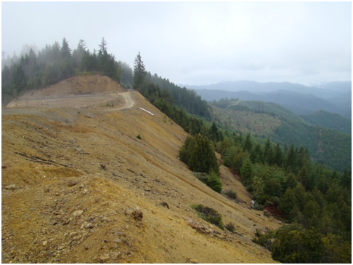
Approach can be applied at various project phases and in various levels of detail
Reconnaissance Phase
Quick field survey
Limited or no laboratory verification
Qualitative data analysis
Site Characterization Phase
More detailed surveys
Laboratory verification
Statistical data analyses
Reclamation or remediation phase
Confirmatory sampling
Detailed surveys
Lab verification
Statistical data analysis
Formosa Mine- West Encapsulation Mound Waste Rock Dump
Formosa is a good example of a comprehensive site characterization phase program

Slide 7
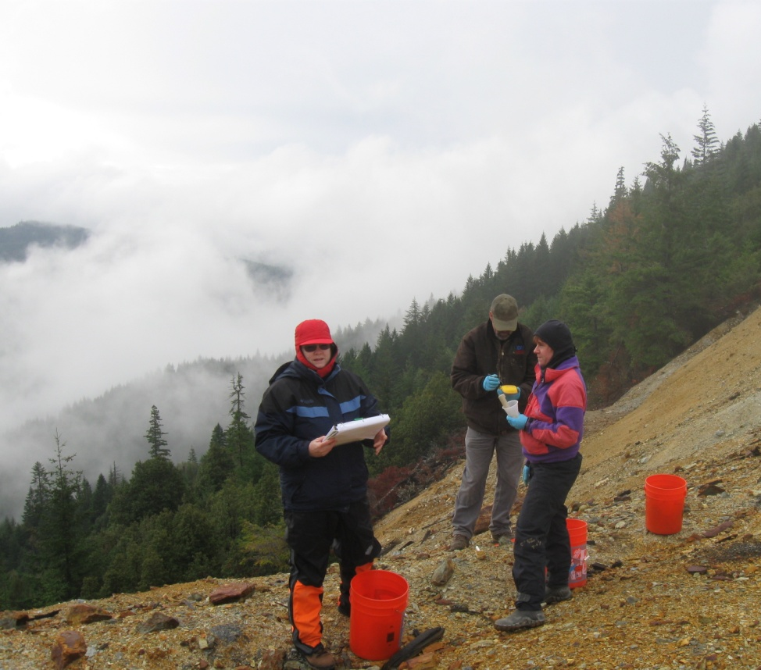
Interdisciplinary Field Team
Geologist
Identifies mineralized rock based on lithology, alteration, and mineralization
Guides dynamic work strategies based on geology and other visual indicators of mine materials
Environmental scientist
Collects field paste pH and FPXRF measurements
Collects samples for laboratory analysis
Field technician
Collects GPS data using a resource grade instrument (<1m accuracy)
Improving Remediation Planning though Effective Mine Material Delineation, Formosa Mine Superfund Site

Slide 8
Coupled Laboratory Analyses
Acid base accounting
Modified Sobek (1978) method
Estimates propensity of sample to generate ARD in the future
Extraction Tests
Modified Synthetic Precipitation Leach Procedure
Estimates propensity of sample to leach metals and metalloids when exposed to percolating water
Total Metals Analyses
Provides information regarding “total” content of selected metals and metalloids
SEM-EDS mineralogical analysis
Provides information on mineralogy of samples to support ABA data interpretation
Improving Remediation Planning though Effective Mine Material Delineation, Formosa Mine Superfund Site

Slide 9
Putting it All Together
Goals
Identify mine materials that are causing water quality problems
Delineate the areal extent, depth and volume of these materials
Weight of Evidence Approach
No one laboratory analysis can answer the study questions
Sound answers are developed with weight of evidence approach
Components
ARD potential
ML potential
Metals concentrations
Improving Remediation Planning though Effective Mine Material Delineation, Formosa Mine Superfund Site

Slide 10
Field Paste pH Data
pH measured in a paste of fine grained sample and DI water
Measures products of previous sulfide oxidation and acid generation
Only appropriate for weathered mine materials
Data show Formosa mine materials to be moderately to strongly ARD generating
Surface
Subsurface
Improving Remediation Planning though Effective Mine Material Delineation, Formosa Mine Superfund Site

Slide 11
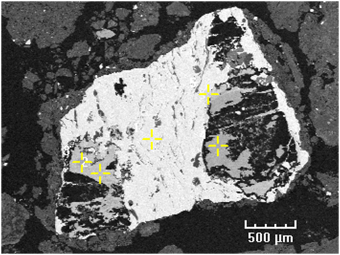
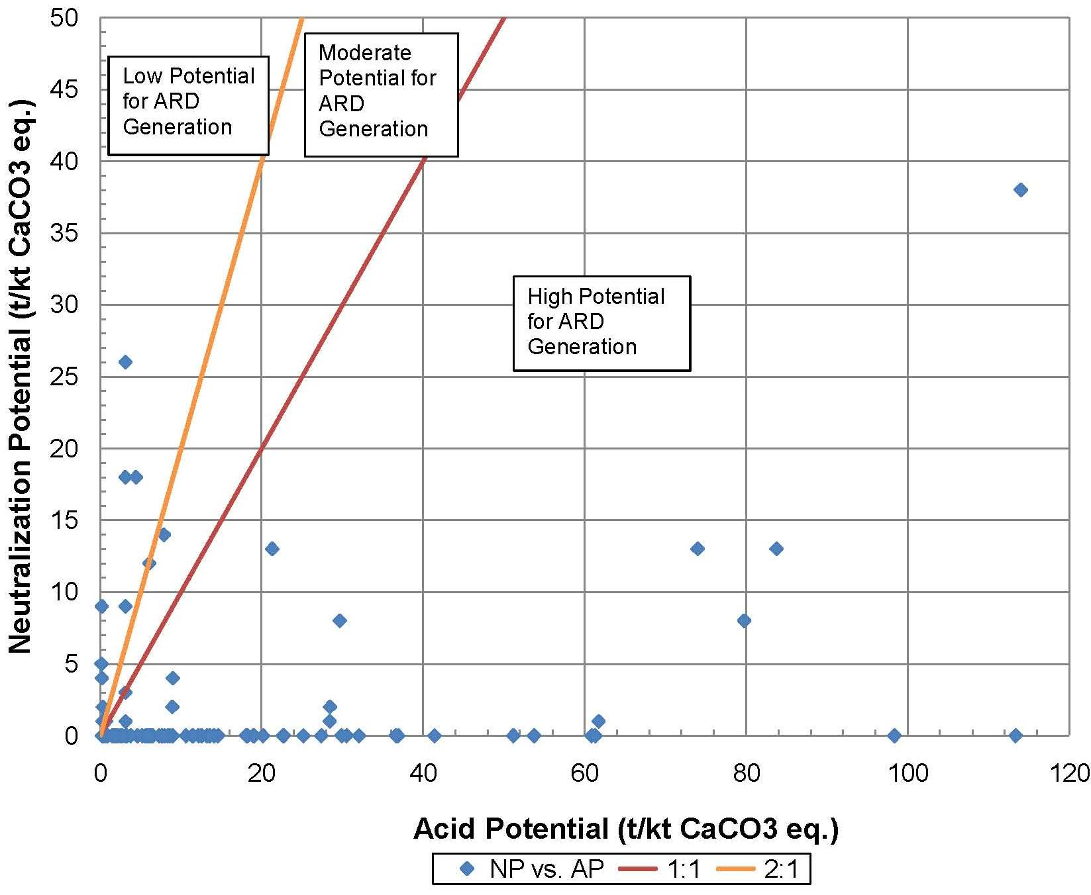
Laboratory Acid Base Accounting Data
5
1
4
3
2
Exhibit 3.3-1. SEM-EDS photomicrograph of barite mineral grain (1), associated with chalcopyrite (2 and 3), pyrite (4), and tennantite (5).
Mineralogical data used to improve ABA interpretation
Improving Remediation Planning though Effective Mine Material Delineation, Formosa Mine Superfund Site

Slide 12
Comparison of Field Paste Ph with ABA
Improving Remediation Planning though Effective Mine Material Delineation, Formosa Mine Superfund Site

Slide 13
Extraction Tests
Evaluates metals and metalloids that are rinsed from the sample when it is exposed to water
Bottle roll or column rinse tests
Generally use deionized water or simulated precipitation as an extraction fluid
Examples
Synthetic Precipitation Leach Procedure (EPA Method 1312)
Meteoric Water Mobility Procedure (ASTM Method E2242-07)
USGS Field Leach Test
Modified SPLP extraction tests used at Formosa
Reduced water to rock ratio as compared with standard SPLP
Improving Remediation Planning though Effective Mine Material Delineation, Formosa Mine Superfund Site

Slide 14
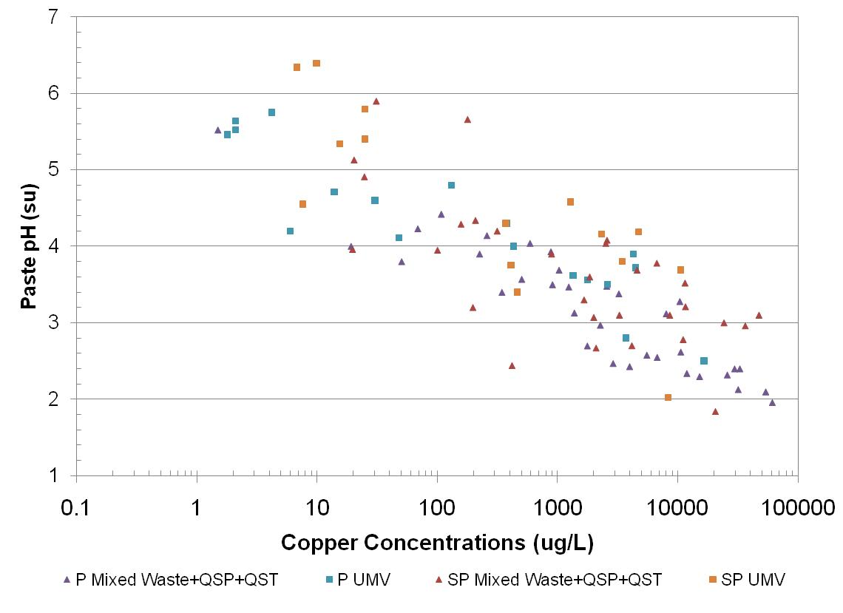
Modified SPLP vs. Paste pH- Cu
Improving Remediation Planning though Effective Mine Material Delineation, Formosa Mine Superfund Site

Slide 15
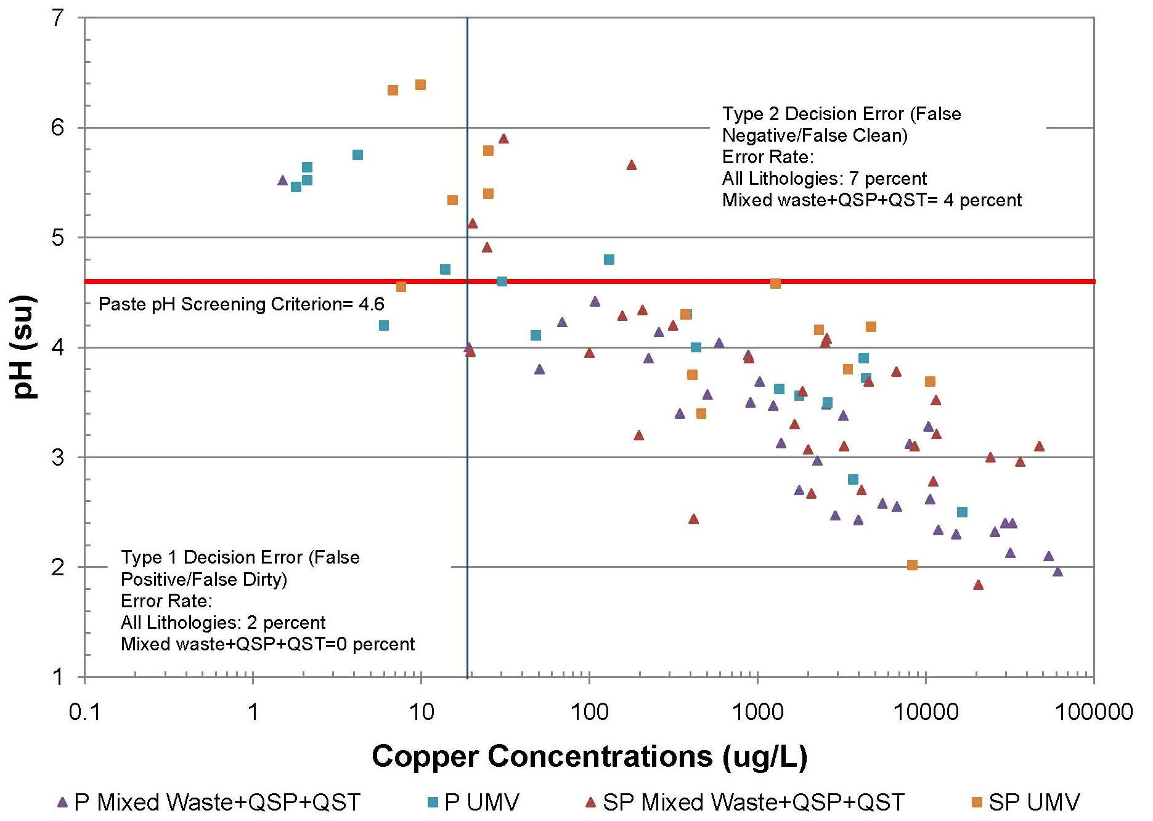
Development of Field Paste pH Criterion- Cu
MWMP Screening Criteria based on Site Conceptual Model
Improving Remediation Planning though Effective Mine Material Delineation, Formosa Mine Superfund Site

Slide 16
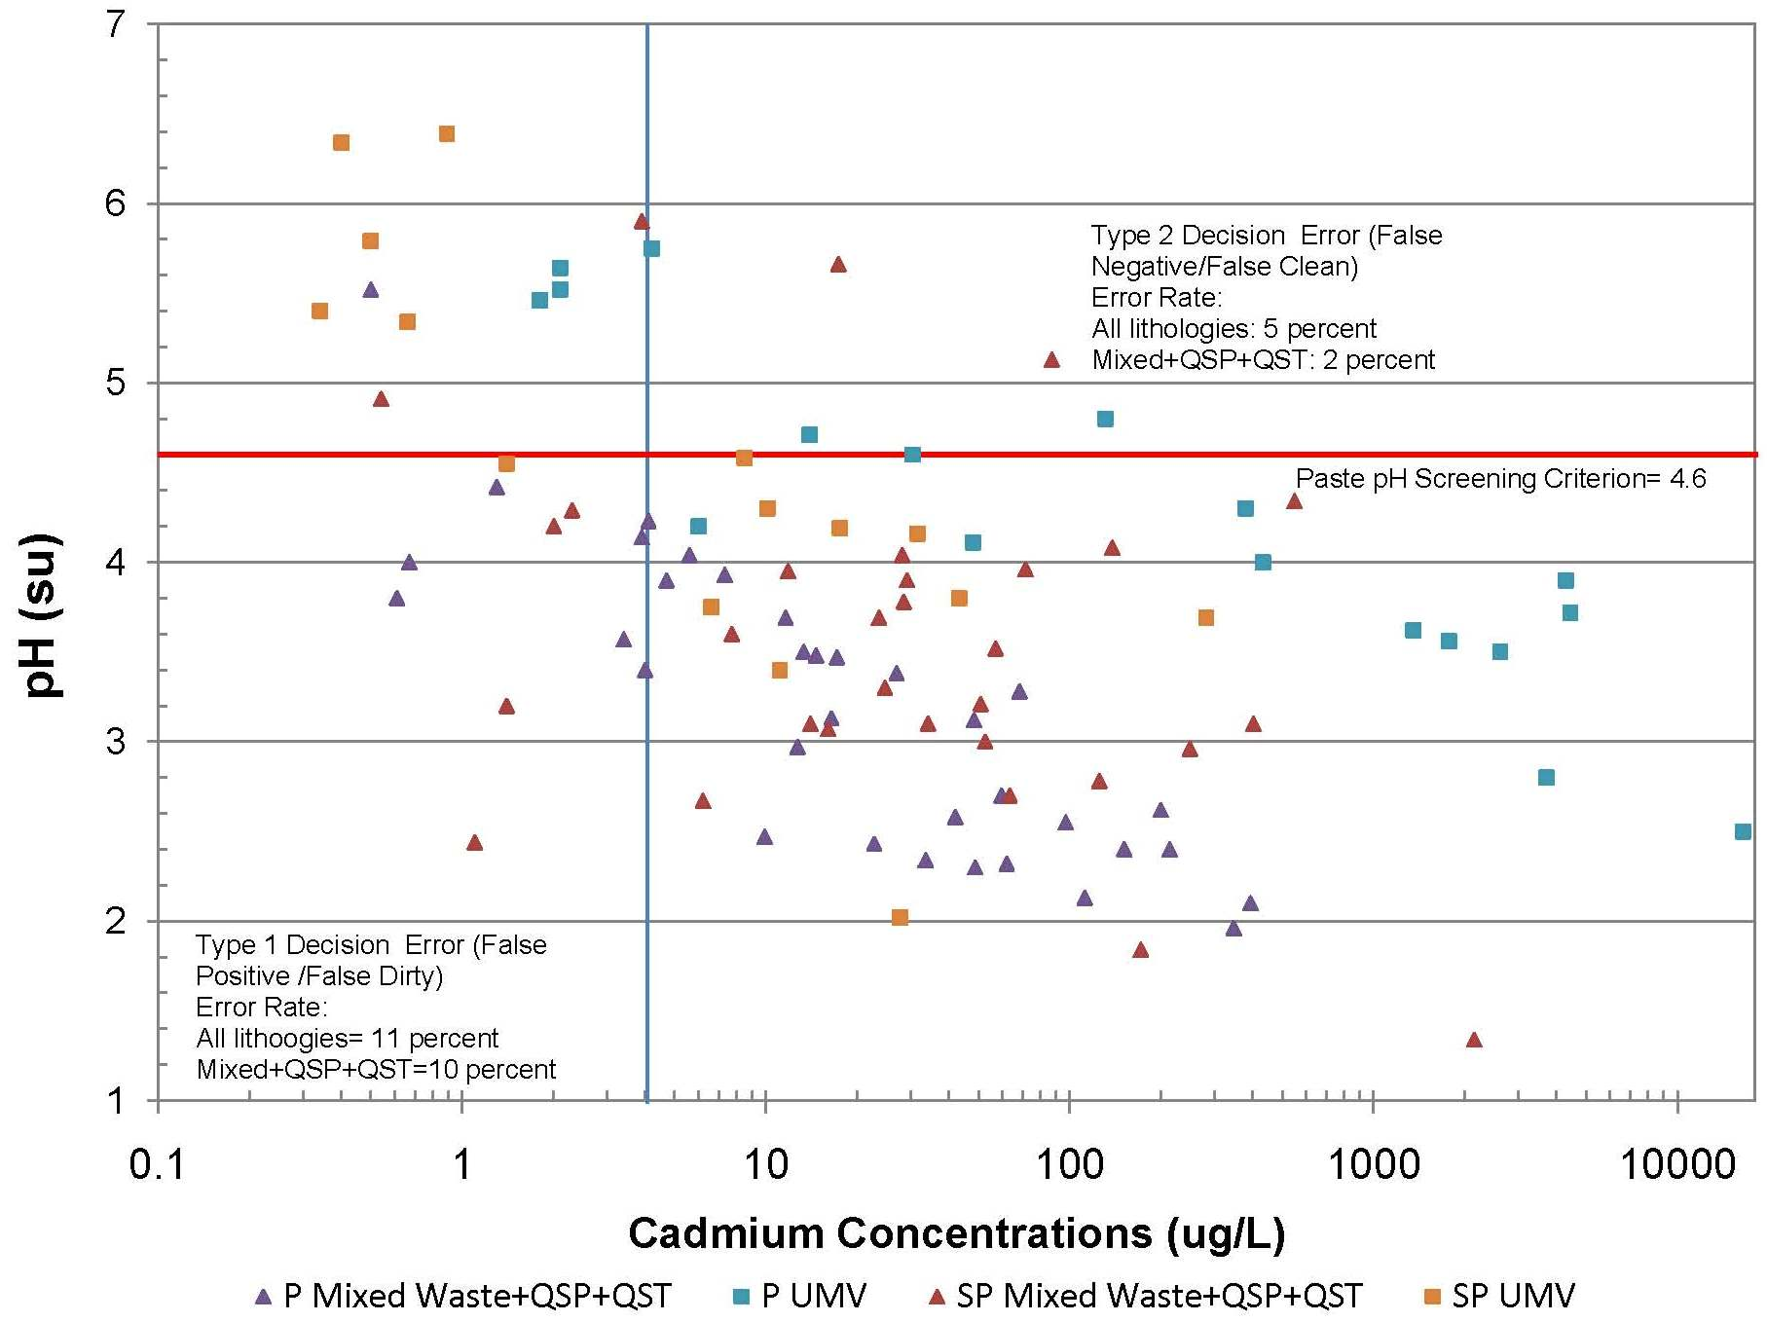
Development of Field Paste pH Criterion- Cd
Improving Remediation Planning though Effective Mine Material Delineation, Formosa Mine Superfund Site

Slide 17
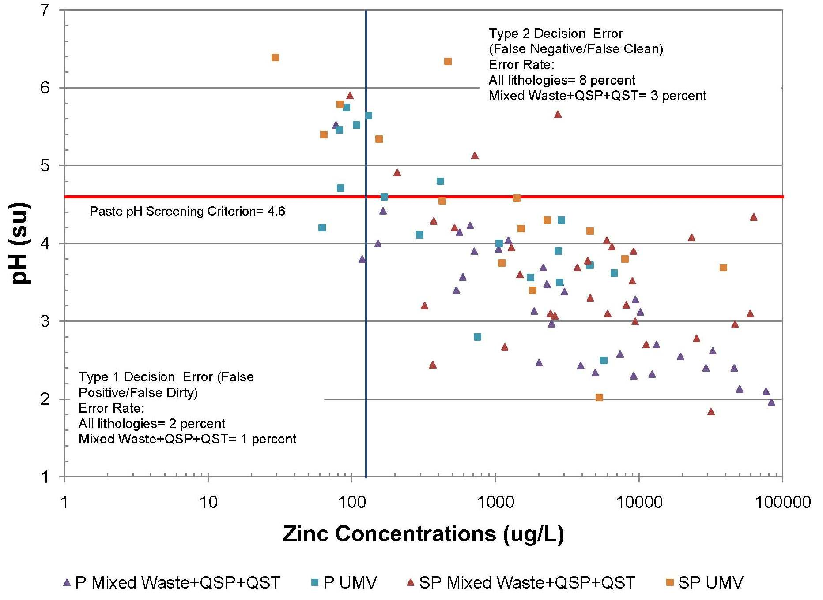
Development of Field Paste pH Criterion- Zn
Improving Remediation Planning though Effective Mine Material Delineation, Formosa Mine Superfund Site

Slide 18
Analysis of Field Paste pH Criterion
Decision Error Rates
Field Paste pH Criterion: 4.6 su
 | Paste pH |  | Paste pH+ Lithology
Analyte | False Negative (%) | False Positive (%) | False Negative (%) | False Positive (%)
Cadmium | 5 | 11 | 2 | 10
Copper | 7 | 2 | 4 | 0
Zinc | 8 | 2 | 3 | 1
Weight of Evidence Approach Improves Decision Error Rate
Improving Remediation Planning though Effective Mine Material Delineation, Formosa Mine Superfund Site

Slide 19
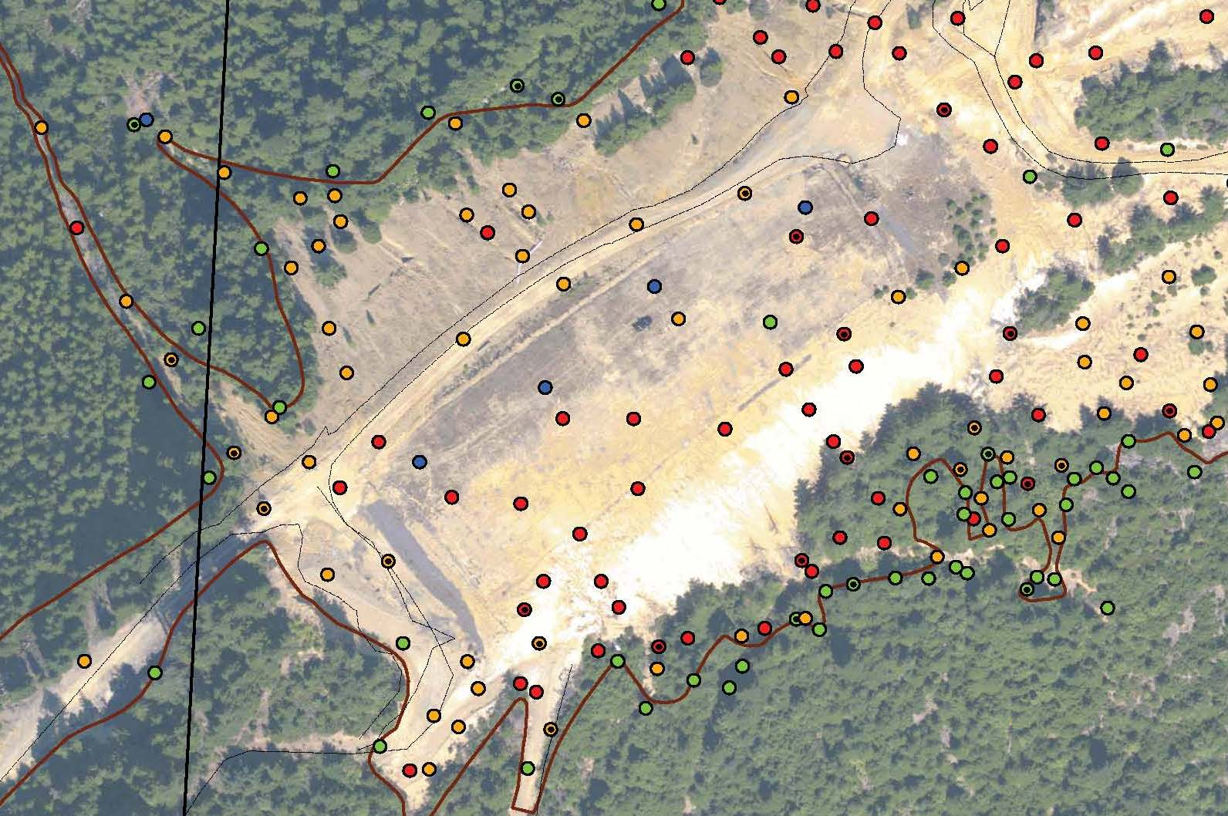
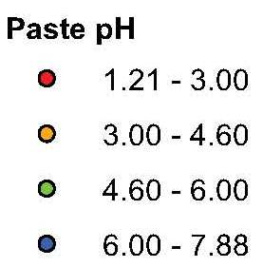
GIS Analysis based on Field Paste pH Criterion
Improving Remediation Planning though Effective Mine Material Delineation, Formosa Mine Superfund Site

Slide 20
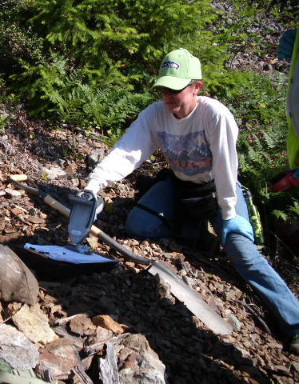
Use of Field Portable XRF
Useful to measure total metals concentrations
Total metals concentrations do not necessarily correlate to potential water quality effects
Used at Formosa to evaluate boundary between mine materials and natural soils
Samples prepared in the field using disposable -1.5 mm sieves
XRF data validated with laboratory check samples
Improving Remediation Planning though Effective Mine Material Delineation, Formosa Mine Superfund Site

Slide 21
FPXRF Accuracy- Zn
FPXRF data biased low at concentrations over approximately 200 mg/kg
Improving Remediation Planning though Effective Mine Material Delineation, Formosa Mine Superfund Site

Slide 22
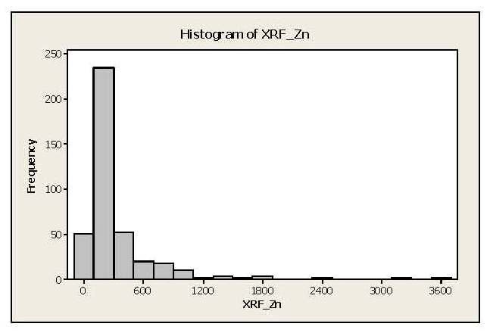
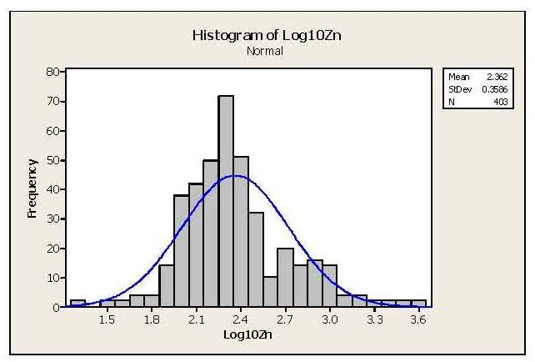
Formosa FPXRF Data- Zn
Data are positively skewed
Log transformation suggests bimodal distribution
Hypothesized to be related to sampling of the geological boundary between mine materials and natural soils
Improving Remediation Planning though Effective Mine Material Delineation, Formosa Mine Superfund Site

Slide 23
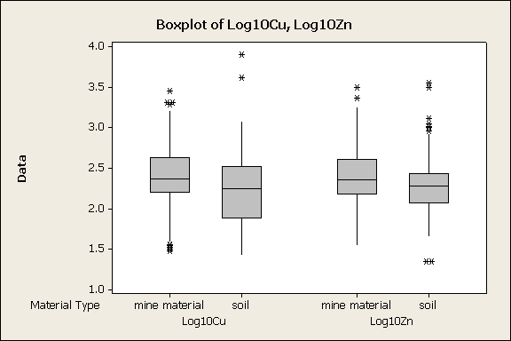
Formosa FPXRF Data
Improving Remediation Planning though Effective Mine Material Delineation, Formosa Mine Superfund Site

Slide 24
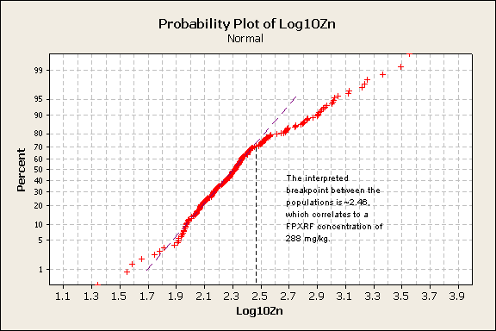
FPXRF Inspection Criteria
Inspection criteria for Cu and Zn based on breakpoint of cumulative probability plot
Improving Remediation Planning though Effective Mine Material Delineation, Formosa Mine Superfund Site

Slide 25
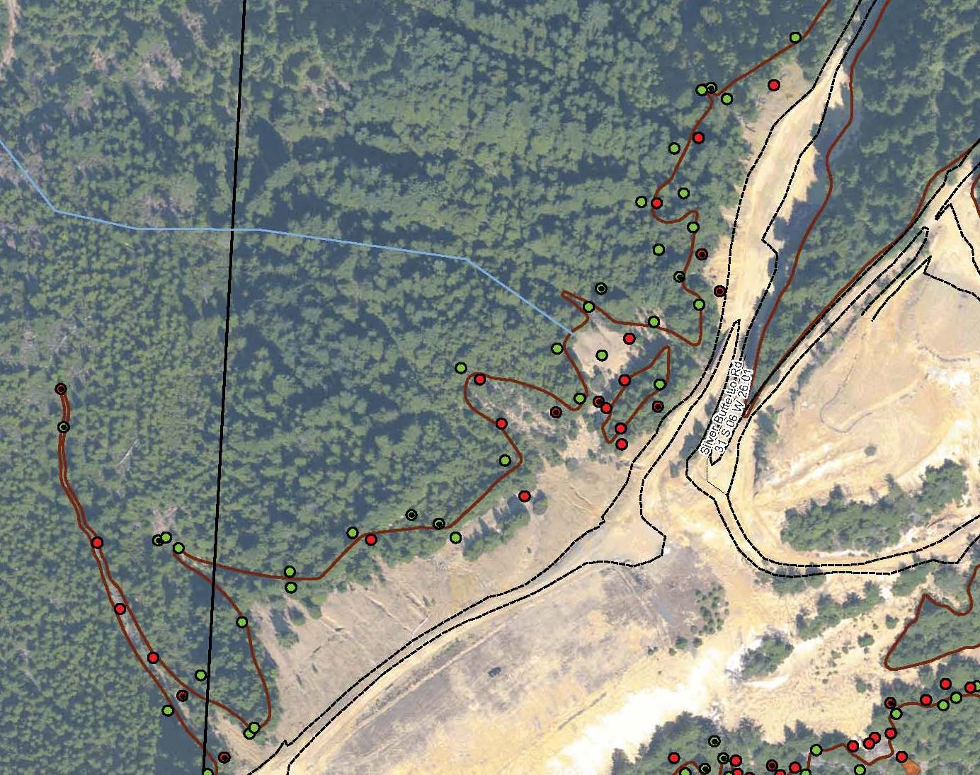
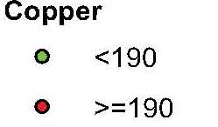
Application of FPXRF Inspection Criteria
Improving Remediation Planning though Effective Mine Material Delineation, Formosa Mine Superfund Site

Slide 26
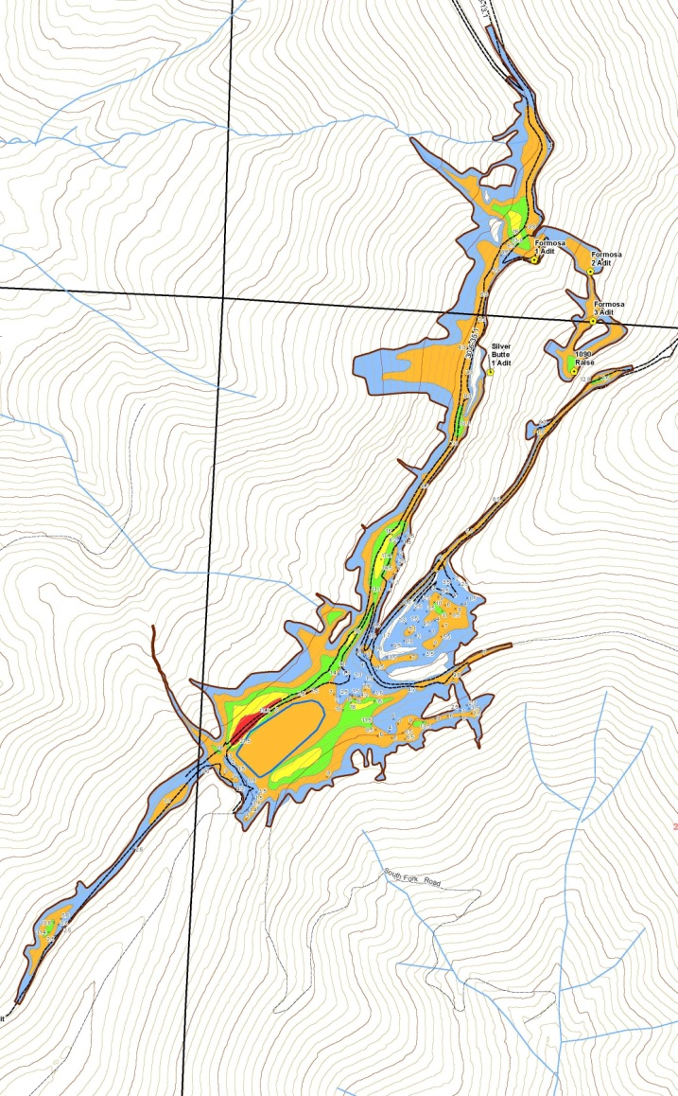
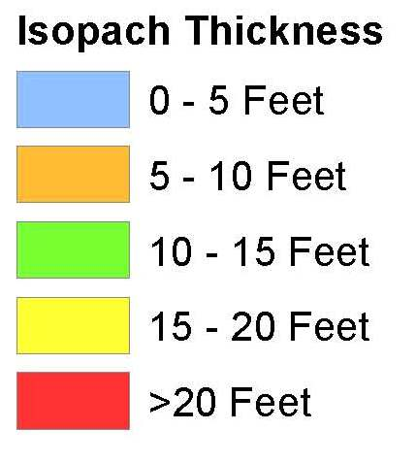
Adding the Third Dimension
Depth shown as thickness isopachs
3-dimensional model generated in ArcGIS Spatial Analyst to support volume estimation
Depth and volume characterized in sufficient detail to support feasibility study analyses
Improving Remediation Planning though Effective Mine Material Delineation, Formosa Mine Superfund Site

Slide 27
What Did We Learn?
Study Questions
Study Conclusions
ARD potential?
Metals leaching potential?
Horizontal and vertical extent?
Volume?
ARD generating mine materials identified
Mine materials that leach metals delineated
Evaluated with respect to CSM
Known and acceptable decision error rates
Areal extent, depth and volume defined
Improving Remediation Planning though Effective Mine Material Delineation, Formosa Mine Superfund Site

Slide 28
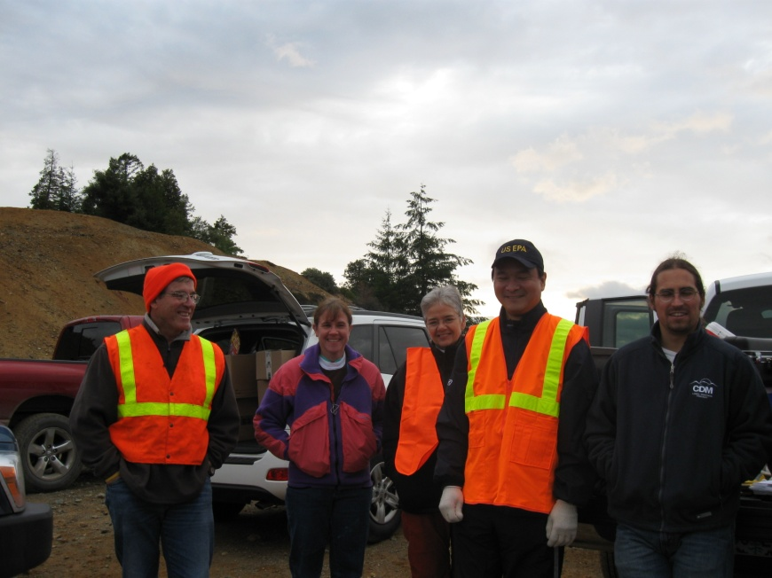
Conclusions
Rapid field geochemical characterization performs well at answering study questions
Method applicable at various project phases and in various levels of detail
Provides for efficient and detailed characterization, while managing investigation costs
Thanks to our partners!
US EPA
US Bureau of Land Management
Oregon DEQ
USGS
Improving Remediation Planning though Effective Mine Material Delineation, Formosa Mine Superfund Site

