Slide 1
Superfund and Mining Sites: A Review of the Past and Observations Concerning the Future
U.S. EPA Hardrock Mining Conference: Advancing Solution for a New Legacy
April 2012
Roger Olsen, Ph.D.
Denver, CO

Slide 2
Discussion Topics
Investigations
  Real Time Analyses -> Triad
  RI/FS Process
  Site Conceptual Models
  Water Balances
Evaluations
  Human Health and Ecological Risk Assessments
Remediation
  Regulatory Drivers
  Water Treatment
  In Situ Treatment

Slide 3
INTEGRATION
Water Treatment
Pilot Studies
In Situ
RI/FS Systematic
Evaluation
Processes
Water Balance
Predictive
Modeling
Innovative
Cost-effective
Alternatives
Real Time Analyses
TRIAD
3D visualization
Monitoring
Risk Assessments
Human Health
Ecological
Regulations and
Regulatory Agencies
Site Conceptual
Model

Slide 4
Discussion Topics
Investigations
  Real Time Analyses -> Triad
  RI/FS Process
  Site Conceptual Models
  Water Balances
Evaluations
  Human Health and Ecological Risk Assessments
Remediation
  Regulatory Drivers
  Water Treatment
  In Situ Treatment

Slide 5
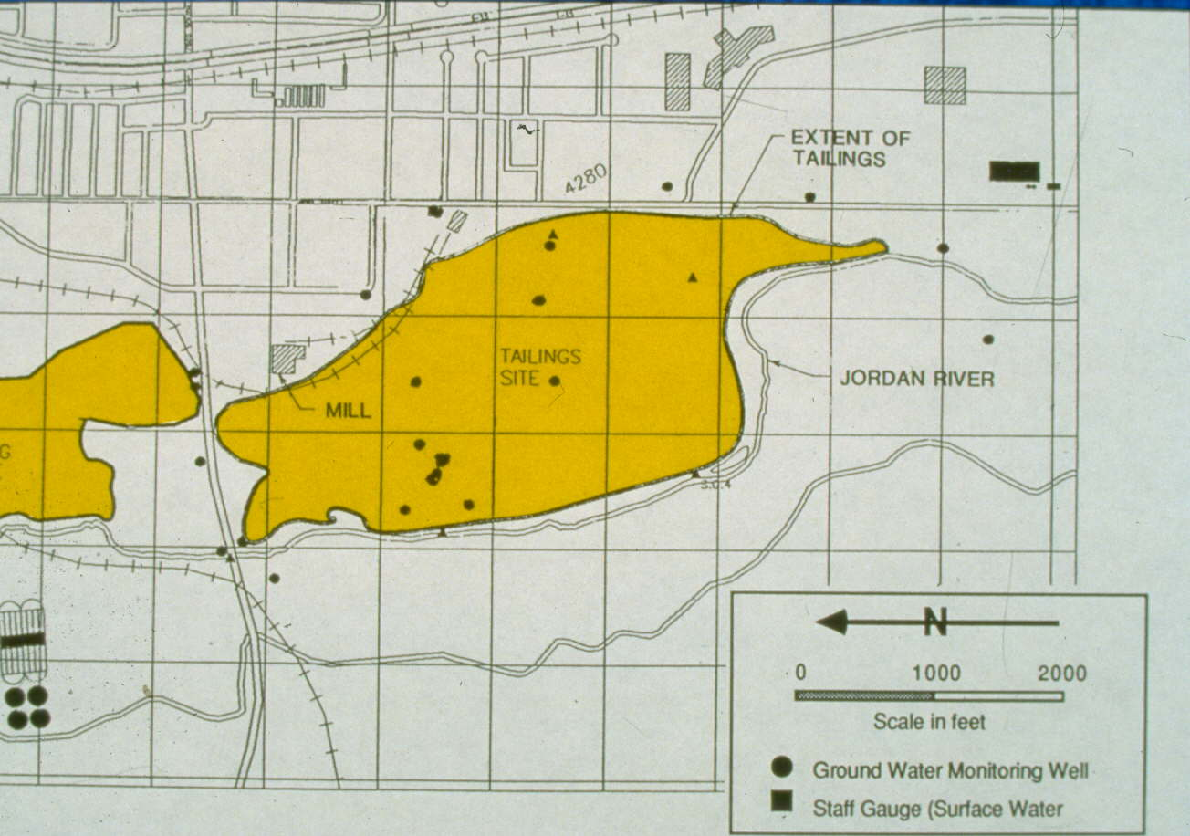
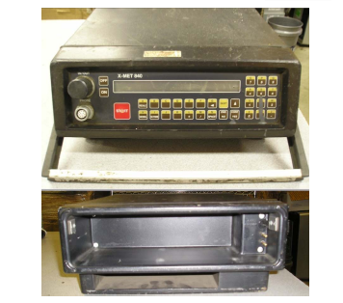
Sharon Steel - Real Time Analyses and Evaluations
X-MET 840

Slide 6
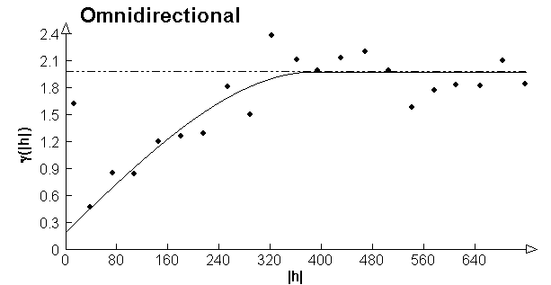
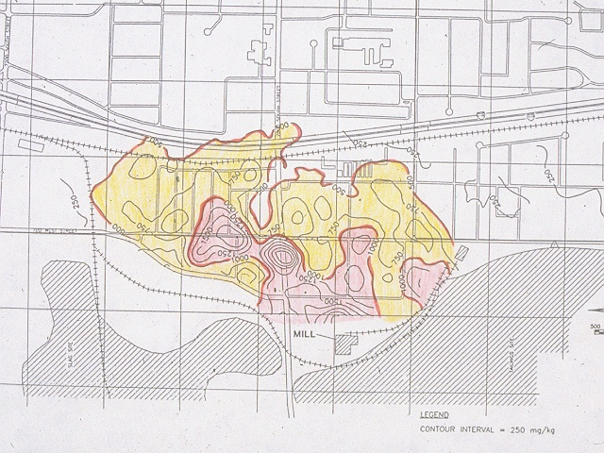
Sharon Steel
Kriged Pb Concentrations

Slide 7
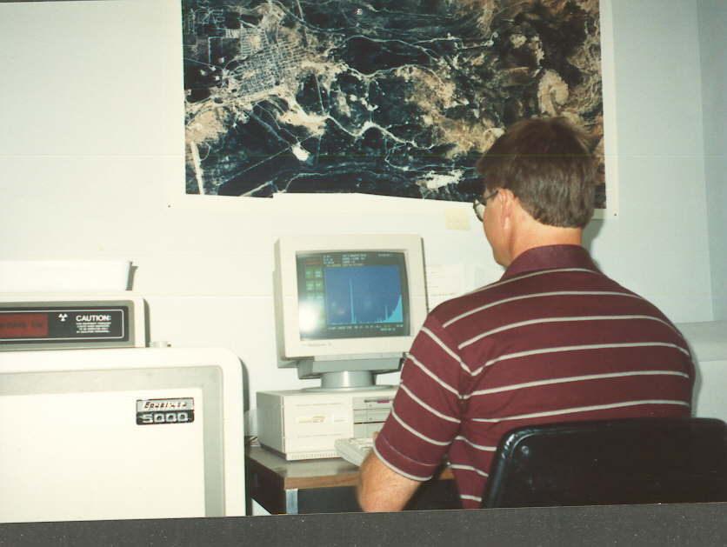
Leadville,
Colorado

Slide 8
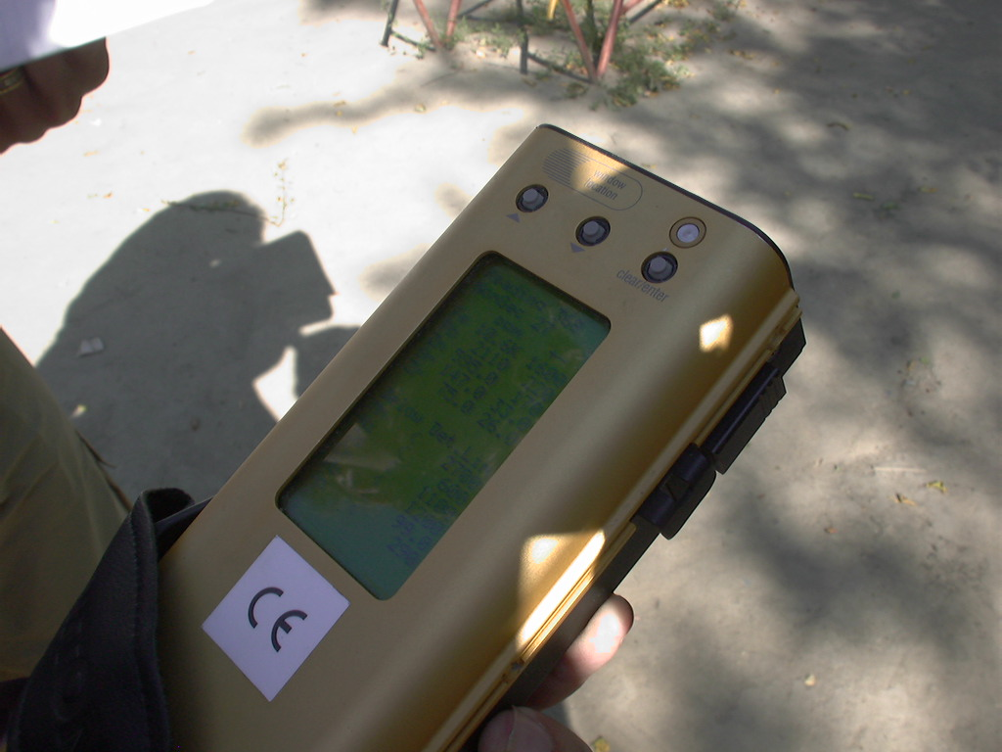
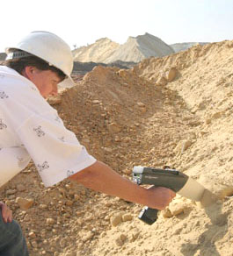
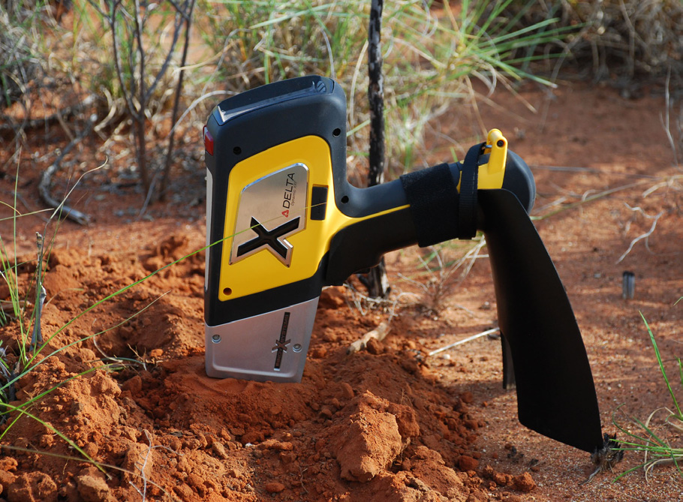

Slide 9
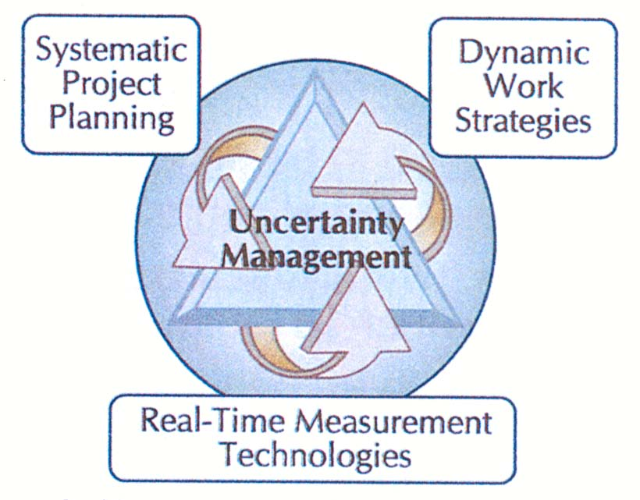
TRIAD Approach
Systematic project planning providing roadmap and benchmarks
Dynamic Work Plans
  Guide Investigation
  Flexible
Use of real time measurement technologies
  Real time data
  Real time interpretation
  Real time decisions

Slide 10
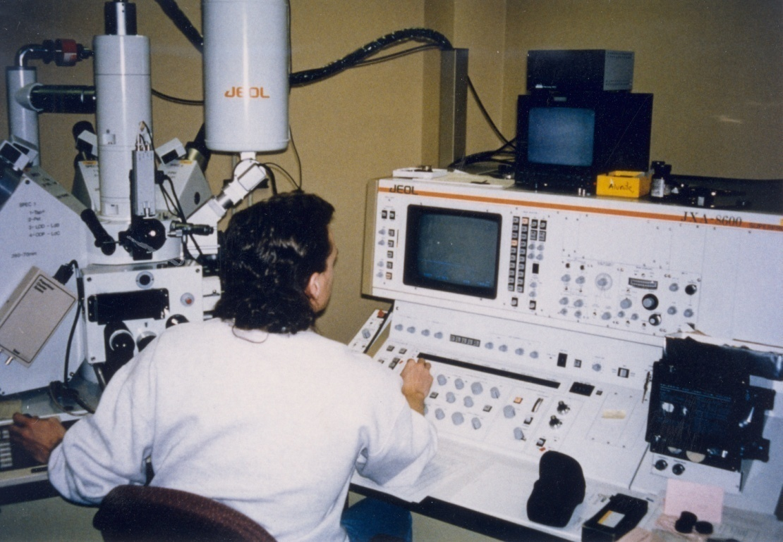
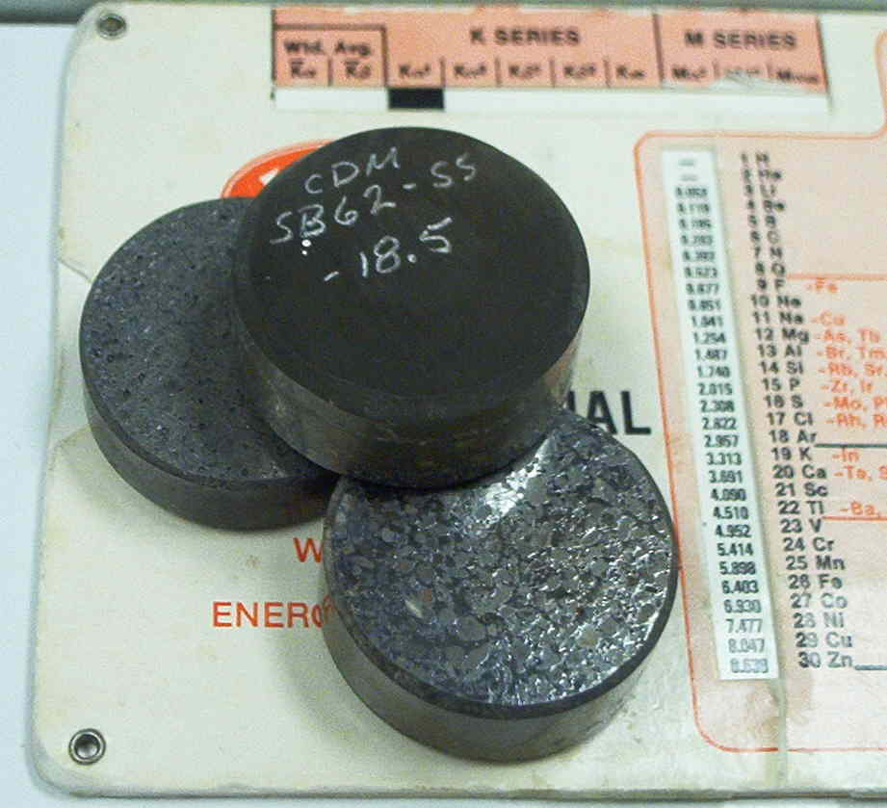
Electron Microprobe Analysis
Can view samples at 300,000X magnification
Can analyze particles as small as 2 μm in diameter
Can determine the forms (mineralogy) of As, Cu, Pb, and Zn

Slide 11
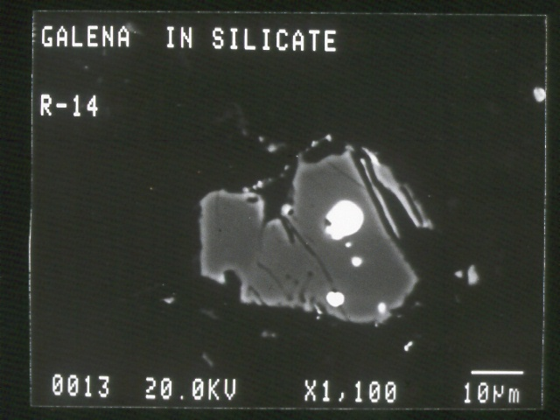
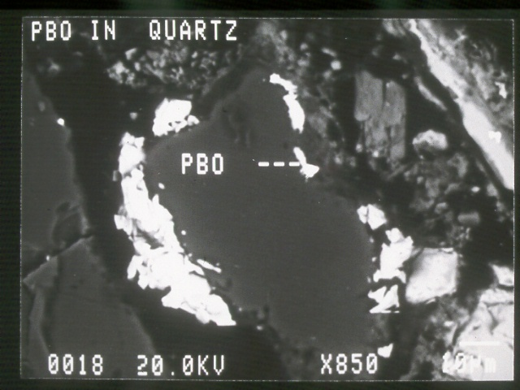
Sharon Steel, Utah
Residential Soil Samples

Slide 12
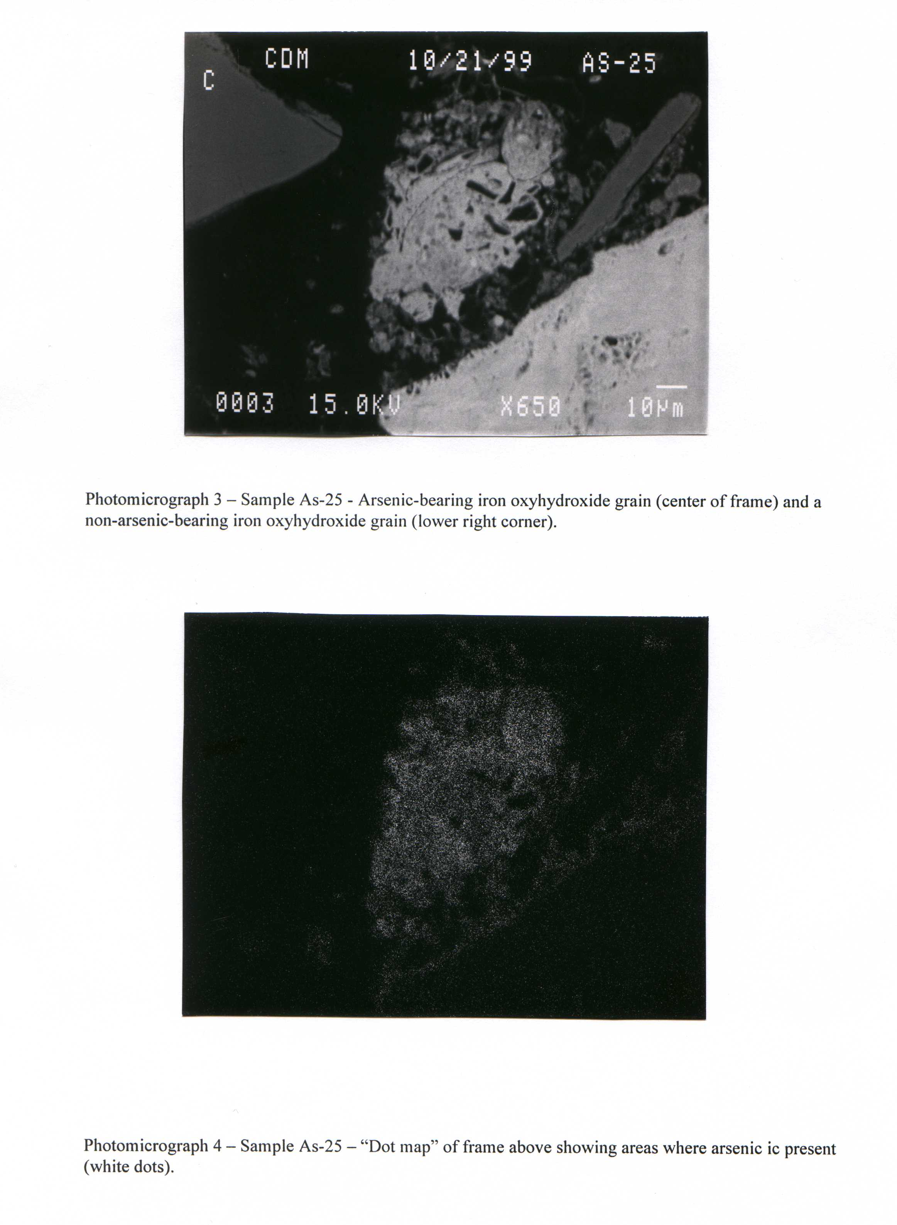
Sample As-25 - Iron Oxyhydroxide Dot Map

Slide 13
Systematic Early Planning
Existing Information
Work Plans
Evaluations and Reports
Evaluation
Investigations
Historical
Chemical Data
Inspections
Site Conceptual Model (SCM)
Exposure Pathway Evaluation
Preliminary Remediation Goals
Preliminary Remedial Options
Data Gaps
Sampling & Analysis Plan
Quality Assurance Project Plan
Health & Safety Plan
TRIAD Approach
Does Information Fit CSM?
Fill Data Gaps
Nature & Extent of Contamination
Risk Assessment
Feasibility Study
Data Gaps & Additional Investigations

Slide 14
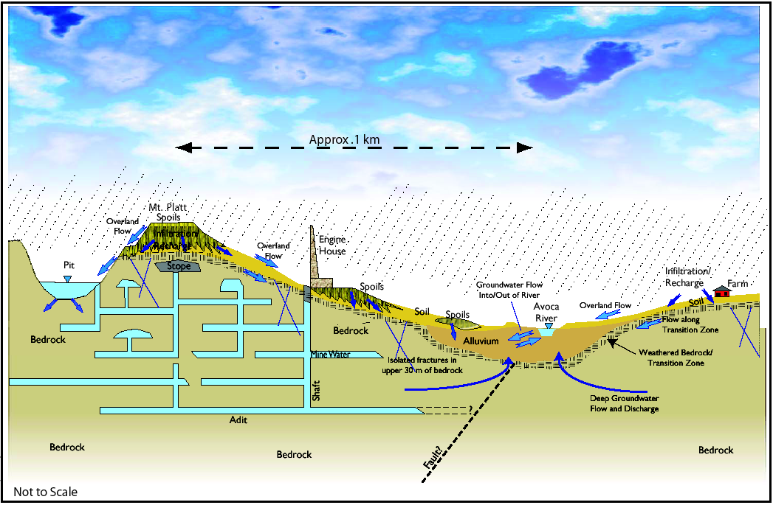
Site Conceptual Model

Slide 15
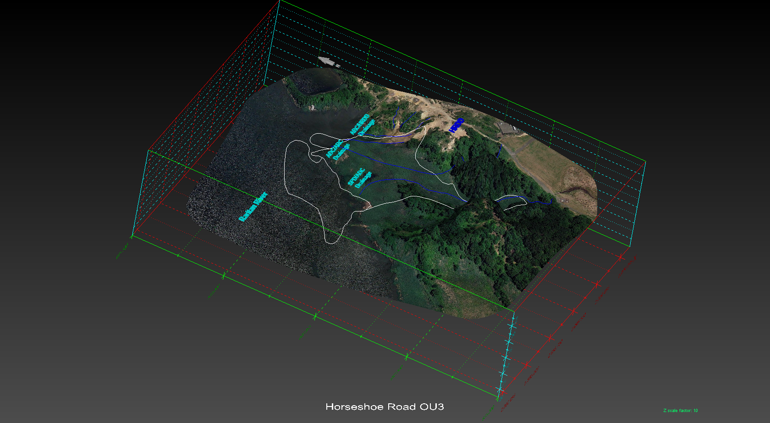
3D Visualization - MVS

Slide 16
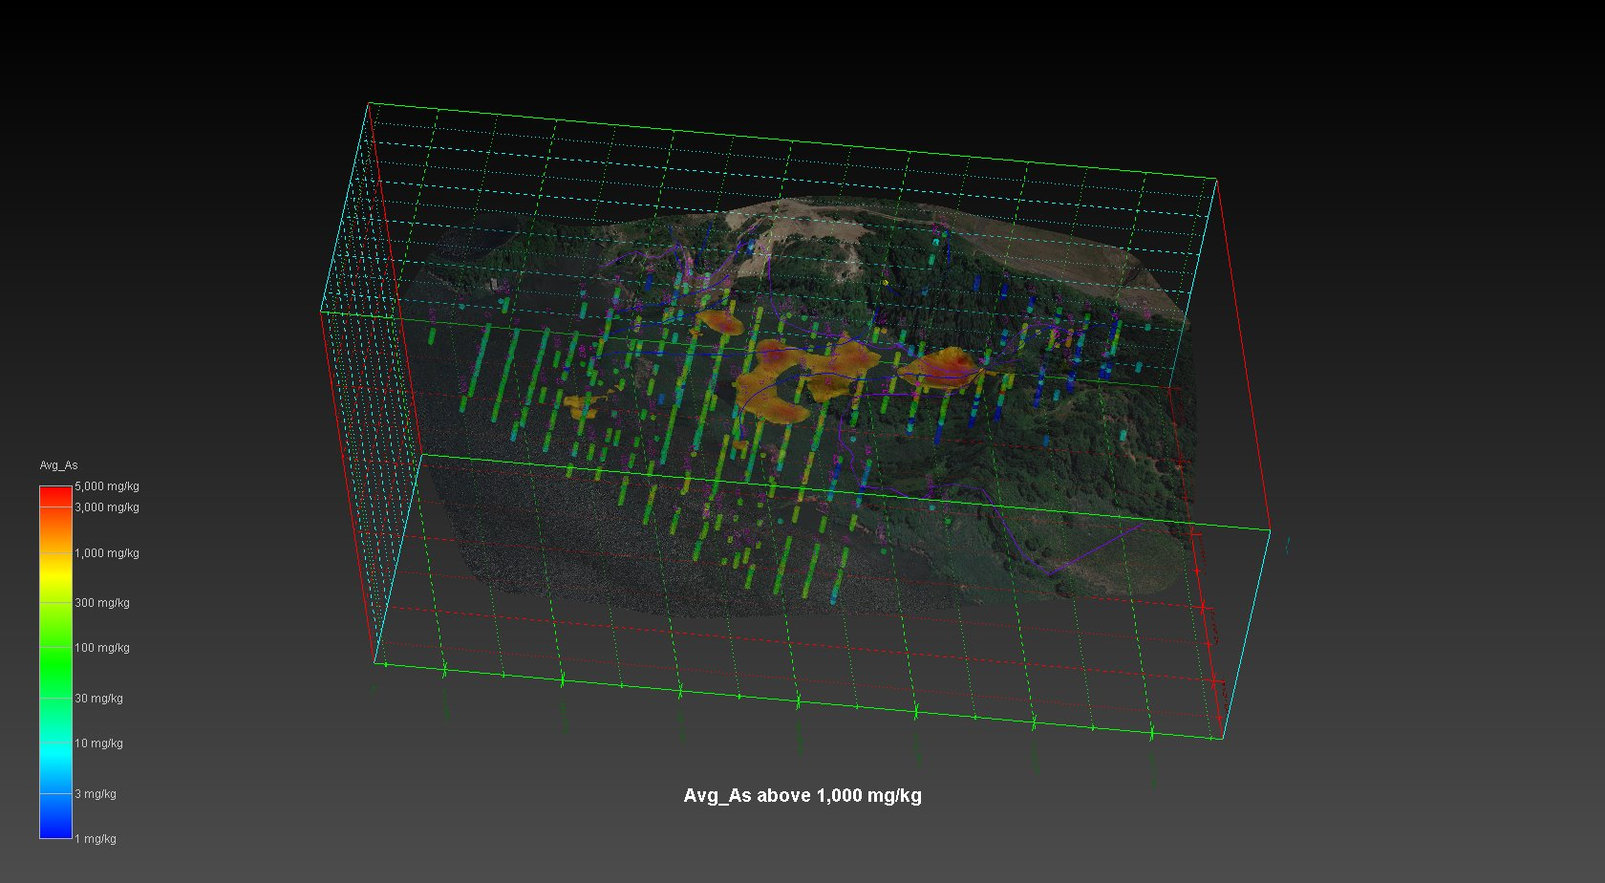
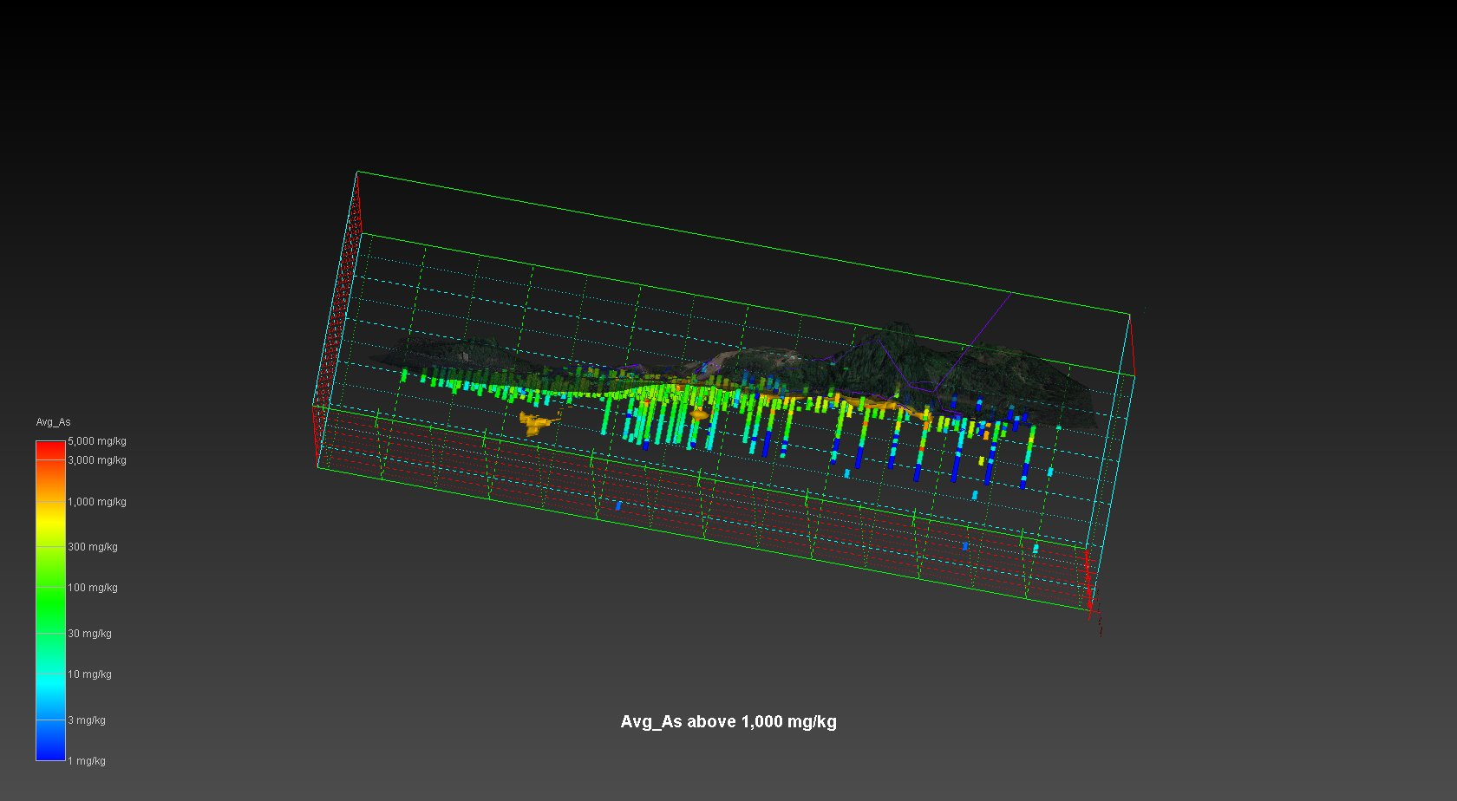

Slide 17
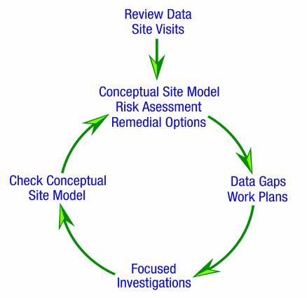
Investigative Approach
Conceptual Site Model Development
Preliminary Risk Assessment
Identification and Evaluation of Potential Remediation Options
Outcome Data Gaps
Key:
Site Understanding leads to
Innovative & Cost-effective Solutions

Slide 18
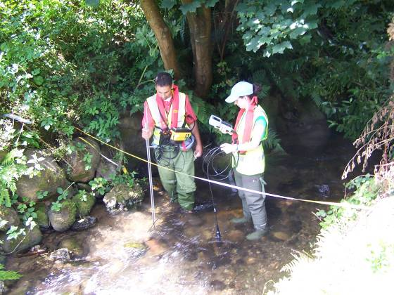
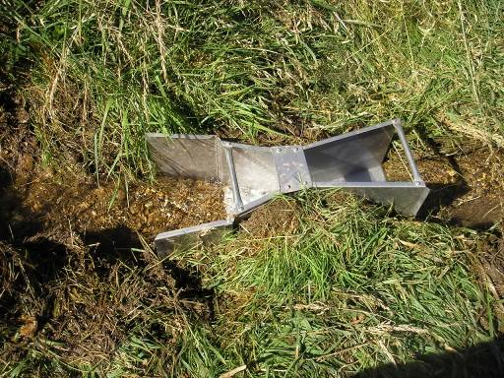
Water and Mass Balances
Flow and Field Parameter Measurements

Slide 19
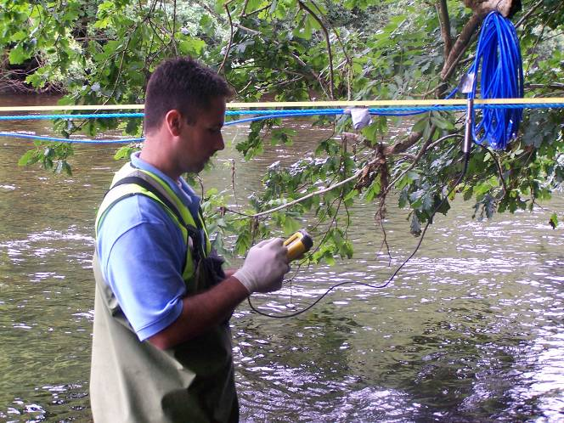
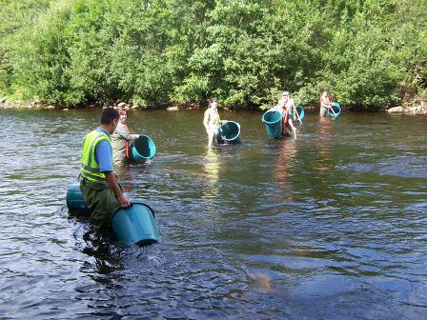
Tracer Study

Slide 20
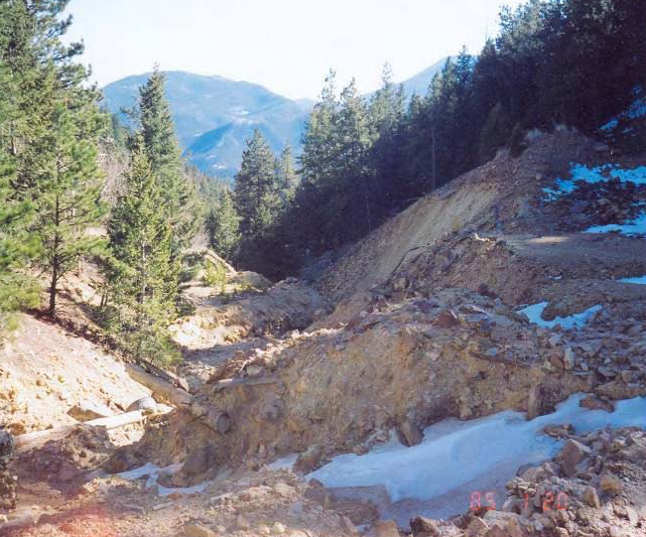
Virginia Canyon – Nonpoint Souce Load
Virginia Canyon Ground Water Project: 200 to 500 lb zinc per day

Slide 21
Discussion Topics
Investigations
  Real Time Analyses -> Triad
  RI/FS Process
  Site Conceptual Models
  Water Balances
Evaluations
  Human Health and Ecological Risk Assessments
Remediation
  Regulatory Drivers
  Water Treatment
  In Situ Treatment

Slide 22
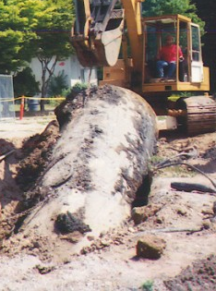
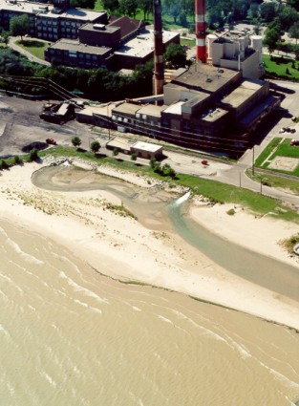
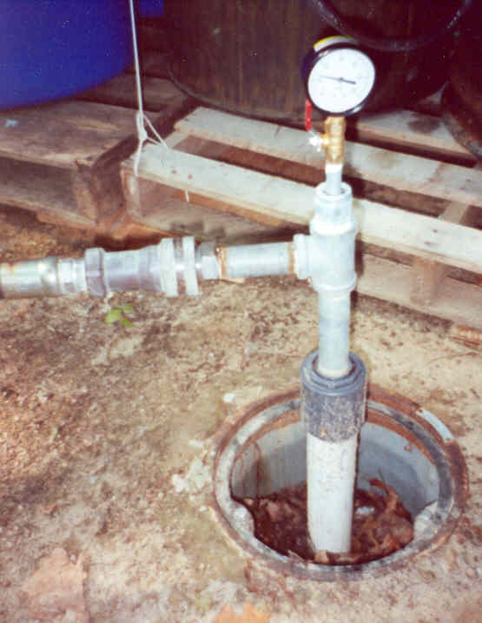
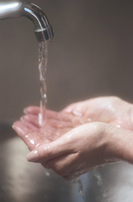
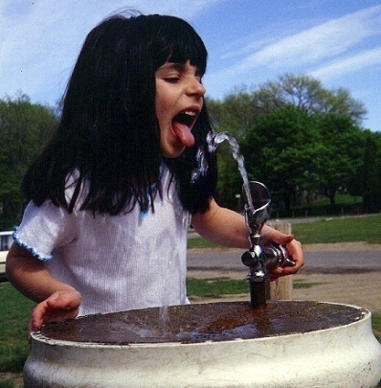
Risk Assessment
Elements of an Exposure Pathway
Source
Origin: waste piles, mine drainage, etc.
Transport & Transformation
Release mechanisms: blowing dust, erosion, leaching, geochemical changes, etc
Exposure Point
Locations where people or ecological receptors contact COPCs: residential wells, stream sediments, etc.
Exposure Route
How chemical enters the body: ingestion, breathing, skin contact
Receptor
People or species potentially exposed to COPCsl

Slide 24
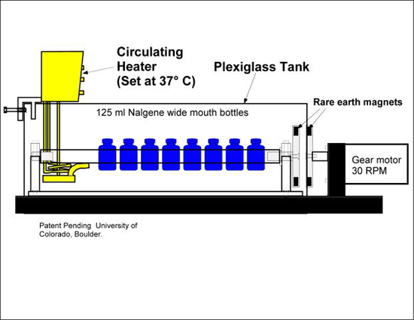
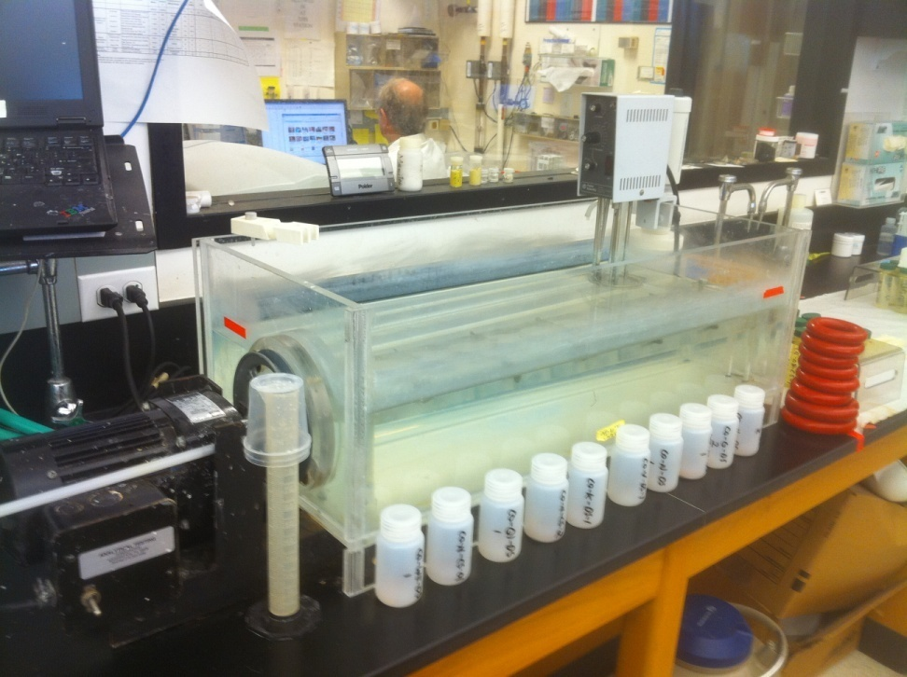
In-Vitro Bioassay
1 g spoils (<250 μm), 100 mL leach solution
  Leach solution (glycine solution adjusted to pH 1.5)
  Agitated for 1 hr in a rotary tumbler
  EPA Approved Methodology

Slide 25
Bioassay Results
 | Pb in <250 μm Fraction (mg/kg) | Bioavailable Pb | As in <250 μm Fraction (mg/kg) | Bioavailable As
Minimum | 58.6 | 0% | 14.8 | 0%
Maximum | 56,022 | 28% | 2,560 | 8%
Median | 5,524 | 3% | 706 | 0%
Mean | 15,194 | 5.5% | 927 | 0.5%
Standard Deviation | 17,948 | 6% | 673 | 1%
Covariance (%) | 118% | 118% | 73% | 302%

Slide 26
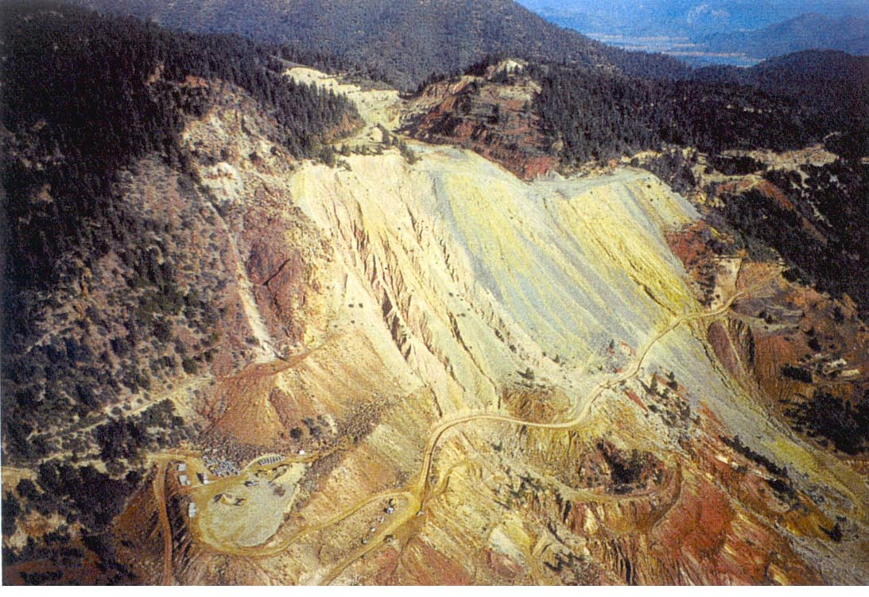
Other Human Health
Activity based exposures and sampling
Realistic scenarios: less conservative and more accurate
  Transfer coefficients dermal
Site specific evaluations and values
Bioavailability: Se, Sb , Mo

Slide 27
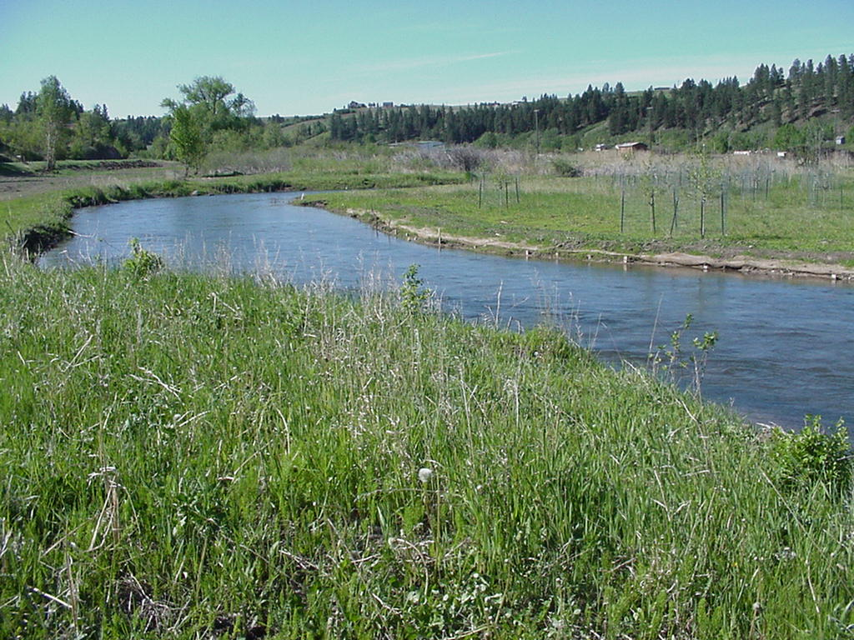
Ecological Risk Assessment
Aquatic Macrofauna as Ecological Sentinels

Slide 28
Chronic Surface Water Criteria and Toxicity Reference Values (TRVs)

Slide 29
Discussion Topics
Investigations
  Real Time Analyses -> Triad
  RI/FS Process
  Site Conceptual Models
  Water Balances
Evaluations
  Human Health and Ecological Risk Assessments
Remediation
  Regulatory Drivers
  Water Treatment
  In Situ Treatment

Slide 30
Regulatory Drivers
Water Quality Standards Challenges
  Strict Enforcement and no partial improvement
  Designated use at highest level
  Numeric criteria protective of complex and variable ecosystems
  Lack of precision
Potential Solutions: Use of Site-Specific Cleanup Goals
  Performance Based Criteria
  Risk Assessment
  Use Attainability Analyses
  Technical Impracticability
  Alternate Cleanup Levels
  Water Quality Trading
ITRC Mining Waste Treatment Technology Selection

Slide 31
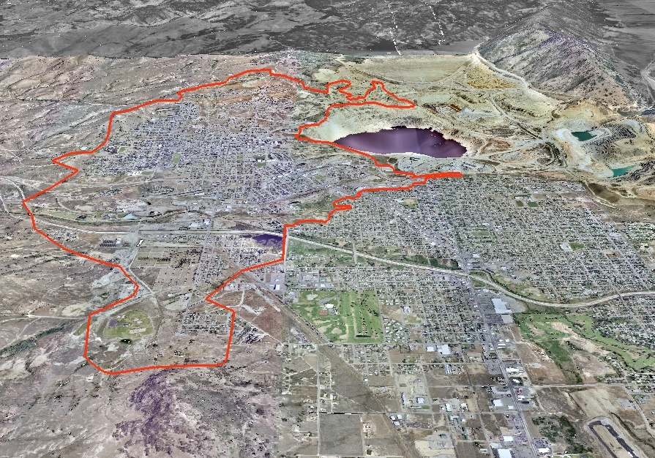
Butte, Montana – Technical Impracticability Waiver Deep Groundwater
Mining began in the 1870s and continued until 1975
10,000 miles of mine workings beneath the city.
Mining in the Berkeley Pit began in 1955.

Slide 32
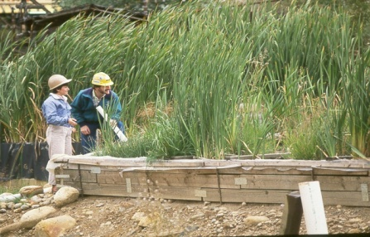
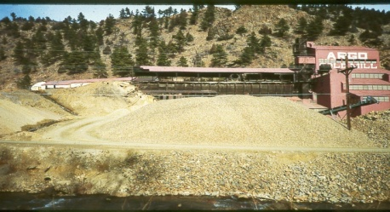
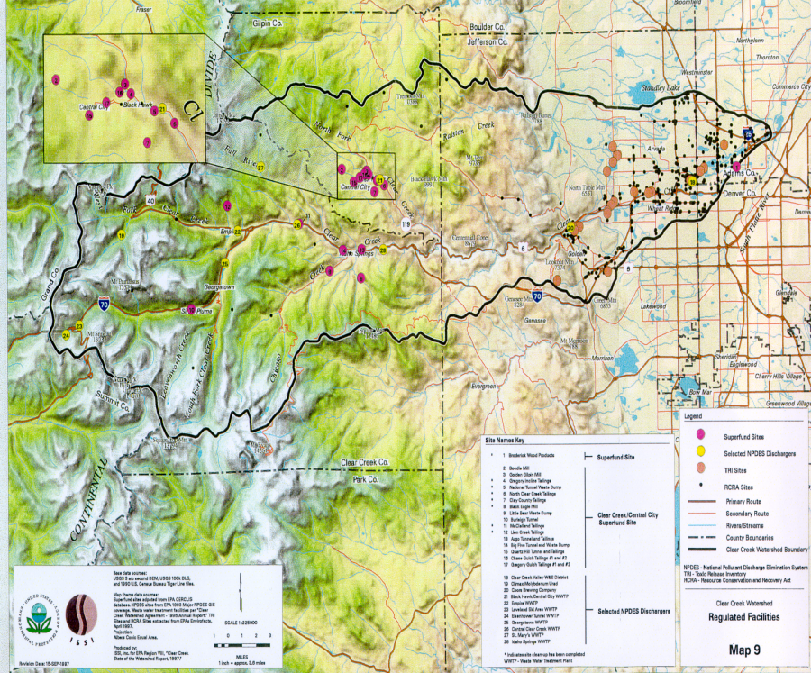
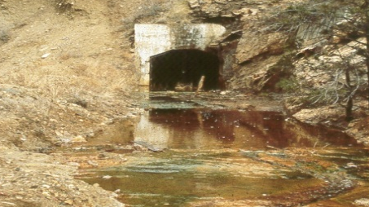
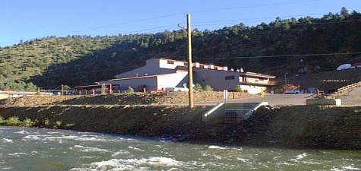
Clear Creek/Central City Superfund Site
Mine Site
Selected NPDES Dischargers
TRI Sites
RCRA Sites
Primary Route
Secondary Route
Rivers/Streams
County Boundaries
Clear Creek Watershed Boundary
Runon/Runoff Control at Waste Rock Piles
Passive Treatment
Clear Creek/Central City
Selected/NPDES Dischargers
800
No Treatment
* Map and habitat improvement information provided from “State of the Watershed Report - Clear Creek, 1977” by USEPA and Colorado Department of Public Health and the Environment.
700
Alt. No. 2B
600
Creek
Tunnel
Alt. No. 4B
/L)
500
g
Quayle
Burleigh
WFCC
Golden
F
Big 5
NCC
(
Zn
400
ARGO
300
Argo Tunnel Before Remediation
200
100
0
35
30 25 20
Distance from Golden (
15 10 5
0
mi
)
Receiving Water Modeling
Argo Tunnel After Remediation

Slide 33
Predicted Zinc Concentrations in Clear Creek
800
700
600
500
400
300
200
100
0
Burleigh Tunnel
Quayle Creek
Zn (ug/L)
WFCC
Big 5
Golden
NCC
ARGO
35 30 25 20 15 10 5 0
Distance from Golden (mi)
No Treatment
Alt. No. 2B
Alt. No. 4B

Slide 34
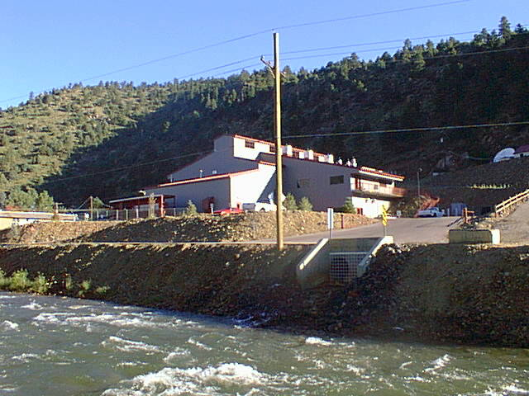
Argo Treatment Plant

Slide 35
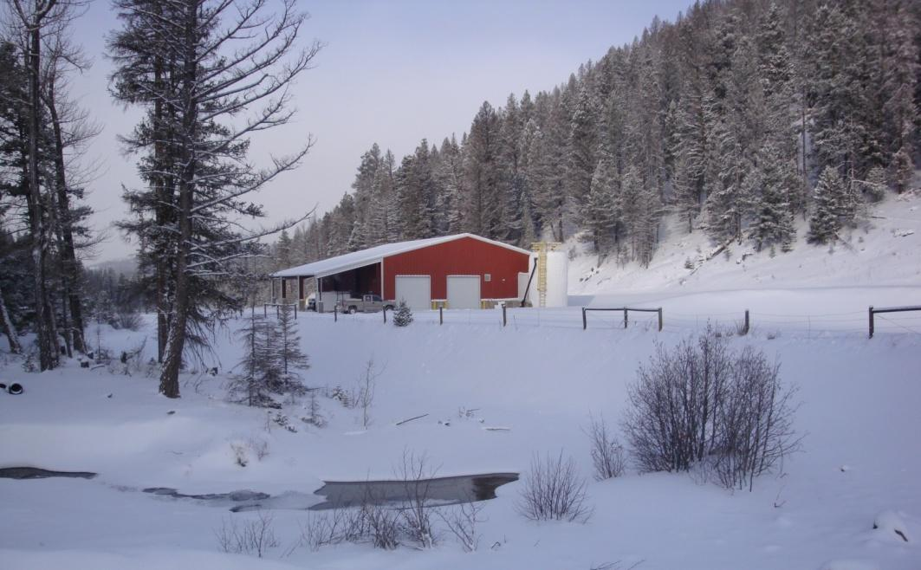
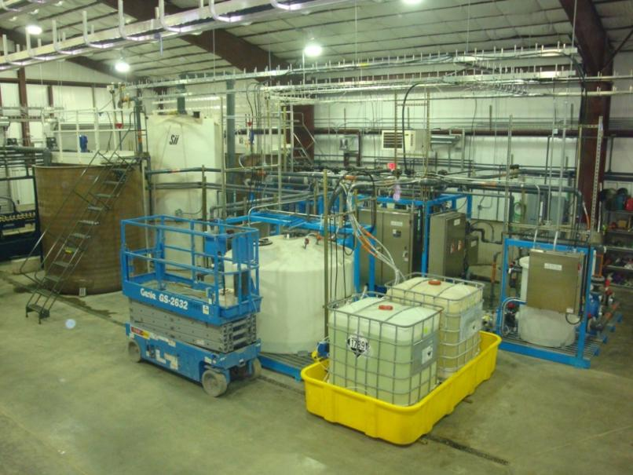
Mike Horse Mine Water Treatment System, Montana

Slide 36
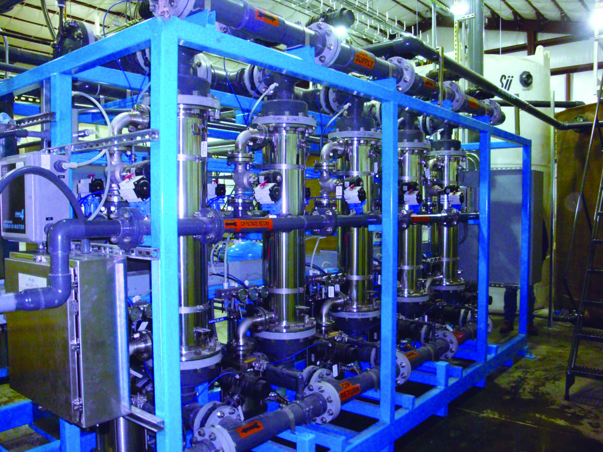
Active Treatment System
Upper Blackfoot River Mike Horse Mine Water Treatment System, Lincoln, Montana
  For treating acid mine drainage from two adits
  Replaced a passive wetlands system
  Caustic precipitation and ceramic microfiltration treatment system
  Design Build Operate
  Ceramic filtration to 0.1 um
  Re-circulates water through the system at a rate of 2,100 gpm

Slide 37
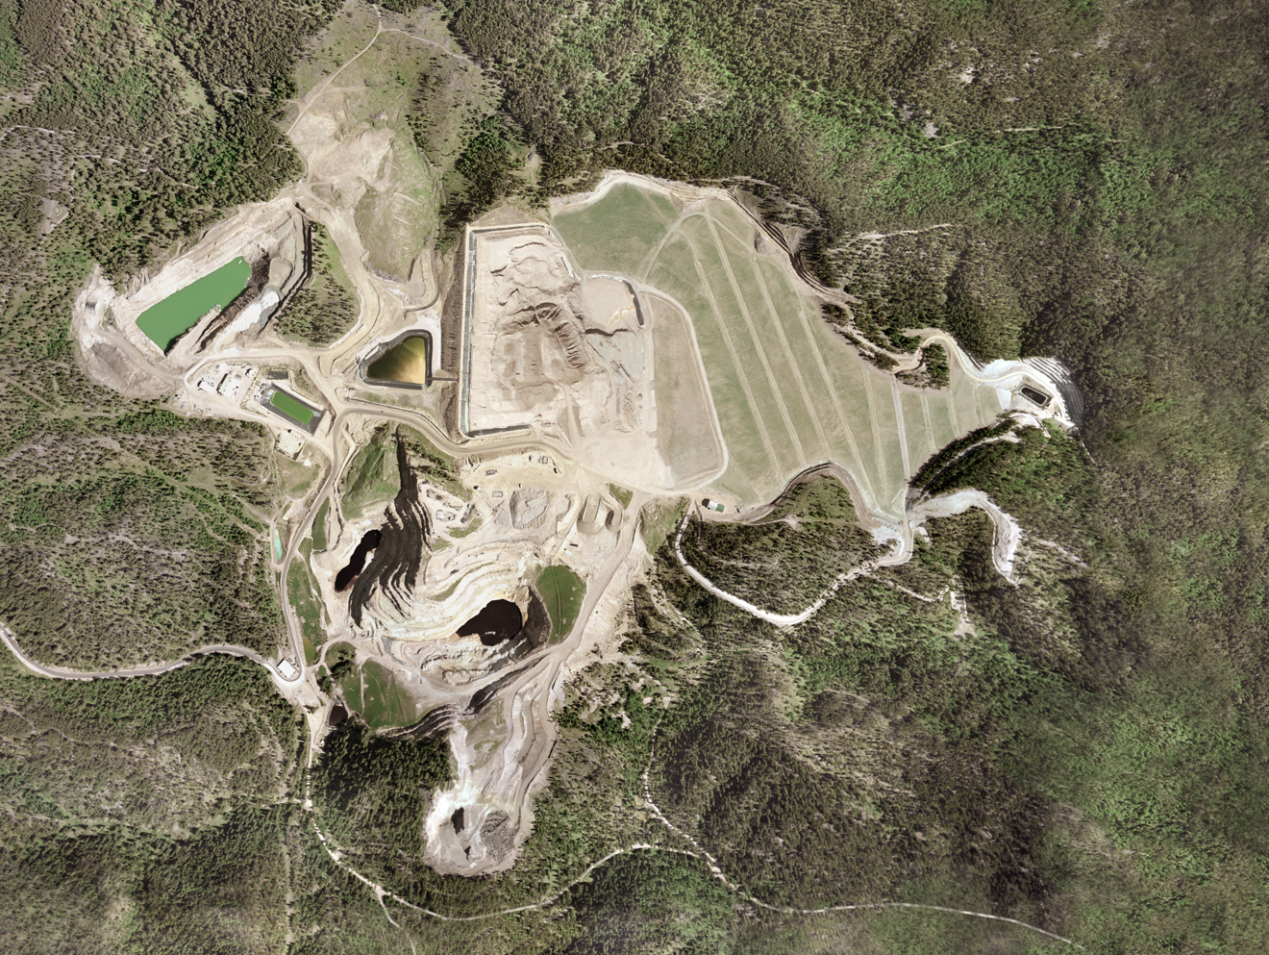
Gilt Edge Superfund Site – South Dakota

Slide 38
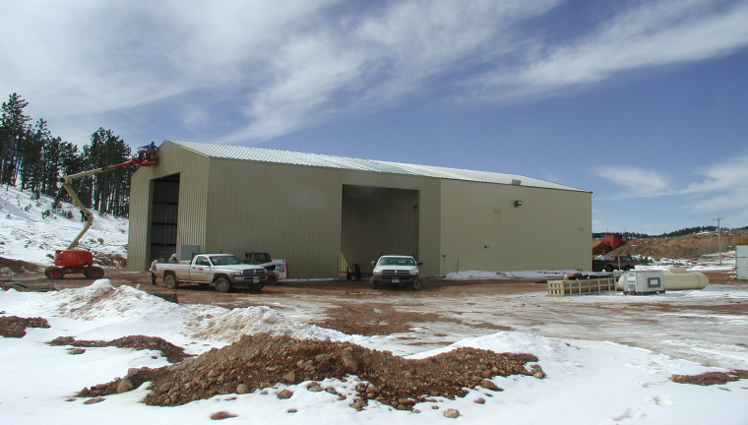
Gilt Edge Active Treatment Plant

Slide 39
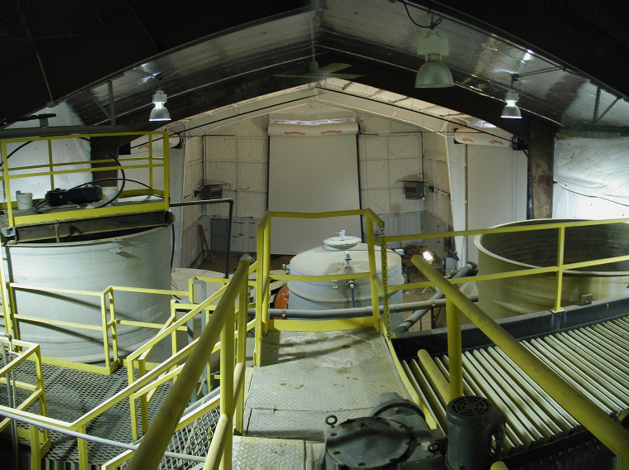
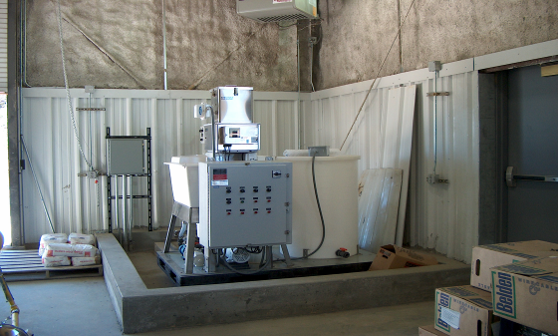
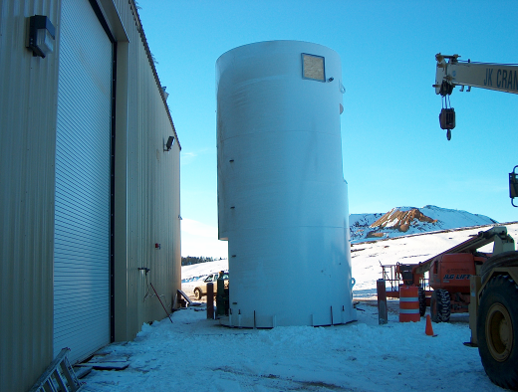

Slide 40
Bench Testing Water Quality Results (µg/L) – Sulfide Addition + pH Adjustment
40

Slide 41
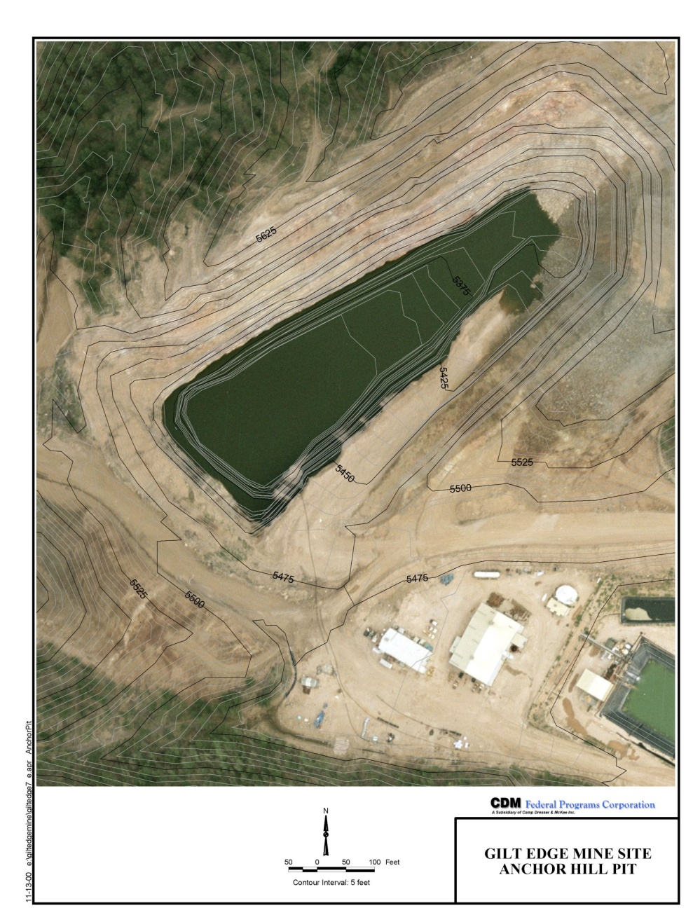
Anchor Hill Pit

Slide 43
NO3-NO2 and Dissolved Cu/Cd/Zn vs. Time
Notes:
pH came up three-tenths between 8/29 and 10/21

Slide 44
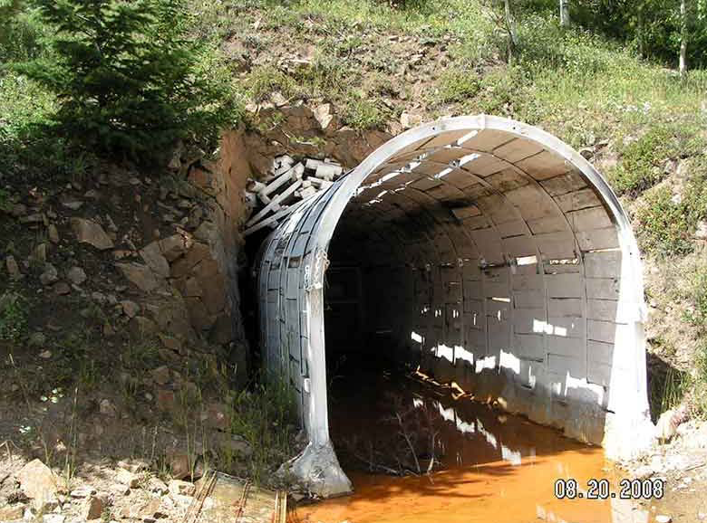
Captain Jack Mine
Left Hand Creek, Colorado
In Situ Mine-Pool Treatment
Big Fiver Tunnel

Slide 45

Mine Waste Remediation and Sediment Control
Clear Creek/Central City
Church Placer Repository

Slide 46


Pre-Remediation
Capping, cover and Revegetation - Woburn, MA
Post-Remediation

Slide 47

Anaconda Smelter Reclamation
Record of Decision (1998) specified in-place land reclamation for 11,600+ upland acres
  Design Specifications (2005-2006):
  in-place soil tillage for metals dilution (6, 12, 18”)
  amendments: organic matter and lime for pH adjustment
  coversoil or soil removal
  custom seed mixtures for soil conditions and land use

Slide 48



2011 Phytotoxicity Studies

Slide 49

Key Plant and Soil Relationships
Significant decrease in desirable species cover with increase in soil metal concentrations.

Slide 50



Need to Work in a 3-D World
Vulcan Software

Slide 51



Closures and Planning Using Vulcan

Slide 52
Future is Now - INTEGRATION
Do What You Can: basin wide approaches with water quality improvement in lower river segments as indicated by biological community + regulatory acceptance
Do it In Situ: In situ water treatment + 3D visualization + real time monitoring and maintenance
Do a better job:
  Risk assessments
  soil covers + species selection
  nonpoint contamination control
  water management, run-off/run-on and sediment control
  Monitoring and maintenance

Slide 53

Questions and Answers?

