Slide 1
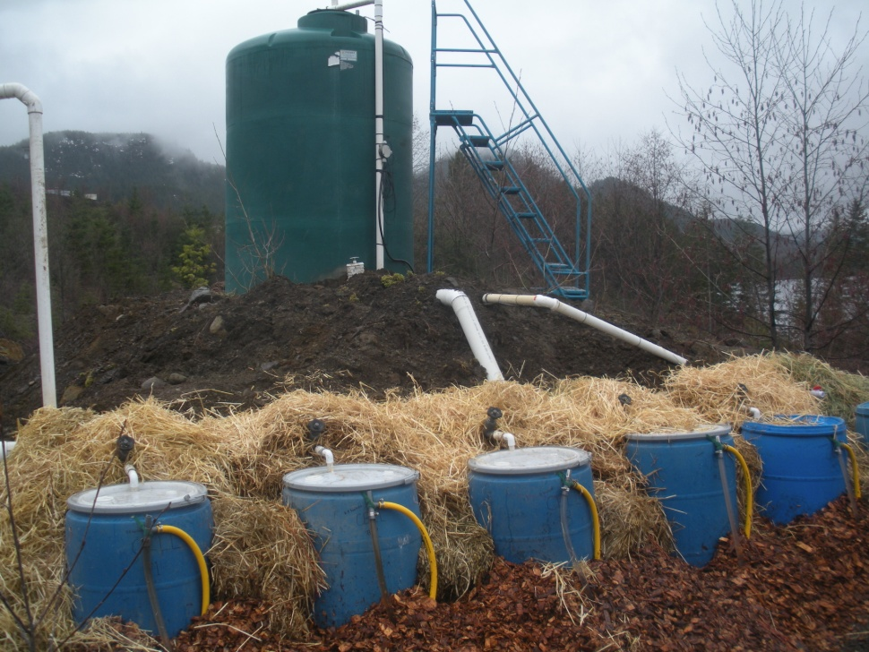
Results from a Bench Scale
Passive Treatment System
Designed for Removing Sulfate at a Site on Vancouver Island, BC
Presented by,
Eric Blumenstein, PE, Golder Associates Inc.

Slide 2
Presentation Overview
Site Location / Background
Desires / Needs of Site
Traditional Sulfate Removal Technologies
Biological Sulfate Removal
Bench Testing Construction (March 2011)
Bench Testing Results (Summer 2011)
Consideration for Demonstration System Design
Demonstration System Design Overview
Path Forward

Slide 3
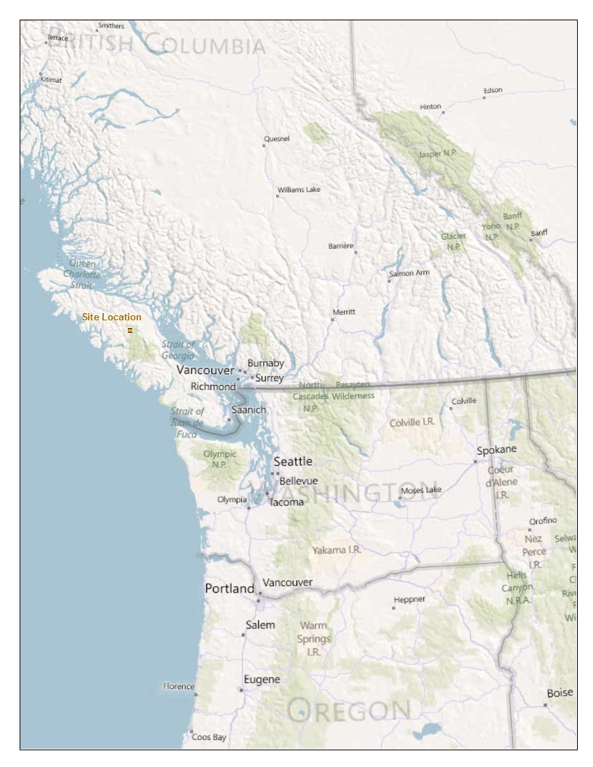
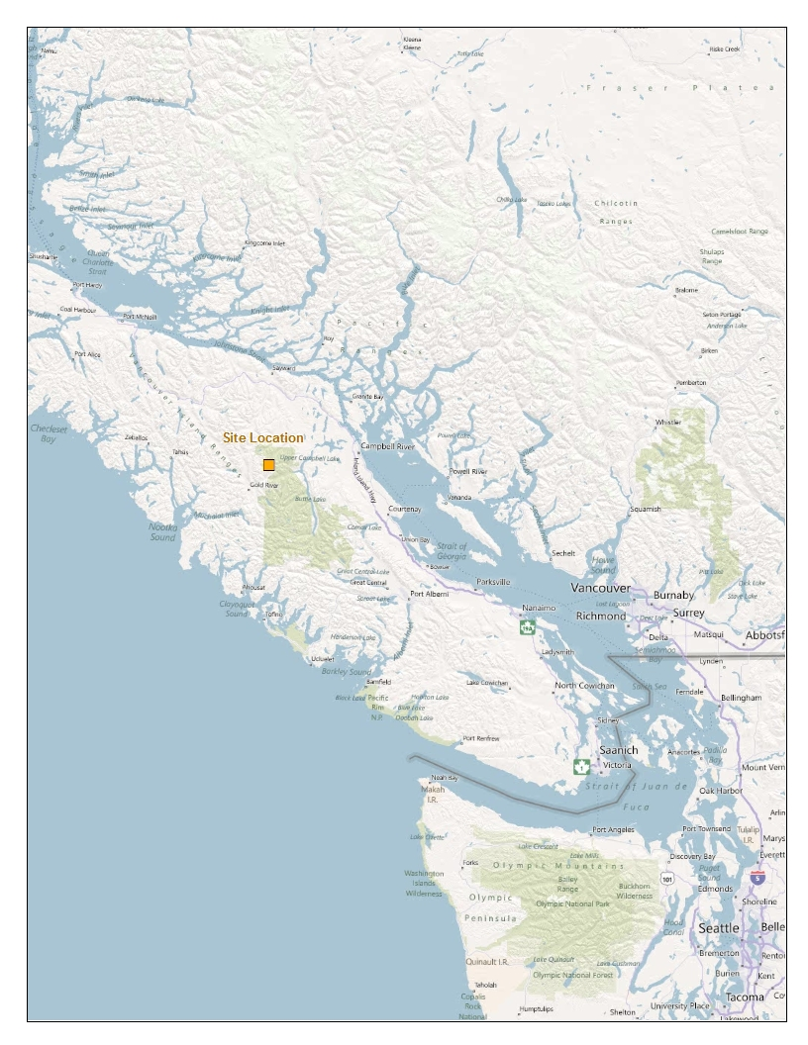
Site Location / Background / Needs
Underground coal mine
(not hard rock)
Active workings
Inactive workings
Seep into freshwater lake
Mining influenced water:
  Sulfate
  Iron
  Arsenic
Desire for:
  Low long-term operating and maintenance costs
  Operate in cool weather
  Fit on available land

Slide 4
SULFATE REMOVAL
TECHNOLOGIES

Slide 5
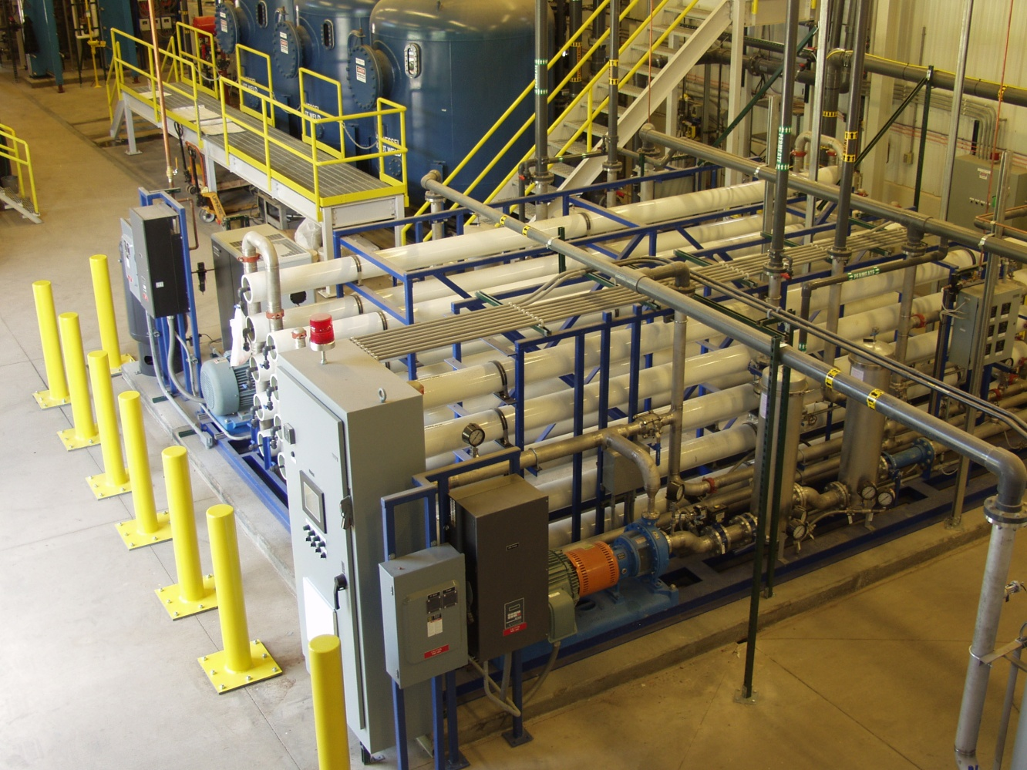
Traditional Sulfate Removal Technologies
Reverse Osmosis (RO) Membrane Filtration:
  Proven technology
  Capital cost
  Operating and maintenance cost
    Labor
    Chemicals
    Power
    Equipment maintenance
  Brine production / disposal

Slide 6
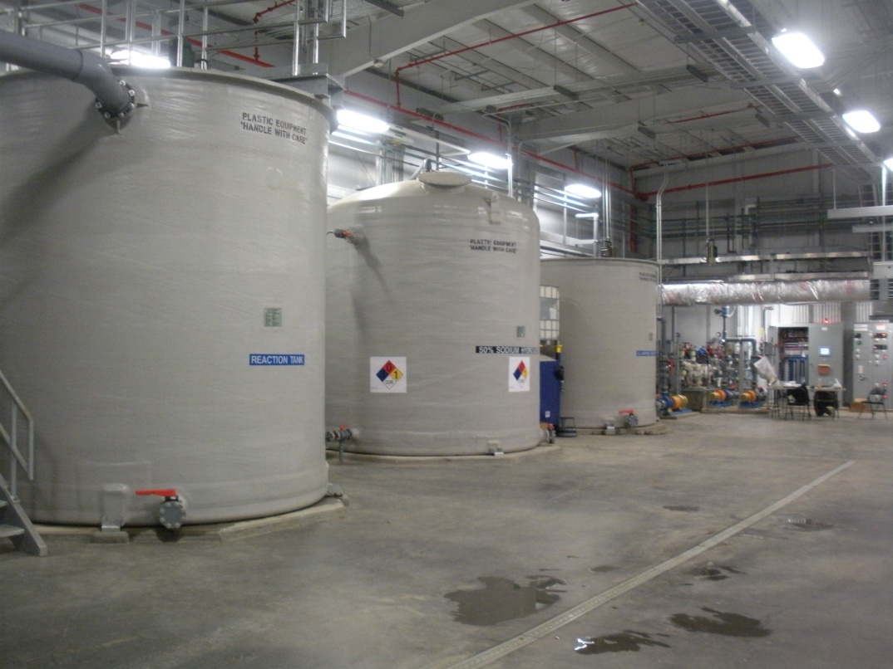
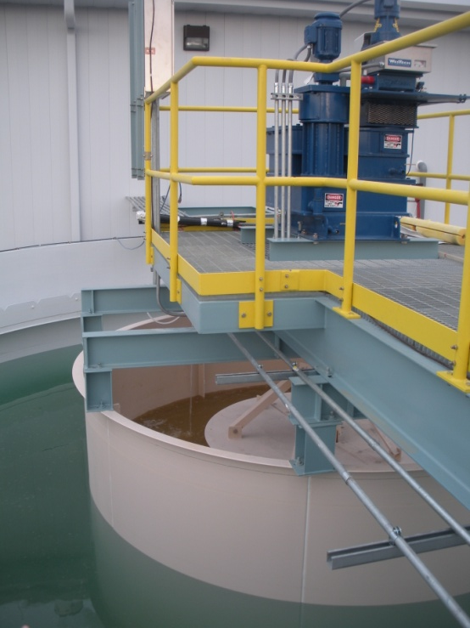
Traditional Sulfate Removal Technologies
Chemical Precipitation
  Barium chloride
  Lime
  Proven technology
  Capital cost
  Operating and maintenance cost
    Labor
    Chemicals
    Power
    Equipment maintenance
  Sludge production / disposal

Slide 7
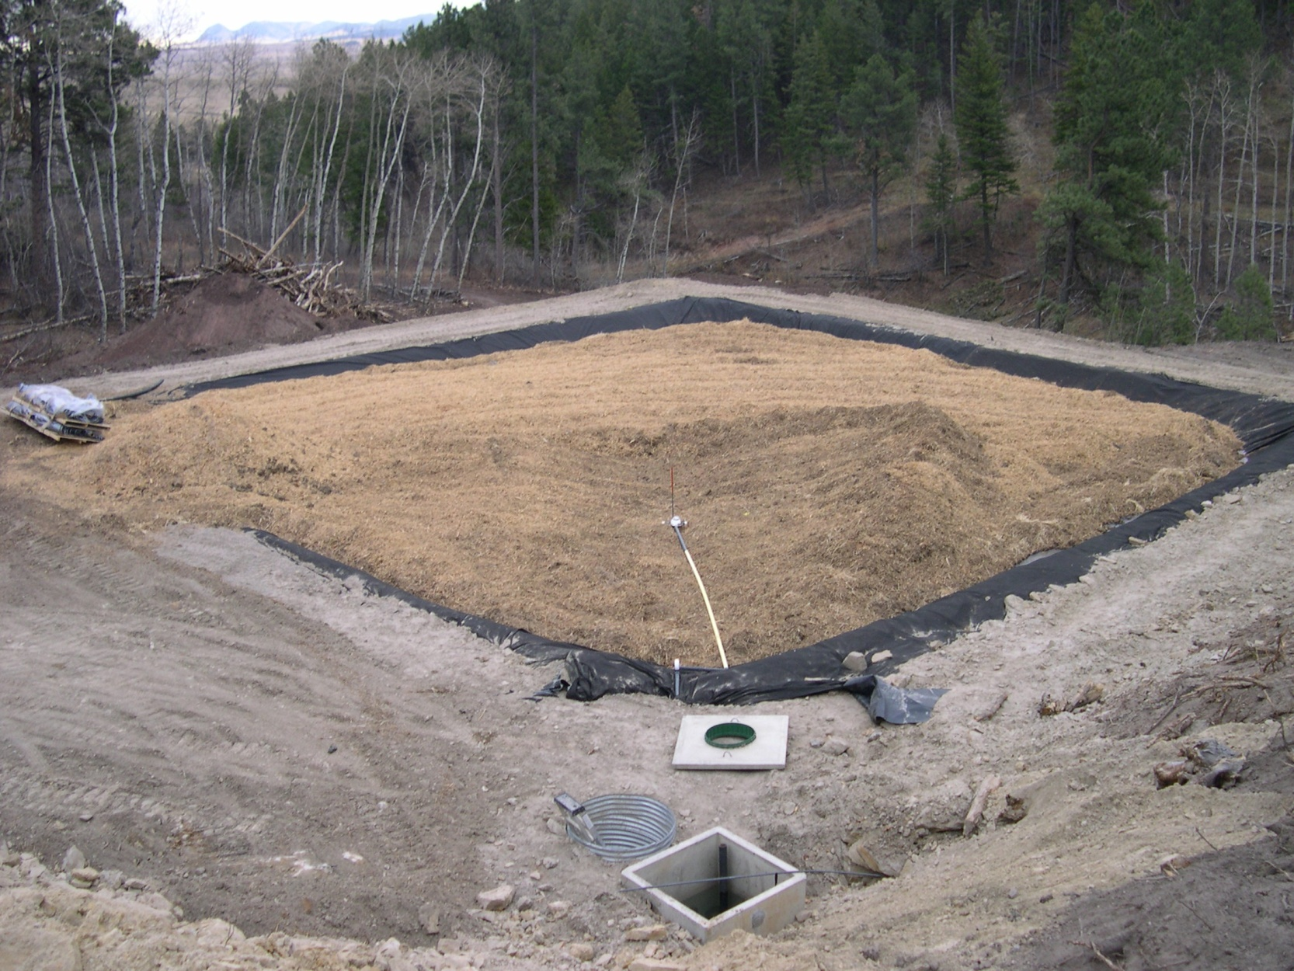
Potential New Sulfate Removal Technology
Biological sulfate removal:
  Active or passive
  Not a new concept
  Biochemical reactors (BCR):
    Sulfate reducing bioreactors (SRBR)
    Succesive alkalinity producing systems (SAPS)
    Reducing alkalinity producing sytsems (RAPS)
  Limitations:
    Sulfate reduction is limited by carbon availability
    Need to sequester reduced sulfate

Slide 8
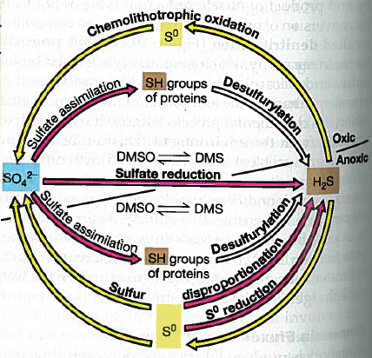
Potential New Sulfate Removal Technology
Sulfate biologically reduced to sulfide:
  Some sulfide forms metal precipitates (metal sulfides)
  Some adsorbs to surface area on substrate
  Some sulfide leaves the BCR as sulfide anion or hydrogen sulfide
Excess sulfide in BCR effluent can:
  Cause health and safety issue and
  Convert back to sulfate upon leaving cell and being re-oxidized
Brock Biology of Microorganisms, 10th Edition

Slide 9
Potential New Sulfate Removal Technology
Options for “sequestering” excess sulfide:
  Harvest reduced sulfate in BCR effluent (difficult to design and extensive O&M)
  Add source of sacrificial iron (sulfide anion binds to iron cation and form iron sulfide precipitate):
    Add iron prior to BCR
    Mix iron into BCR substrate
    Add iron to BCR effluent

Slide 10
BENCH SCALE
BIOCHEMICAL REACTOR CONSTRUCTION
March 2011

Slide 11
Bench Scale Design / Construction
CELL MIXTURES ON AN AS RECEIVED BASIS
Material | Cell 1 | Cell 2 | Cell 3 | Cell 4 | Cell 5
Wood Chips | 74.7% | 59.7% | 53.7% | 50.7% | 74.7%
Sawdust | 0% | 15% | 0% | 0% | 0%
Hay | 10% | 10% | 10% | 10% | 10%
Limestone Chips | 15% | 15% | 10% | 7% | 15%
Natural Iron Ore | 0% | 0% | 0% | 32% | 0%
Hedin Iron | 0% | 0% | 26% | 0% | 0%
Animal Manure (Inoculum) | 0.3% | 0.3% | 0.3% | 0.3% | 0.3%
Total | 100% | 100% | 100% | 100% | 100%
Logic | Baseline 1 Woodchips | Baseline 2 Woodchips + Sawdust | Hedin Iron Fe(OH₃) | Natural Iron Ore 40% Iron | Baseline 1 Woodchips

Slide 12
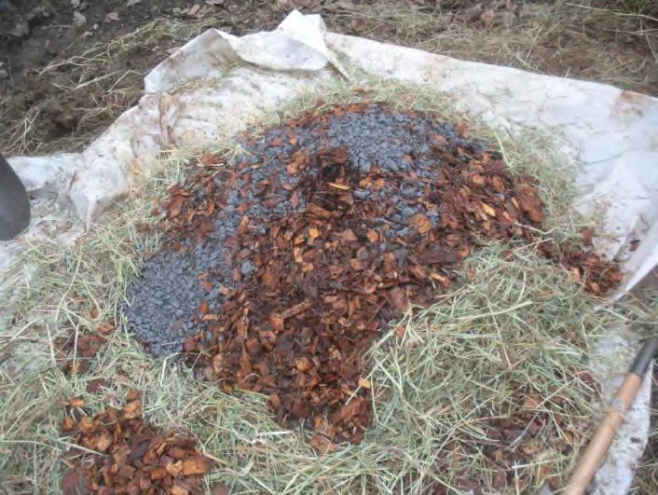
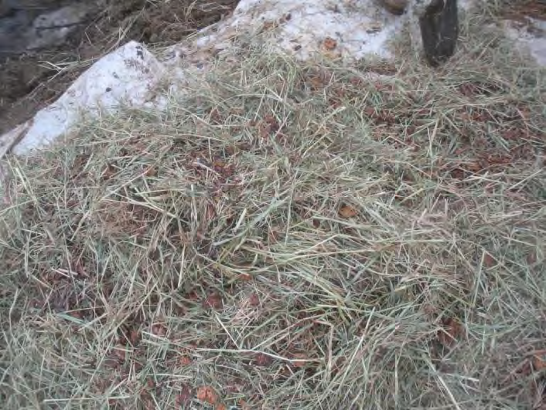
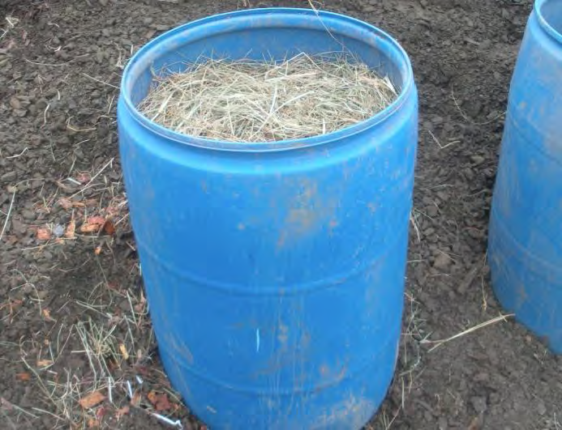
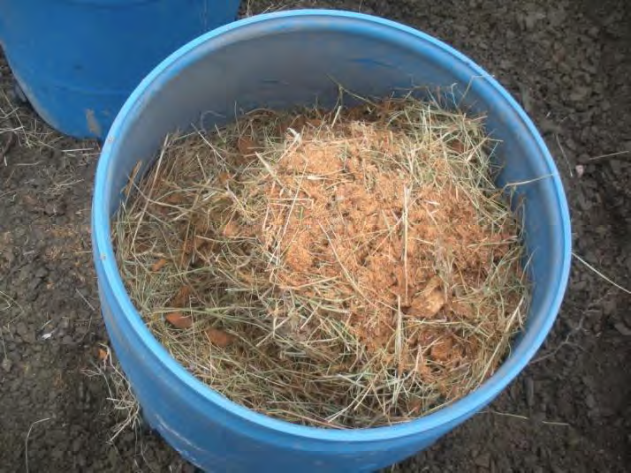
Bench Scale Design / Construction

Slide 13
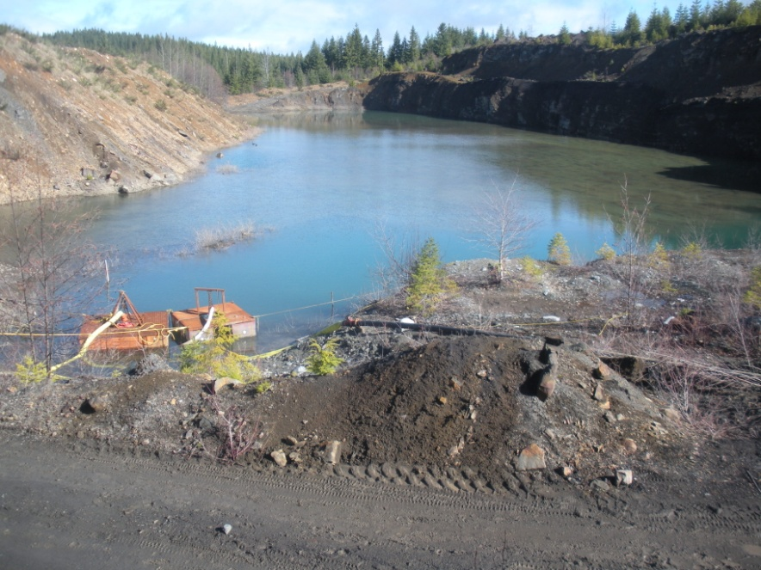
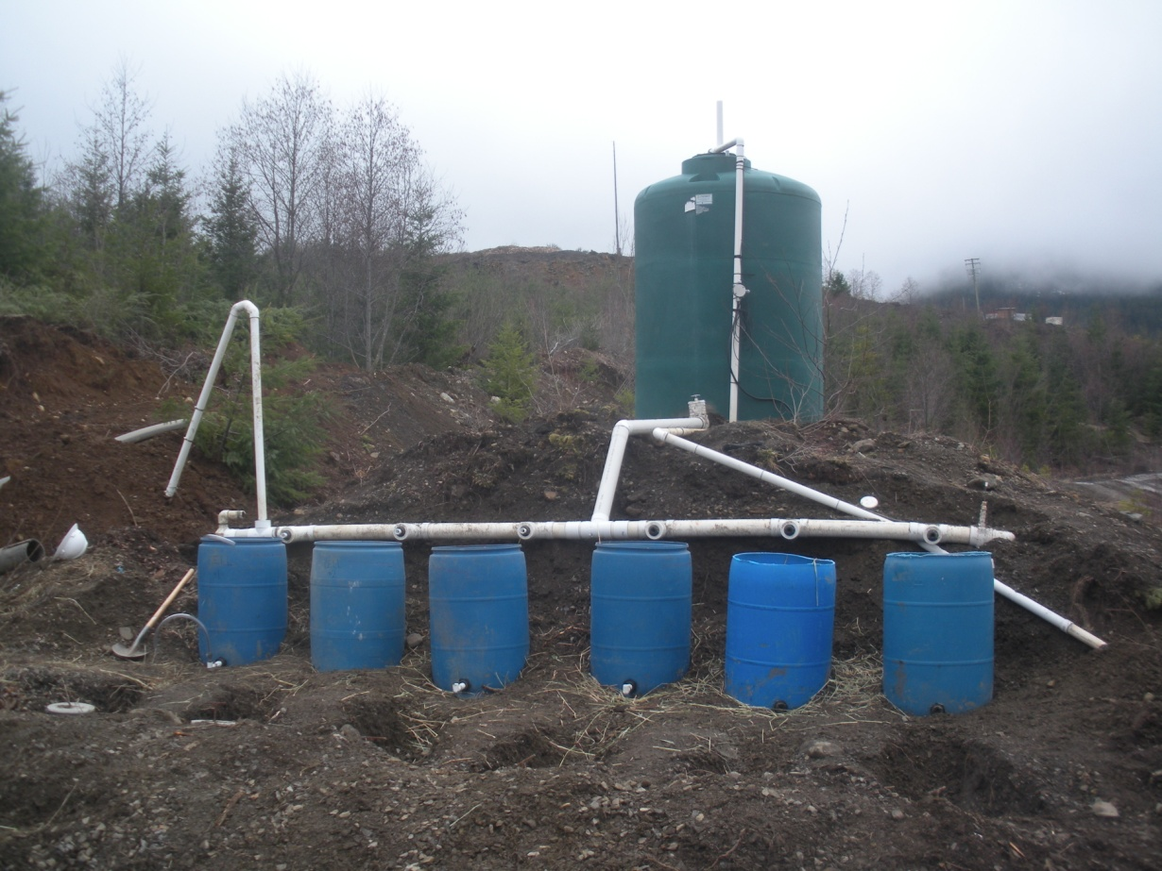
Bench Scale Design / Construction

Slide 14
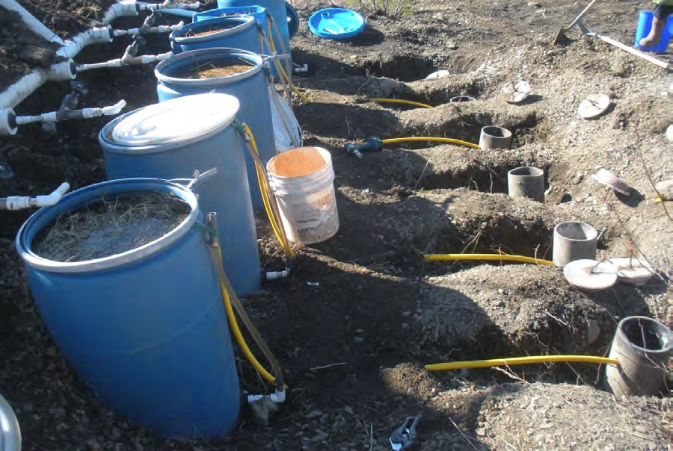
Bench Scale Design / Construction

Slide 15
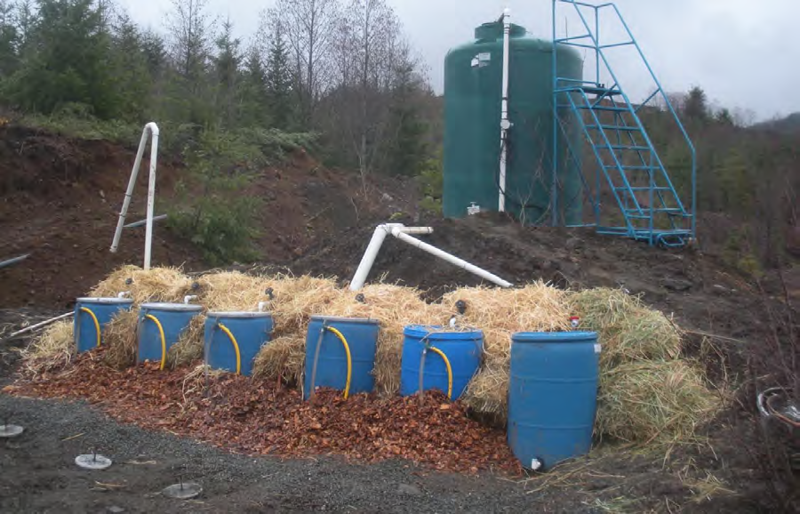
Bench Scale Design / Construction
BCR1
BCR2
BCR3
BCR4
BCR5
BCR6

Slide 16
BENCH SCALE
BIOCHEMICAL REACTOR
RESULTS
March – September 2011

Slide 17
Bench Scale Testing Periods
Initial Incubation Period (31 March – 6 April)
Primary Start-up Period (7 April – 12 May)
Second Incubation Period (13 May – 8 June)
Second Start-up Period (9 June – approximately 7 July)
Steady-State Operations (approximately 7 July – 1 September)

Slide 18
Bench Scale Results – Temperature

Slide 19
Bench Scale Results – pH

Slide 20
Bench Scale Results – ORP

Slide 21
Bench Scale Results – Flow Rate

Slide 22
Bench Scale Results – Alkalinity

Slide 23
Bench Scale Results – Sulfate (full test)

Slide 24
Bench Scale Results – Sulfate (steady state)

Slide 25
Bench Scale Results – Sulfate Reduction (full)

Slide 26
Bench Scale Results – Sulfate Reduction (steady state)

Slide 27
Bench Scale Results – Sulfide

Slide 28
Bench Scale Results – Biochemical Oxygen Demand (BOD)

Slide 29
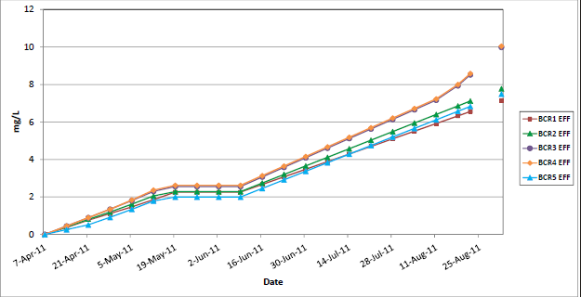
Bench Scale Results – Pore Volumes Treated

Slide 30
Bench Scale Results – Arsenic

Slide 31
Bench Scale Results – Iron

Slide 32
Bench Scale Results – Manganese

Slide 33
Bench Testing Conclusions
Each of the five BCR cells demonstrated that sulfate can be removed to the levels desired (>50% removal)
Each of the five BCR cells demonstrated sulfate removal at the maximum possible rate (0.20 mol/m₃/day)
When flow rate sent to BCR3 and BCR4 was doubled, sulfate removal also doubled (0.40 mol/m₃/day)
While BCR3 and BCR4 provided acceptable sulfide sequestration in situ, iron levels dropped throughout testing, leading to concerns about iron longevity (6 months – 3 years)
Because of a variety of nuisance parameters present in BCR effluent (BOD, TOC, arsenic, manganese, etc.), it is necessary to include an aerobic polishing step in a demonstration/full-scale system
Arsenic and manganese levels may increase in BCR cell, another reason why an aerobic polishing step is required
Maximum operational flexibility must be included (bypass piping)

Slide 34
DEMONSTRATION
SYSTEM
DESIGN
Fall 2011

Slide 35
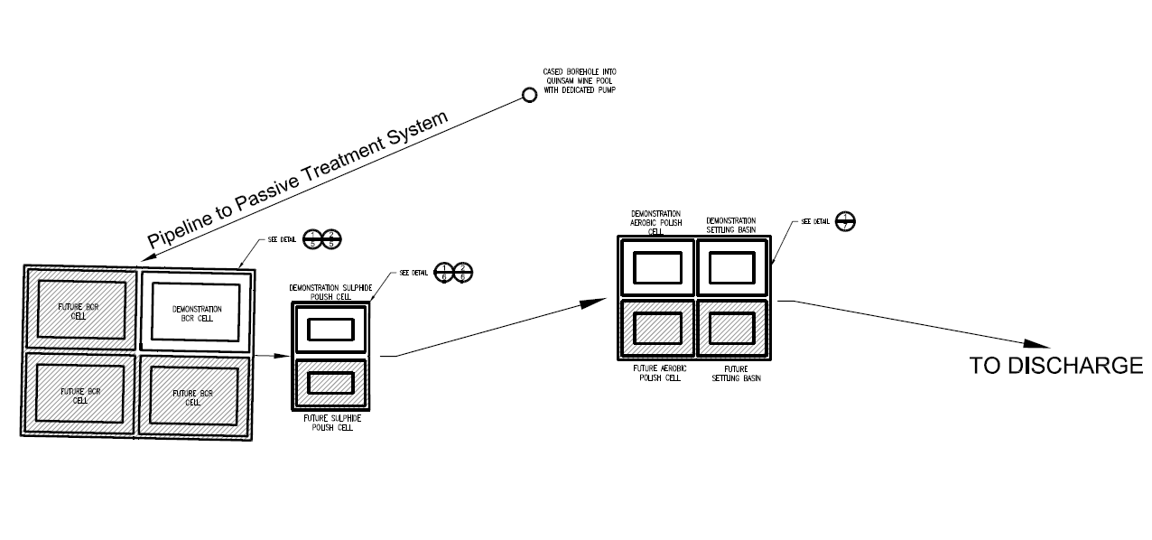
Demonstration System –
Flow Schematic

Slide 36
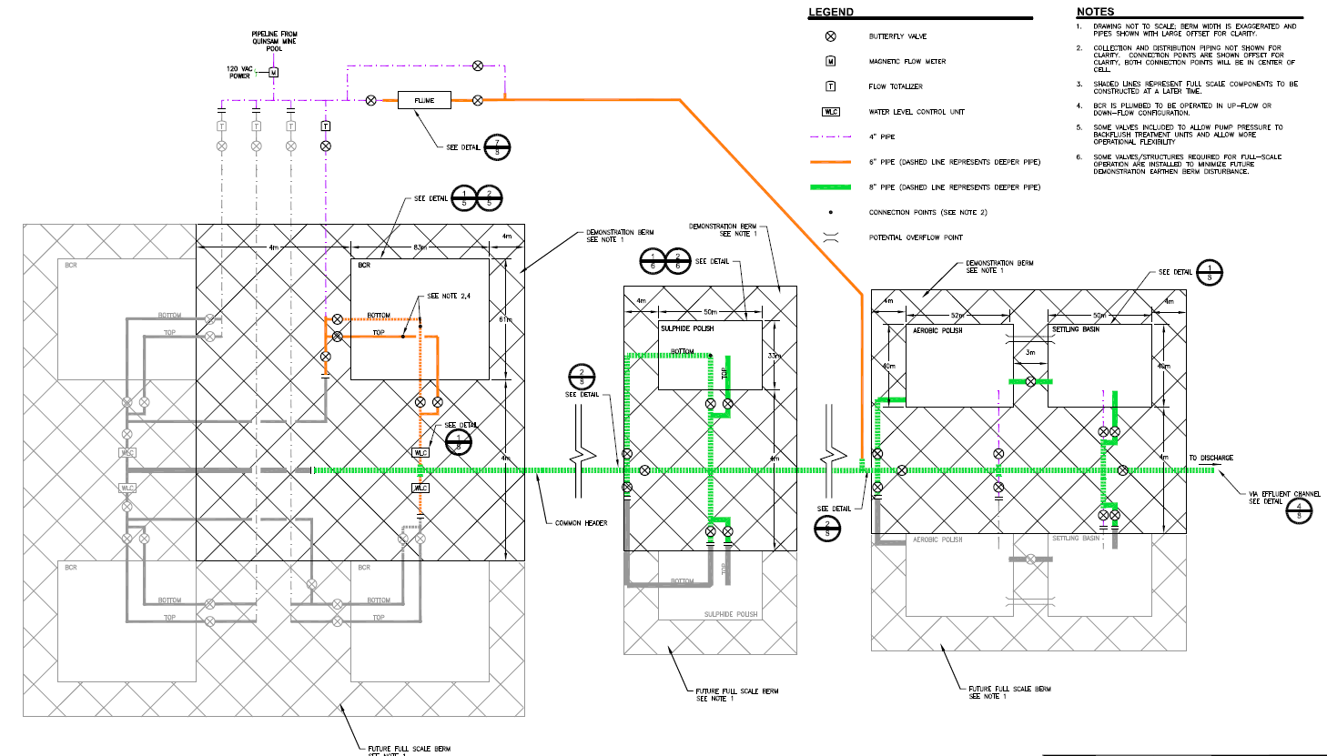
Demonstration System –
General Piping Arrangement

Slide 37
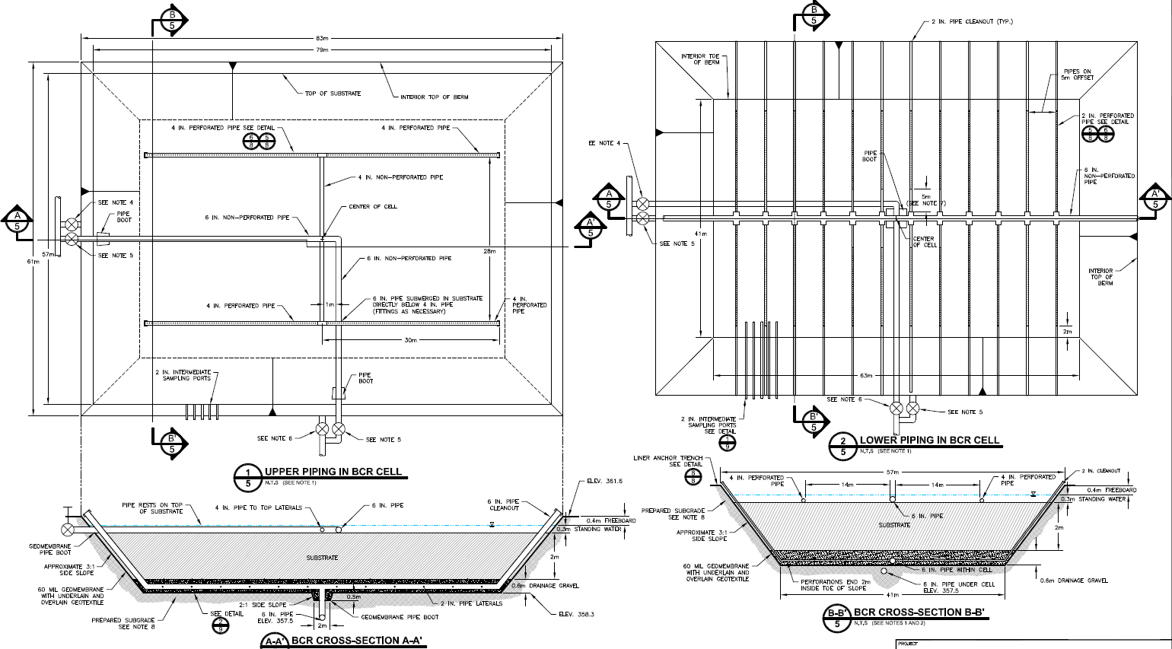
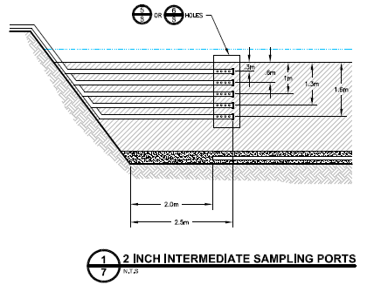
Demonstration System –
BCR Cell

Slide 38
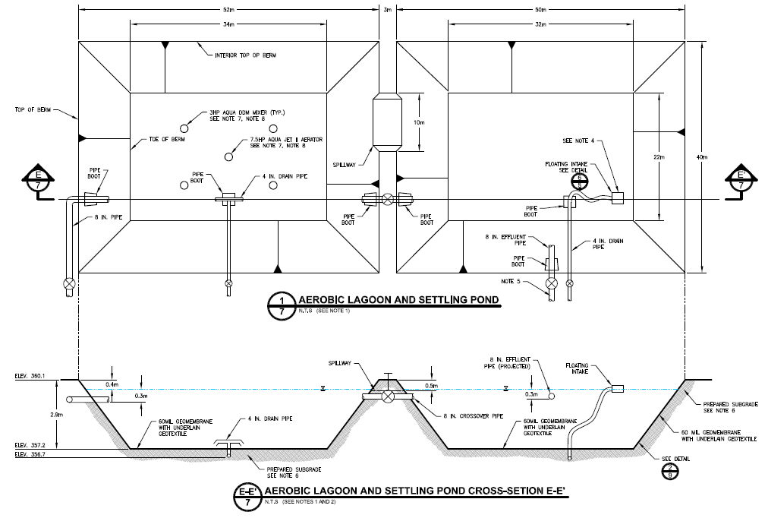
Demonstration System –
Aerobic Polishing System

Slide 39
Demonstration System –
Path Forward
Construction to begin in late April, complete in June
Incubation for two weeks during June
Begin minimum of one year demonstration testing period
Move forward to full-scale system (incorporating demonstration system)
Looking into testing / developing biological sulfate reduction process:
  Fully passive system (no pumping, passive aeration)
  Hybrid system (minimal power and O&M requirement)
  Fully active system (ICB fixed-film media with carbon/nutrient dosing)

Slide 40
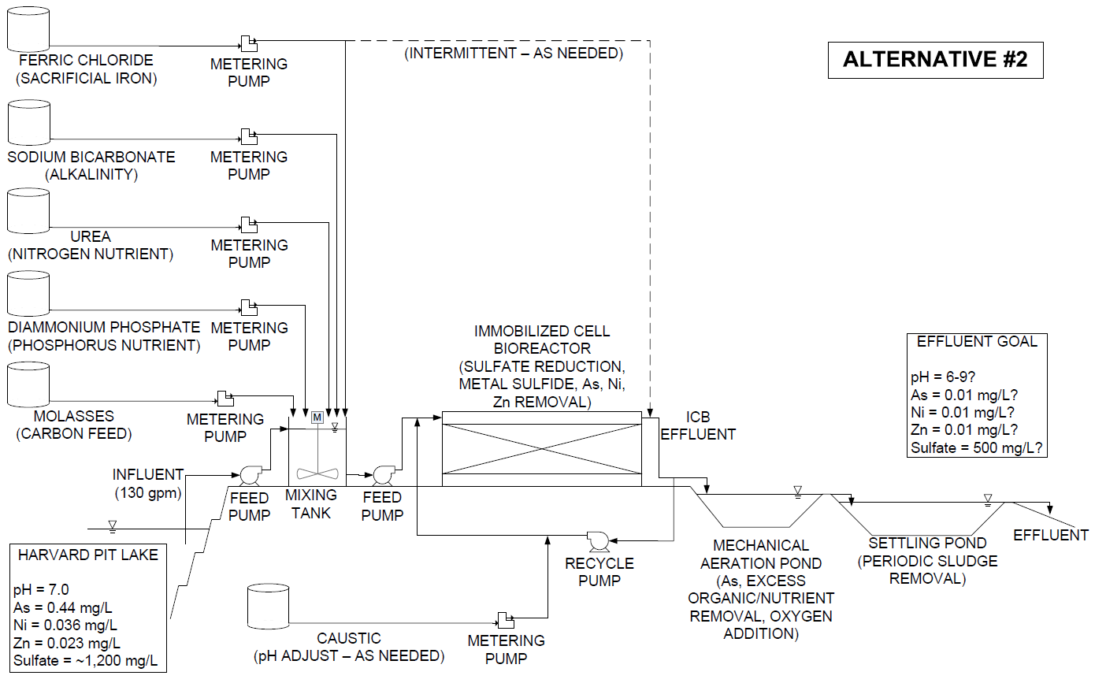
Future of Biological Sulfate Removal

Slide 41
THANK YOU!
Co-author Jim Gusek
eblumenstein@golder.com

