Slide 1
An Innovative Method for Mitigating Impacts from Acid-Producing Rock
By Jim Gusek, P.E. Golder Associates Inc.
Brian Masloff & John Fodor, Cellular Concrete Solutions LLC

Slide 2
Acid Rock Drainage

Slide 3
Overview of Best Practice Methods
Early avoidance of ARD problems is a best practice technique that is integrated into mine planning, design and waste mgt strategies
REF: GARD Guide 2010
www.gardguide.com
Sources
Intervention
Measure
Performance
Vertical Pathway
Receptors
Groundwater Perspective
Pathways

Slide 4
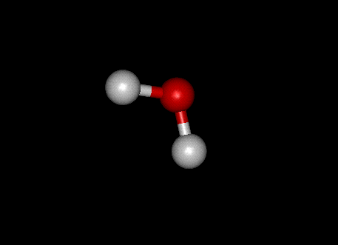
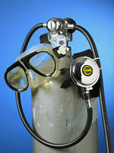
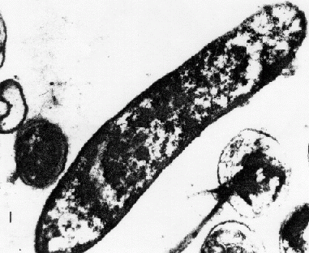
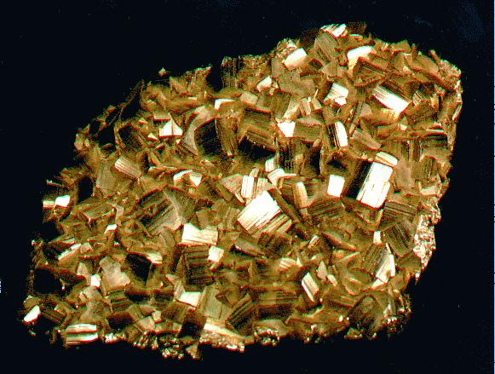
Acid Rock Drainage Tetrahedron
Fuel
Water
FIRE
Air
Heat
ARD
Oxidizer
(Air, Fe⁺³)
Bacteria
Pyrite

Slide 5
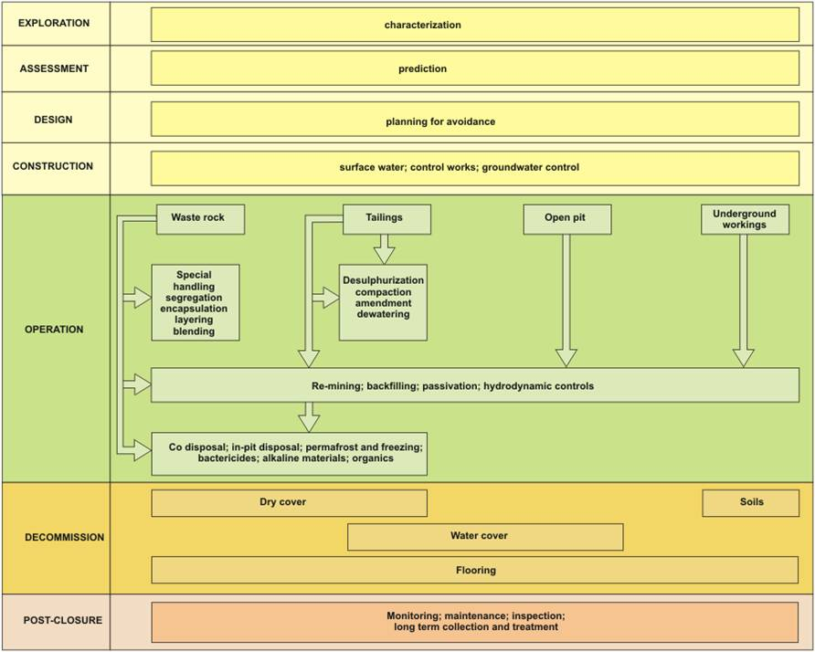
ARD Mitigation Framework
REF:
GARD Guide
2010
Also see:
Coal Mine Drainage Prediction and Pollution Prevention in Pennsylvania; Brady et al., 1998
Planning for avoidance
Passivation
Co-disposal, in-pit disposal… bactericides, alkaline materials, organics

Slide 6
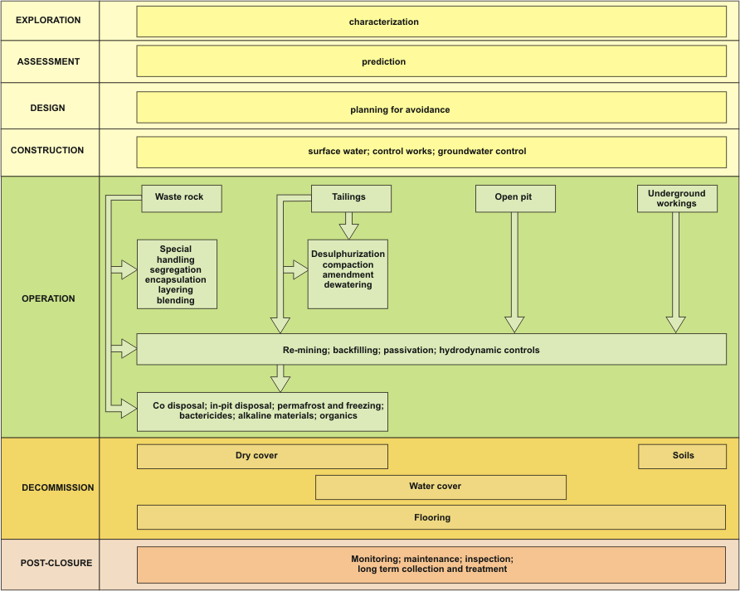
Best Practice Methods (1)
Best Practice Methods - Avoidance
Avoidance
Special handling methods
Incorporate into mine plan
Segregation
Tailings desulphurization
Compaction and conditioning
Encapsulation and layering
Blending
Co-disposal
Permafrost and Freezing
Re-mining; backfilling; passivation; hydrodynamic controls
What about abandoned mines?
REF: GARD Guide 2010

Slide 7
Best Practice Methods
Best Practice Methods (Decommissioning)
Dry Cover Methods
Soil
Alkaline
Organics
$ynthetics
Gas barriers
Vegetation
Landform design
Water Cover Methods
Subaqueous disposal
Partial water cover
Wetland covers
Attenuation
Stream flow regulation
Water recycle and reuse
Re-mining; backfilling; passivation; hydrodynamic controls
REF: GARD Guide 2010

Slide 8
Best Practice Methods (2)
Best Practice Methods- Passivation
Additions and Amendment Methods
Passivation
Alkaline materials
Organics
Bactericides (Brady, Ch. 15)
Water Management Methods
Hydrogeological & Hydrodynamic Controls
Dewatering
Diversion
Flooding
Seals
???
Re-mining; backfilling; passivation; hydrodynamic controls
How do you to implement these methods at abandoned mines?

Slide 9
THE REAL PROBLEM: A Medical Analogue
ARD is a global bacterial infection.
There are plenty of geo-antibiotics available but the current situation is akin to the patient taking a shower with Tums dissolved in orange juice - not very effective or practical.
What’s needed is a mining-analogue to an I-V drip of tetracycline and/or oral antibiotics.
And then there’s the question: Do we need to Vaccinate or Medicate?
What is currently available in the ARD prevention “pHarmacy”?

Slide 10
Known bactericides
Sodium lauryl sulfate (EPA-endorsed)
Alkyl-benzene sulfonate (laundry soap)
Waste milk (bacteria out-complete acido-thiobacillus)
Sodium Thiocyanate (NaSCN)
Bi-Polar Lipids
Note: We need to consider the physics of delivering and distributing a weak bactericide solution into a porous, unsaturated medium (it’s been done, but it wasn’t easy)

Slide 11
Cheap alkalinity (acidity)
Limestone (quarried) – crusher fines?
Dolomite
Lime kiln dust or cement kiln dust
Steel slag
Sodium bicarbonate
Note: We need to consider the physics of delivering and distributing a solid into a porous unsaturated medium

Slide 12
Cheap organics (oxygen)
Sawdust (the finer, the better)
Paper (newsprint, office waste [shredded])
De-inking residue
Biosolids
MicroCgTM, LactoilTM, others?
Note: We need to consider the physics of delivering and distributing a solid into a porous, unsaturated medium

Slide 13
Passivation coatings (oxygen)
Keeco Mix (micro-silica)
Potassium permanganate (Glen Miller, UNR)
Oil and latex based paint
Potassium humate (commercial agricultural amendment)
Others?
Note: We need to consider the physics of delivering and distributing a coating into an unsaturated porous medium

Slide 14
One Particular Problem
Treating existing waste rock dumps
Deliver bactericides without complete flooding of waste rock mass
Focus the delivery of alkalinity in the “hot zones”
Deliver organics in hot zones and without complete flooding

Slide 15
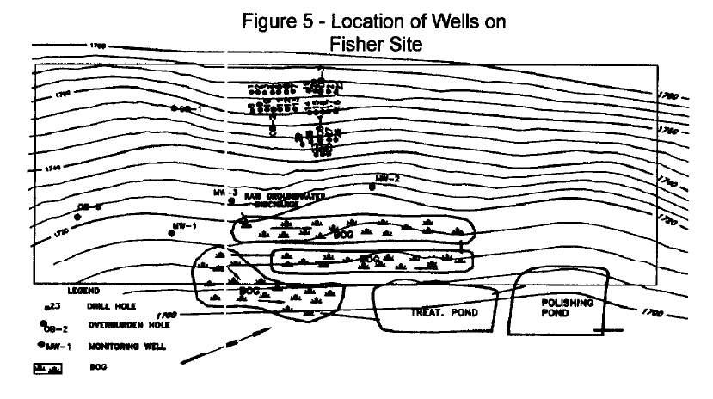
Has it been done before?
Fisher Coal Mine, PA – 1995 Vapco Engineering
Geophysics targets 3 ARD–generating zones
Multiple injection boreholes on a tight spacing
Injection of 20% NaOH solution simultaneously into 12 shallow (3 m deep) boreholes with packers
Injection of 2% sodium lauryl sulfate bactericide
Seepage continues to be net alkaline 16 years later, bond release is reportedly imminent

Slide 16
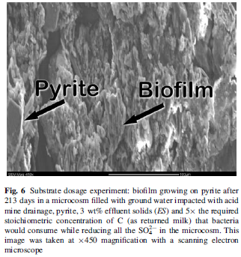
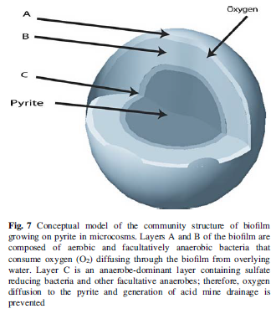
Has it been done before?
Sesquatchie Coal Mine, TN – 2008 Western Research Institute
Geophysics used to target ARD
Two doses - drip application of waste milk and biosolids (as inoculant)
Seepage reportedly net alkaline after four years.
Patent issued January, 2012
Check out ITRC website
Ref: Jin et al., 2007
http://www.itrcweb.org/miningwaste-guidance/cs31_sequatchie.htm
THERE HAS TO BE A BETTER WAY

Slide 17
Perhaps a better way:
Use engineered FOAM as a delivery medium for bactericide “cocktail”
Use waste milk (biocide) in the liquid phase
Use sodium lauryl sulfate (bactericide) as part of the surfactant mix
Add powdered limestone for alkalinity
Add paper, sawdust, or biosolids as the organic (hoof & horn protein surfactant too)

Slide 18
Perhaps a better way:
Use engineered FOAM as a delivery medium for bactericide “cocktail”
This process is very similar to pressurized grouting, only the grout mass is mostly gaseous, engineered to be temporary, and designed to deposit a coating of active ingredients

Slide 19
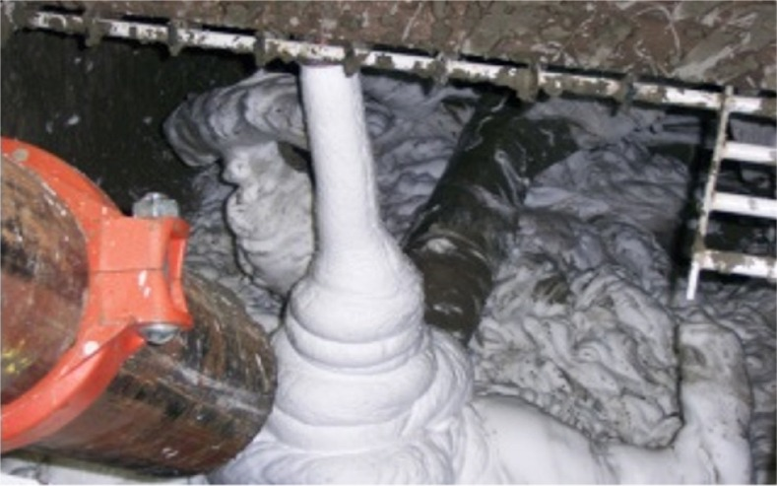
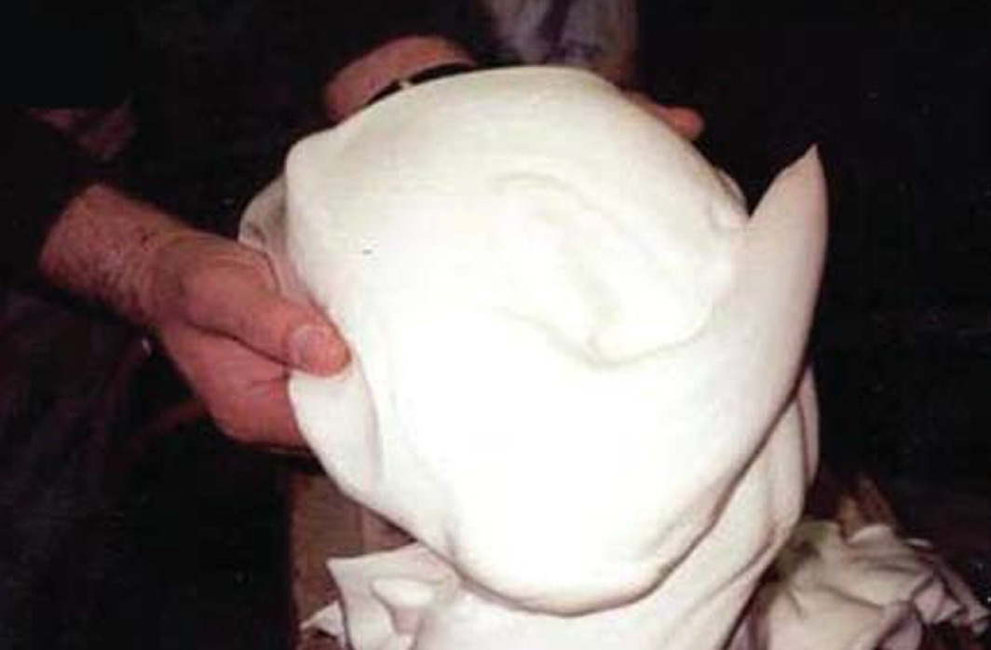
Foam Characteristics (Think shaving cream – a LOT of it)
Two-phase “colloid”, the gas phase is separated by a liquid phase
Foam can contain a third phase – suspended solids
“Dry” foam (e.g., shaving cream)
“Wet” foam (e.g., hand soap)

Slide 20
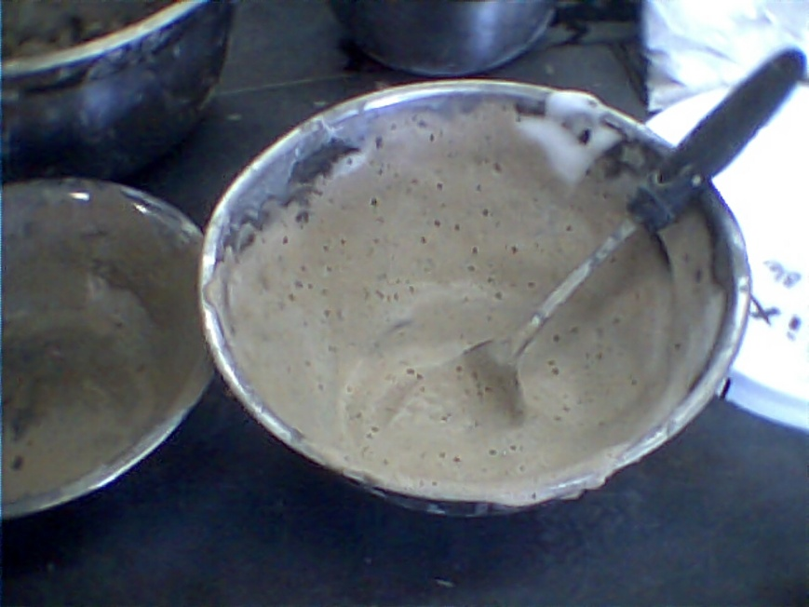
Adding pHoamTM containing powdered limestone to gravel in the lab

Slide 21
Recent Experiments in the Laboratory
Limestone-Coated Gravel

Slide 22
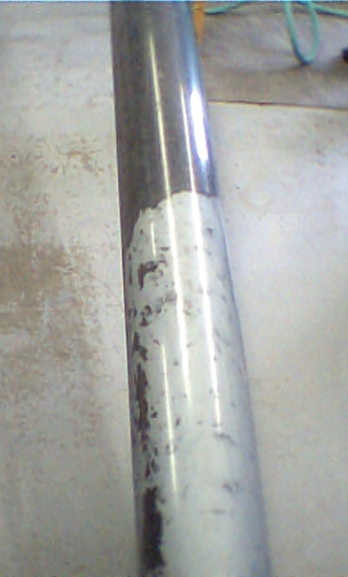
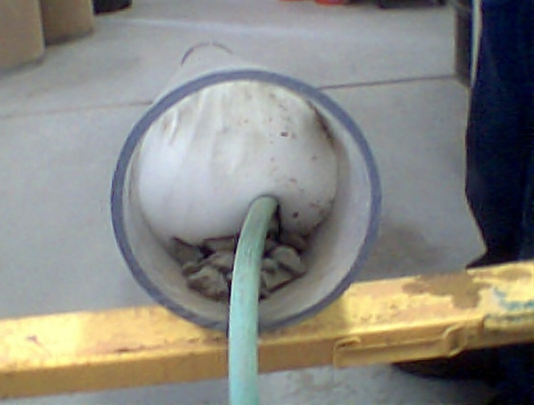
Recent Experiments in the Laboratory
Garden hose tremmie pipe

Slide 23
What’s the difference between foam and pHoamTM ???
pHoamTM is a mixture of traditional foam plus one or more “active ingredients” that induce a desirable biological, geochemical, or process-related reaction
or
Foam + active ingredients that suppress an undesirable reaction.

Slide 24
Some Potential Application Concepts
Vaccination (Prevention) | Medication (Mitigation)
Waste rock dumps at active mines (“sterilize” ARD rock by the truckload before it is placed in the dump) | Small-scale “dog hole” abandoned underground mines that produce ARD
Active coarse coal refuse piles (sterilize refuse by adding a “wet” pHoamTM in the feed hopper of a conveyor belt) | Waste rock dumps or coarse coal refuse facilities at abandoned mines (even if they are capped)
Active tailings storage facilities (sterilize the cycloned coarse tails in the embankment – the material most likely to form ARD before capping and revegetation) | Abandoned underground mine stopes (use geophysics for targeting and inject pHoamTM through bore holes) – use mine fire/foam equipment?
Active underground mine stope backfill materials | Backfilled pits (coal or metal) that are poorly capped

Slide 25
Application Concept: Mine Dumps
Waste Rock Dump = Big Humidity Cell

Slide 26
Application Concept: Mine Dumps
Waste Rock Dump

Slide 27
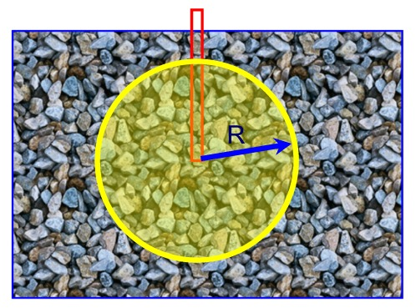
pHoam injection kinetics - theory
Assumed injection conditions: 29% voids, pHoam injected at 3.7 cy/min (100 cfm)

Slide 28
Application Concept: Mine Dumps
Injection Borehole
After G.W. Wilson, 2008

Slide 29
The “Heat-Seeking Missile” Effect in ARD Suppression
Pyrite oxidation is exothermic
If a pHoamTM encounters a “hot zone” with elevated pyrite, the bubbles should collapse and preferentially deposit the “active ingredients”
This feature could potentially give pHoamTM a “heat-seeking missile” capability that could automatically deliver more ARD-suppressing active ingredients to a mine waste site in the zones where it is needed the most.

Slide 30
Implementation Concepts
pHoam injection system layout is simple

Slide 31
Teaming Partners
Golder Associates Inc.
Water Treatment and Geochemistry Groups
Colorado School of Mines Chemistry Dept.
Golder Construction Division
Cellular Concrete Solutions LLC (CCS)
Site owner/operator or interested entities like watershed groups

Slide 32
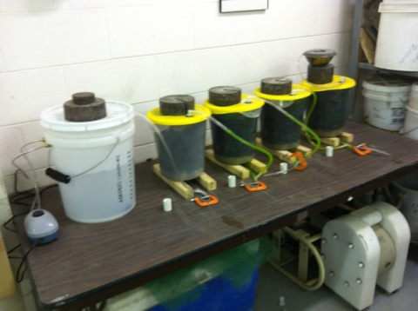
Development Steps
Initial patent filing (16 August 2011)
Initial demo – injecting into a gravel-filled pipe (done)
Lab Testing (4Q 2011 to 2Q 2012)
Entity provides pyrite waste rock dump samples (done)
CCS treats samples with foam & amendments (done)
Golder/CCS conducts humidity cell tests in-house (ongoing)
CCS evaluates foam flow through porous medium (gravel) [planned]
Demonstration Site (injecting into a real dump) 3Q 2012
Monitor demo site Q4 2012 and beyond

Slide 33
What about CO$T$????
Need to do comparison with perpetual ARD treatment (either active or passive technologies) or other remedies
We have a cost model but it has not been validated/ calibrated, so we need demonstration sites
Example: to perpetually treat ARD from a 73 hectare waste rock dump in Western USA would cost about $US 30 million. If one assumes that only 25% of the total dump volume would accept or require pHoamTM, the treatment cost is on the order of $US 15 million.
Longevity of the treatment is a big issue. The non-pHoamTM treatment at the Fisher Coal Mine in 1995 with NaOH and bactericide is still effective after 16 years.

Slide 34
What about CO$T$????
Our cost model is appears to be most sensitive to the cost of solid active ingredients and the surfactant.
Even a minor credit for disposal of a local waste (e.g., biosolids) could result in a break-even condition.
Without the credit, cost of treatment might be less than $1.00 per ton of rock to a fraction of that, depending on whether the rock is “vaccinated” or “medicated”.

Slide 35
Ideal pHoamTM Demonstration Site
Has re$earch funding available
Contains mine waste that is fully characterized, mapped, and is acid-generating
Is relatively small in scale (1 to 2 acres) (<1Ha)
Is relatively accessible by conventional construction equipment
Is amenable to “dissection” after pHoam application
Has documented ARD impact
Is on publicly-owned land (USFS, USBLM, USEPA Superfund)
Is not a part of or contingent upon ongoing litigation

Slide 36
WHY IS pHOAMTM SO SPECIAL?
Uses very little water
Flexible design (wet/dry/stiff/flow-able)
Flexible longevity (hours to days)
Flexible active ingredients for suppressing ARD – whatever is inexpensive locally
Easy to manufacture with traditional equipment
Heat-seeking missile effect
Pumpable or flow-able
Biodegradable surfactants can double as bactericides
Permeates unsaturated zones of mine waste to deliver anti-ARD “cocktail” that could last for decades, maybe longer

Slide 37
Thank You
Nihil simul inventum est et perfectum
Latin Proverb
jgusek@golder.com
or
ddunham@cellularconcretesolutions.com

Slide 38
Thank You
Nothing is invented and perfected at the same time
Latin Proverb
jgusek@golder.com
or
ddunham@cellularconcretesolutions.com

