Slide 1
The Biotic Ligand Model: Unresolved Scientific Issues and Site- and Species-specific Effects on Predicted Cu Toxicity
Jeffrey Morris,¹ Ann Maest,¹ Alison Craven,² and Joshua Lipton¹
¹ Stratus Consulting Inc.
² University of Colorado-Boulder
Boulder, CO
EPA Hardrock Mining Conference 2012: Advancing Solutions for a New Legacy
Denver, CO
April 4, 2012

Slide 2
Background
The Biotic Ligand Model (BLM) is used to evaluate the site-specific toxicity of copper to aquatic organisms
Can be used to develop site-specific water quality criteria (EPA, 2007)
Ongoing investigations into different aspects of the Cu-BLM: geochemical, biological
Current research: quantifying Cu-organic carbon complexation in low hardness waters and subsequent implications for predicting fish toxicity using the BLM

Slide 3
Presentation Outline
Overview of BLM
Site-specific Cu-binding studies and metal-DOM binding
Cu toxicity in low-hardness waters
Approaches to incorporating Cu binding constants of “biotic ligands” into BLM

Slide 4
BLM: Background
Water quality criteria for Cu (and many other metals) expressed as a function of hardness.
Increased hardness => decreased toxicity => higher WQC
Observed in many controlled experiments
Well understood that Cu toxicity to aquatic biota is affected by other constituents in water
Dissolved organic carbon has been found to reduce Cu toxicity
BLM developed to numerically address the influence of multiple chemical factors on Cu toxicity

Slide 5
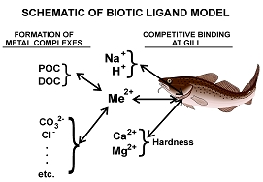
BLM: Conceptual Model
Cu speciation/sorption to gill binding sites (“biotic ligand”) affects bioavailability and toxicity
L_{BL}
http://www.hydroqual.com/wr_blm.html

Slide 6
BLM: Conceptual Model (cont.)
BLM: predict concentration of dissolved Cu that would cause toxicity to aquatic biota over a range of water quality conditions
BLM uses “lethal accumulation” on gill to estimate toxicity
Three elements of model
Geochemical speciation code CHESS (Santore and Driscoll, 1995)
Calculates inorganic metal speciation
WHAM V model (Tipping, 1994)
Calculates degree of metal-organic interaction
Biotic ligand (e.g., fish gill) binding constant (Di Toro et al., 2001)
Geochemical Speciation
Metal-organic Interactions
Binding to fish gill

Slide 7
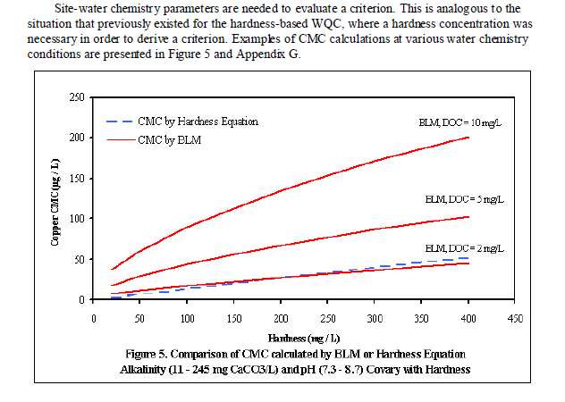
BLM Illustration: Acute WQC in the Presence of DOC

Slide 8
Evaluating Cu-Organic Complexation in a Low-hardness Stream

Slide 9
Site-specific Cu Binding Studies
Purpose: Evaluate Cu binding properties of ambient DOM
Performed laboratory studies of site-specific Cu binding in low-hardness waters
Finding: Stream DOM had less ability to complex Cu than calculated by the BLM

Slide 10
Methods
Isolated DOM from three low hardness headwater streams in AK
Cu-ISE titration
Fit to a 2-ligand model
CLE-SPE (competitive ligand exchange-solid phase extraction)
Environmentally relevant [Cu]
Used MINTEQ and empirically derived “effective log K” to estimate free Cu²⁺
Compared to BLM free Cu

Slide 11
Ambient Water Quality
pH: 7.1–7.6
Alkalinity: 13.5–33.9 mg/L as CaCO₃
Hardness: 13.4–28.4 mg/L as CaCO₃
Dissolved Cu: 0.2–1.3 μg/L
DOC: 1.3–2.2 mg/L

Slide 12
Results: Titration and CLE-SPE
“Effective log K” (net Cu complexation) of site waters a function of Cu:DOM ratio
Increasing Cu relative to ambient DOM results in lower log K

Slide 13
Comparison with Other Studies
This Study

Slide 14
Site-Specific Cu Binding Summary
Cu-organic binding a function of relative amounts of Cu and DOM present – net affinity changes as more Cu is added
Distribution of binding sites in DOM
High affinity (high log K) sites less abundant than lower affinity sites
As Cu concentrations increase, progressive shift to binding with lower affinity sites
Cu:DOM ratio is important in predicting complexation

Slide 15
Modeling Free Cu: Empirical Data

Slide 16
Modeling Free Cu: Comparison to BLM

Slide 17
Adjusting DOC Concentrations in BLM to “Match” Empirical Data
Previous authors (De Schamphelaere et al., 2004; Welsh et al., 2008) proposed adjusting DOC concentration (input to BLM) to match Cu-DOC complexation toxicity results
Adjustment factor of 2 used
This study: adjust [DOC] from 2.2 mg/L to approx. 0.3 mg/L to match experimental data
Adjustment factor of approximately 8
Notes:
De Schamphelaere, K.A.C., Vasconcelos, F.M., Tack, F.M.G., Allen, H.E., Janssen, C.R., 2004. Effect of dissolved organic matter source on acute copper toxicity to Daphnia magna. Environ. Toxicol. Chem. 23, 1248–1255.
Welsh, P.G., Lipton, J., Mebane, C.A., Marr, J.C.A., 2008. Influence of flow-through and renewal exposures on the toxicity of copper to rainbow trout. Ecotoxicol. Environ. Saf. 69, 199–208.

Slide 18
Adjusting DOC Concentrations

Slide 19
Implications: Estimating Cu Toxicity with Adjusted DOC
~5-fold reduction in effects concentration

Slide 20
Summary of Cu Binding Results
BLM under-predicted free Cu compared to site-specific estimates
Needed to lower DOC in BLM to attain same free Cu results – similar findings to other researchers (e.g., De Schamphelaere et al., 2004; Welsh et al., 2008), but somewhat greater magnitude of adjustment
Results in a ~ 5-fold decrease in instantaneous WQC compared to BLM

Slide 21
Other Issues: Modeling Cu in Low Hardness Waters?
Ran series of BLM simulations to further evaluate implications of Cu-DOC complexation in low hardness waters
Used site-water data as base water quality
Temperature = 19°C
pH = 7.13
DOC = 2.17 mg/L (HA = 10%)
Ca, Mg = 4.09, 1.1 mg/L (hardness = 14.7 mg/L CaCO₃)
K = 0.1 mg/L
SO₄ = 1.7 mg/L
Cl = 0.5 mg/L
Alkalinity = 22.3 mg/L CaCO₃
S = 0.001 mg/L (default, non-functional)

Slide 22
Simulation Results: Varying Hardness; Unadjusted DOC

Slide 23
Simulation Results: Rainbow Trout LC50 Varying Hardness and DOC

Slide 24
Hardness Simulation: Artifact of DOC Complexation?

Slide 25
Equivalent LC50, 10-fold Difference in Hardness

Slide 26
BLM Simulations: Summary
Outputs at low hardness in BLM suggests Cu preferentially bound to DOC rather than the biotic ligand (gill)
BLM may under-predict toxicity of Cu because of DOC complexation (log K data)
Degree of under-predicted toxicity of Cu may be exacerbated in soft water

Slide 27
Predicting Cu Toxicity: Implications of Biotic Ligand Component
Cu toxicity a function of relative complexation: log K of DOC v. log K of biotic ligand
Biotic ligand not as refined as other two BLM components
Current BLM uses a constant log K value for the biotic ligand
Shifts in relative log K of DOC in water v. constant log K in biotic ligand alter predicted toxicity

Slide 28
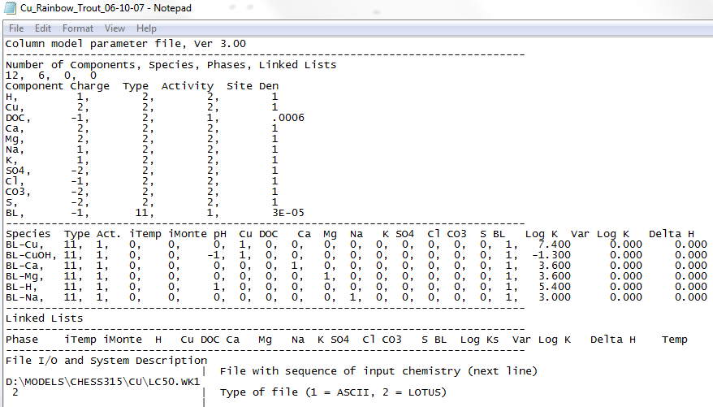
Biotic Ligand (gill) Log K in the BLM

Slide 29
Log K in the BLM

Slide 30
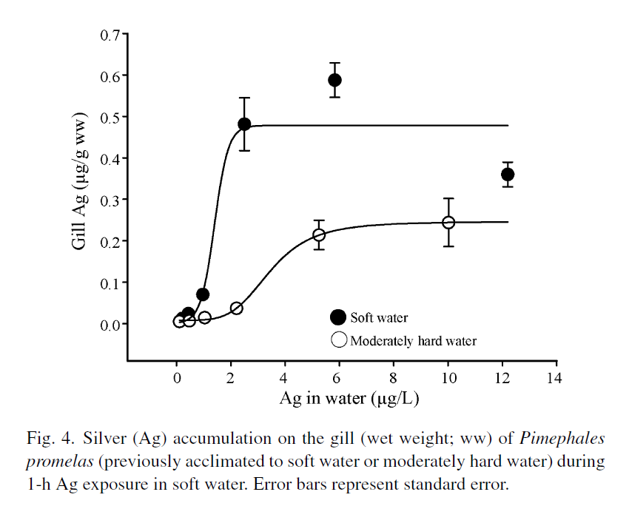
Shifts in Apparent Gill Log K with Hardness?
Bielmyer et al., 2008.

Slide 31
Measured Gill Log Ks in Different Species

Slide 32
Effects of Varying Log K on Predicted Toxicity

Slide 33
Biotic Ligand Log K Summary
Gill Log K known to change with water chemistry – dynamic
Using Log Ks developed for different species may result in ~ 2-fold change in LC50 at DOC = 2 mg/L
Variable log K in gill + variable log K in site water = variable predicted toxicity

Slide 34
Conclusions
BLM under-predicted free Cu compared to site-specific estimates
Needed to lower DOC in BLM to attain same free Cu results – similar findings to other researchers (e.g., De Schamphelaere et al., 2004; Welsh et al., 2008), but somewhat greater magnitude of adjustment
~ 5-fold decrease in instantaneous WQC

Slide 35
Conclusions (cont.)
Simulation modeling with BLM suggests Cu preferentially bound to DOC rather than the biotic ligand (gill) at low hardness
Degree of under-predicted Cu toxicity
Variable log K in gill + variable log K in site water = variable predicted toxicity
Uncertainty in Cu toxicity can be reduced with supplemental site-specific data
Cu-DOC complexation
Species-specific toxicity testing

