Slide 1
Research Initiatives in Recycling and Substitutes of Rare Earth Elements
Dr. Michael McKittrick
U.S. Environmental Protection Agency
Office of Research and Development

Slide 2
Disclaimer
The perspectives, information and conclusions conveyed in this presentation convey the viewpoints of the presenter and may not represent the views and policies of ORD and EPA

Slide 3
Recycling and Reuse
  Challenges
  Opportunities
  EPA SBIR
Substitutions
Federal Government Efforts
  Office of Science and Technology Policy (OSTP)
  DOE Critical Materials Strategy

Slide 4
Recycling and Reuse

Slide 5
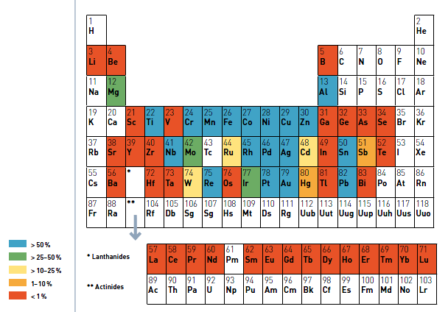
EOL Recycling Rates
Recycling Rates of Metals - United Nations Environmental Programme, 2011

Slide 6

Availability of Material
Technology, infrastructure and logistics
Viability of Recycling
Economics
Opportunities
End of Product Life Recycling |  | 30% of fluorescent bulbs are already recycled for mercury removal, but phosphors end up in landfills
Reducing/Reusing Manufacturing Loss |  | 30% loss of magnetic material during machining, but could be reduced
DOE Critical Materials Strategy, 2011
6

Slide 7

Potential of Recycling Consumer Electronics
NdFeB magnets
  30% Nd by weight
  Desktop HDDs
    ~13 g magnet/drive
    23 million sold in US in 2010
  Laptop HDDs
    ~6 g magnet/drive
    40 million sold in US in 2010
Challenges/Opportunities
  Removal of HD from computer
  Adhesives and nickel plating on magnets
  Magnetization
  Purity
  Lack of processing capability
  Need for improved Product Design
  EH&S issues

Slide 8
EPA Small Business Innovation Research (SBIR) Program
Electron Energy Corporation
Recovering REEs from manufacturing swarf
Recycling magnets from consumer electronics
OnTo Technology
Developing process to recover REEs from NiMH batteries
Potential application to Li-ion technology
EPA SBIR Phase I awards: $80K – 6 months
FY13 solicitation now open
Topics of interest include: More efficient and effective separation techniques, recycling technologies and technologies to facilitate collection

Slide 9
Substitutes

Slide 10
Substitutes for Rare Earth Permanent Magnets for Motors and Wind Generators
FY 2011 R&D Investments
ARPA-E REACT | EERE Vehicle Technologies Program | EERE Wind Program
$30 million | $6 million | $7.5 million
Material Level Substitutions
Component/ System Level Substitutions
PMs with reduced or no REE content
Next generation drive trains
Advanced electric machine topologies
Notes:
Significant investment in FY11 – majority of research is in early stages

Slide 11
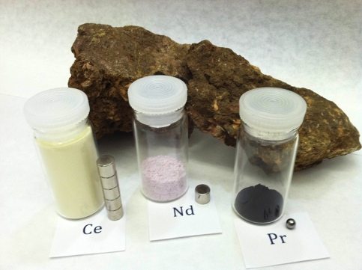
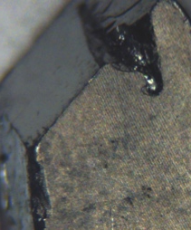
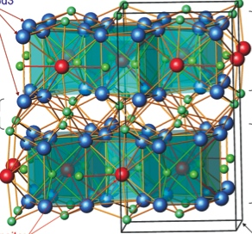

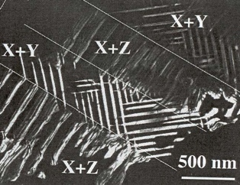
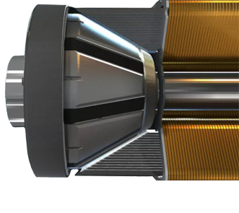
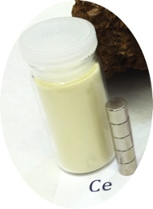


Novel High-Energy Permanent Magnets without Critical Elements
PI: R. William McCallum, Ames Laboratory, Ames, IA
50% of oxide in ore is Ce
Designer Ce-TM Magnet
Larger-Field Motor via Magnet Shape Design
Usable Drive Motors
Volt
1
2
3
Molycorp Minerals
Ames Laboratory
NovaTorque
General Motors
Stan Trout
R. W. McCallum, D. Johnson,
V. Antropov, K. Gschneidner,
M. Kramer, V. Pecharsky
John Petro
Fred Pinkerton
Molycorp Bastnasite
4x (12x) more Ce than Nd (Pr)
=> 4x more Ce-based magnets than Nd-Pr-based magnets
Suitable Ce-based magnets are undeveloped. Via integrated computational engineering and advanced synthesis and processing, Ames Laboratory will:
Control and manipulate the intrinsic and extrinsic magnetic properties of Ce-Transition-Metal permanent magnets for automotive traction motors.
Develop a Ce-TM based magnet for motors having Tc > 300 C, a remnant magnetization >1 Tesla, and a coercivity >10 KOe, needed for technology.
Key Milestones & Deliverables
Jointly characterize Ce-TM baseline alloys Develop/assess Ce-(Fe,TM)-X alloys (X=H,N).
Evaluate and down-select interstitially and/or substitutionally modified Ce-TM magnets
Courtesy of
Notes:
Important contributions of this project:
Abundant cerium used for magnets
Computer modeling used to enable a more comprehensive evaluation of potential alloying modifications

Slide 12
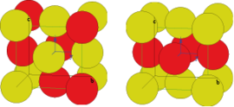
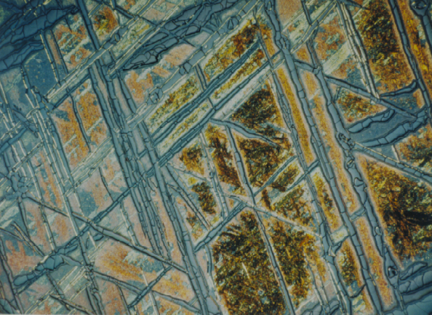
Multiscale Development of L1₀ Materials for Rare-Earth-Free Permanent Magnets
PI: L. Lewis, Northeastern University
L1₀ FeNi phase in large numbers of stony, stony-iron and iron meteorites.
Typical cooling rates: 0.2 K/Myr to 2,000 K/Myr for chemical ordering at the low temperatures (<300 ºC) where the desired phase forms.
Ordered structures are magnetic -BH_{max} = 40 MGOe (NdFeB- BH_{max} = 59 MGOe)
Disordered
Ordered
(From http://www.neel.cnrs.fr/spip.php?article1083&lang=en)
Ordered
Disordered
J.I. Goldstein, et al., Chemie der Erde - Geochemistry, Volume 69, Issue 4, November 2009, Pages 293-325.
Courtesy of

Slide 13







  Office of Science and Technology Policy (OSTP) convened four work groups:
    Critical Material Criteria and Prioritization
    Federal R&D Prioritization
    Globalization of Supply Chains
    Depth and Transparency
    of Information

Slide 14
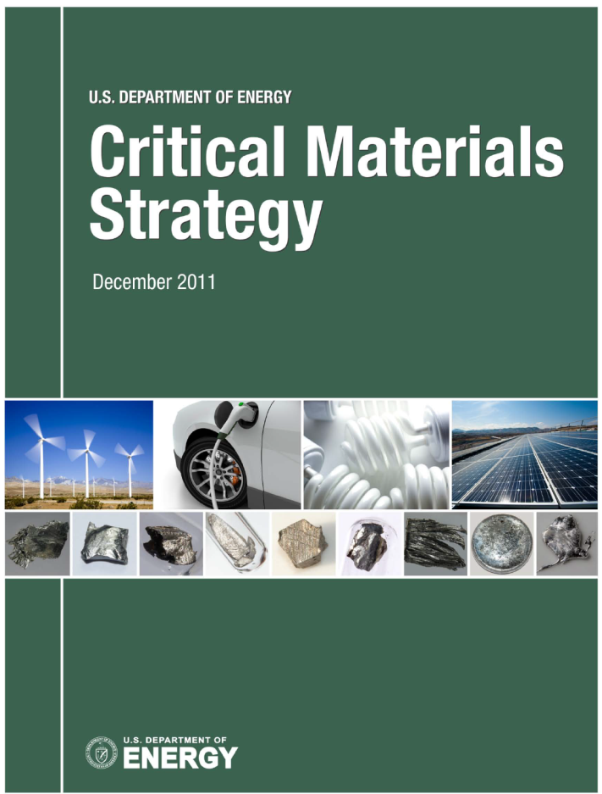
2011 Critical Materials Strategy
  2011 Critical Materials Strategy:
  Provides an updated criticality analysis
  Sets forth several case studies, including oil refining catalysts
  Discusses critical materials market dynamics
  Presents DOE’s Critical Materials R&D Plan

Slide 15
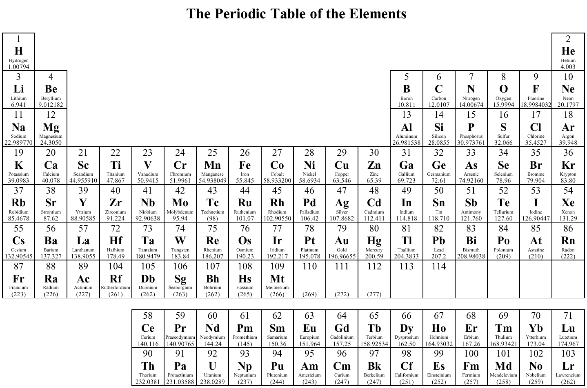
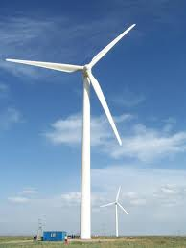


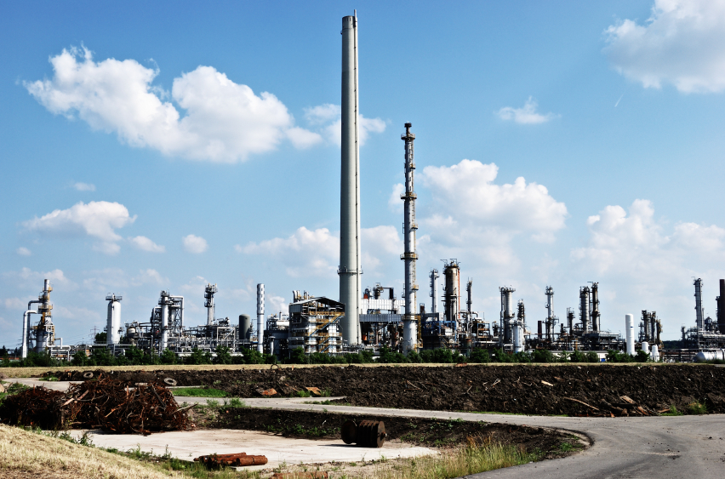
2011 DOE Critical Material Strategy Scope
New for 2011
Vehicles
Lighting
Solar PV
Wind
Notes:
We focused on four of the fastest growing clean energy technologies – vehicles, wind, solar power and energy efficient lighting.
These technologies can use materials from a wide cross section of the periodic table, including rare earth elements.
[Note: Samarium and Praseodymium are shown as potential materials in vehicles and wind, although we do not include them in our demand calculations. Samarium is not widely used and the extent of praseodymium use in magnets is uncertain.]
The 2011 Critical Materials Strategy also includes several technology case studies, including the use of critical materials in oil refining.

Slide 16

DOE’s 2011 Critical Materials Strategy
Criticality Assessments
Methodology adapted from National Academy of Sciences
Criticality is a measure that combines
    Importance to clean energy technologies
      Clean Energy Demand; Substitutability Limitations
    Risk of supply disruption
      Basic Availability; Competing Technology Demand; Political, Regulatory and Social Factors; Co-Dependence on Other Markets; Producer Diversity
Time frames:
  Short-term (Present - 2015)
  Medium-term (2015 - 2025)

Slide 17
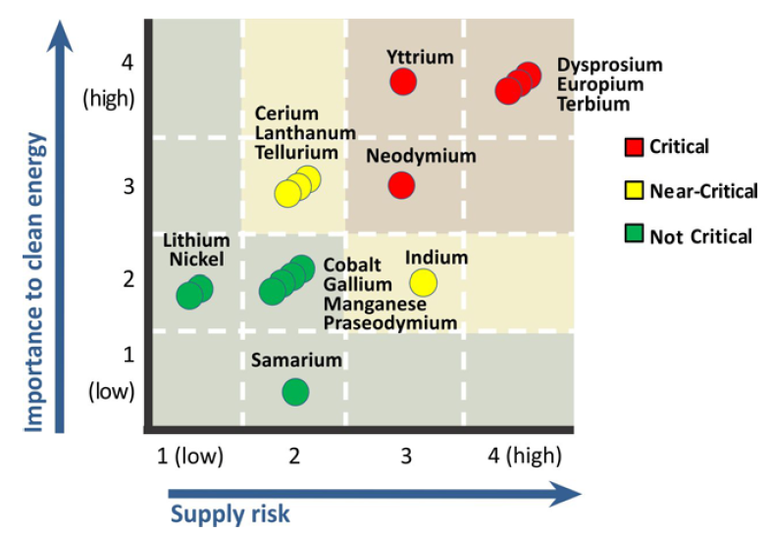
2011 CMS Short-Term Criticality (Present - 2015)

Slide 18
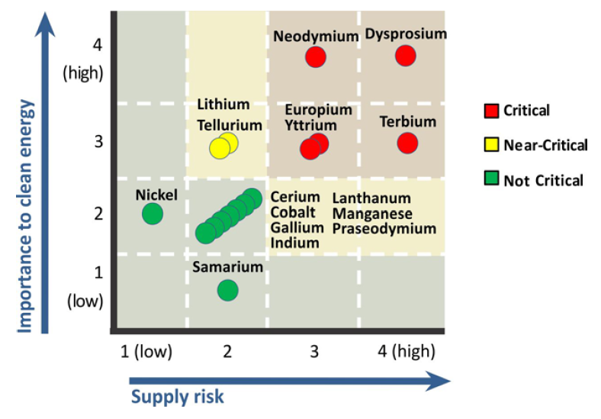
2011 CMS Medium-Term Criticality (2015-2025)

Slide 19
Strategic Pillars
Diversify global supply chains
Develop substitutes
Reduce, reuse and recycle
Material supply chain with environmentally-sound processes
Notes:
DOE’s Strategy with respect to critical materials rests on three pillars.
First, diversified global supply chains are essential. To manage supply risk, multiple sources of materials are required. This means taking steps to facilitate extraction, refining and manufacturing here in the United States, as well as encouraging other nations to expedite alternative supplies (in all cases in an environmentally-sound manner).
Second, substitutes must be developed. Research leading to material and technology substitutes will improve flexibility and help meet the material needs of the clean energy economy.
Third, recycling, reuse and more efficient use of critical materials will improve resilience. Widespread recycling and reuse could significantly lower world demand for newly extracted rare earths and other materials.

Slide 20
Next R&D Challenges and Opportunities
Separation & Processing
Substitutes for
Lighting Phosphors
Efficient & environmentally friendly processes
Recycling
Substitute critical REEs with abundant materials
New separation processes could apply to recycling
Related DOE R&D Initiatives
Critical Materials Energy Innovation Hub –identifying more efficient use of critical materials in energy technologies and improving the efficiency, and reducing the production costs, for supplies of critical materials – April 3rd workshop
Innovative Manufacturing Initiative – transformational manufacturing process and materials technologies
Small Business Innovation Research (FY12 FOA)– lanthanide separation & processing topics

Slide 21
DOE’s 2011 Critical Materials Strategy - Main Messages
Critical supply challenges for five rare earths (dysprosium, neodymium, terbium, europium, yttrium) may affect energy technologies in years ahead
In past year, DOE and other stakeholders have scaled up work to address these challenges
Building workforce capabilities through education and training will help realize opportunities
Much more work required in years ahead

Slide 22
Summary
Recycling
  Opportunities available to take advantage of recycling potential
  Need for R&D to facilitate these opportunities
Substitutes for REEs
  DOE has supported a wide variety of programs to reduce dependence on REEs for green energy applications
  Most work underway is early stage research
Federal Efforts
  Many agencies are engaged on issues related to REEs
  Interagency efforts are being coordinated through OSTP

Slide 23
Contact Information
Mike McKittrick
U.S. EPA
Office of Research and Development
National Center for Environmental Research
703-347-8100
mckittrick.michael@epa.gov

Slide 24
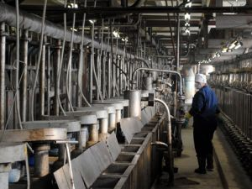
Separation & Processing
Solvent Extraction
  REEs are very chemically similar which makes them difficult to separate
  Very small separation factors
  Hundreds of solvent extraction stages
  Up to 1 year to process ore

Slide 25
Potential Advances
New Molycorp Facility
  Combines chlor-alkali process with REE separation
  Recycles 90% of wastewater
  Eliminates 120 acres of evaporation ponds
  Recycle reagents
  More cost effective
Other routes
  Supercritical Fluid extraction
  Biologically inspired approaches
  Electrochemistry
  Ionic liquids
  Selective Extraction

Slide 26
Demand Projections: Four Trajectories
Material Demand Factors
 | Market Penetration | Material Intensity
Trajectory D | High | High
Trajectory C | High | Low
Trajectory B | Low | High
Trajectory A | Low | Low
Market Penetration = Deployment (total annual units of a clean energy technology) X Market Share (% of units using materials analyzed)
Material Intensity = Material demand per unit of the clean energy technology
Notes:
Estimates of future demand for key materials in clean energy applications were calculated as the product of three factors:
Deployment: total units of the generic clean energy technology in a given year
Market Share: the percentage of installations captured by a specific clean energy application
Material intensity: demand for the material in each unit of the clean energy application
A High Penetration case and a Low Penetration case were developed. The High Penetration case combines a high level of global deployment for the generic technology with a high market share captured by the clean energy application. The Low Penetration case combines a low level of global deployment for the generic technology with a low market share captured by the clean energy application.
A Low Materials Intensity case was constructed reflecting a low, but feasible estimate of material required per unit of technology deployed. A High Materials Intensity case was similarly constructed describing a high but feasible estimate of material required.
High and low values for material intensity and market share represent best estimates of these parameters in the short and medium term. Global deployment rates, on the other hand, are not intended to be predictive. For magnets, batteries and photovoltaics, global deployment is based on International Energy Agency (IEA) estimates of technology deployment under different assumptions about national policies and clean energy objectives. For phosphors, global deployment is based on linear growth of historical demand.

Slide 27
Neodymium - Supply and Demand Projections
Critical Materials Strategy 2011
Notes:
As part of our assessment, we developed projections of future supply and demand for key material use.
For supply, we looked at estimates of 2010 supply, in addition to forecast production capacity expected by 2015.
For demand, we calculated the material requirements under four different trajectories. One set of trajectories was based on high deployment of clean energy technologies, the other on low or baseline deployment. For each deployment scenario, we constructed two curves. One was based on the technology using high (or current) amounts of material per unit. The other curve was based on reasonable improvements in efficient material use that would reduce the amount of material required per light bulb, windmill, vehicle or solar cell.
These projections do not represent a forecast of what will come. Rather, they illustrate how the supply and demand picture could look under a number of different scenarios. For neodymium, they illustrate the importance of improvements in both supply and demand.
On the demand side, the figure illustrates the importance innovations to reduce neodymium content or find substitutes. We simply cannot build deploy large numbers of new vehicles and wind turbines under current supply constraints without more efficient use of neodymium.
On the supply side, the projections also illustrate the importance of increasing supply through recycling, reuse and the environmentally sound development of new mines.

Slide 28
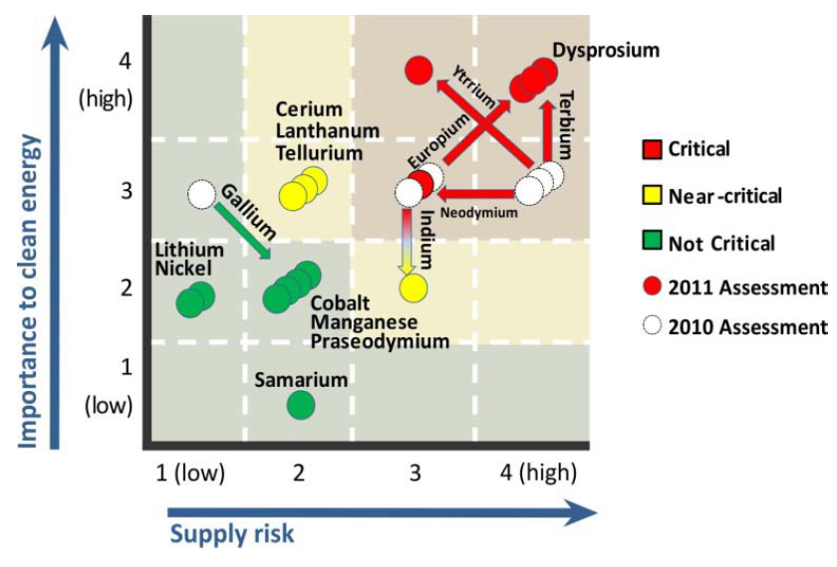
Short-Term Comparison between 2010 CMS and 2011 CMS
Notes:
For the short term, comparing the criticality assessments from the 2011 Critical Materials Strategy to last year’s findings, we see that:
The importance to clean energy has increased for rare earth elements in phosphors (yttrium, europium, terbium)
The supply risk for neodymium has decreased due to new mines and reduced demand
The importance to clean energy has decreased for indium and gallium due to a reduced outlook for CIGS thin-film PV cells

Slide 29
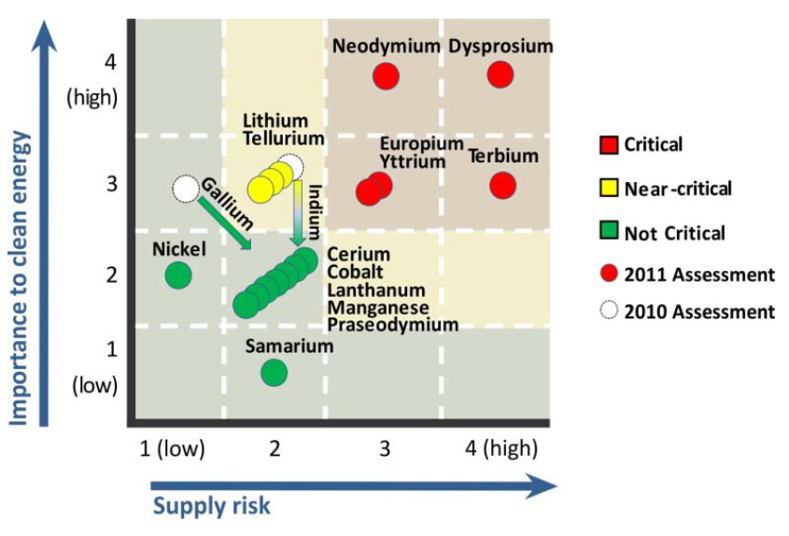
Medium-Term Comparison Between 2010 CMS and 2011 CMS
Notes:
In the medium-term, criticality assessments have remained largely the same.
The only exceptions are that the importance to clean energy has decreased for indium and gallium, again based on lower CIGS deployment.

